Slide 1
Odata with Windows Phone 7
ODATA Enabled WP7 Applications In 4 Steps
@djsolid
John Katsiotis

Slide 2
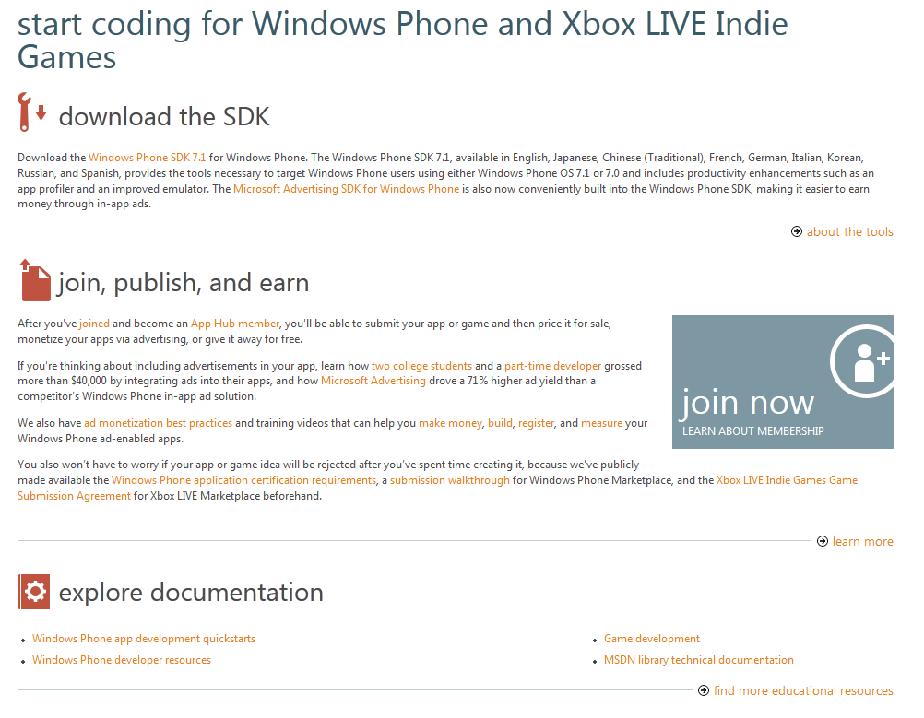
Step 1
http://create.msdn.com – Download The Tools

Slide 3
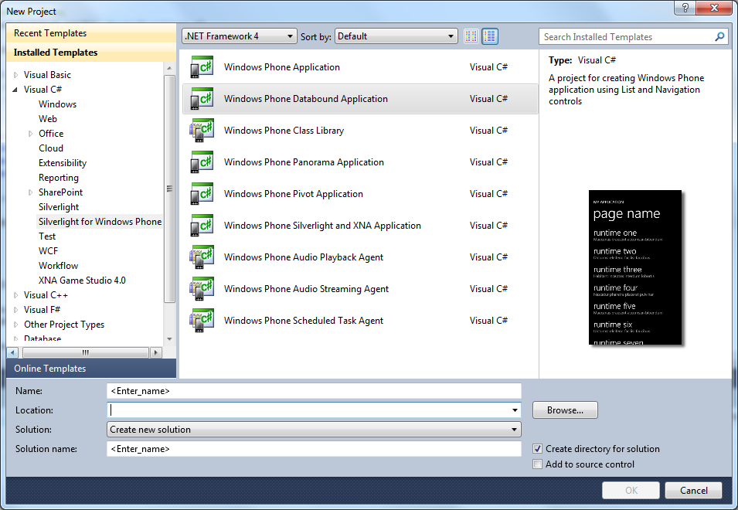
Step 2
Create A New Windows Phone App Project

Slide 4
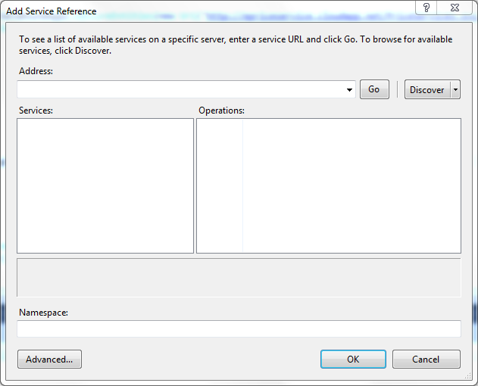
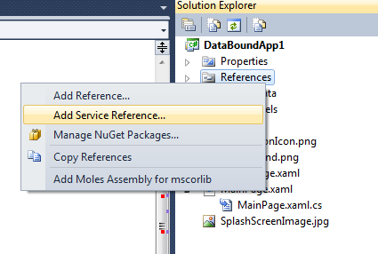
Step 3
Add Your Service Reference

Slide 5
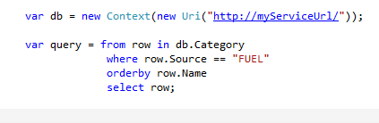

Step 4
Start Querying For Data

Slide 6
Step n-2
demo

Slide 7
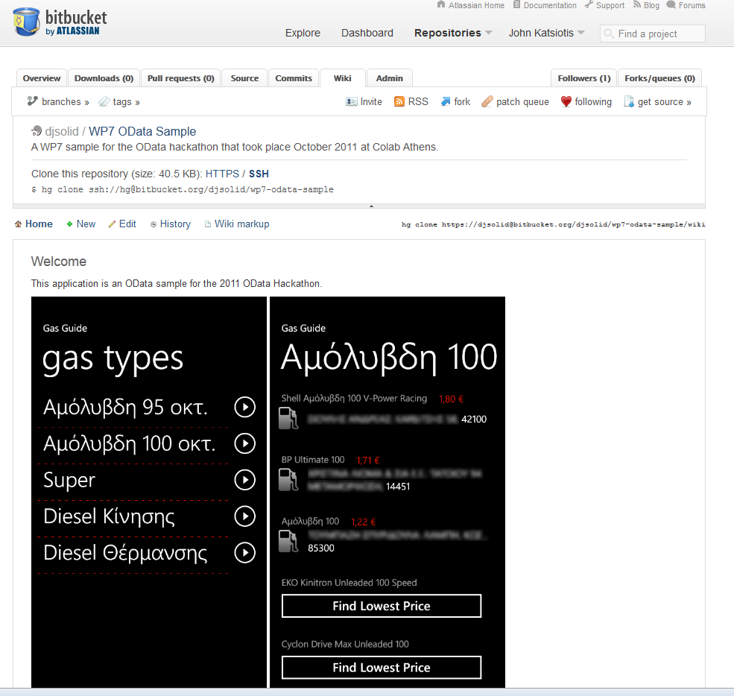
Step n-1
A sample to Start bit.ly/wp7odatahack

Slide 8
Step n
Questions And Thanks-giving
@djsolid
john@katsiotis.com

