Slide 1
Sounds of the Diaspora
Mock 1 – 2.3.2011

Slide 2
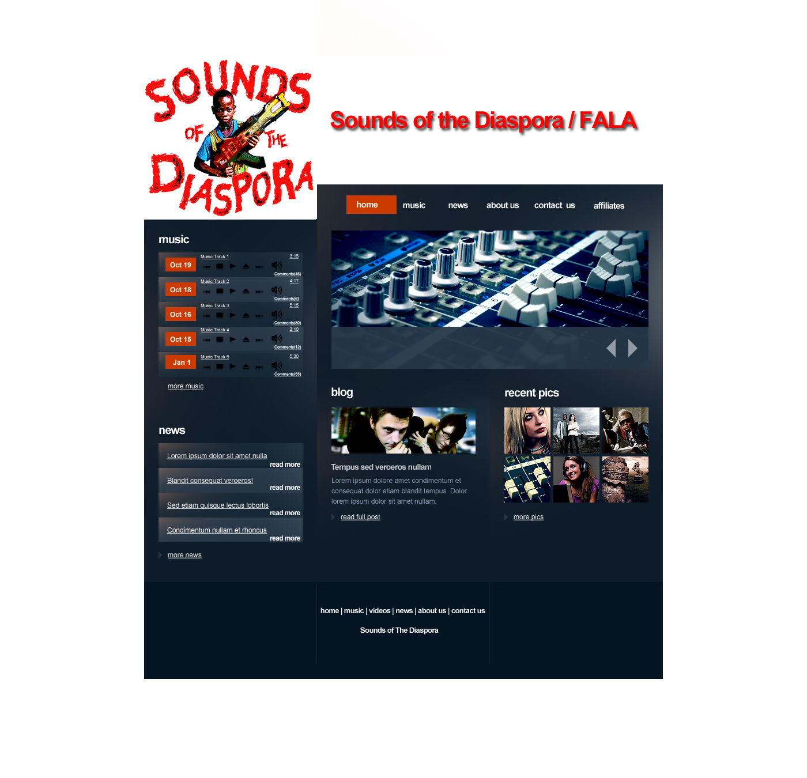
Please outline any creative feedback in the box below:
Are we keeping recent pics on the home page?
Is the SOTDF logo going to blend in with the background color of the site?
Are these the colors they chose for this site, or is it going to change to SOTDF theme colors/complementary colors?
[Current pic of audio machine] – can we have a working equalizer, so when people come to the site, and music plays, you see the equalizer moving? Or is this going to remain a picture slideshow?
Are we keeping the news portion there? Do they currently have news content?
Do they have blog content [blog portion of site]
Is there going to be an About US portion on the homepage, or will that reside under the About US tab only?

Slide 3
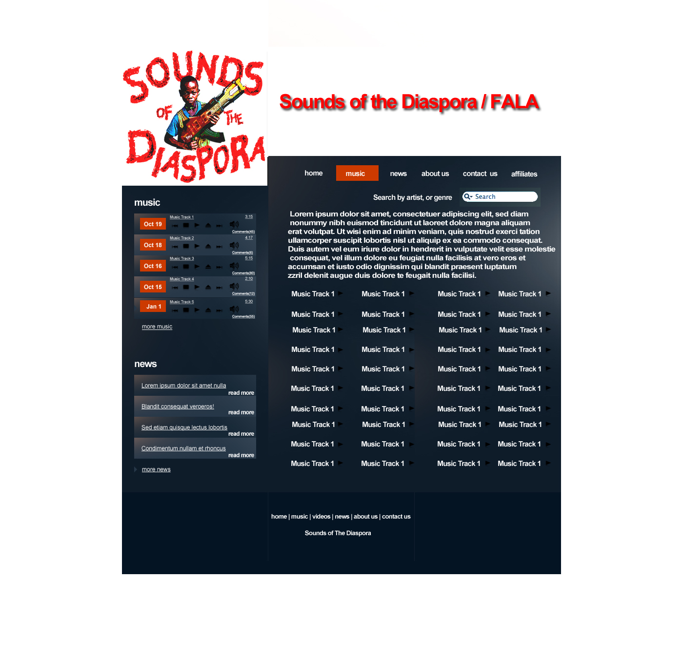
Please outline any creative feedback in the box below:
Don’t like the boxy/column feel of the Track Listings
Can there be Images next to each Music track?
The search functionality is for : Song Name? Top Rated? Newest?
Is the song track page going to be different from the podcast page? Are they the same thing?

Slide 4
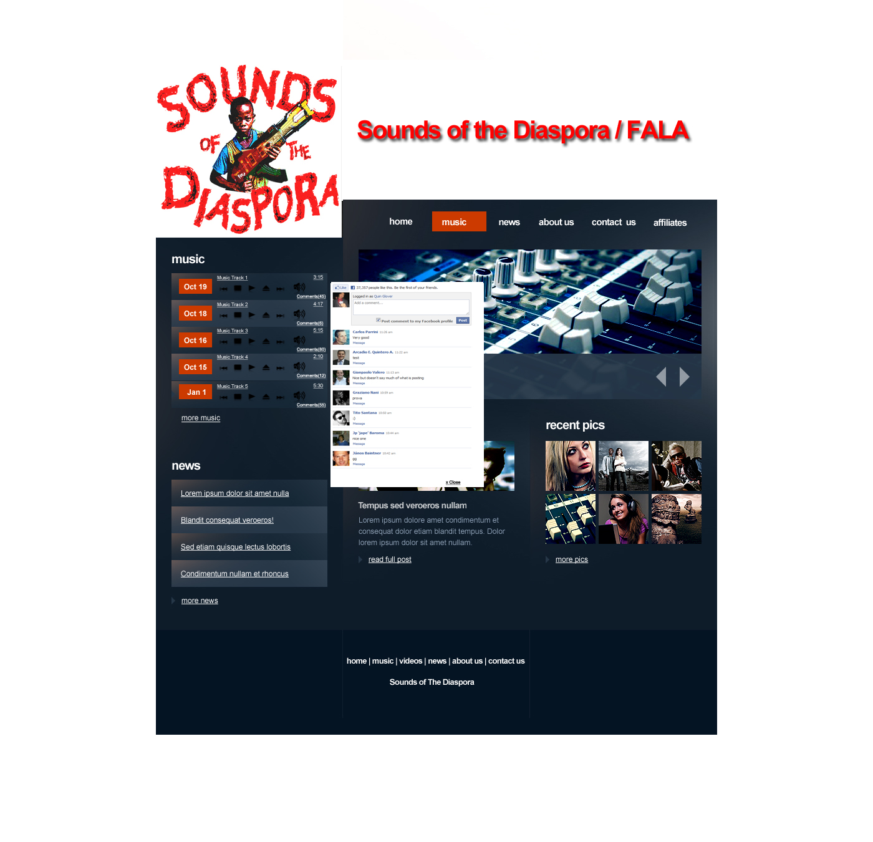
Please outline any creative feedback in the box below:
The FB connect looks oddly place where it is.
Can this only be access on the homepage, when you comment on the song?
Can we change the color of the FB connect, cause its conflicting with the page color
When the FB connect box pops up, can the regular homepage become translucent as an indicator that the user needs to make their comments first, and then they can go back to Homepage?
What other aspects of the site can users Like, comment, share with friends, and post to friends newsfeeds?
If I leave a comment on the homepage, will I see it on the music page and vice versa?

Slide 5
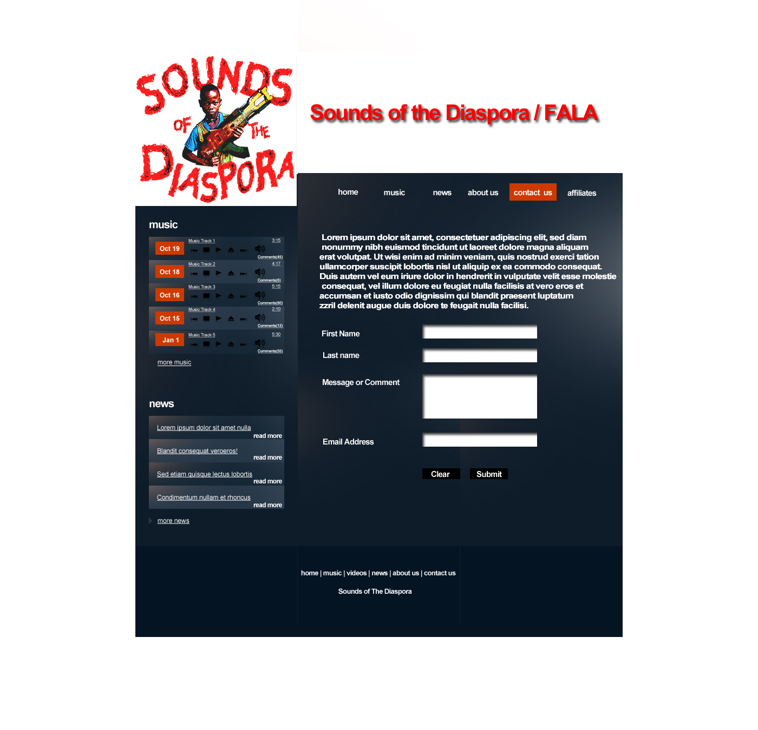
Please outline any creative feedback in the box below:
This is too generic. Can we jazz this up? Can we skin this? Make it into a media player or something exciting?
Are we going to provide actual contact info for the company? Address, phone number, email address?

Slide 6
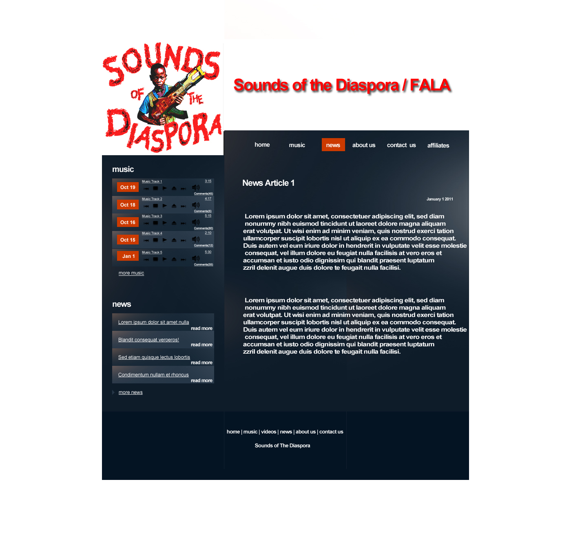
Please outline any creative feedback in the box below:
Is there a difference between News and Blogs?
Where will the RSS feeds go?
Can people subscribe to the SOTDF RSS feed?
Who’s providing the content?
Can we aggregate content from others?
Can this be skinned and have a cooler look or feel?
Can users leave comments, use FB connect, etc. from this page?
Is that music list and news column (left had side) going to remain constant throughout the site? Is that an immovable column?
Are there going to be any cool transitions from page to page?

Slide 7
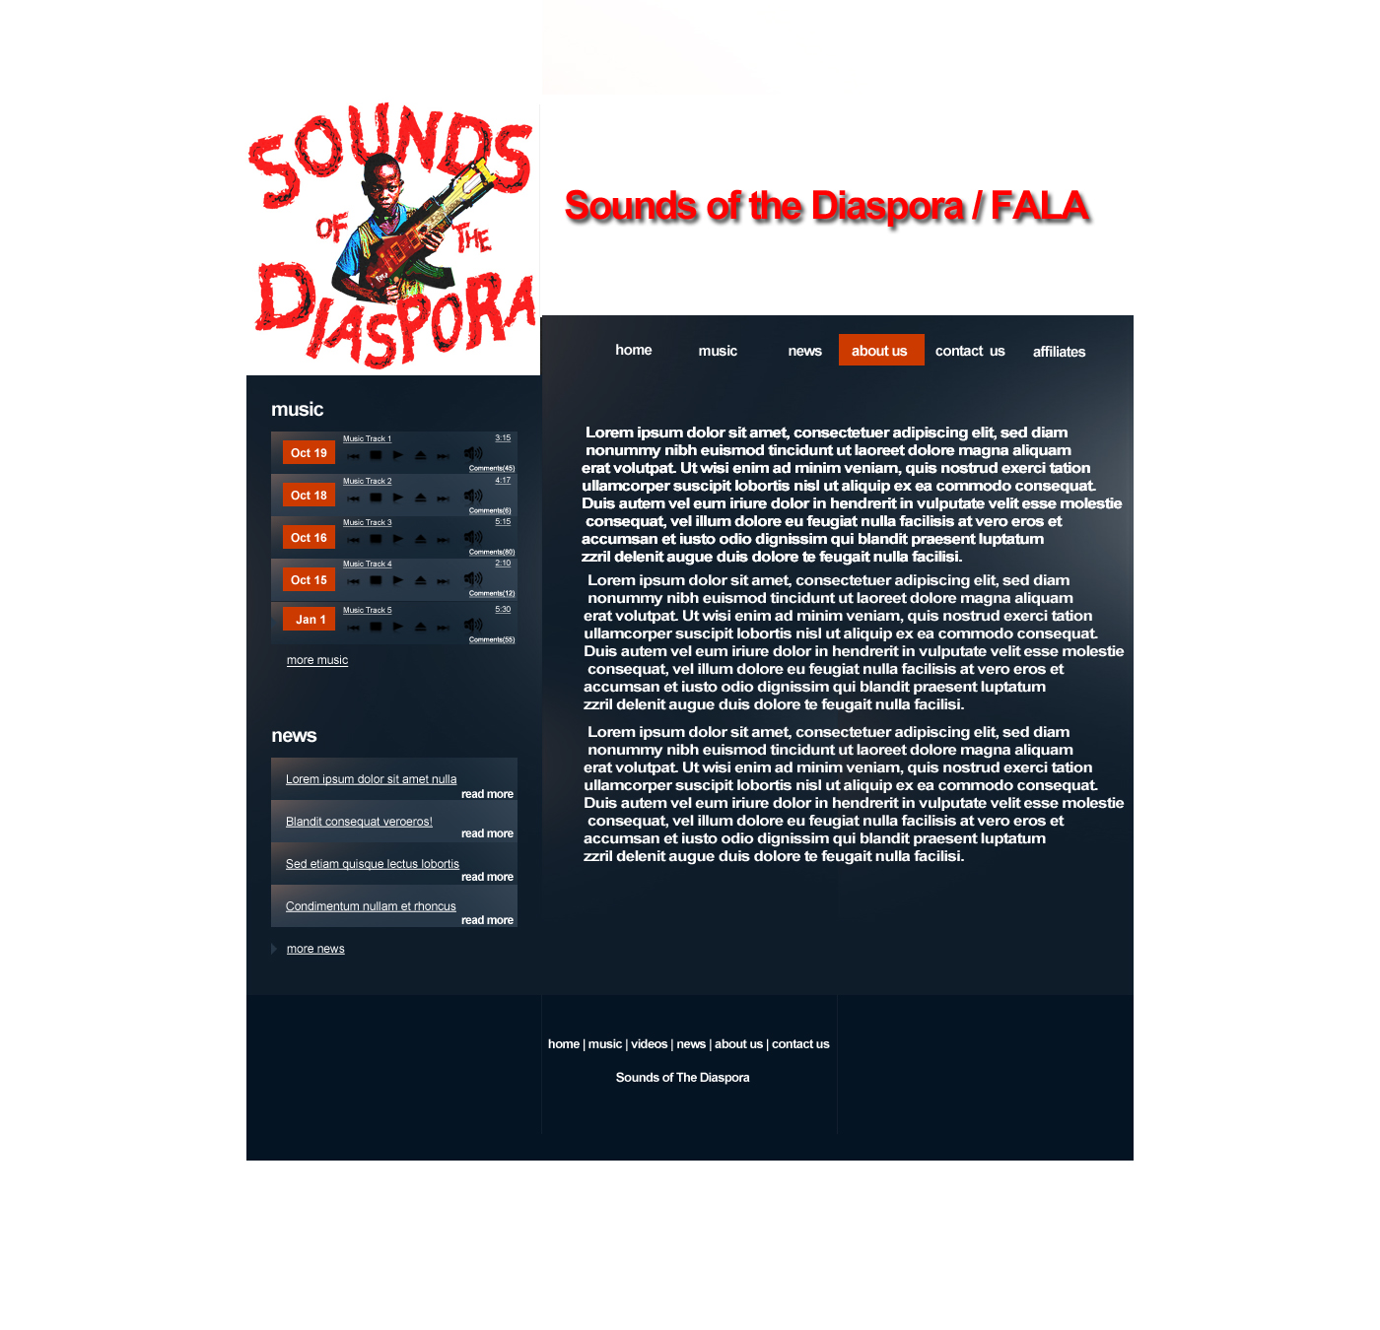
Please outline any creative feedback in the box below:
Needs a skin, too bland
Can we have pictures of the team members, and their respective bios
Can we make this portion interactive? I.E. Allow people to connect to them via fb from here (crazy idea)
What does the affilaites page look like? Are we linking to thisiscarib from here? Can the affiliates page me more than just a list of links?

Slide 8
Please outline any creative feedback in the box below:
Are we keeping recent pics on the home page?
Is the SOTDF logo going to blend in with the background color of the site?
Are these the colors they chose for this site, or is it going to change to SOTDF theme colors/complementary colors?
[Current pic of audio machine] – can we have a working equalizer, so when people come to the site, and music plays, you see the equalizer moving? Or is this going to remain a picture slideshow?
Are we keeping the news portion there? Do they currently have news content?
Do they have blog content [blog portion of site]
Is there going to be an About US portion on the homepage, or will that reside under the About US tab only?

