Slide 1


Slide 2
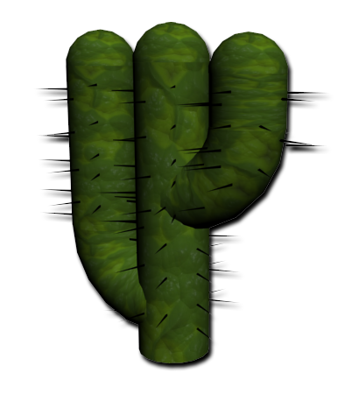

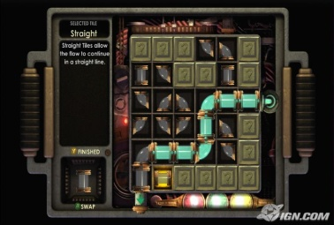

What is Syphon?
Puzzle Game
Inspired by the 2D BioshockTM Hack Mini Game
Syphon uses the 3rd dimension

Slide 3
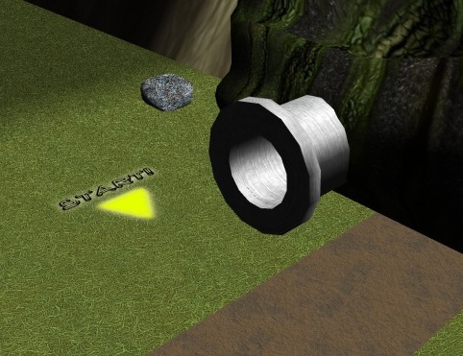
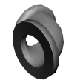
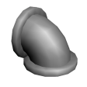
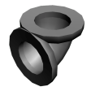
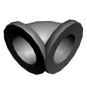
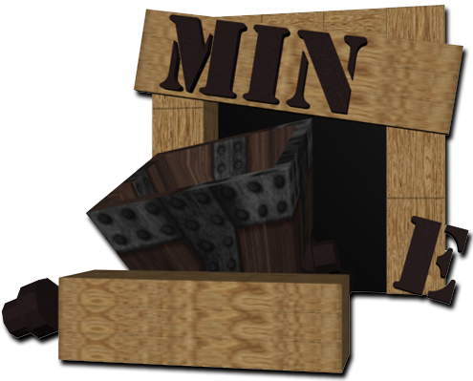
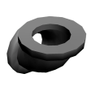
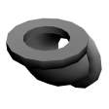
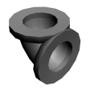
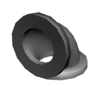
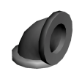
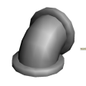
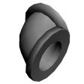
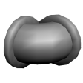
How to play!
Each map has a start point
Then, using a limited selection of the following pipe pieces…
…the user must reach a designated end point!

Slide 4
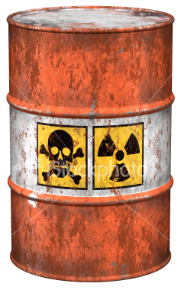
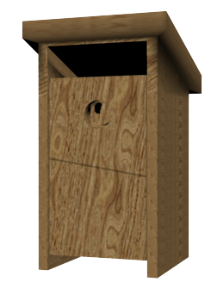
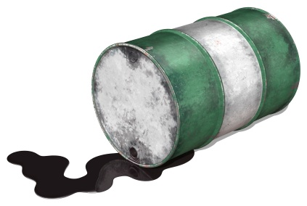
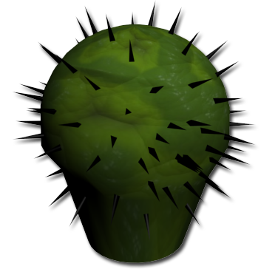
What's the catch?
The start point pumps a liquid which must be diverted before a spillage occurs.
Your path across the map will not be clear!
Interactions with the environment may be necessary in order to progress.

Slide 5
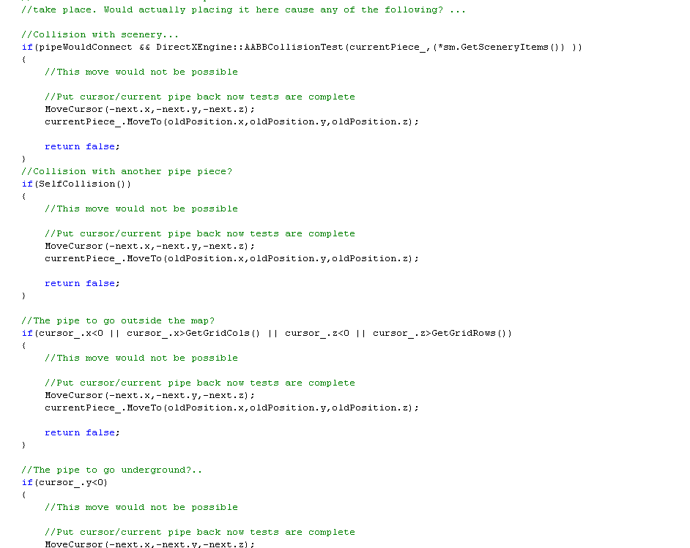
Technology
Pre Loader System
System Structure / Separation of Components
Music & Sounds
Artist / Level Designer tools

Slide 6
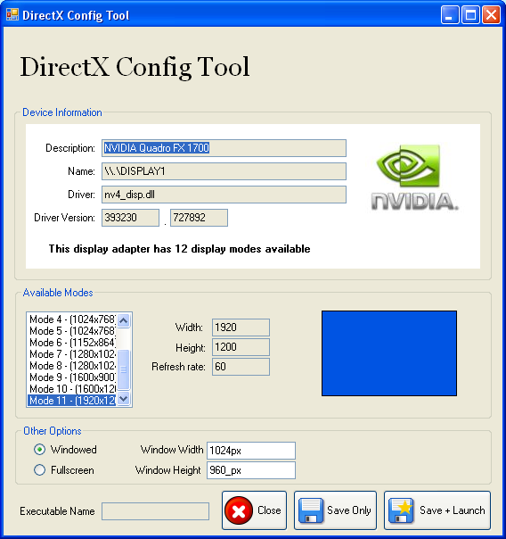
Pre Loader System
Re-coding to work in window / full-screen mode is time consuming.
Can't always use full-screen mode when debugging.
Level Editors may want to toggle modes.
Different machines support different resolutions.

Slide 7
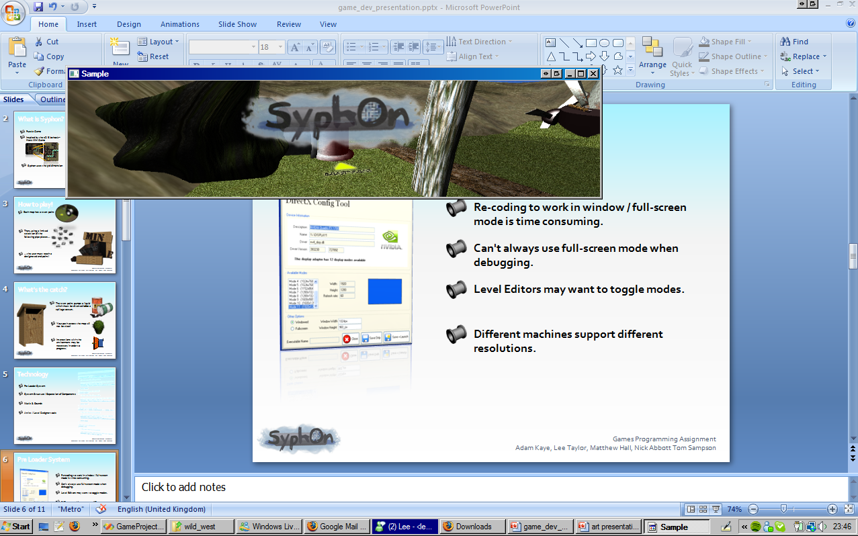

Slide 8









System Structure
DirectXEngine
DirectXPreLoader
Core
Device Management
Window Management
OS Message Handling
Input management
InputManager
Handle Input
static
Game state data
User profile data
Important pointers
static
DataStore
dxConfig.conf
LogManager
Handle logs
Handle errors
Globals.h
#define .....
DirectXPL
SceneManager
SceneryMgr
External
Map
Data
MapParser.h
SceneMgr
Manage & Render Scene
<< utility >>
SkyMgr
Camera
FloorMgr

Slide 9
Pipe Connecting System

Slide 10
Numbering Pattern
2
5
1
4
0
3

Slide 11
Bit Pattern
To represent pipe connectivity we use the char data type (1 byte)
2
The bit positions from left to right represent the numbers of our faces, with the last 2 bits unused.
0000 00xx
Any set bits in this pattern represent a potential connection point in that position
3
Example
The pipe piece to the left would have the following connectivity bit pattern...
Vertical Pipe Piece
0011 00xx

Slide 12
Bit Pattern Examples
The pipe piece to the left would have the following connectivity bit pattern...
1
4
0100 10xx
Horizontal Pipe Piece

Slide 13
Bit Pattern Examples
The pipe piece to the left would have the following connectivity bit pattern...
4
0001 10xx
3
Elbowed Pipe Piece

Slide 14
A starting point
Imagine our starting point is an emerging pipe from the ground. Starting points only ever have ONE SET BIT.
2
The bit pattern for this starting point would be...
0010 00xx

Slide 15
Making a connection!
Consider the following two pieces & their bit patterns...
We can see that these two pieces are capable of connecting
2
0011 00xx
3
2
0010 00xx

Slide 16
Forming a target...
Target = MAX_FACE_NUM – STARTING_POINT_NUM
Starting Point = 0010 00xx
To face number...
2
STARTING_POINT_NUM =
Target = 5 – 2
Target = 3

Slide 17
Can we connect?
Target = 3
A 1 in the target bit position of the connecter represents a VALID CONNECTION
A 0 in the target bit position of the connecter represents an INVALID CONNECTION
2
0 1 2 3 4 5 6 7
0011 00xx
0 1 2 3 4 5 6 7
3
Valid Connection

Slide 18
What next?
What happens after a successful connection has been made?
Remember our target was the number 3....
We therefore remove the 3rd bit from the connector bit pattern
2
0011 00xx
0 1 2 3 4 5 6 7
Becomes..
0010 00xx
0 1 2 3 4 5 6 7
NEW STARTING POINT
Back to slide 7

Slide 19

Music & Sounds
Using FMOD (Sound Engine) to load and play songs.
Load 2D global sounds (Background Music).
Load 3D positioned sounds (Birds/Stream).
Easily cross-fade between two sounds.
Easily play, stop, mute and adjust volume levels from any class in the game.

Slide 20
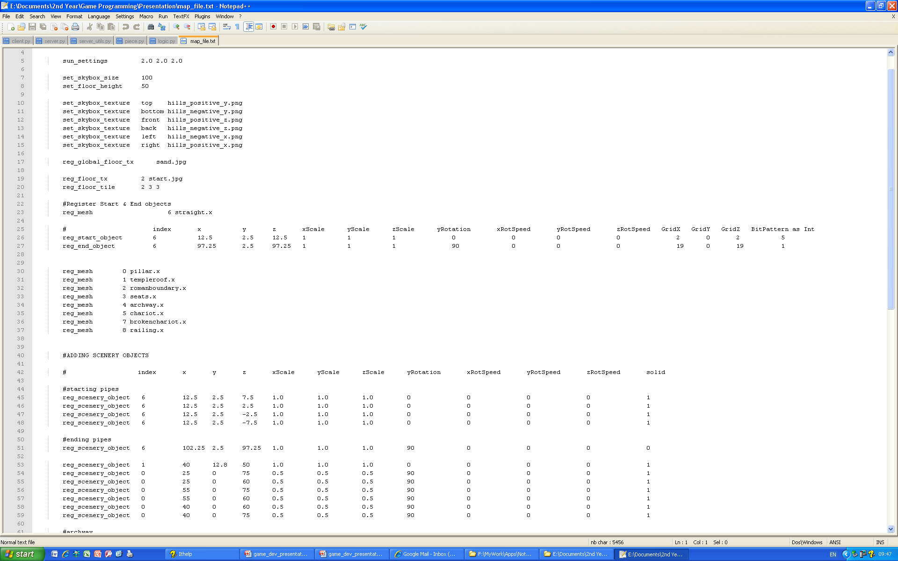
Level Designer Tools – Editable Map File
No need to edit game code, all levels are externally controlled.
Change key aspects of the game by modifying a simple map file.
Load custom floor textures and custom meshes in a few simple lines.
Easily set the start and end point of a map.

Slide 21
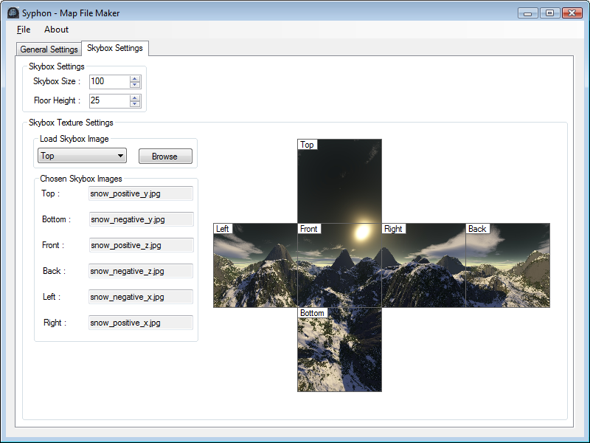
Level Designer Tools –
C# Syphon Map File Maker
Currently a very early work in progress.
Allows a user to edit a Syphon map file, using a GUI interface.
See how textures will look, before making the map file.

Slide 22
The Art of

Slide 23
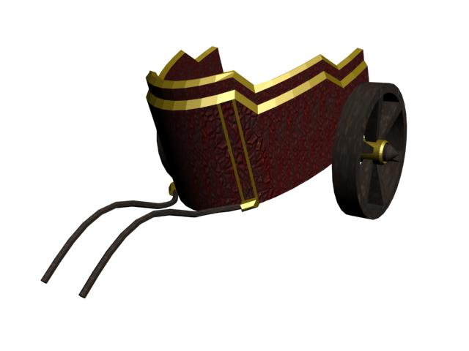
Level Design
Our first task was to think of a variety of different level concepts. Here is the selection of ideas we came up with:
Grassy field
Jungle
Volcano
Underwater
Desert - Wild West
Farmyard
City
Snow
Space
Retro
Roman

Slide 24
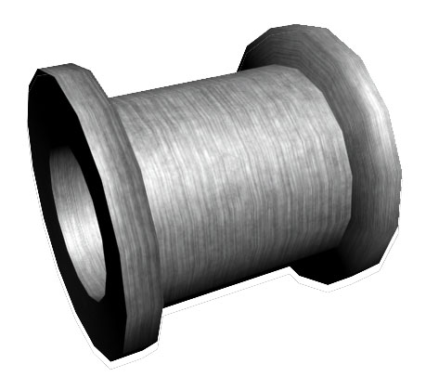
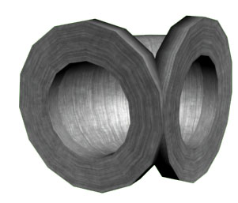
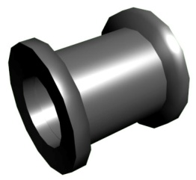
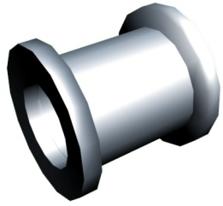
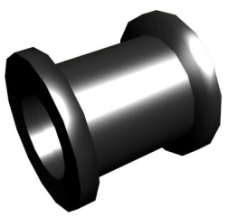
Designing the pipes
We decided to design a pipe that would look industrialand strong, but we also had to make sure that every pipe piece would connect seamlessly with the next pipe. We designed a variety of pipes designed to be used in different levels.

Slide 25
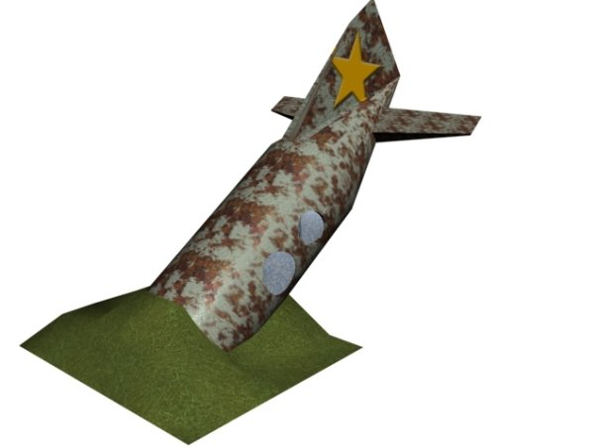
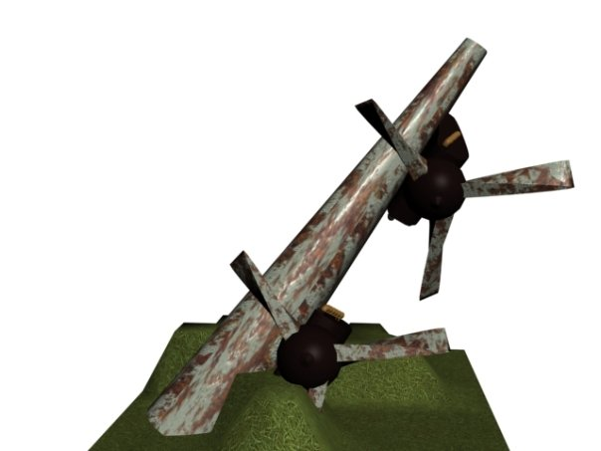
Designing the levels
We decided our levels would be of a cartoony design, incorporating over the top elements and size!
We designed a variety of environment objects as well as the pipes, which we placed at select positions in the maps. we also randomly placed smaller objects, allowing us to ensure no two levels would be the same.

Slide 26
Developing the levels
However, getting our level designs into our game was going to take more than simply making them in 3dsMax. We also had to use Photoshop to create textures that would tile efficiently, or create brand new textures altogether, as well as convert them into a format that DirectX would understand. To do this we used an add on to 3dsMax called "Pandasoft"
Photoshop
to create and modify textures
Pandasoft
to convert the models into an X file
3dsMax
to creating the models
DirectX
to run the game

Slide 27
The Sound of

Slide 28
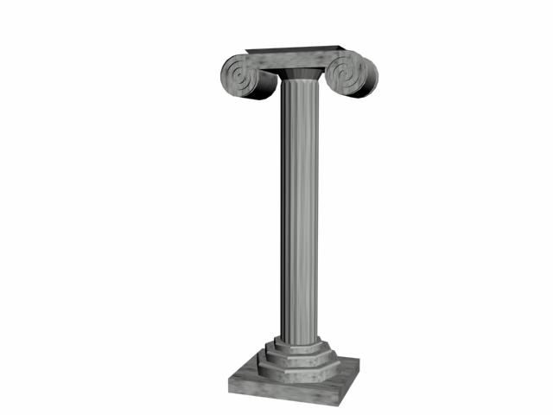
Developing the sound
We designed a variety of sounds with the hope that each one would reflect the atmosphere of the game at the current time. To create the sounds themselves, we used a combination of Reason 4 and Cubase. The sounds we created include:
Background music
Background music (fast) - played when the water is catching up to the current pipe piece
Allow - played when the player successfully places a pipe piece
Deny - played when the player tries to enter a pipe piece which isn't allowed
Win
Lose
Stream - for ambient sound
Birds - for ambient sound
Change pipe piece

