Slide 1
Optimize Search Results in Confluence
Search Assisted
M16A Group 5
Team Quokka
Hang Zhao
Jiyuan Yang
Xianlong Jiang
Yu Shi
Jinjing Xu
Notes:
Good afternoon, everyone! We are team quokka, our project is to optimize search results in Confluence.

Slide 2
Background and Project Introduction
Confluence - a collaboration software.
The search engine can be a bottleneck.
Atlassian has been working on improving the performance for years by enhancing its search algorithm.
The searching process can still be improved.
Notes:
As an outstanding collaboration software, Confluence has helped hundreds of enterprises to manage their intelligence resources. However, the search engine can be a bottleneck of its efficiency. Atlassian has been working on improving the performance of Confluence for years by enhancing its search algorithm. However, the searching process can still be improved and this is our aim. Next, my teammates will present the details.

Slide 3
User Story
As an normal Confluence user, I want to have a better search engine so that I can get more valuable result when I search.
As a team leader, I want to highlight useful documents related to specific key words so that I can let other teammates see them when they search with the same key words.
As a Confluence user, I want to view highlight results easily so that I do not need extra time to find them. (complete)
Notes:
We are aiming to provide better experience for Confluence users by helping 2 main types of users: The normal users(which means they are normal employees or team members) and team leaders. We will achieve this by delivering a search engine plugin. The plugin is mainly about Highlight functions which will be introduced by Arthur later. Our primary user is the normal user. We are actually providing extra tools for team leaders to assist with optimising search result for normal users. As for the use story, the last one is about the UI design and we have already finished it. We are still working on other function realted to other user stories.

Slide 4
Test Plan
The test plan is aimming to test user stories.
For a normal Confluence user, a survey would be done
For team leader, the function would be tested by unit testing, integration testing and system testing.
For the confluence users who would like to view highlighted results. User experience testing can be used to test effectiveness and satisfaction of the user.

Slide 5
Functional and Non-functional Requirements
Functional Requirements
Assign Documents according to keywords.
Guiding document.
UI.
Non-functional Requirements
UI is acceptable and capatible.
Do not slow down the search speed.

Slide 6
Group Processes
Weekly issues on bitbucket
Weekly report and meeting records
Contact with the Client
Process summary
Notes:
Thanks Arthur. Next I am going to talk about our group progress.

Slide 7
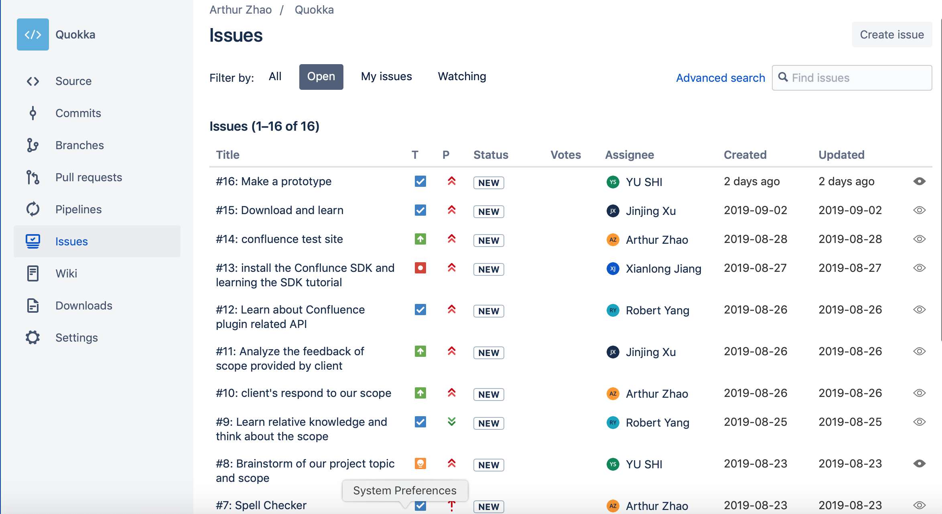
MileStone
Notes:
There are our weekly issues. Now we have gotten 16 issues on the issue board.

Slide 8
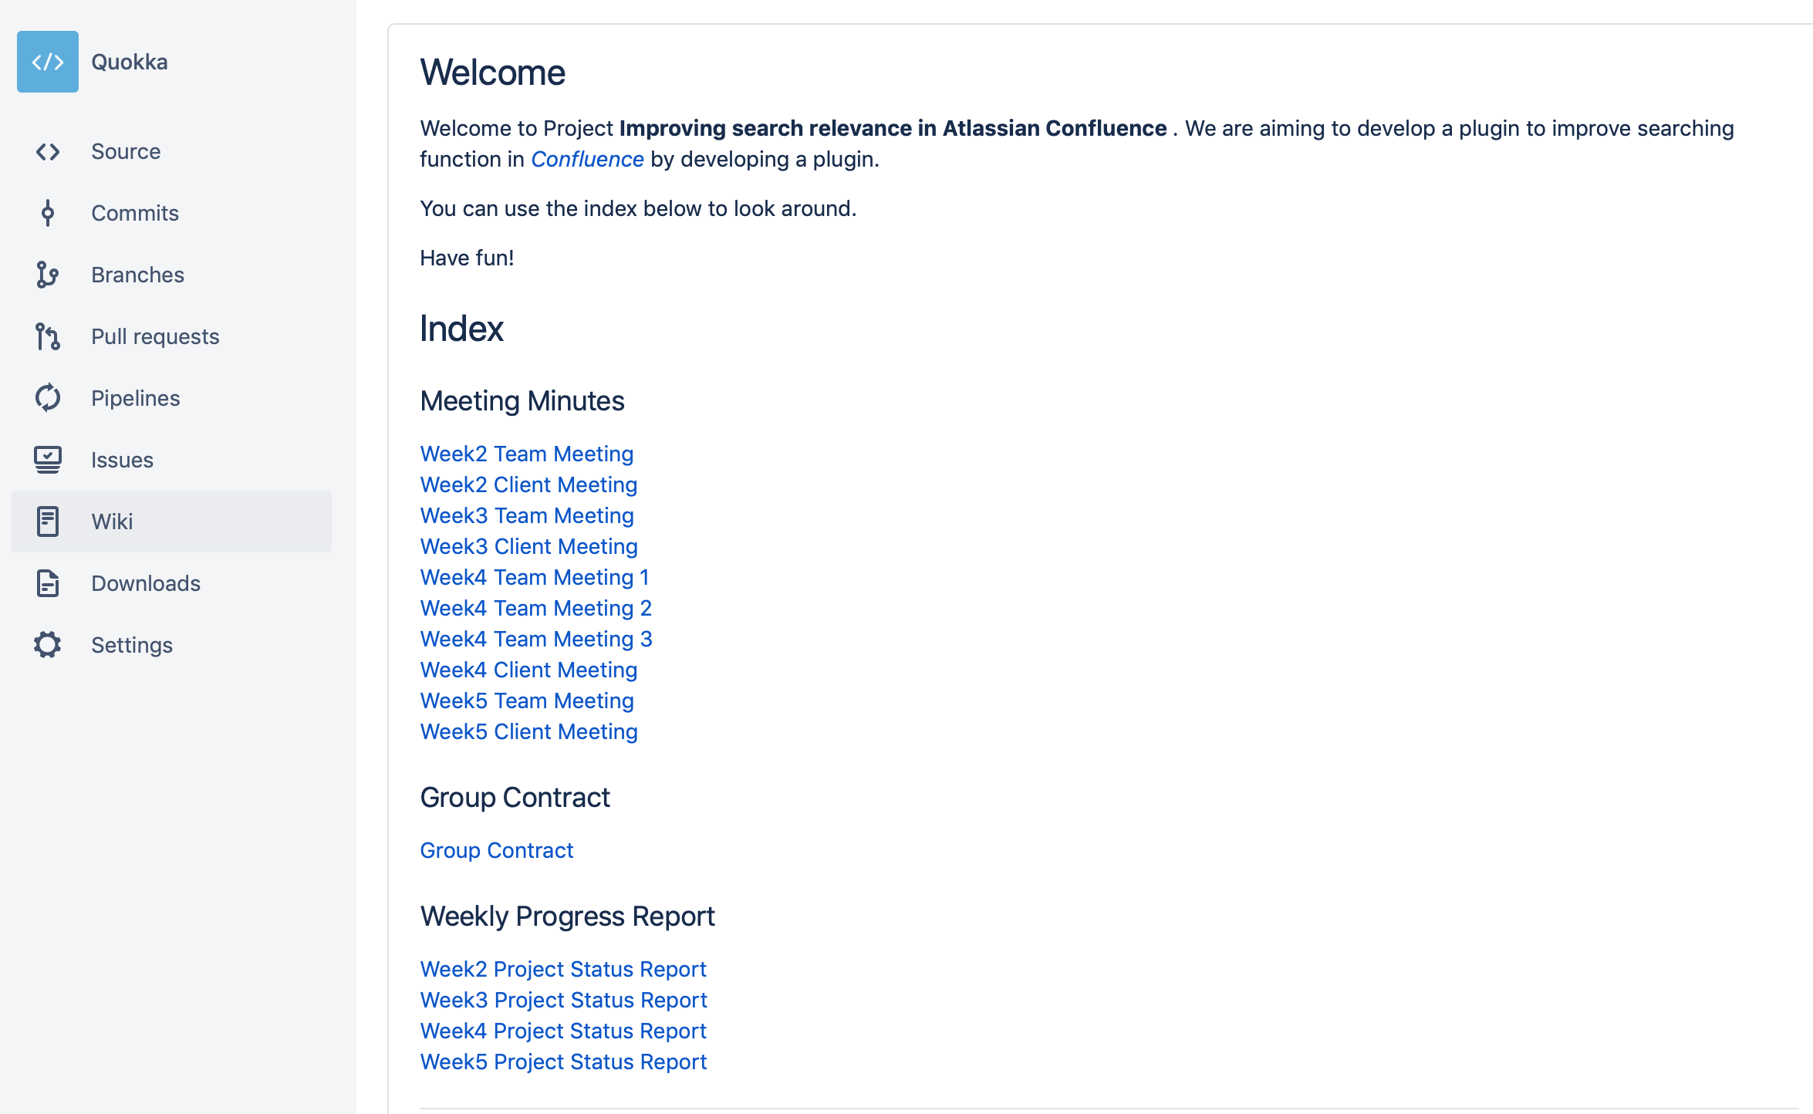
MileStone
Notes:
And on the wiki page, we have recorded the details of each meeting and weekly project status.

Slide 9
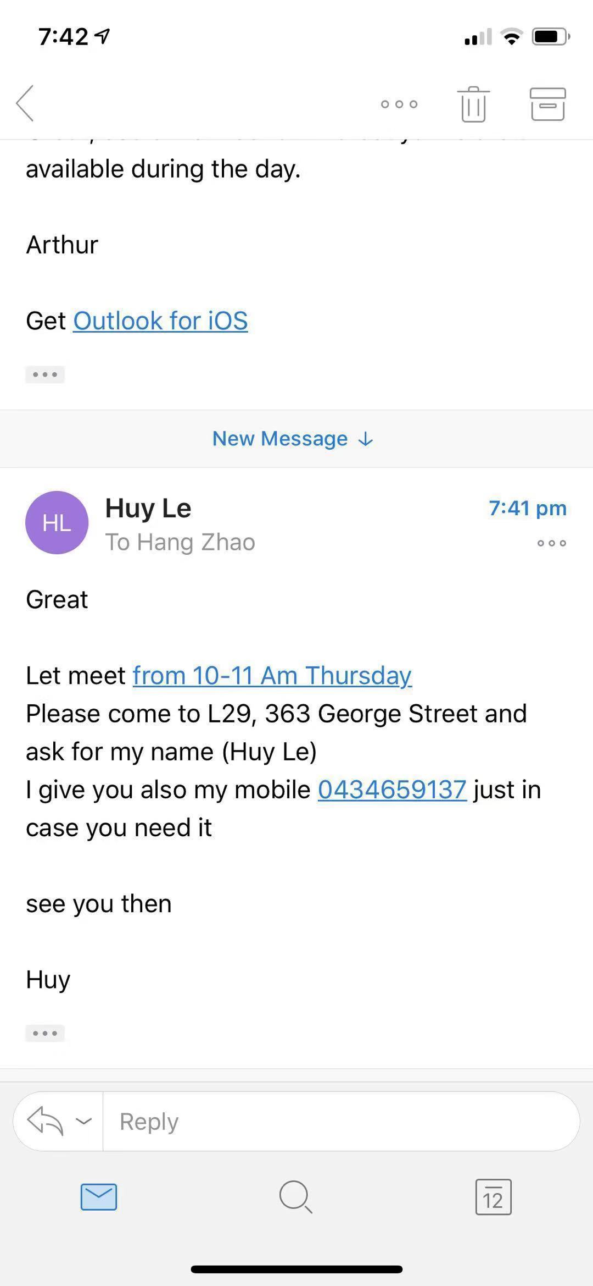
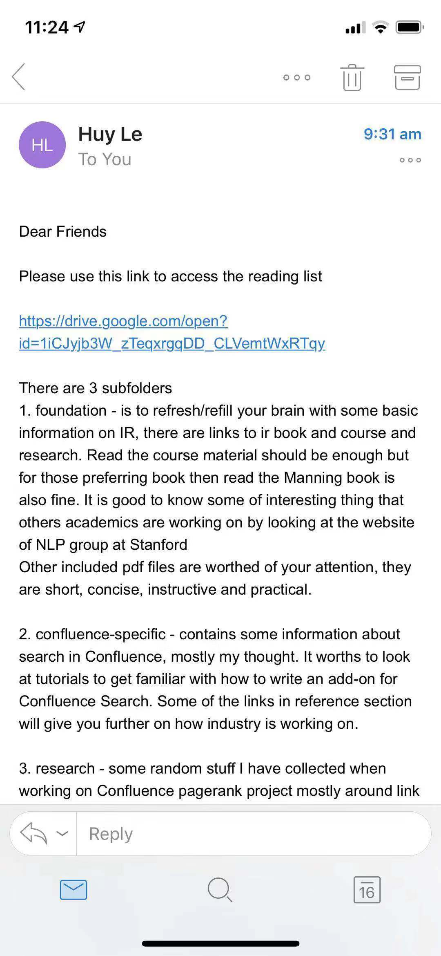
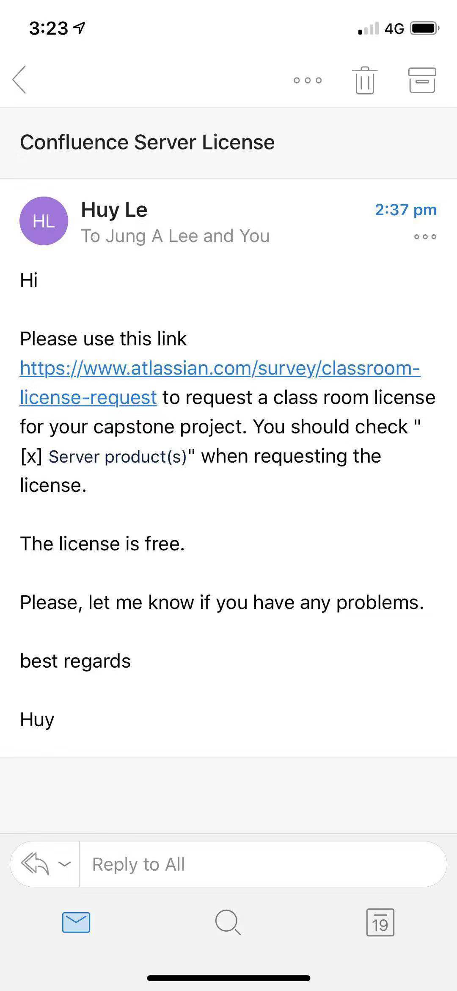
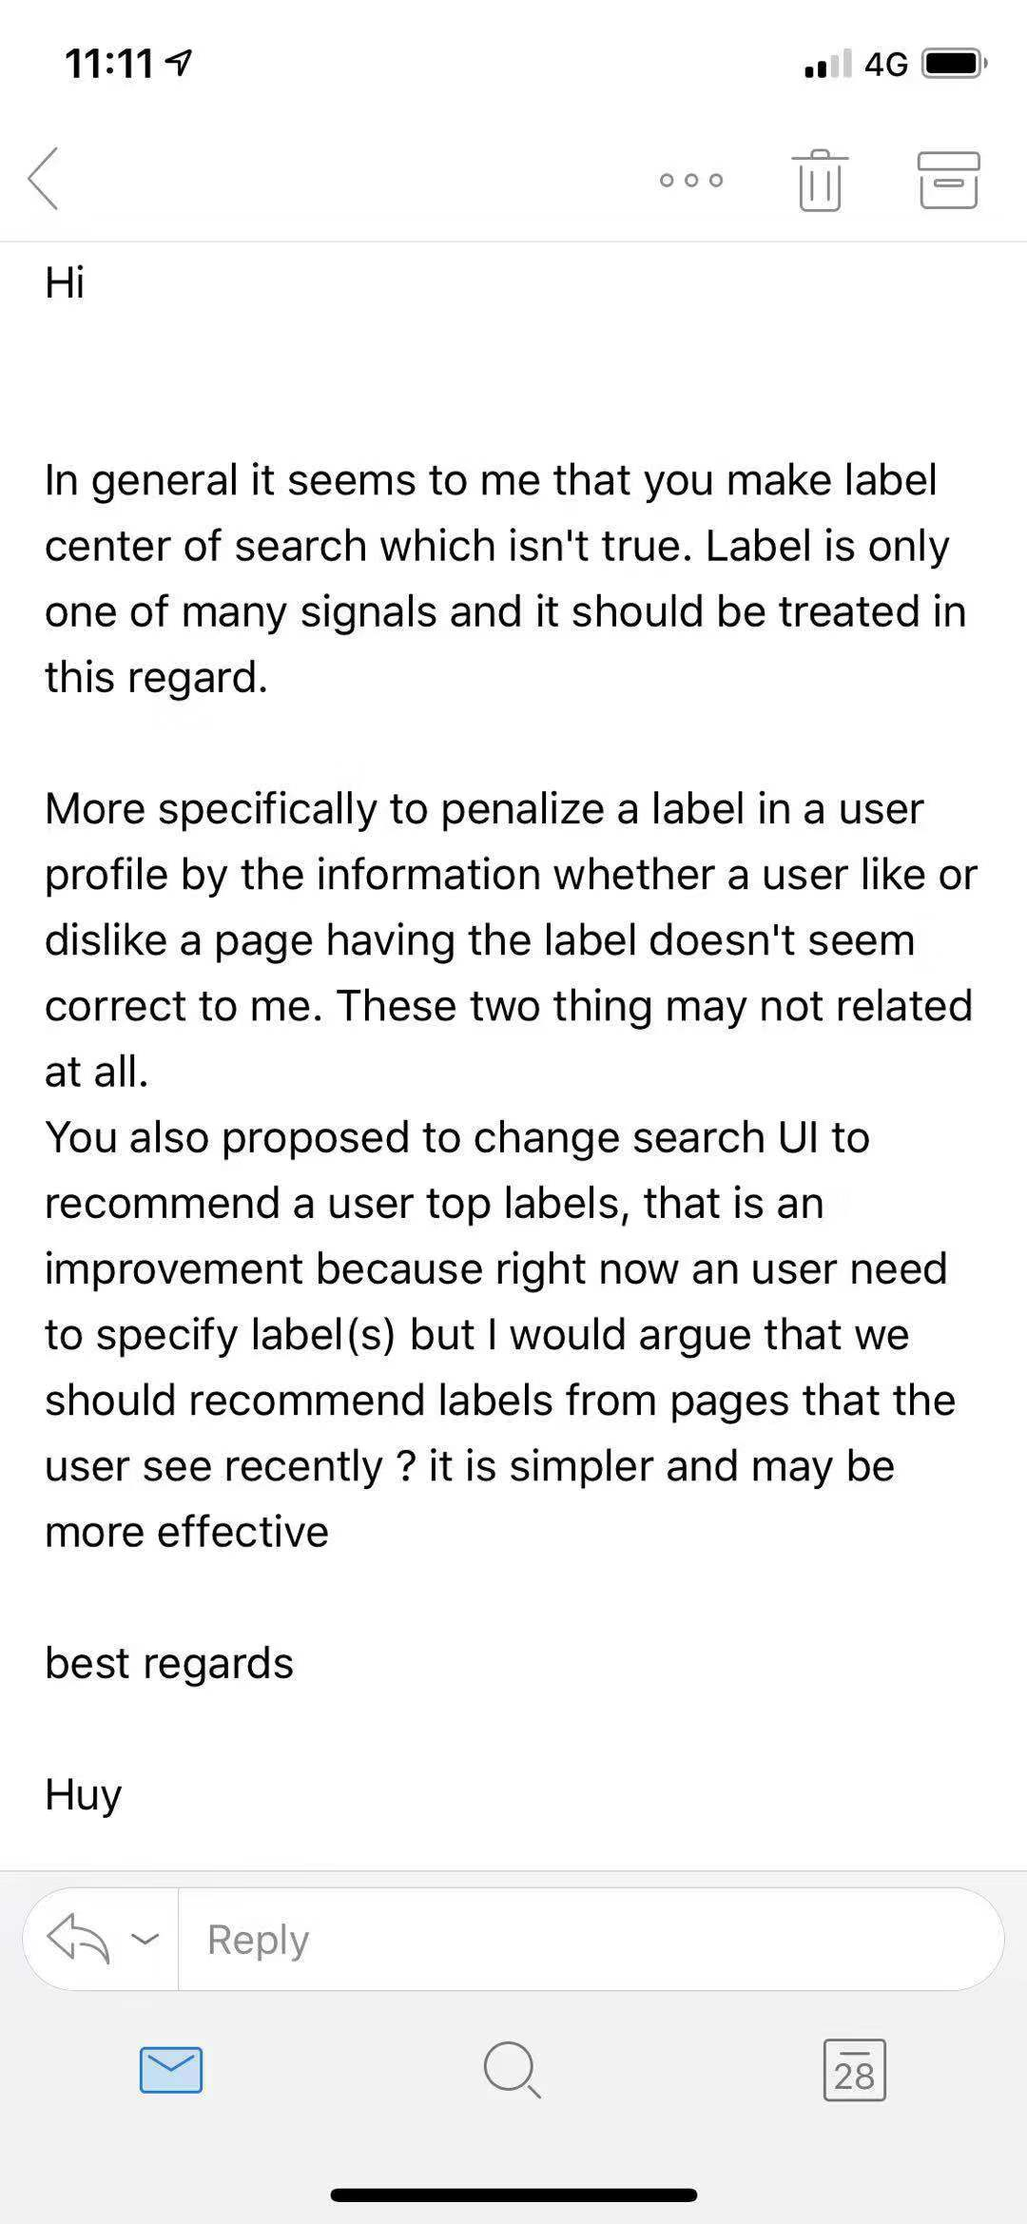
Notes:
Here are some emails we got from our client. He has sent us lots of reading materials and suggestions for our project.

Slide 10
Summary
Well cooperated between team members and client
Very clear design direction of project
Well completed:
To be improved:
A little bit behind schedule and needs to speed-up the process
Notes:
To evaluate our current process, we have well cooperated between team members and the client. And the design direction of the project is very clear. The bad thing is that we didn’t decide the final scope until last week, so we need to speed up our process.

Slide 11
Demo
Notes:
To evaluate our current process, we think the good thing is that we have decided our final scope last week. And we have well cooperated between team members and client. The bad thing is that we are a little bit behind schedule, which requires us to speed up the process.

Slide 12
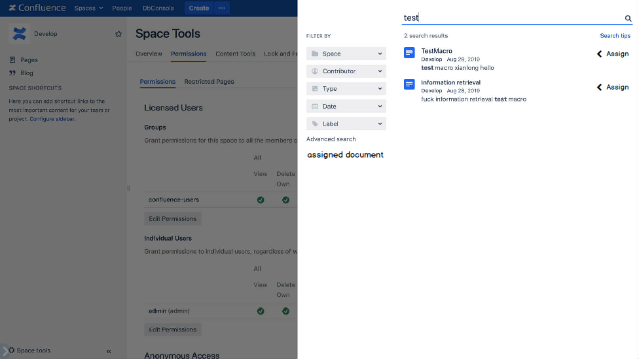

Slide 13
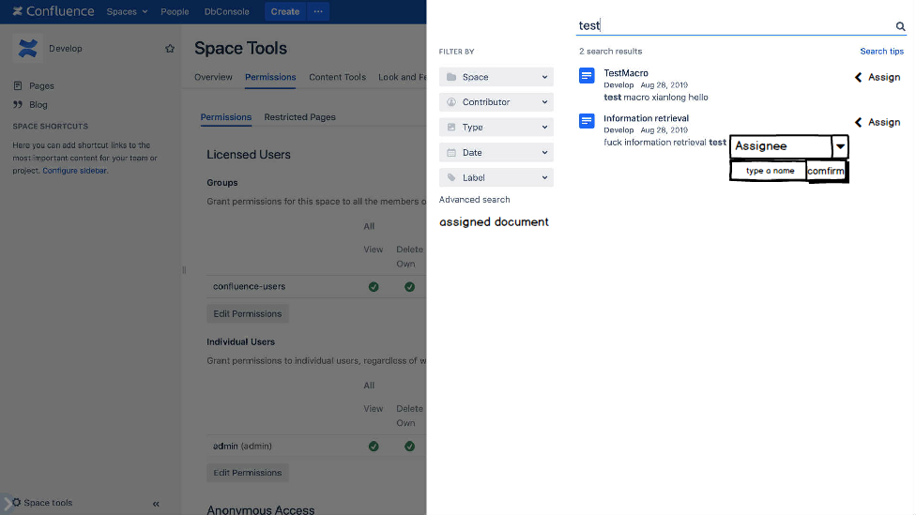

Slide 14
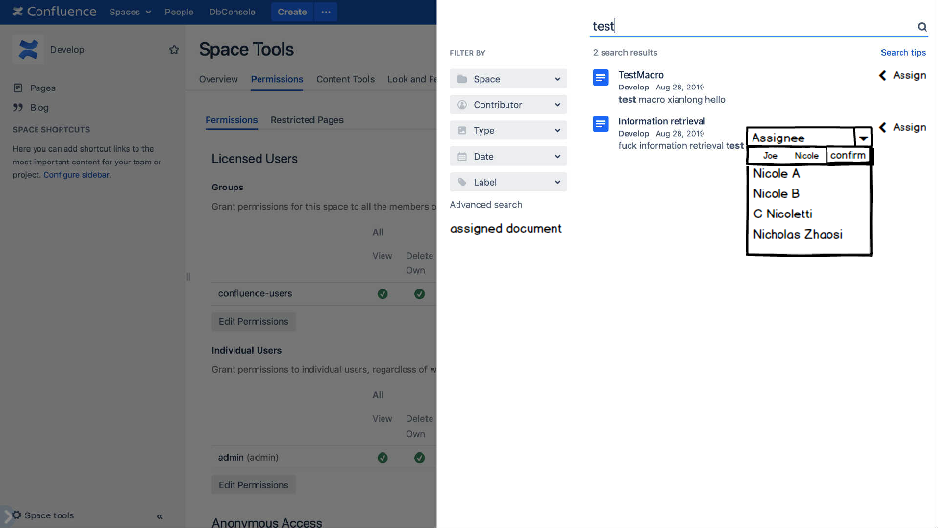

Slide 15
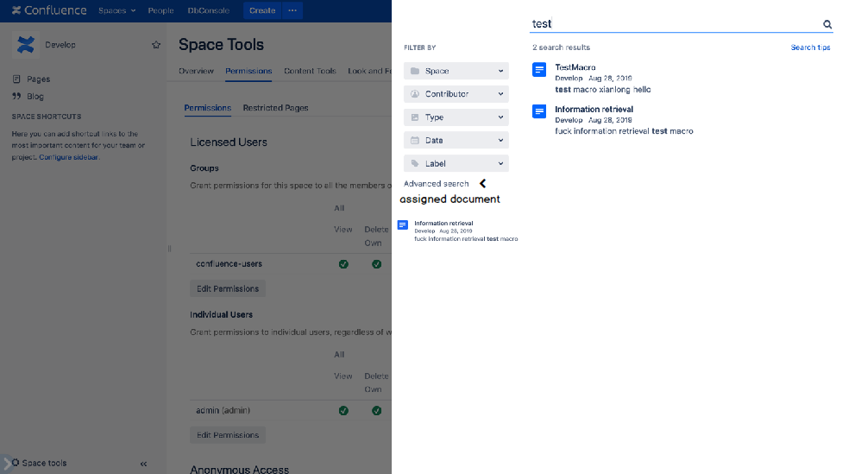

Slide 16
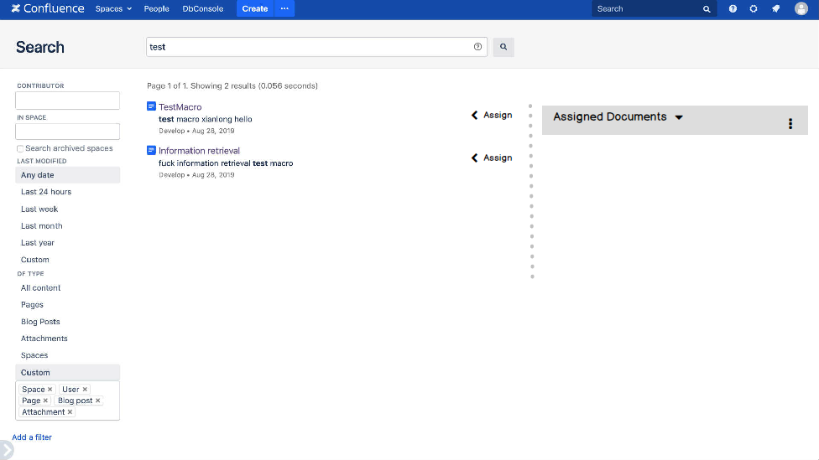

Slide 17
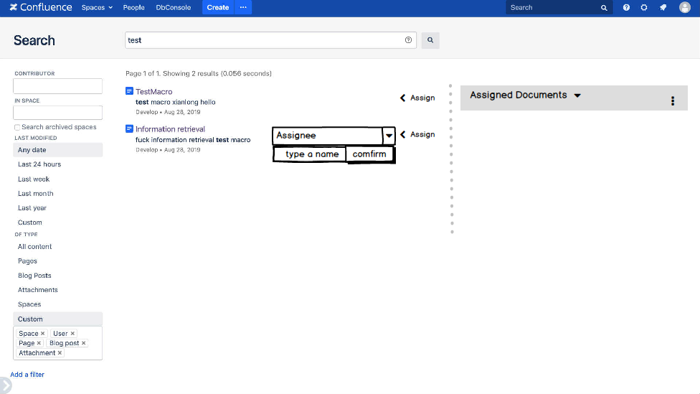

Slide 18
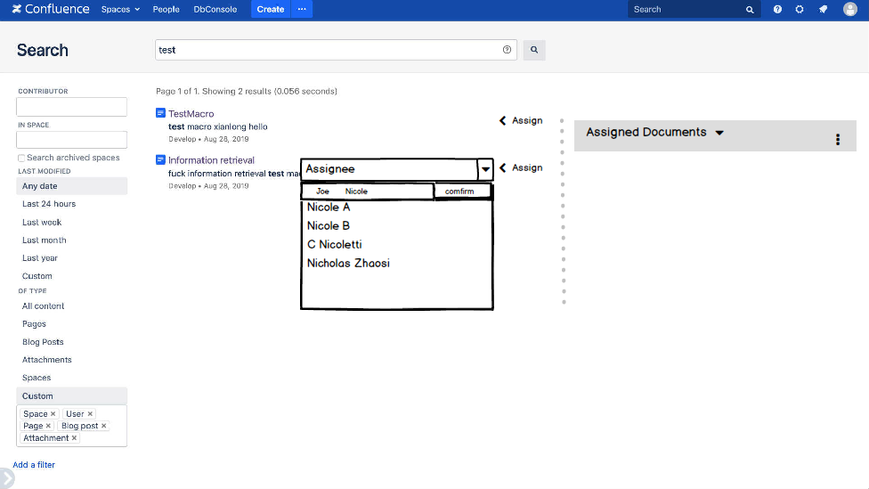

Slide 19
