Slide 1
Optimize Search Results in Confluence
Search Assisted
M16A Group 5
Team Quokka
Hang Zhao
Jiyuan Yang
Xianlong Jiang
Yu Shi
Jinjing Xu
Notes:
Hello, everyone! We are team quokka, our project is to optimize search results in Confluence.

Slide 2
Background and Project Introduction
Confluence - a collaboration software.
The search engine - a bottleneck.
Atlassian - improving the performance for years by enhancing its search algorithm.
The searching process can still be improved.
A plugin - improves the user experience & optimizes search results
Notes:
As an outstanding collaboration software, Confluence has helped hundreds of enterprises to manage their intelligence resources. However, the search engine can be a bottleneck of its efficiency. Atlassian has been working on improving the performance of Confluence for years by enhancing its search algorithm. However, the searching process can still be improved and our project is to create a plugin that tremendously improves the user experience and helps to optimize search results.

Slide 3
Build the required system with quality.
Tools - API
Algorithms - Confluence relevance search
Plugins - confluence-maven-plugin, etc
Knowledge - Learn how to make macro
Notes:
Now, I will present how to build the required system with quality. We used ContentNameSearchSectionsProvider API as tool, Confluence relevance as algorithm, confluence-maven-plugin and others plugins, in addition, we learned how to make macro from some online tutorials.

Slide 4
User Story Overview
Priority Identified using Planning Poker.
Both functional and non-functional requirements are considered and abstracted as user stories.
All user stories are gained approval from client.
2 sets of user stories
3 key users, 2 key actions and 3 priority levels.
In toal 23 user stories in the fianl set, 3 discarded.
Notes:
We are aiming to provide better experience for Confluence users by helping 2 main types of users: The normal users(which means they are normal employees or team members) and team leaders. We will achieve this by delivering a search engine plugin. The plugin is mainly about Highlight functions which will be introduced by Arthur later. Our primary user is the normal user. We are actually providing extra tools for team leaders to assist with optimising search result for normal users. As for the use story, the last one is about the UI design and we have already finished it. We are still working on other function related to other user stories.

Slide 5
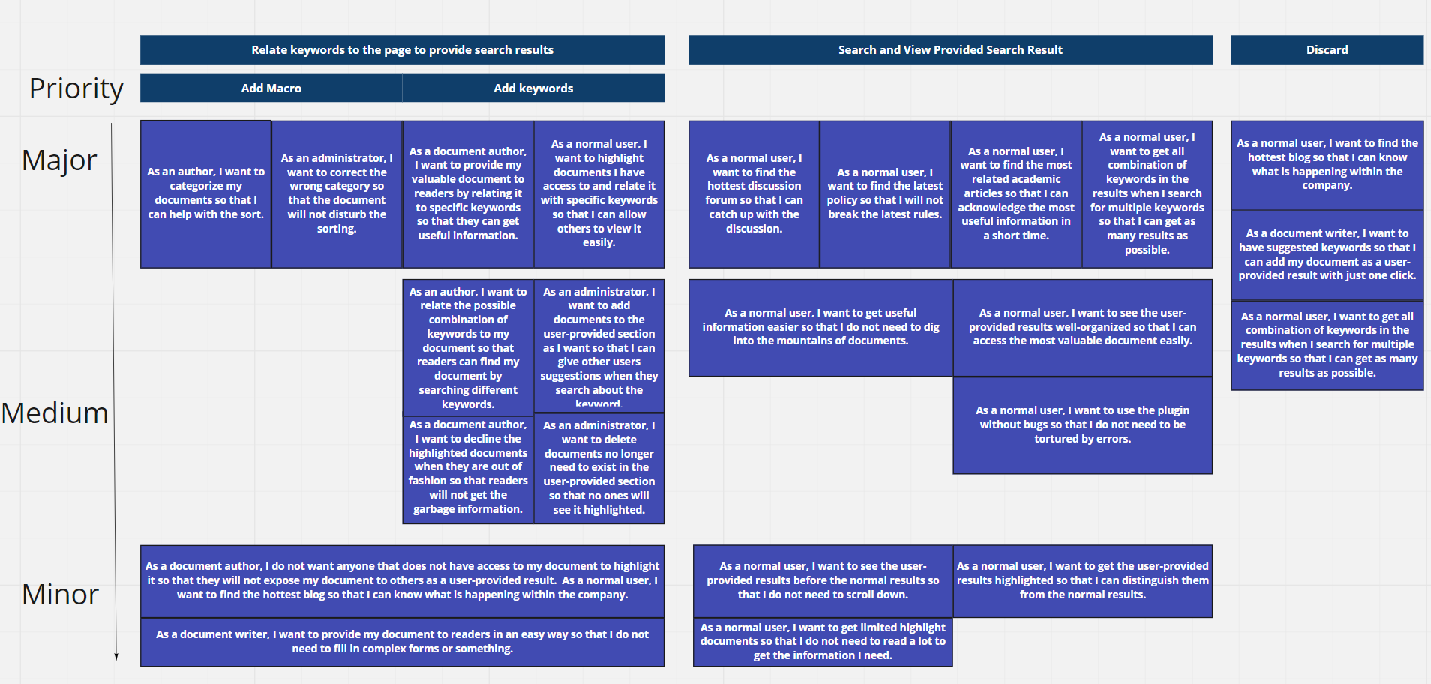
User Story Board

Slide 6
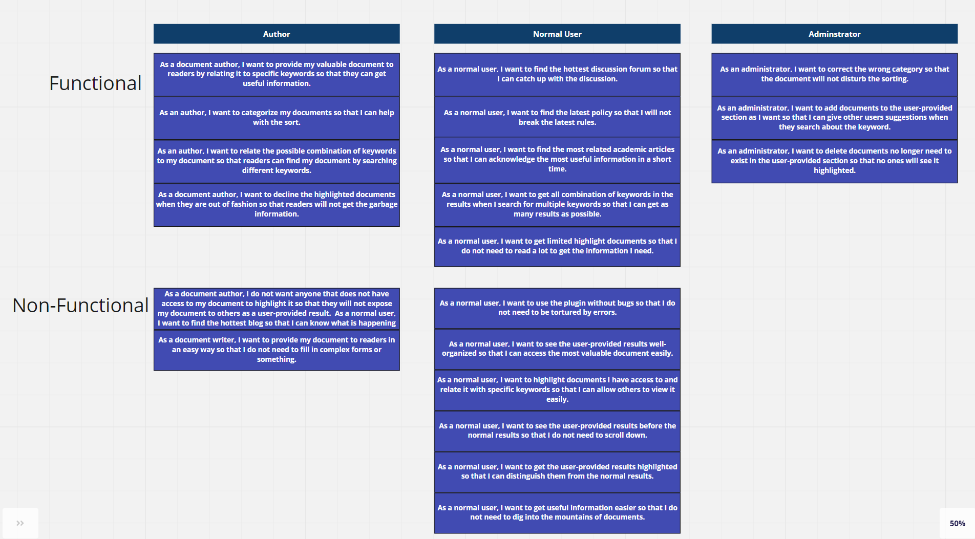
Functional and Non-Functional

Slide 7
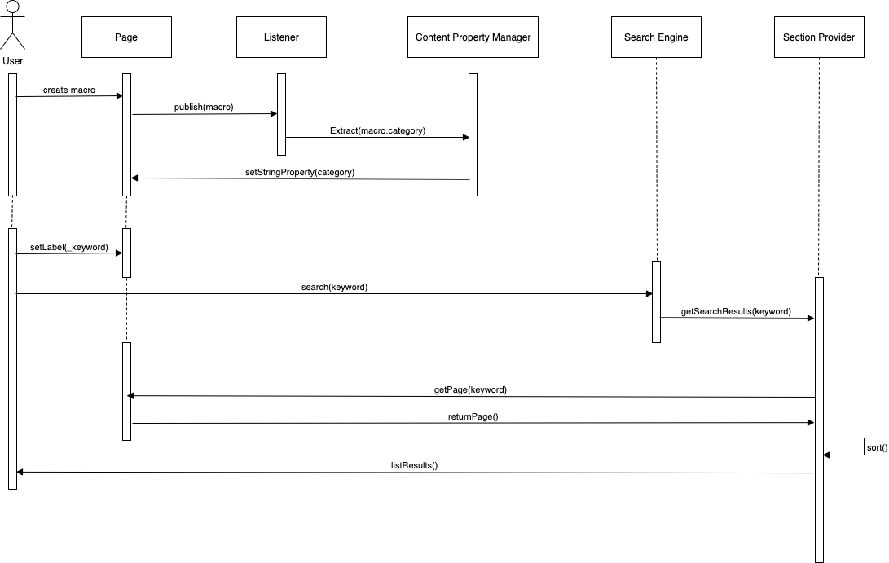
System Architecture

Slide 8
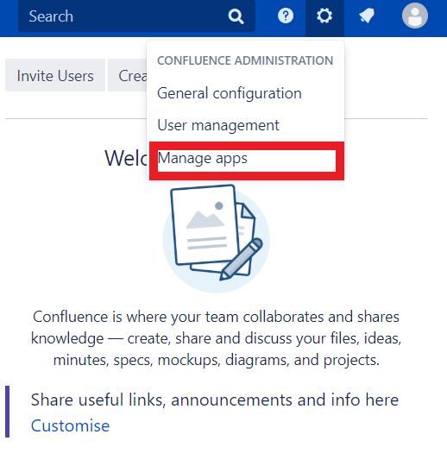
System Demonstration

Slide 9
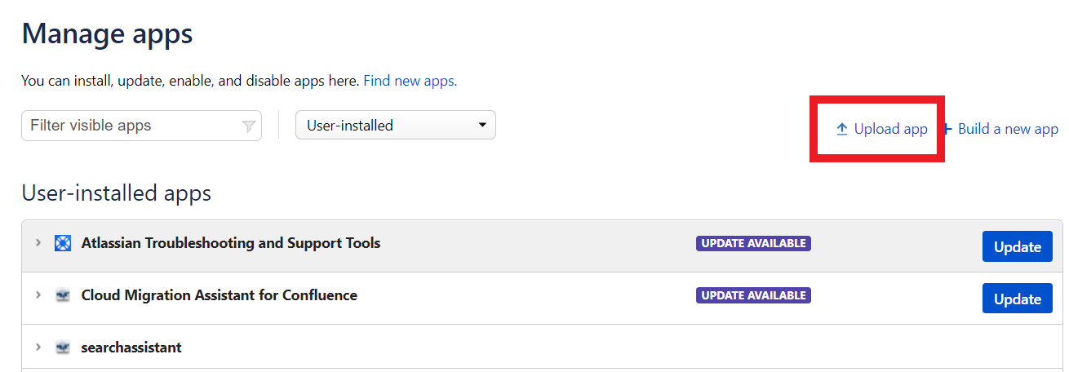

Slide 10
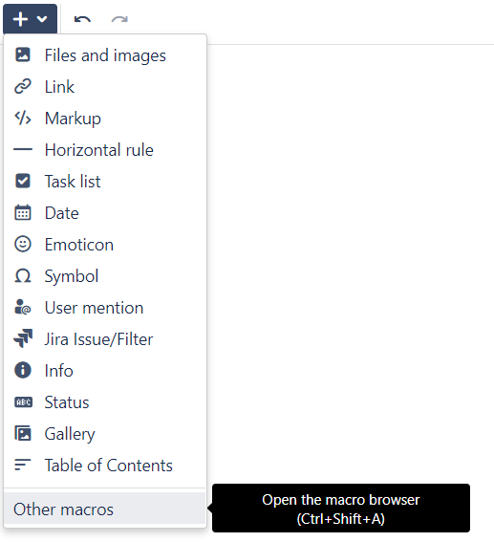

Slide 11
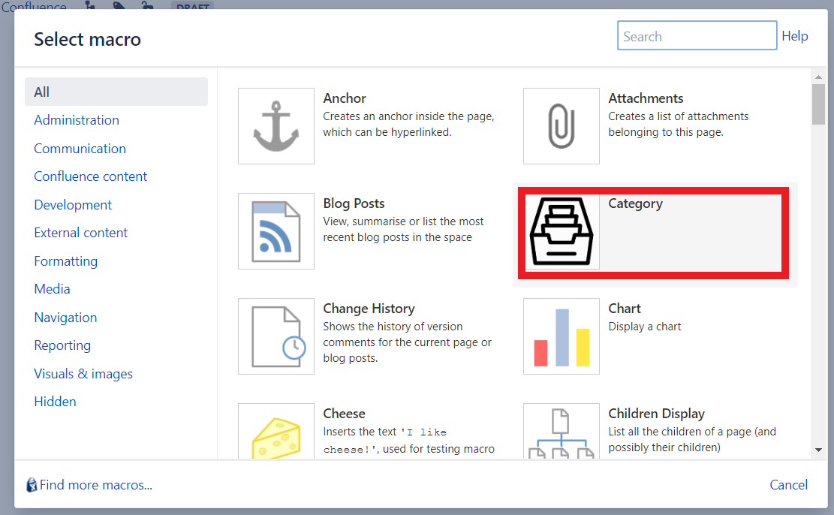

Slide 12
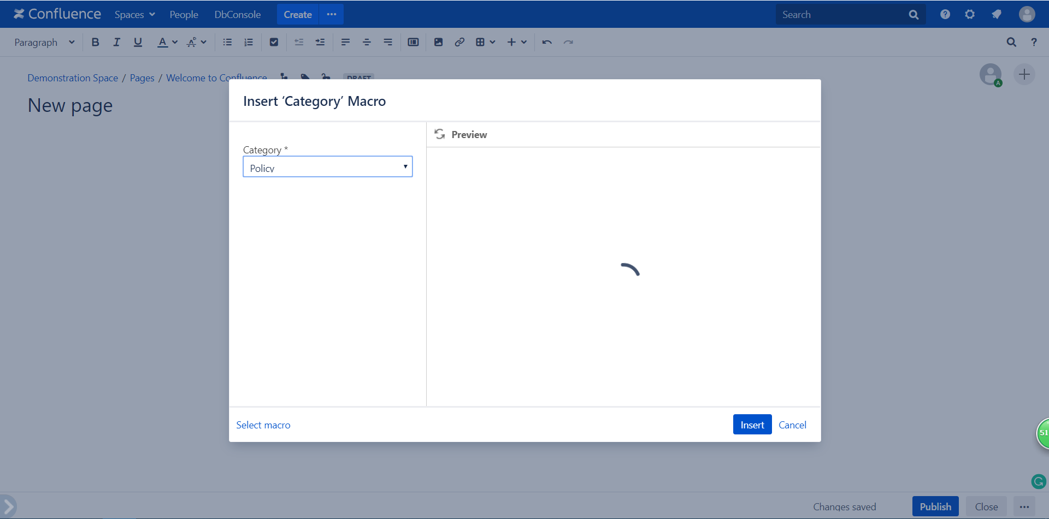

Slide 13
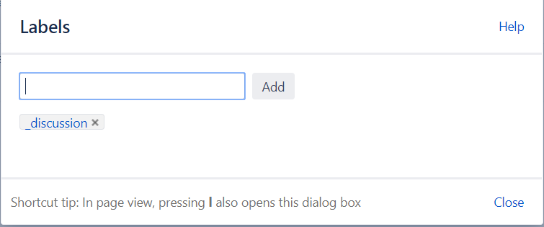

Slide 14
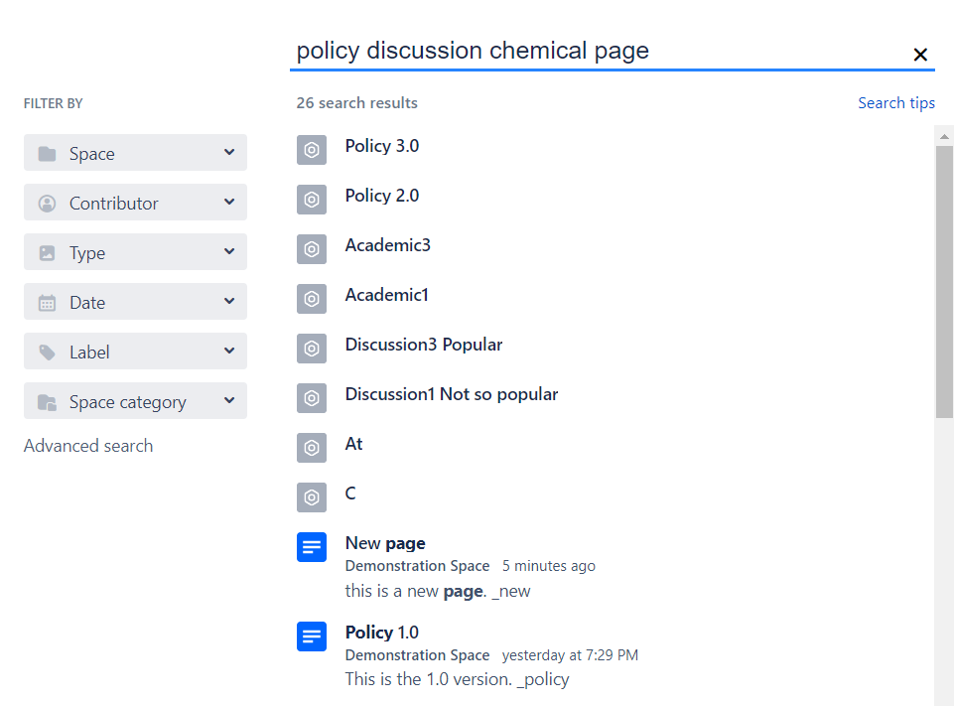

Slide 15
Quality of Testing
The test plan is made before the coding part.
Used relevent test type:
Acceptance testing, usablity testing, atlas-unit testing and atlas-wired testing.
Tools for testing: Confluence SDK, junit4, Mockito, google Gson.
The Equivalance Partationing and boundary analyse are used in relevence testing techniques.

Slide 16
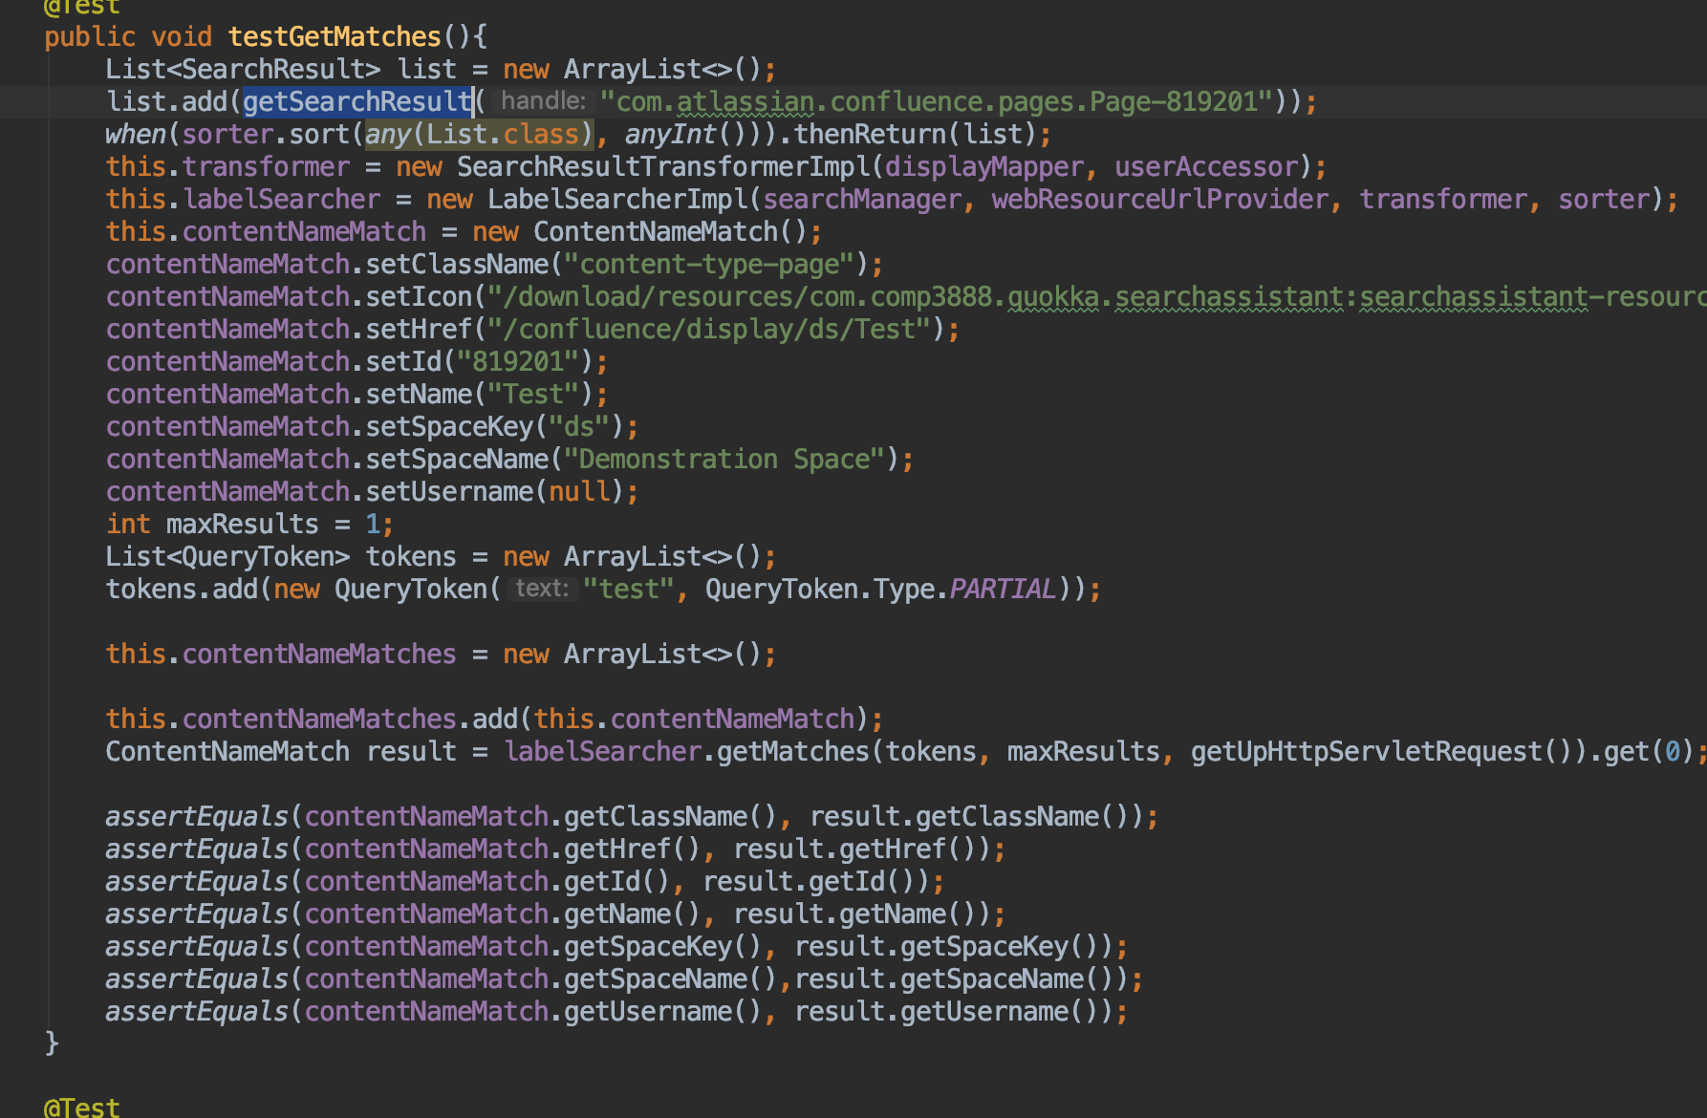
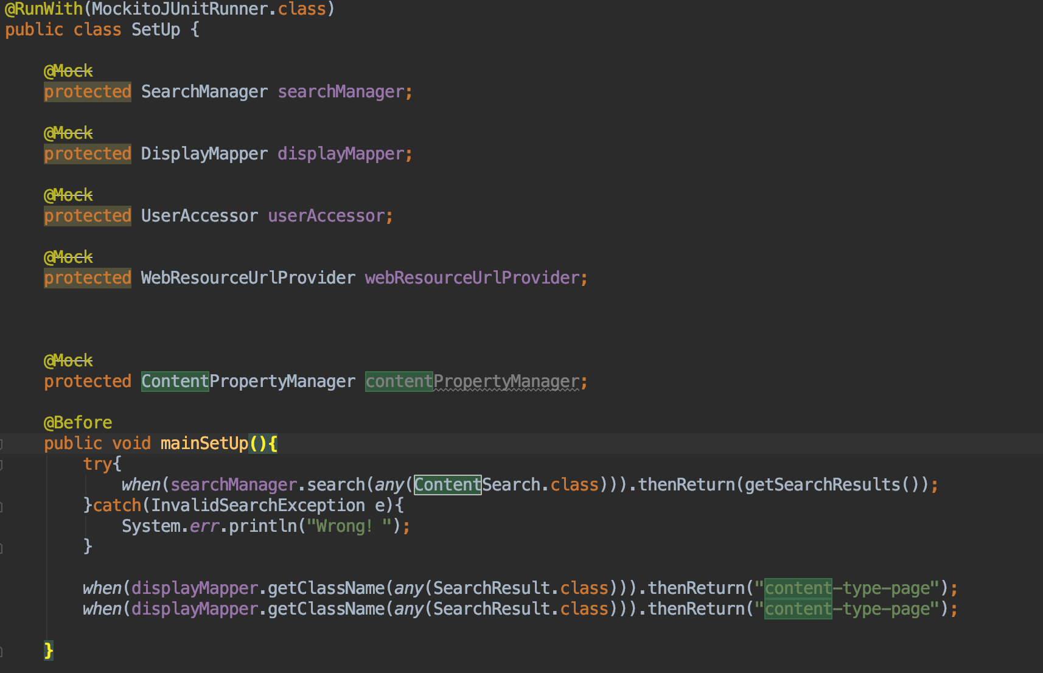
Quality of Testing
Unit Test:

Slide 17
Quality of Testing
Usability test:
Using blackbox test.

Slide 18
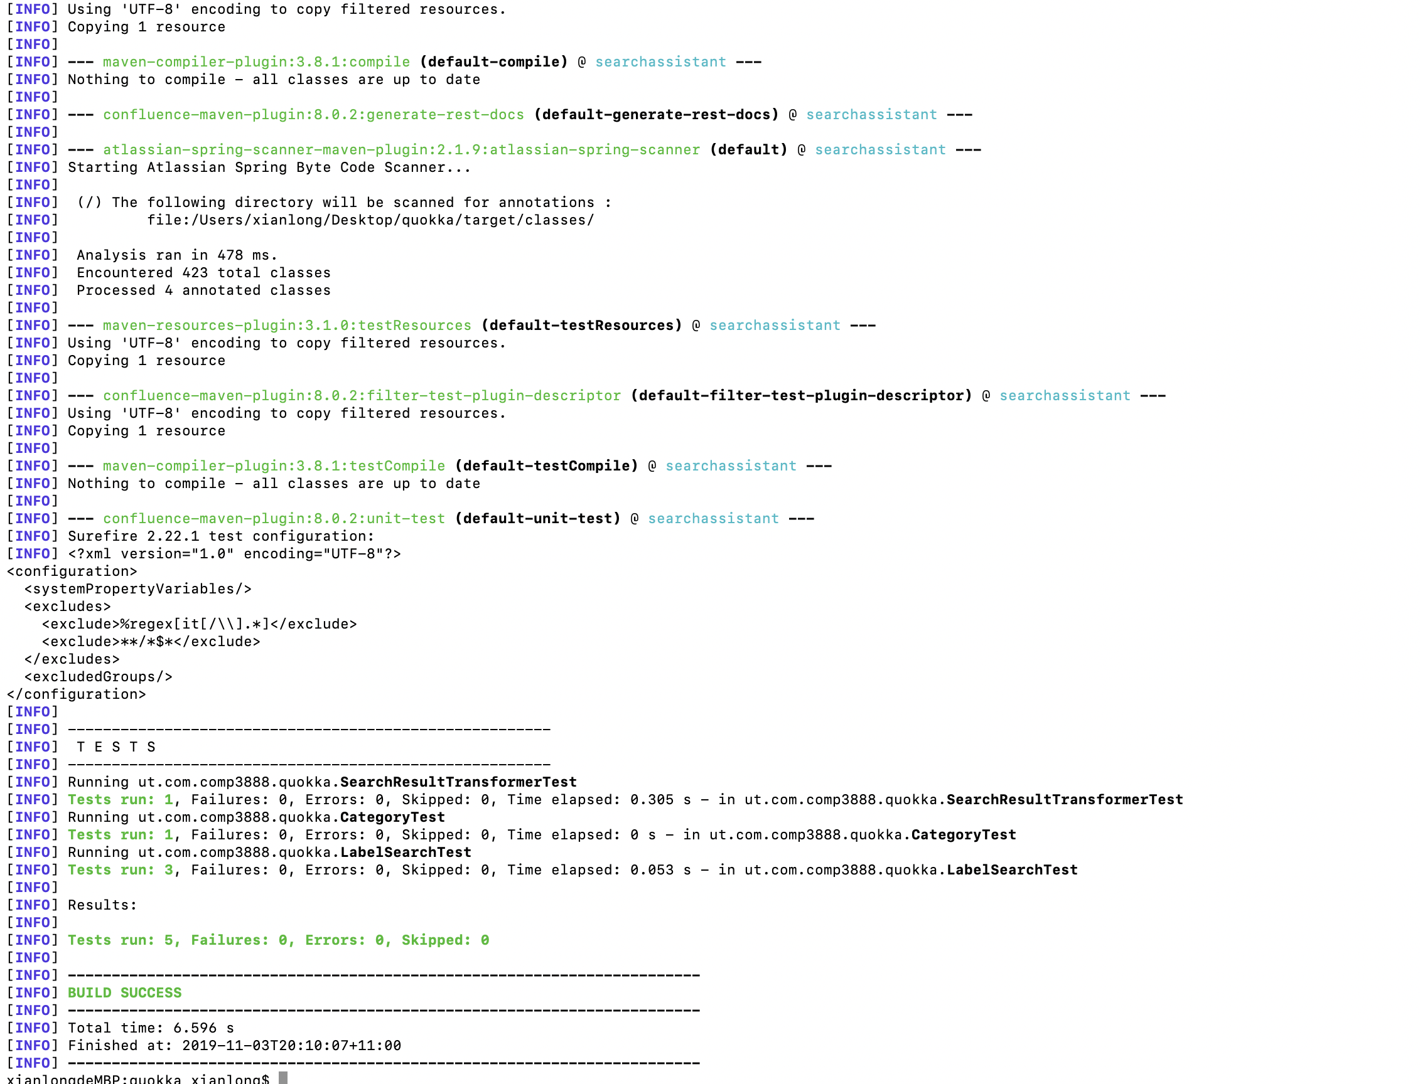
Evidenance of testing success

Slide 19
Test coverage
The Jacoco Test Report

Slide 20
Group Processes
Weekly issues on bitbucket
Weekly report and meeting records
Weekly plan and task allocation
Commits history
Communication with the Client
Process summary
Notes:
Thanks Arthur. Next I am going to talk about our group progress.

Slide 21
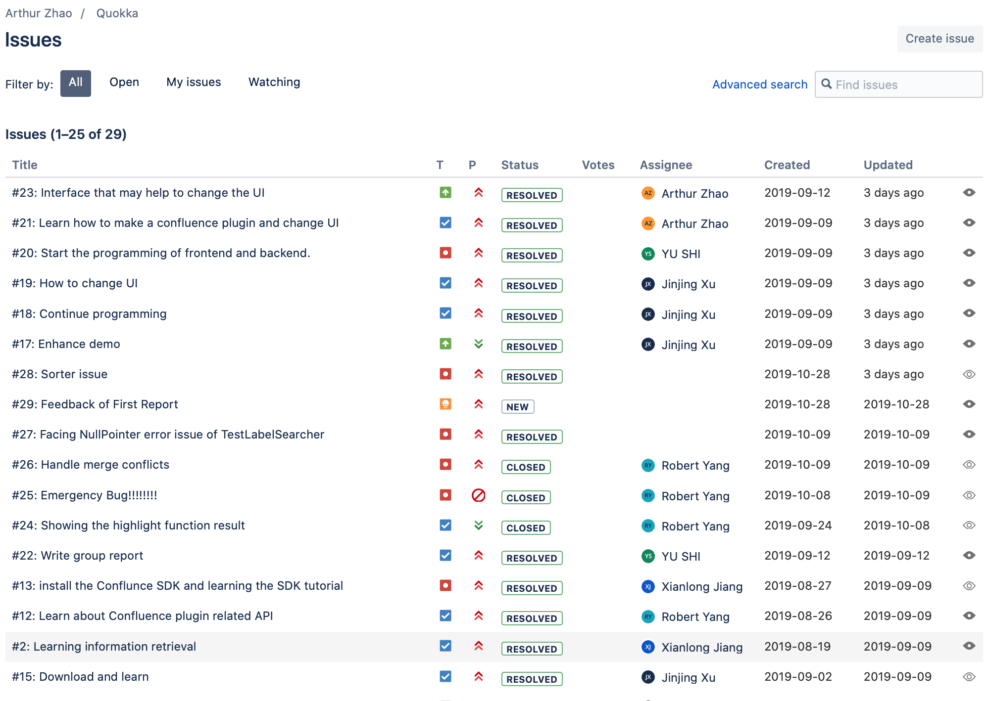
Issues
Notes:
These are our weekly issues. Now we have gotten 16 issues on the issue board.

Slide 22
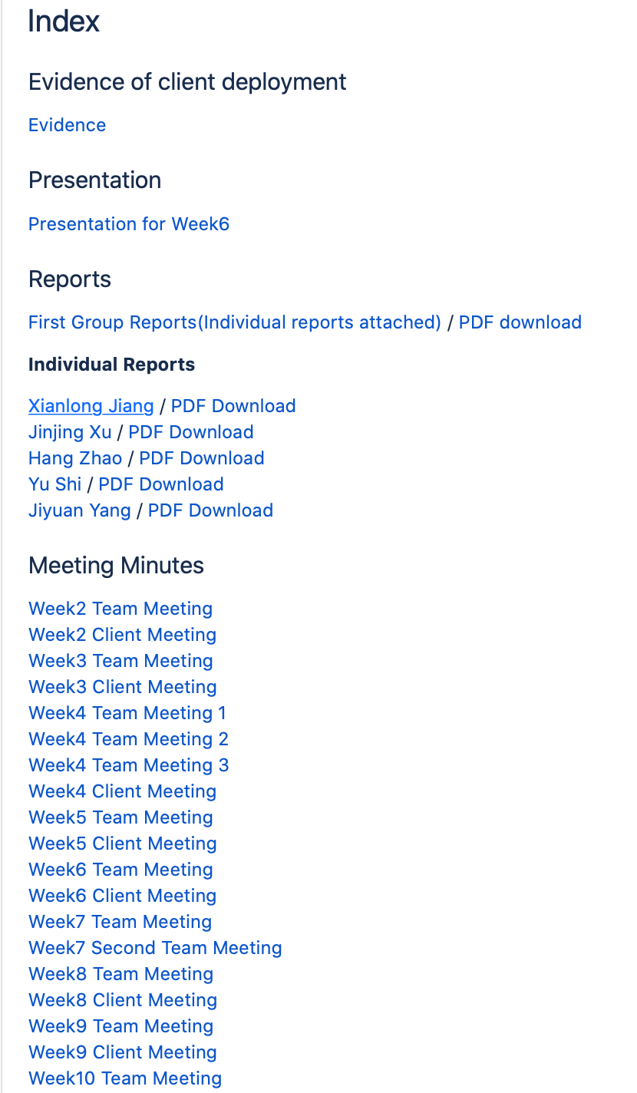
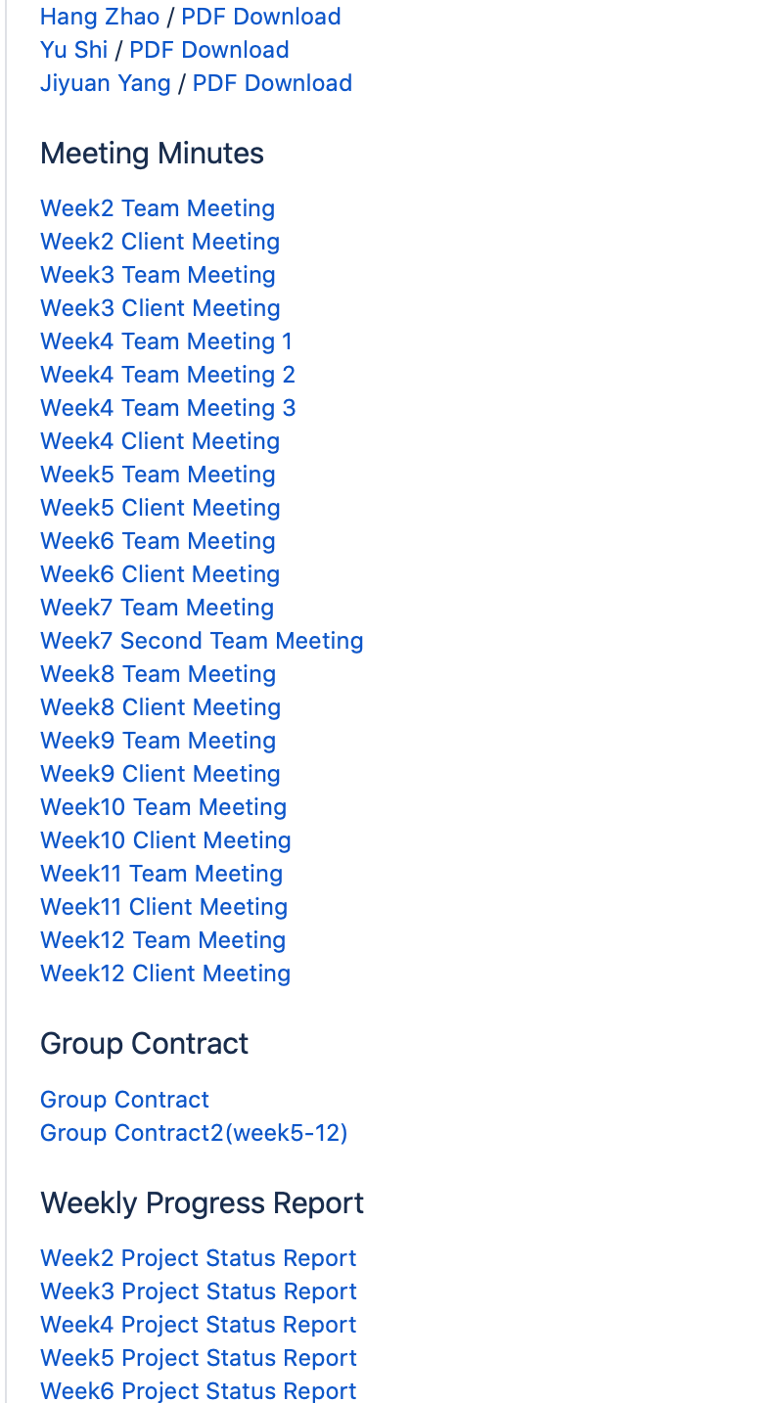
Wiki
Notes:
And on the wiki page, we have recorded the details of each meeting and weekly project status.

Slide 23
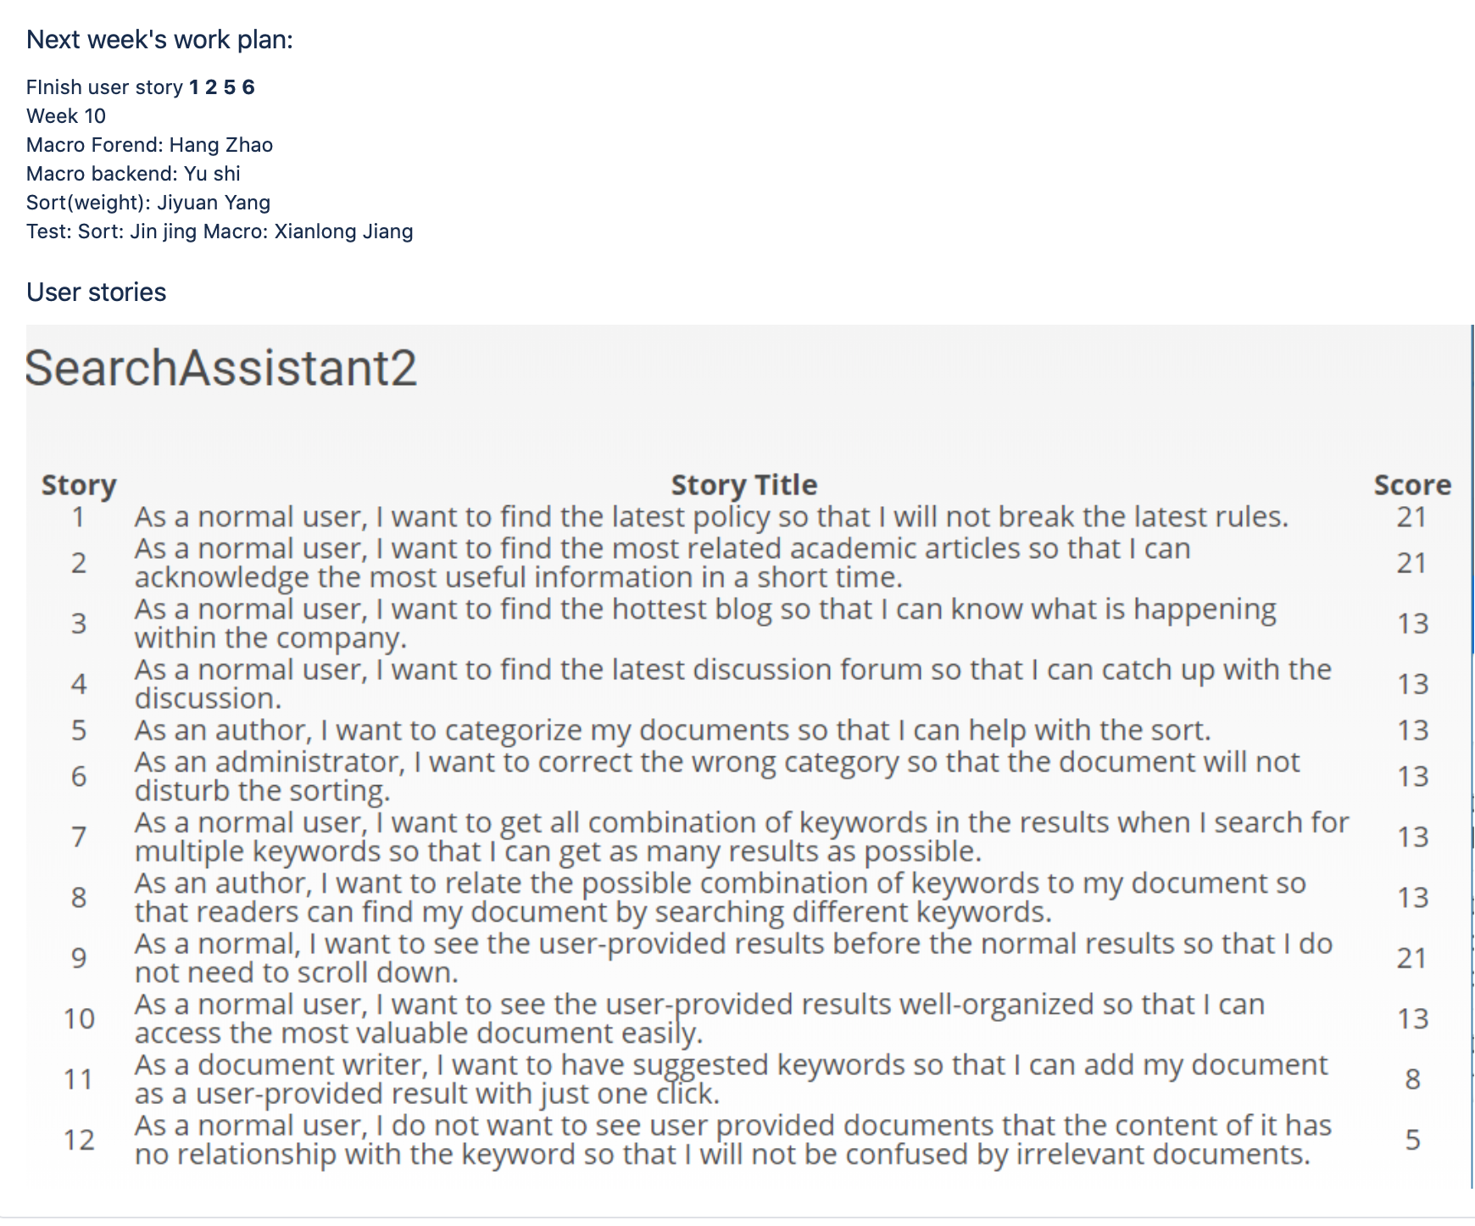
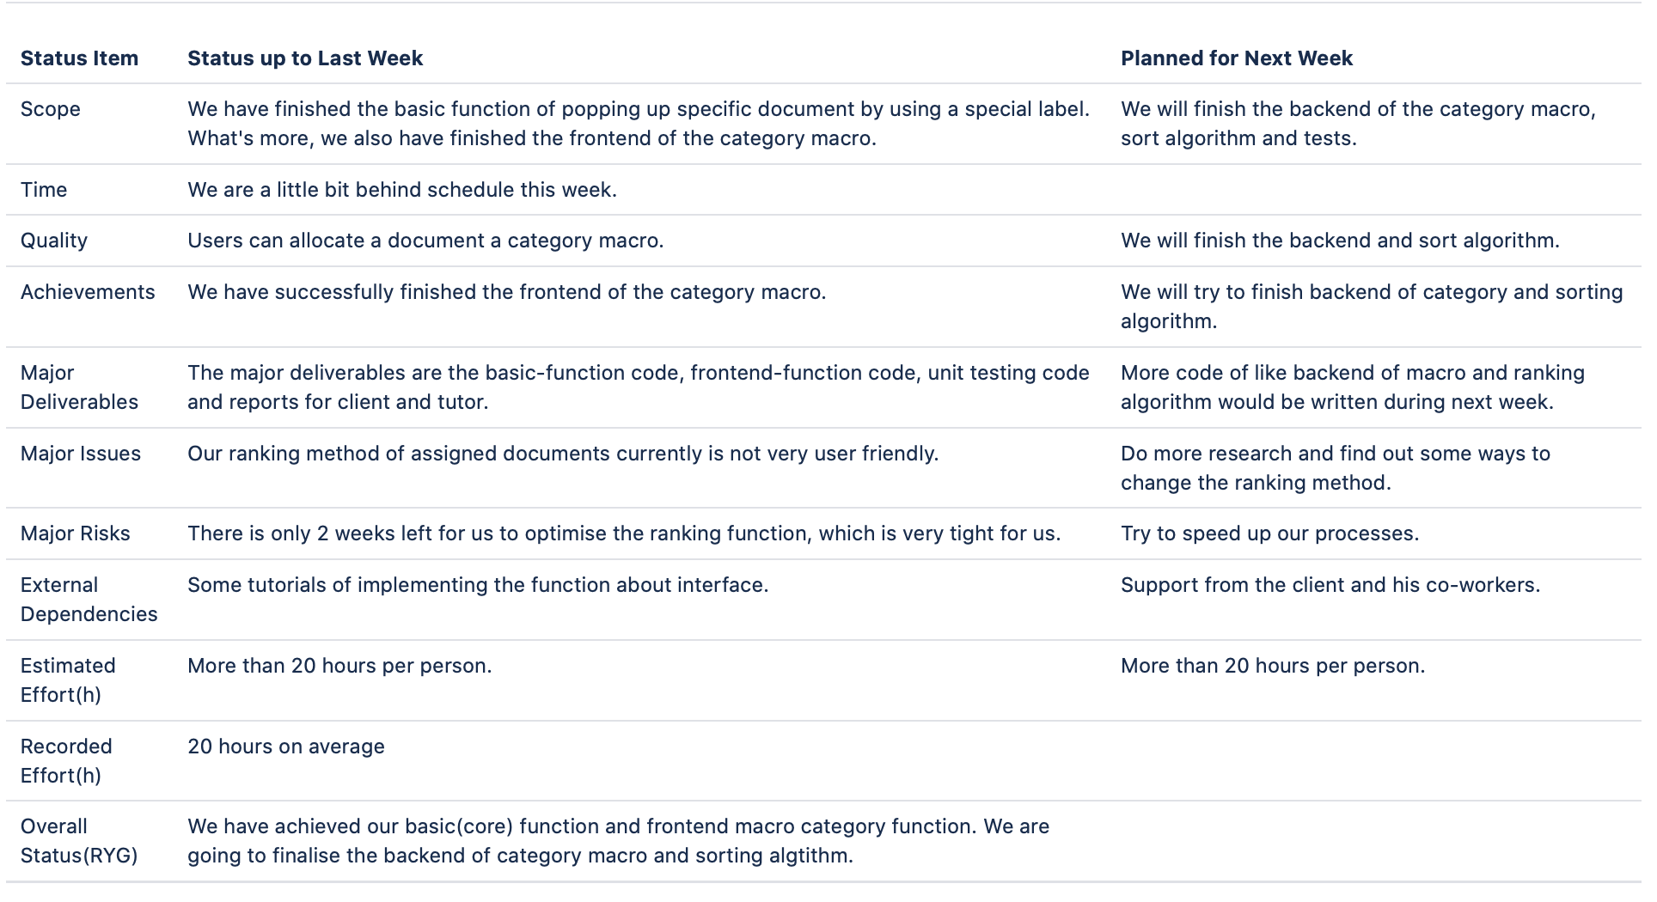
Weekly plan and task allocation

Slide 24
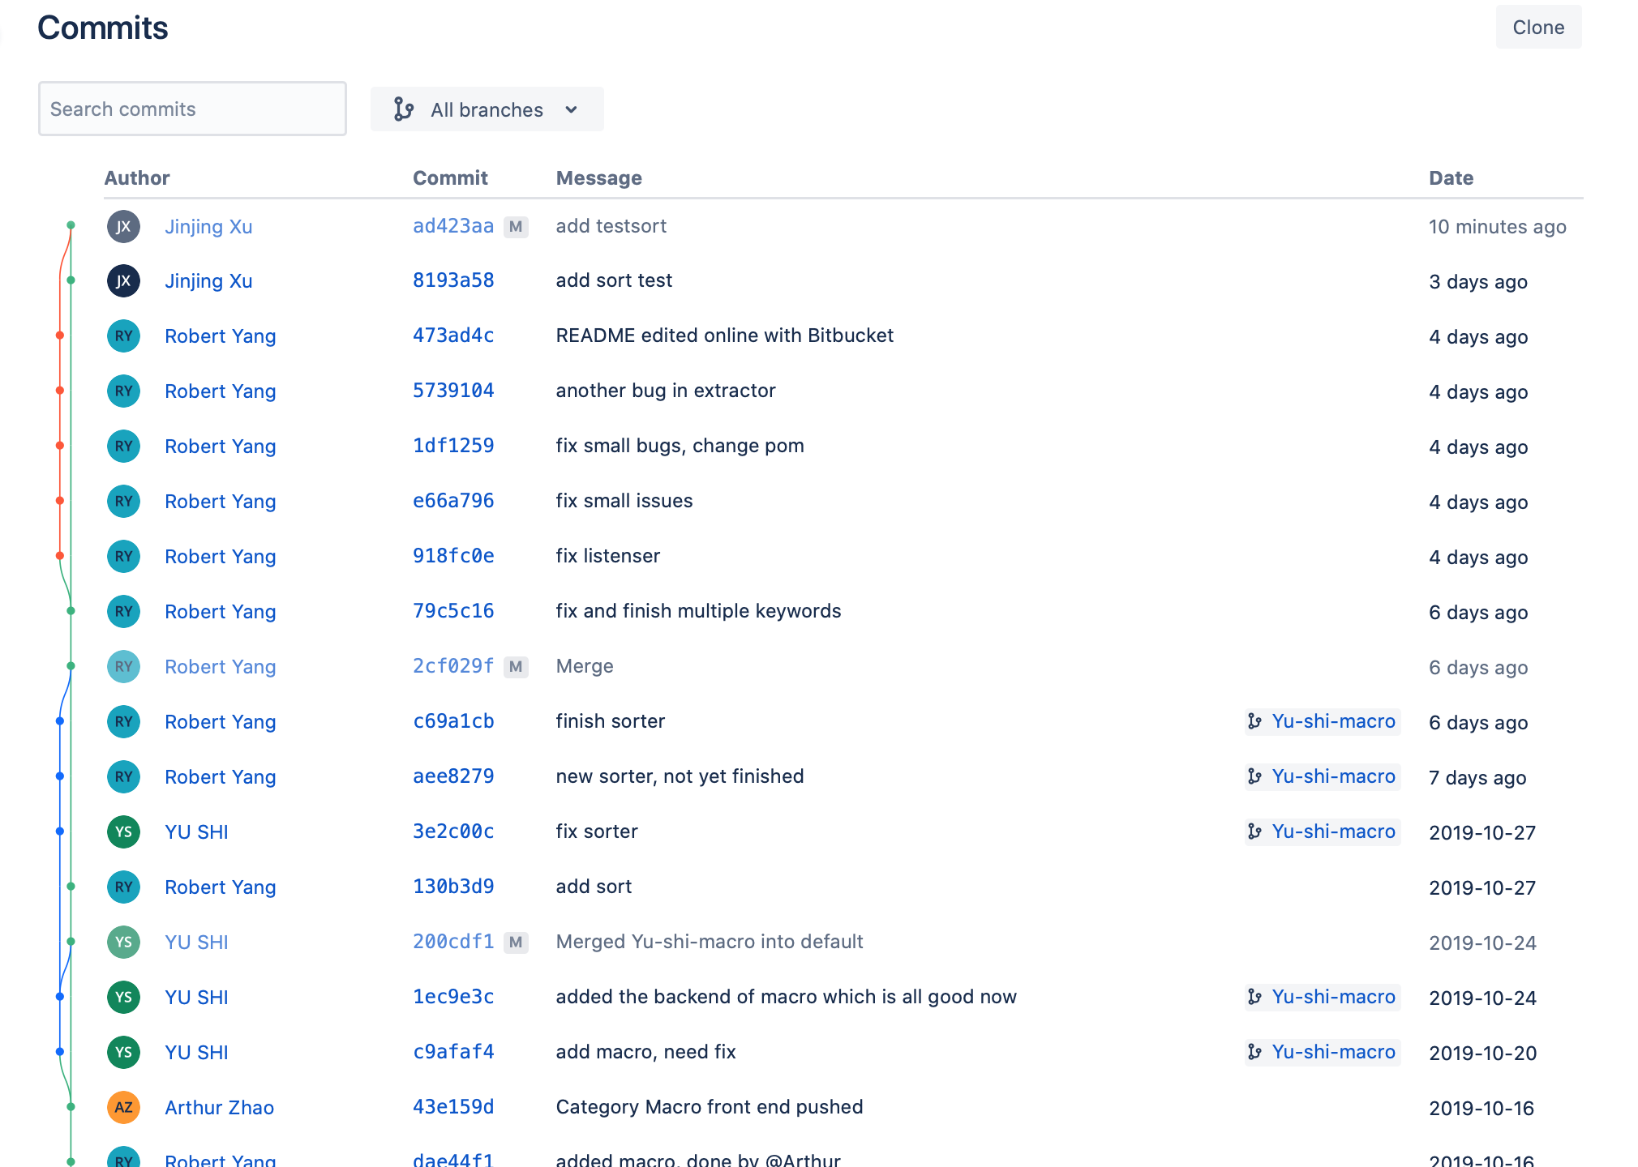
Commits
Notes:
These are some emails we got from our client. He has sent us lots of reading materials and suggestions for our project.

Slide 25
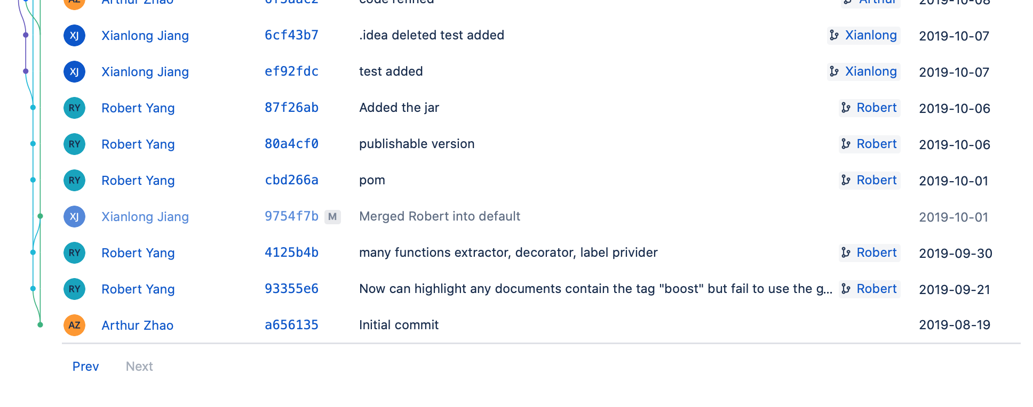
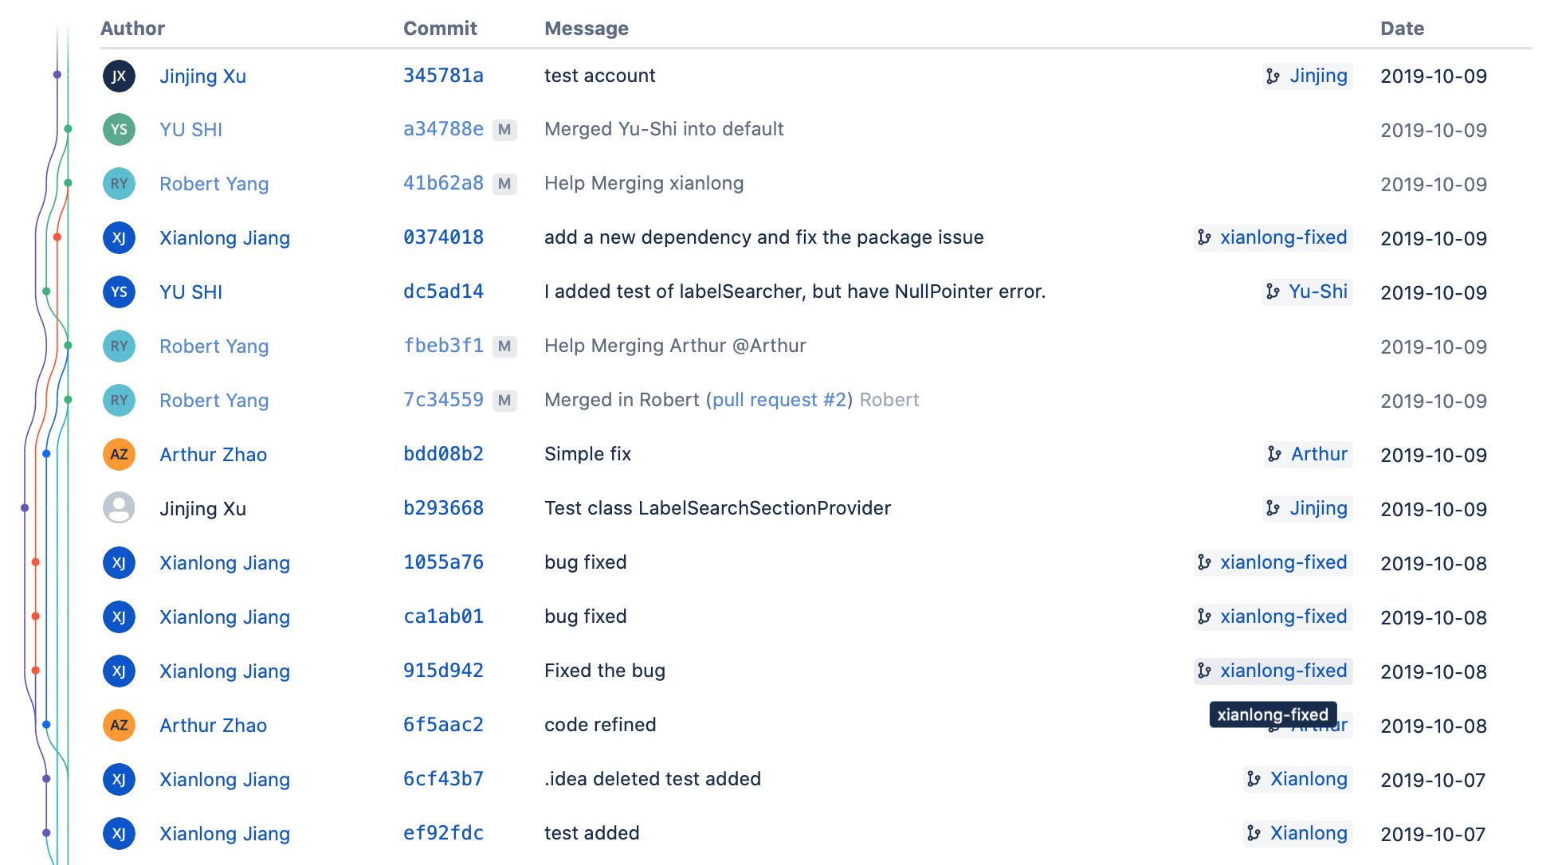
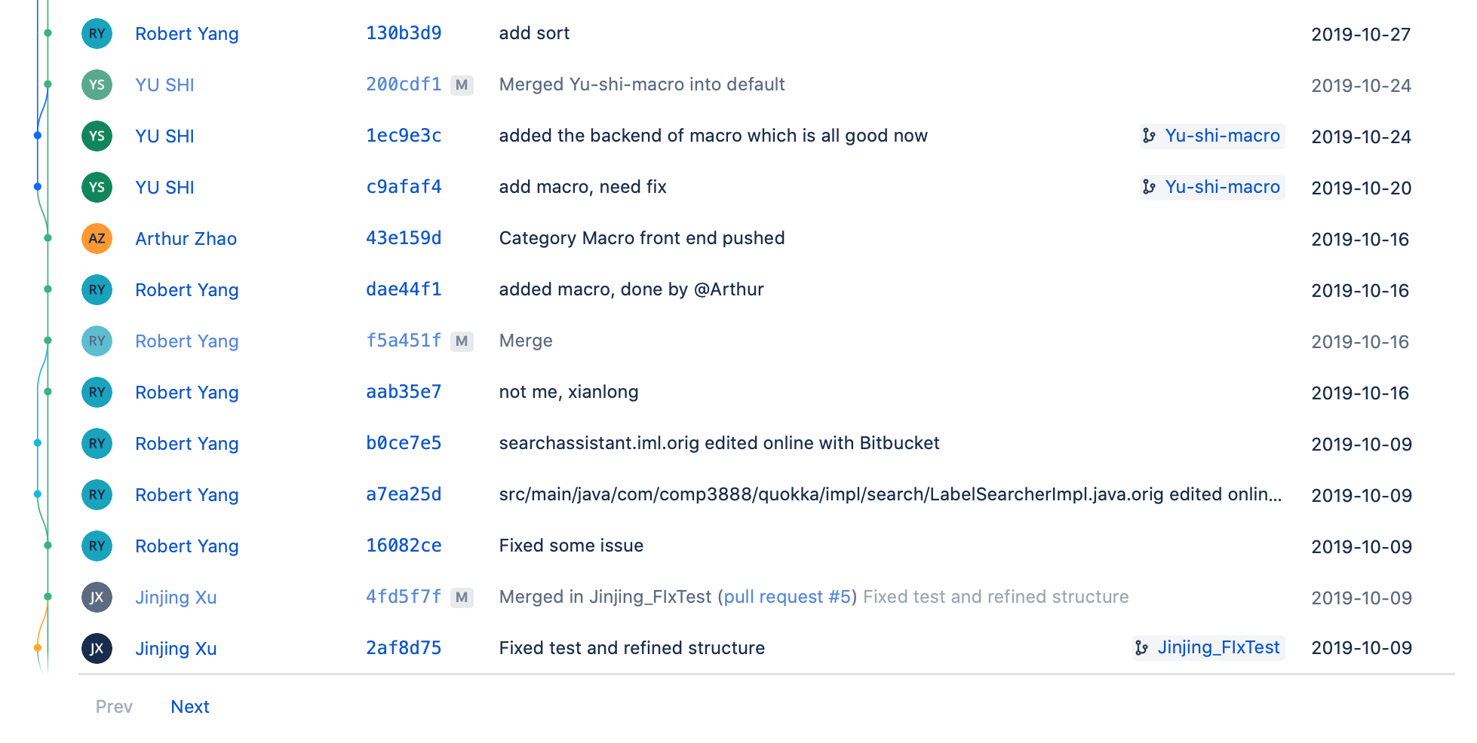
More Commits
Notes:
These are some emails we got from our client. He has sent us lots of reading materials and suggestions for our project.

Slide 26
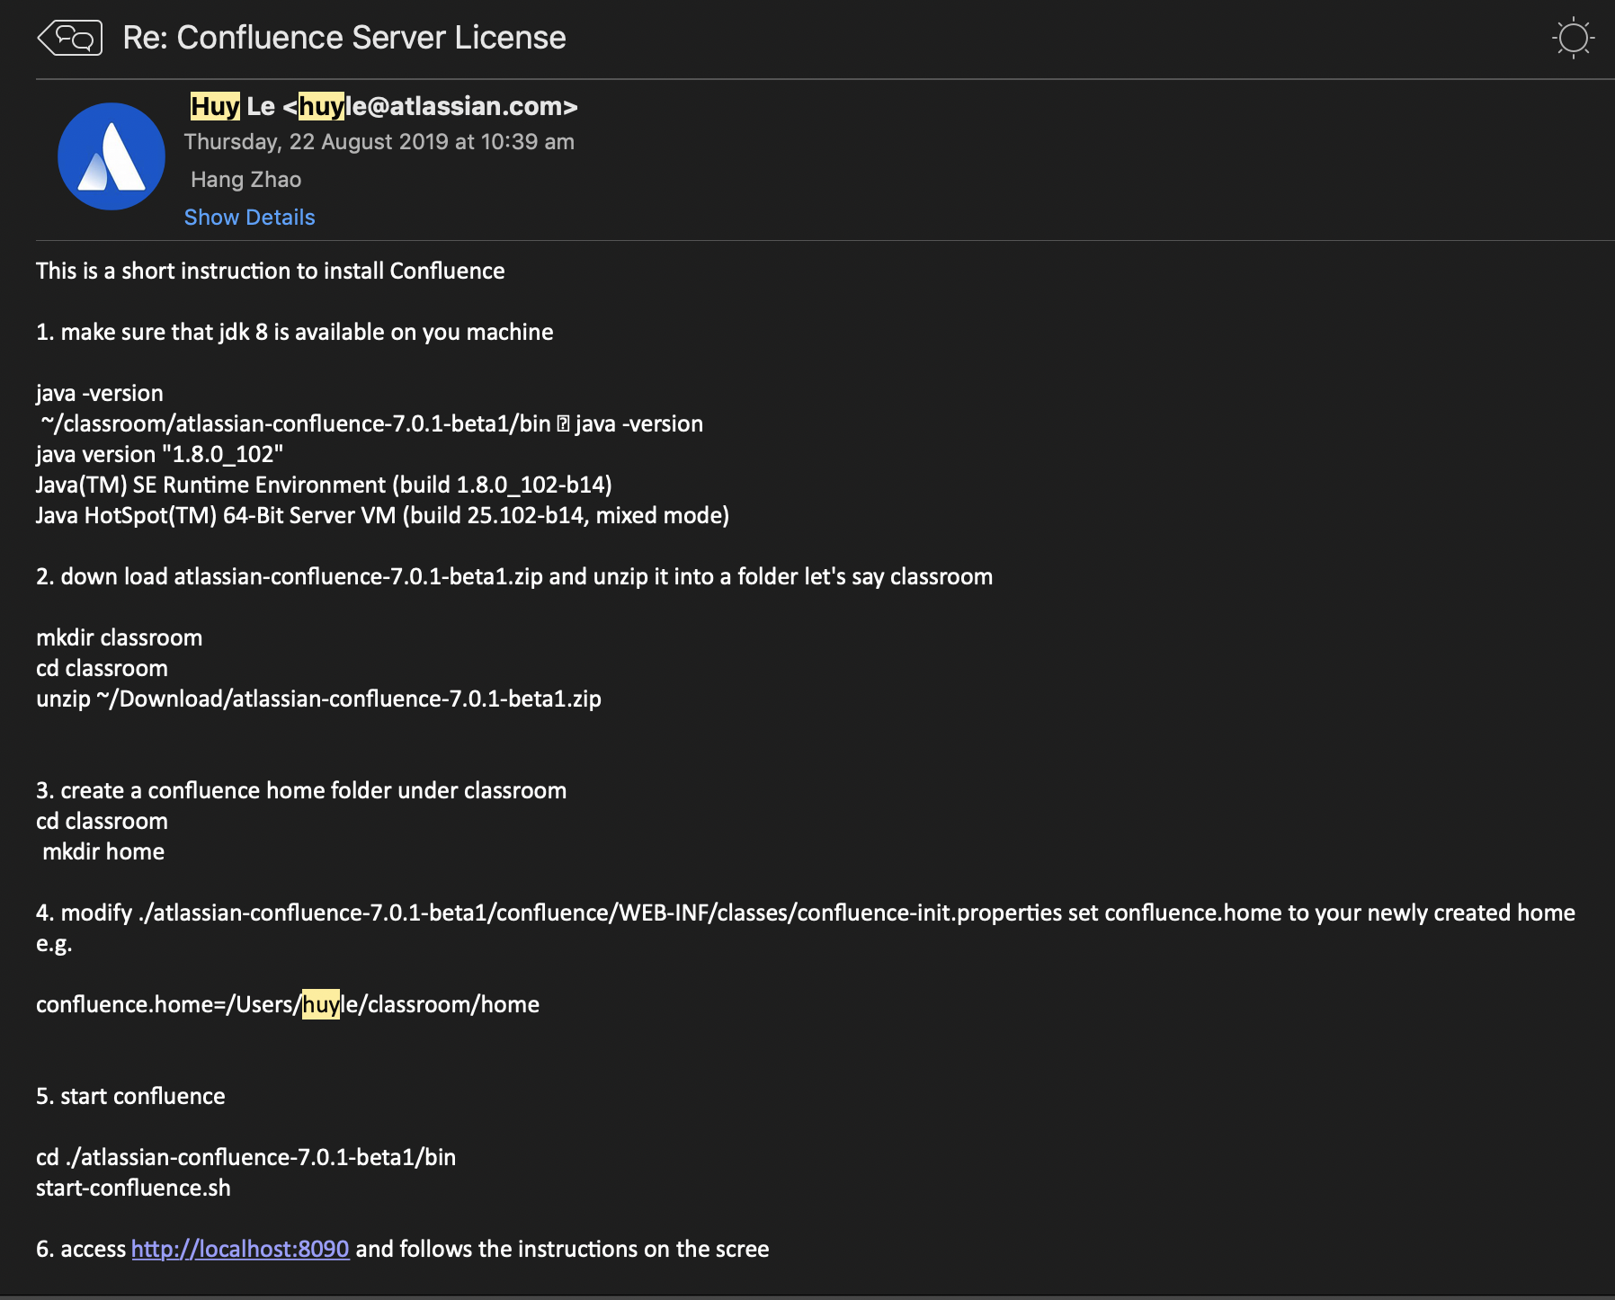
Communication with client

Slide 27
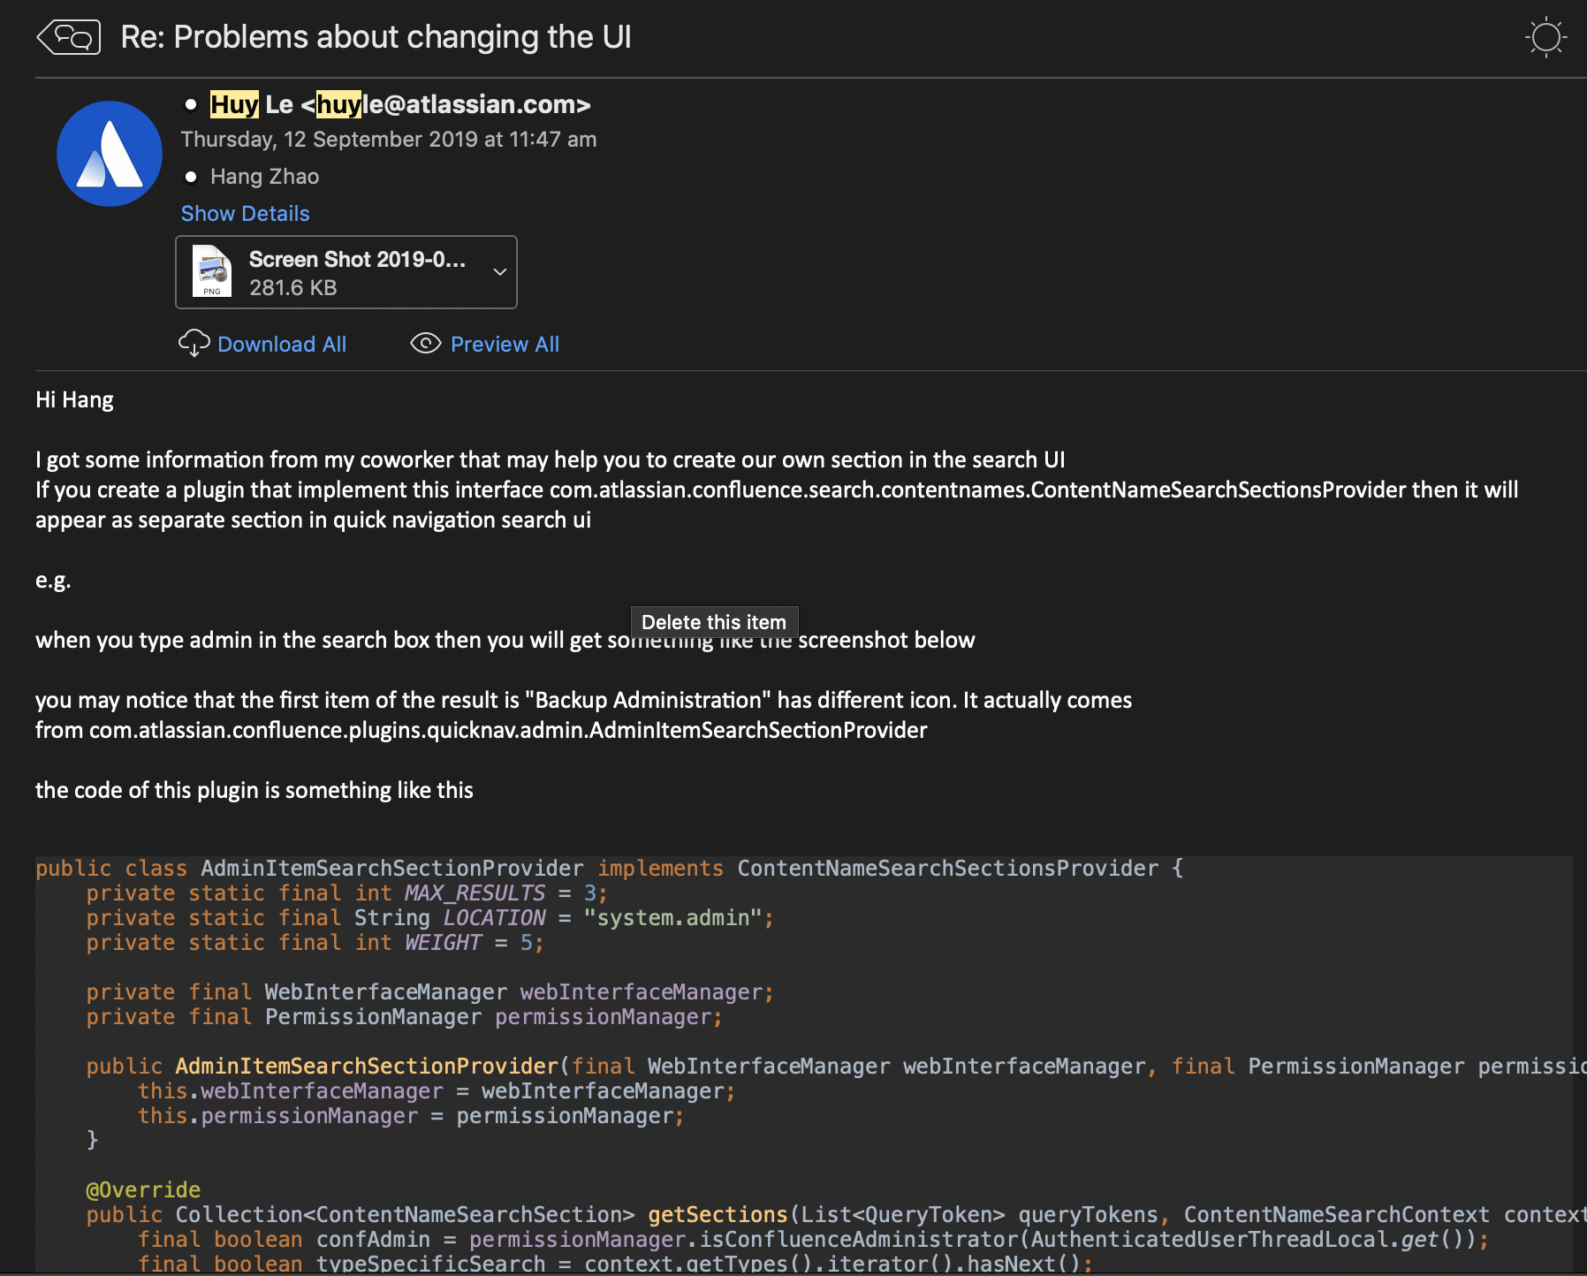
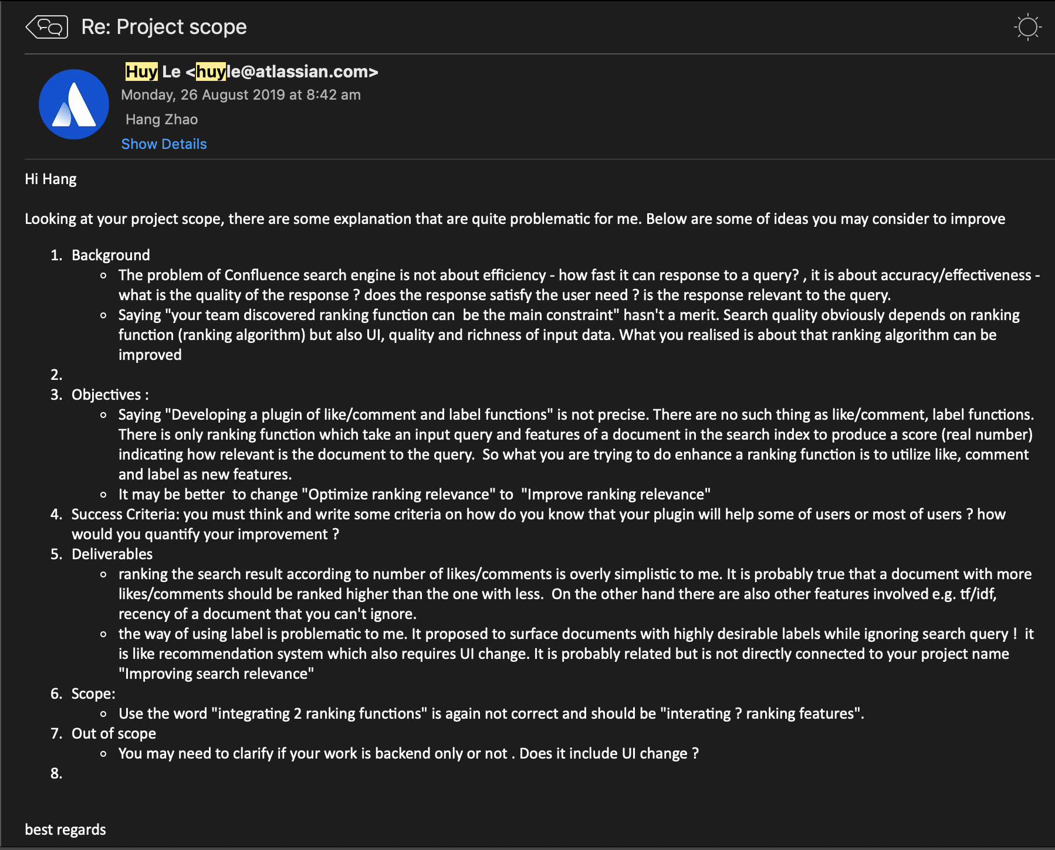
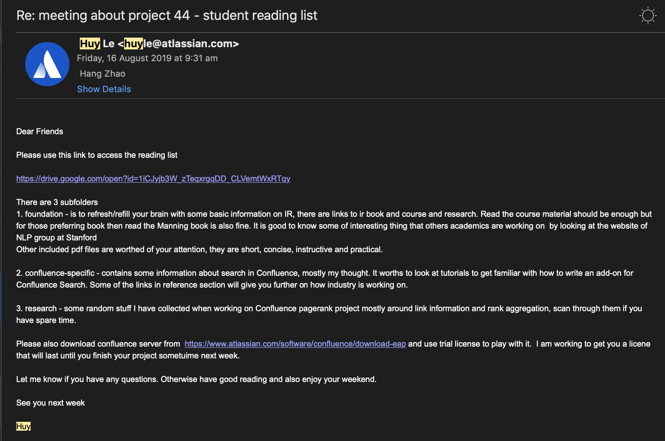
More Emails

Slide 28
Reflection
Well cooperated between team members and client
Successfully achieved our scope
What is good:
What should be improved:
Did not sufficiently take advantage of the client meeting - should make more preparation before meeting
We should define our plugin API as early as possible so team members could work in parallel.
Notes:
To evaluate our current process, we collaberated between team members and the client. And the design direction of the project is very clear. The bad thing is that we didn’t decide the final scope until last week, so we need to speed up our process.

