Slide 1
Vegetable Serve Game
Team: COMP_NVegetable

Slide 2
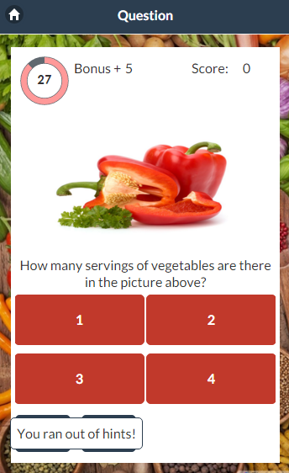
Qt Vege
“Game of the year!”
- Famitsu*
“10/10 Funtastic!”
– IGN*
*This product is not actually endorsed by Famitsu or IGN

Slide 3
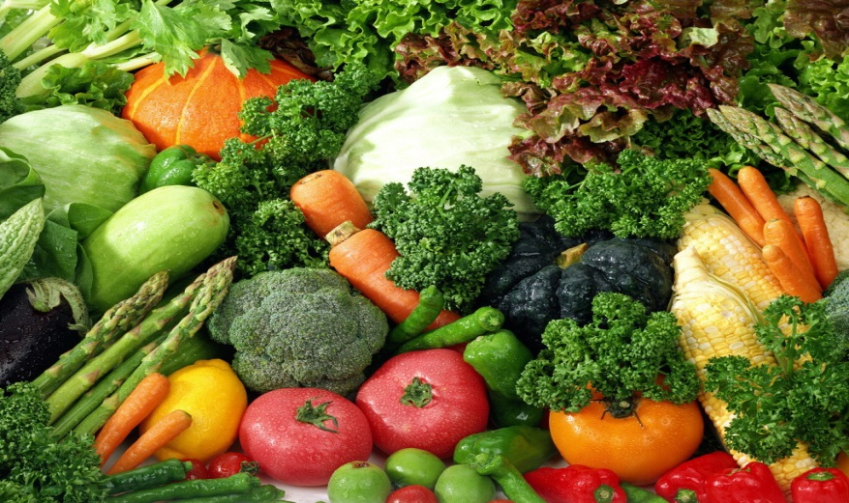
What our Client wanted (Requirements)
An interactive Quiz based game
Vegetable-serve based questions
Leader board
Levels and Challenges
Hints and Mystery Challenges

Slide 4
Achievements Deployed User Stories

Slide 5
What was achieved?
Deployed User Stories
I want to play a vegetable serve game whose purpose is to improve diet for young adults between ages of 18 to 35 so that I can get more knowledge about vegetable serving
I want to read the brief description about vegetables serves provided by the game so that I can get a basic understanding of vegetable serves
I want to start the game from level one and answer all the questions correctly so that I can unlock next level
I want to get 10 marks for each question that I answer correctly and extra 5 marks for
each question that I answer within the time limit so that I can rank up.
5. I want to be able to play the challenge questions so that I can get some extra scores

Slide 6
What was achieved?
Deployed User Stories
6. I want to play this game as a guest so I do not need to create an account to play this
game
7. I want to connect to my Facebook account so that I can share my achievements or invite my friends to play this game with me
8. I want to click on the external link offered by the game when I answer the questions wrong three times in a row so that I can learn more about vegetable serves
9. I want to tap the "hint" button to get a hint to the current question that I am on so that I can get some help

Slide 7
Quality Of Work Based on key user stories

Slide 8
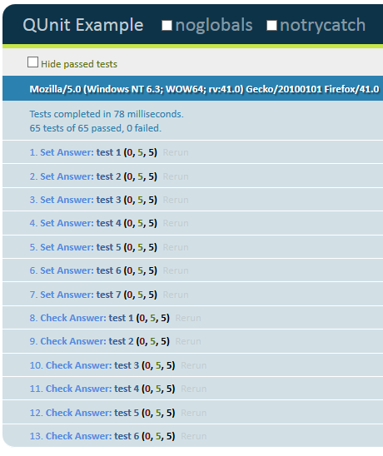
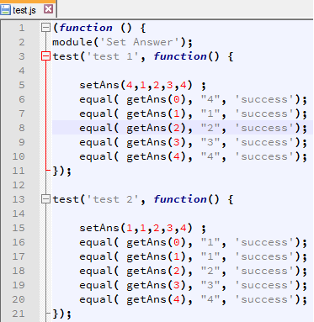
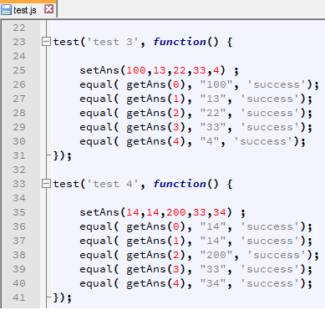
Quality of work done (Unit Testing)
- Utilised QUnit (A Javascript
unit testing framework)
QUnit also served as a form
of regression testing
Example of Qunit in action:
Verifying the correctness of each answer for
key user story no. 9
Code snippets of Qunit:

Slide 9
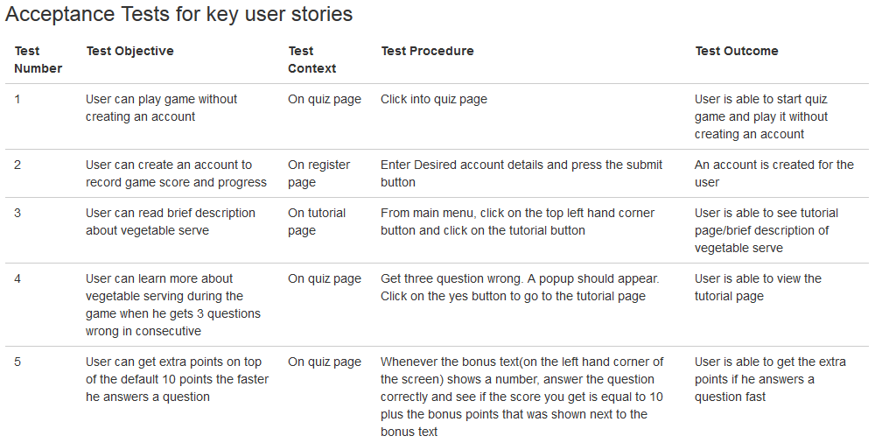
Quality of work done (Acceptance Tests)
Utilising a set of acceptance tests we created(On
Bitbucket) to affirm that all our key user stories work

Slide 10
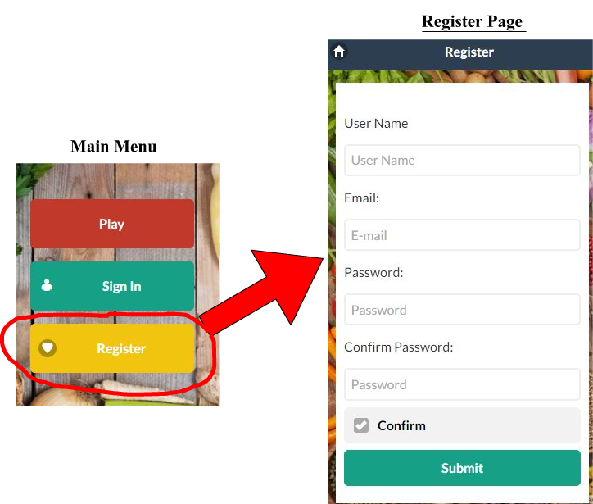
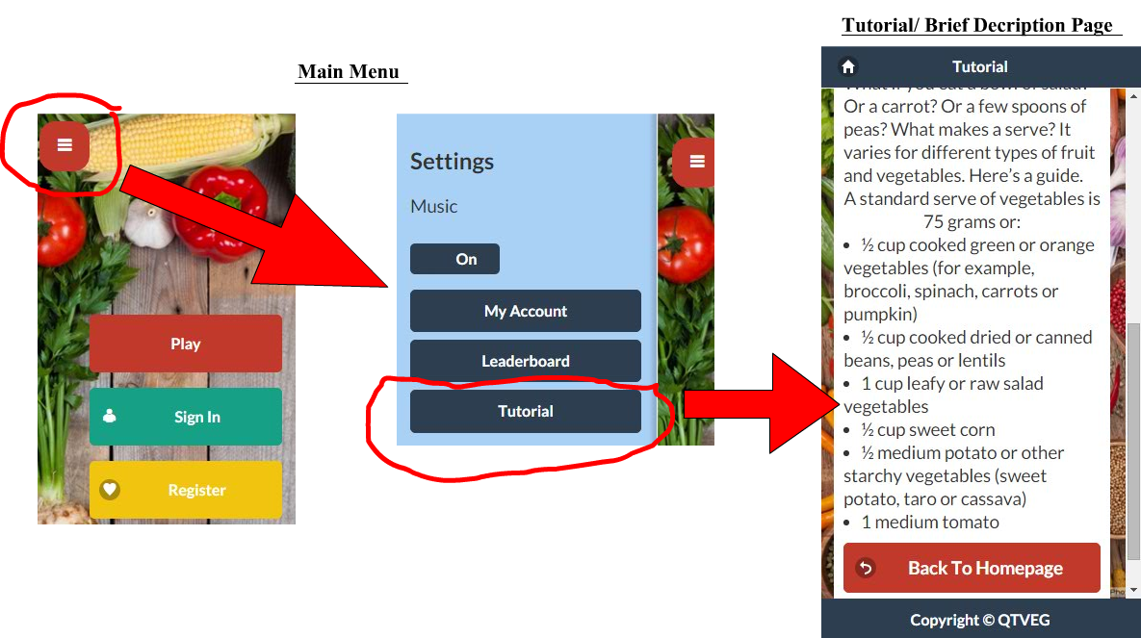
Quality of work done (Features of our game)
Read brief description/tutorial on vegetable serves
Register for an account
Based on user story 2

Slide 11
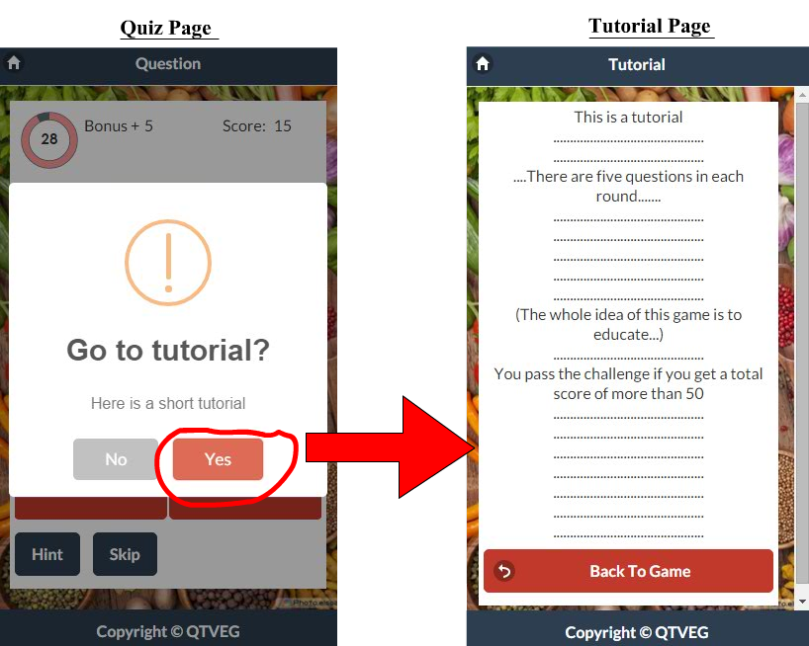
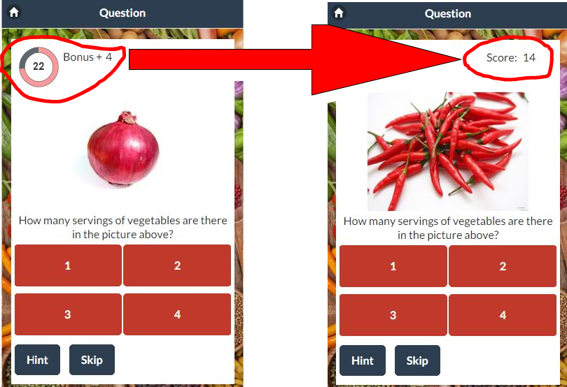
Quality of work done (Features of our game)
Answer within 30 seconds to get bonus points
3 Questions wrong -> Go to tutorial
Based on user story 8
Based on user story 4

Slide 12
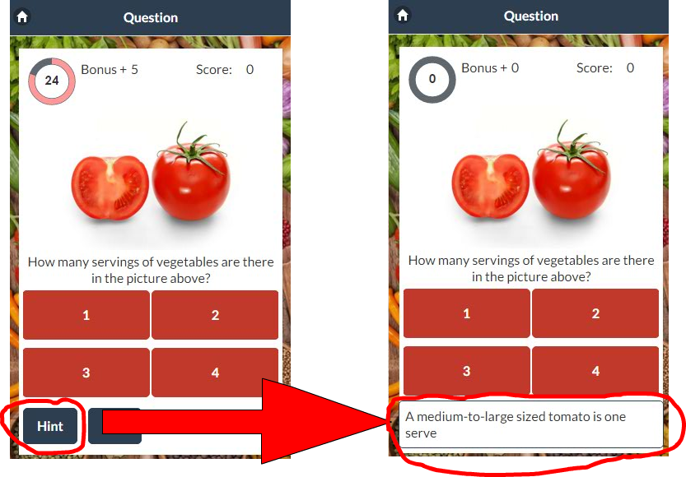
Quality of work done (Features of our game)
Hint button(When there are hints left)
Hint button(When there isn’t any hints left)
Based on user story 9

Slide 13
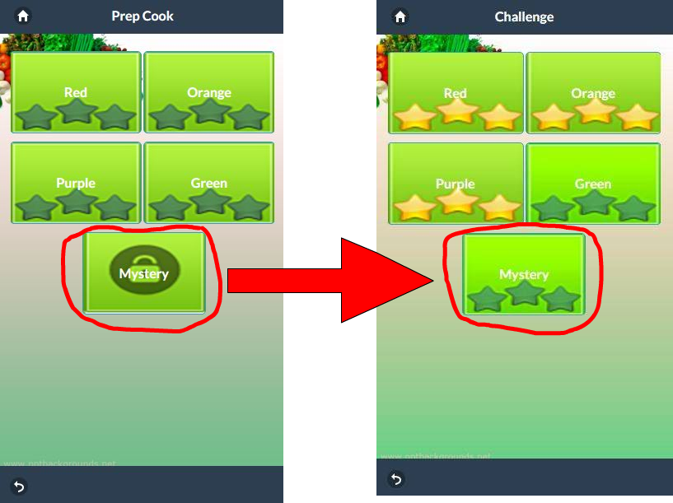
Quality of work done (Features of our game)
Unlocking mystery challenge

Slide 14
Quality of work done (Testing on firebase)
All of our data are stored on firebase. Our app
extracts data from firebase
When adding new level, questions or images onto
firebase, we would go onto our application and
obser ve whether the changes are reflected on our
application or not

Slide 15
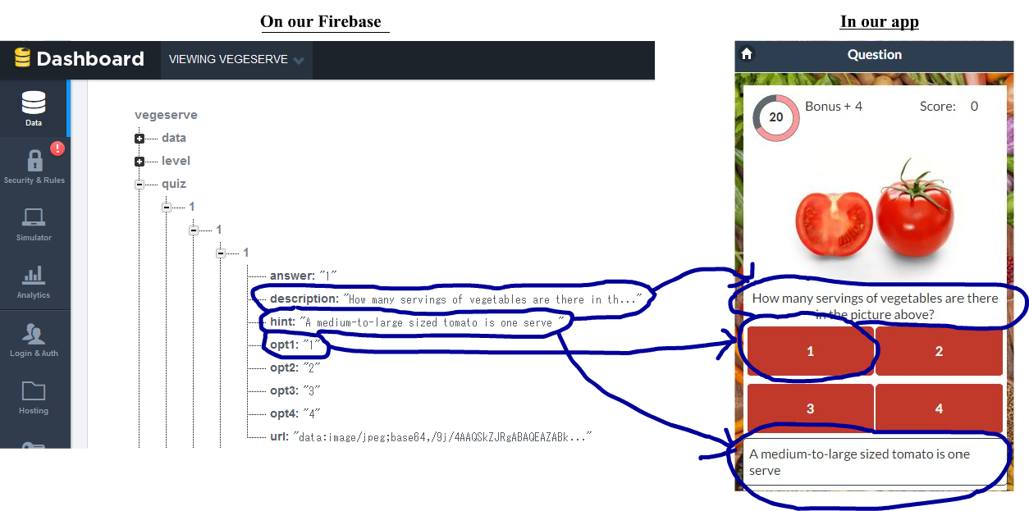
Quality of work done (Testing on firebase)

Slide 16
Quality of Group Processes Internal group management

Slide 17
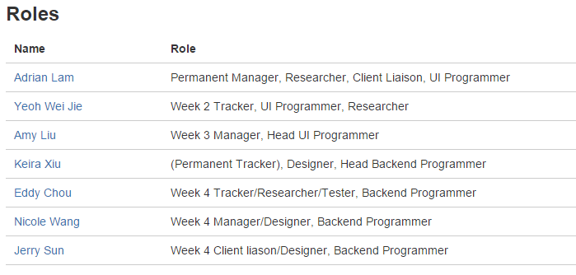
Group Roles

Slide 18
Internal Group Management
Tools Used
Issues
Group Contract
Weekly Plan and Progress
Facebook Group, Bitbucket, Google Docs

Slide 19
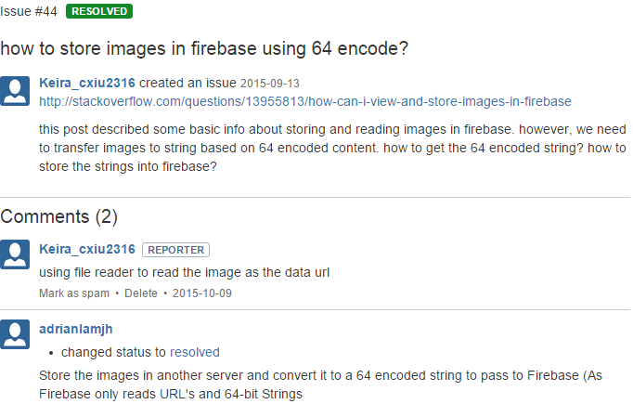
Internal Group Management
Issues
Issue stated
Solution presented

Slide 20
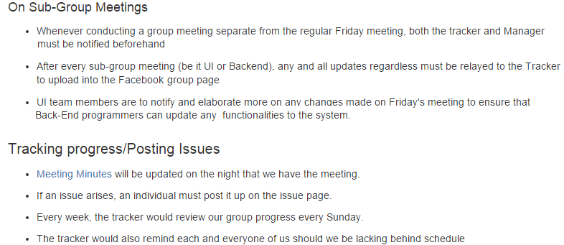
Internal Group Management
Group Contract

Slide 21
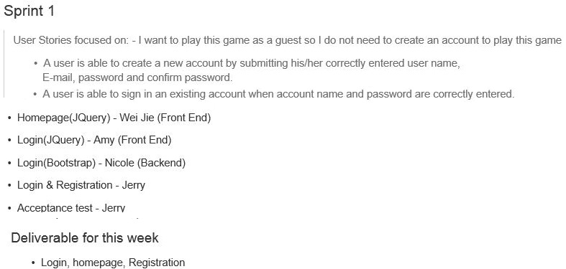
Weekly Plan

Slide 22
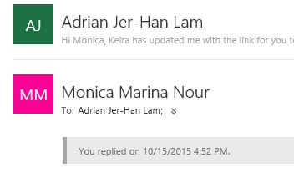
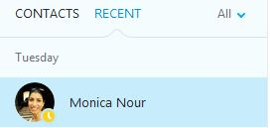
Client Interaction
Emails
Client Meetings- In person, Skype and Phone
Client Interaction Reports

Slide 23
What has worked well?
Team Performance
Interaction with Client
Motivation

Slide 24
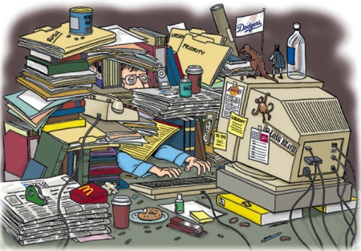
Challenges Failed?
Establishing roles
Code clarity
Unorganized ( Uploading New Versions)
How were they tackled?
Creating concrete roles and structures
Set-structure for implementing UI and functionalities
Code comments and Communication

