Slide 1
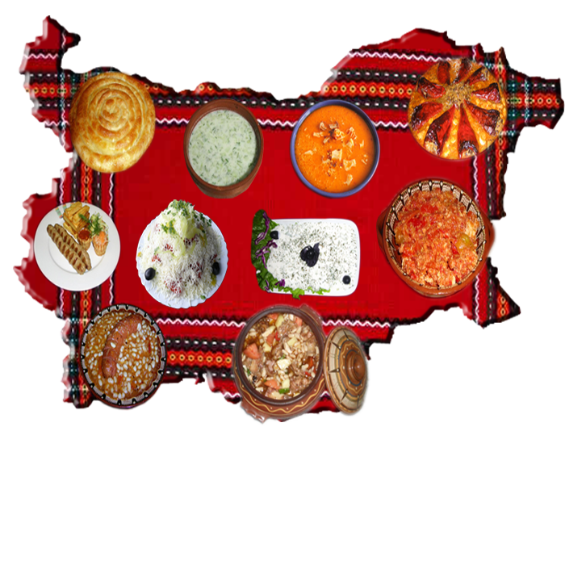
Dishes typical of Bulgarian national cooking

Slide 2
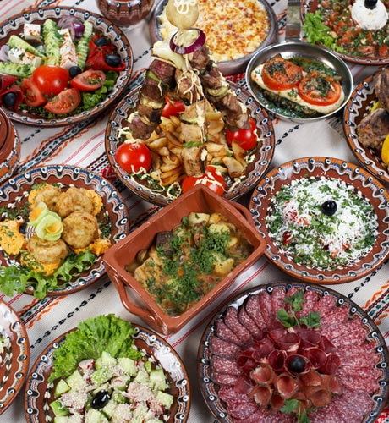
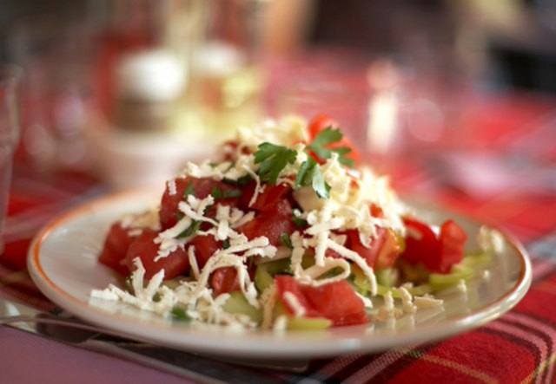
A lot of dishes are prepared from ancient recipes told from generation to generation for centuries.
“Bulgarian cooking” is a relative concept of traditional Bulgarian dishes and present-day contribution from other national cuisines.
Most dishes from our national table are present in the cooking of the other Balkan nations.

Slide 3
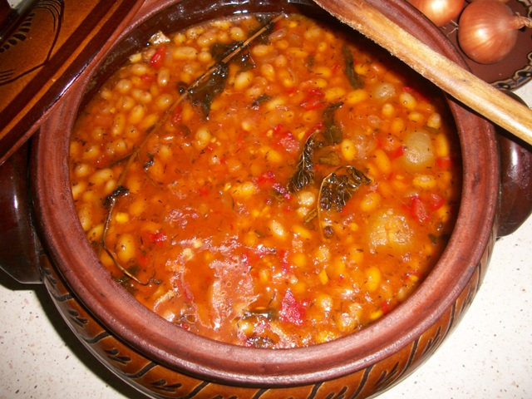
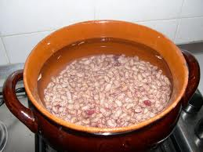
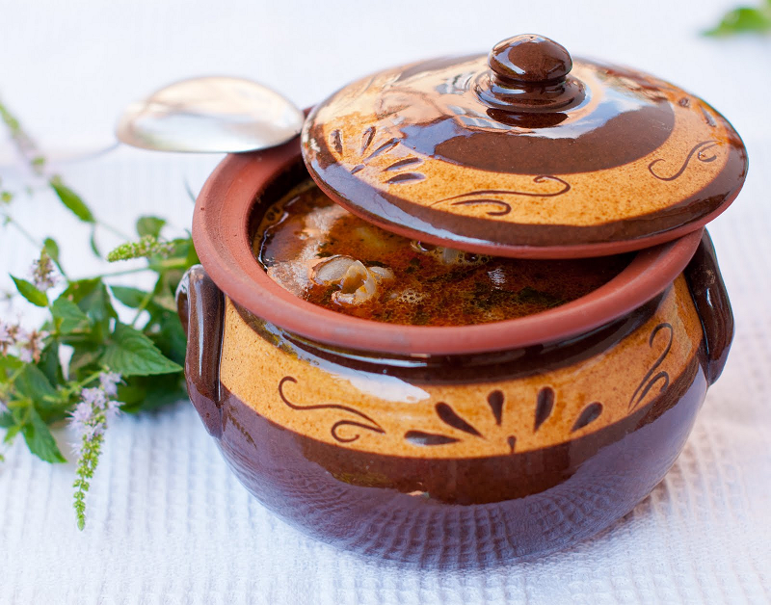
The Bean Soup called “Bob tchorba” is a traditional dish from the Bulgarian cuisine prepared by boiled beans, some vegetables (carrots, tomatoes, peppers, and onions) and some seasoning, which can be eaten with or without thickening. We often add some sausages or chopped beckon to this soup. Bean Soup is prepared as a ritual dish for Christmas Eve (meatless beans).

Slide 4
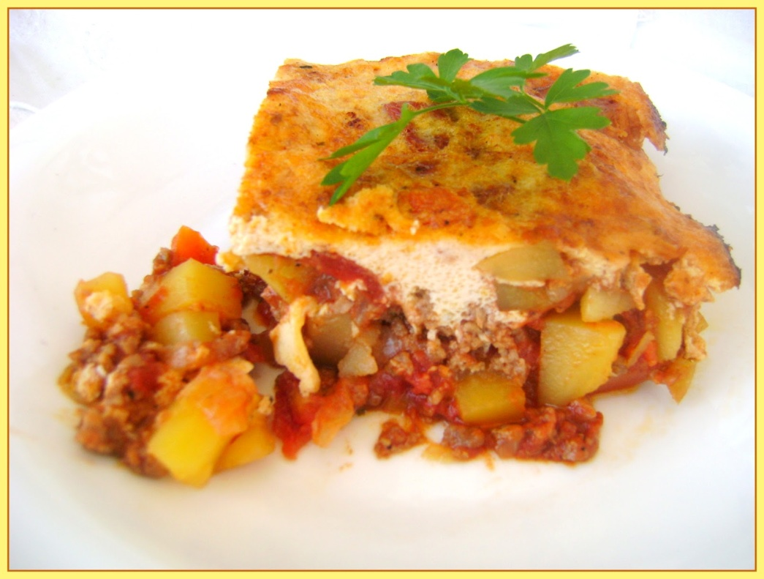
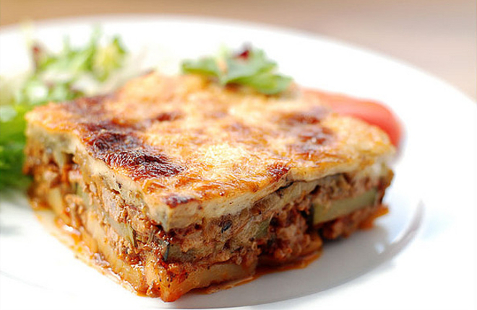
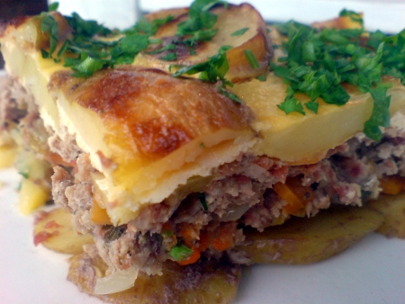
Dish called “Mousaka”

Slide 5
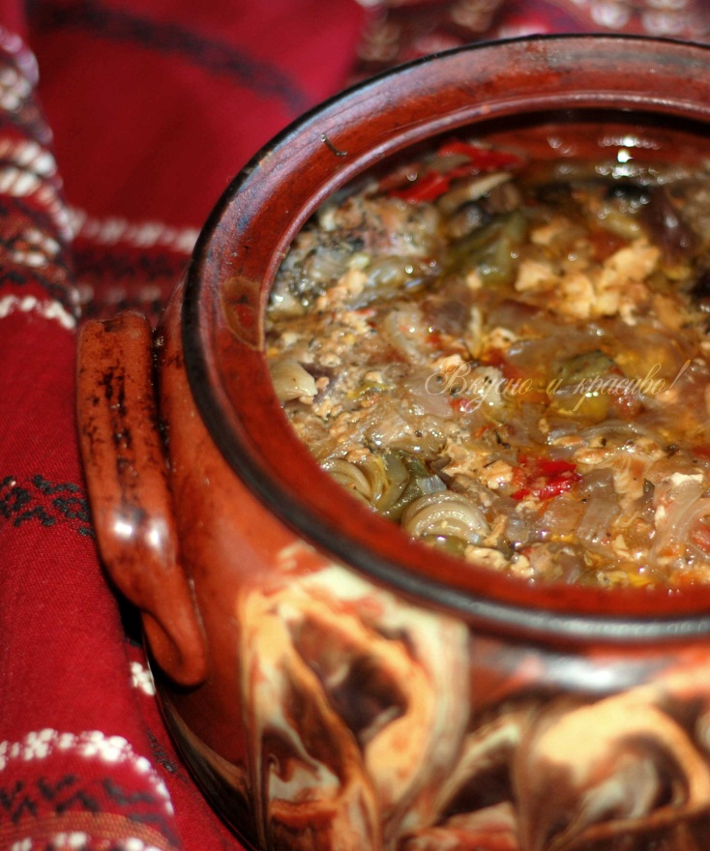
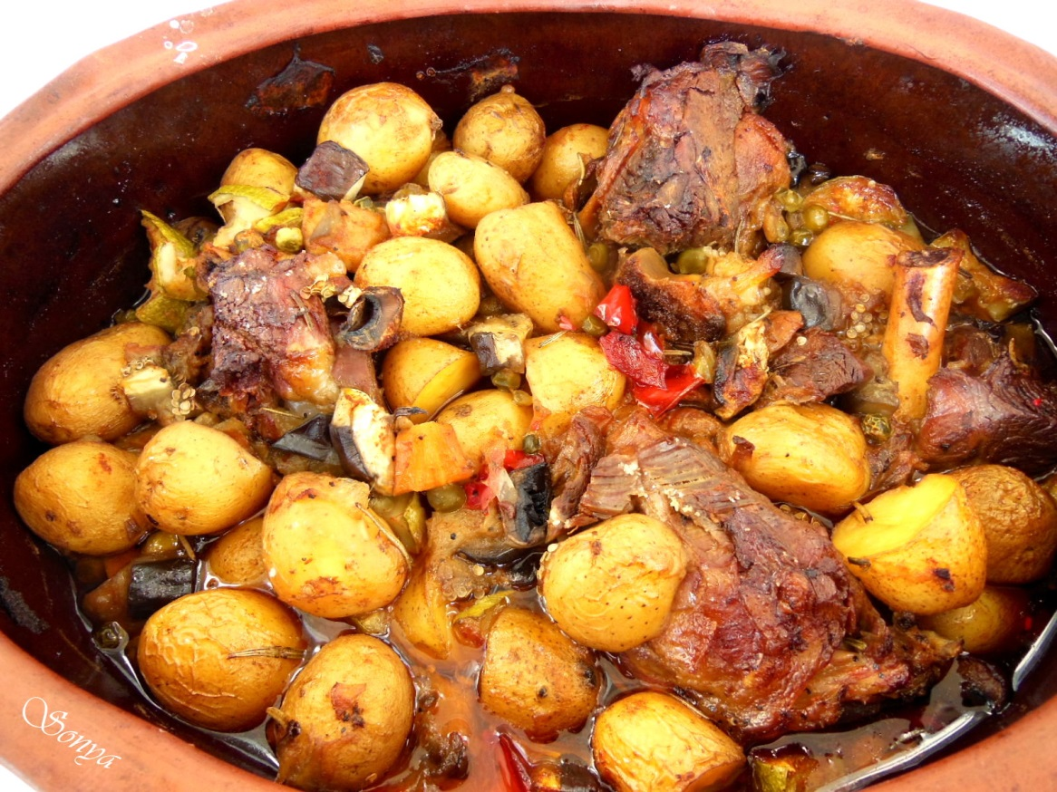
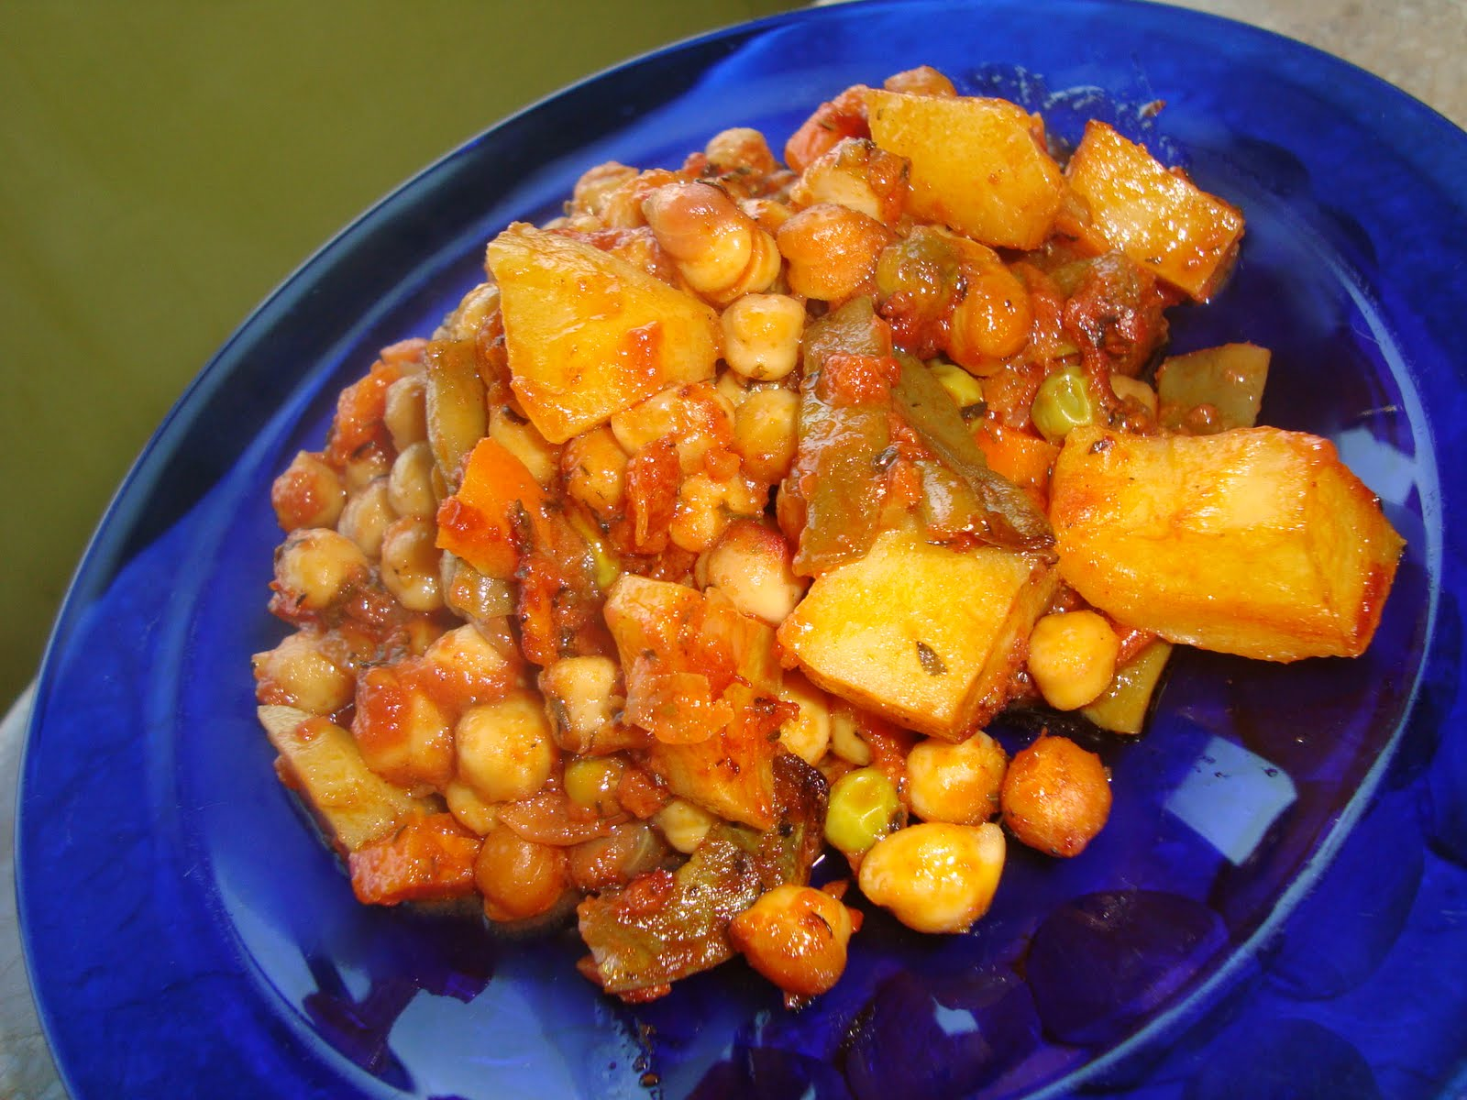
Dish called “Gyuvech”
“Gyuvech” is the summarized name for different Bulgarian dishes cooked in earthen pottery and baked under cover. Actually “gyuvech” is the name of the pottery and if the earthenware is a small one, it is called “gyuvecheh” or “gyuvedgeh”.
“Gyuvech” is prepared from different recipes and can be both with meat (pork, beef, lamb or rabbit) and meatless.

Slide 6
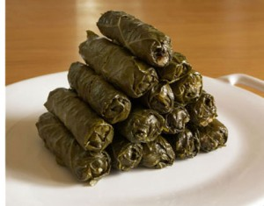
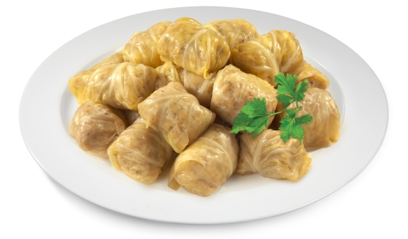
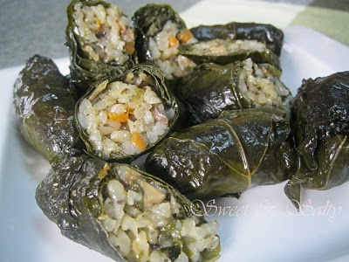
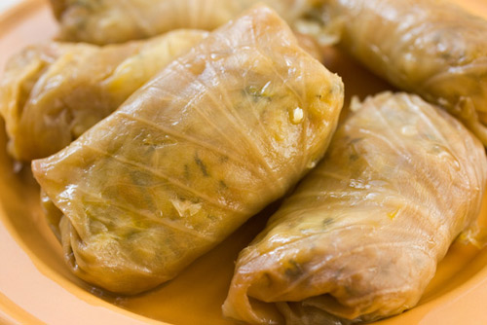
Dish called “Sarmi” – a vine leaf or a cabbage leaf stuffed with rice and minced meat.
Stuffed vine leaf
Stuffed cabbage leaf

Slide 7
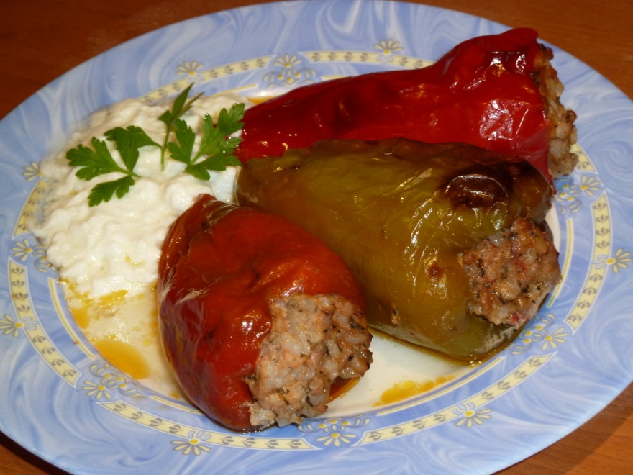
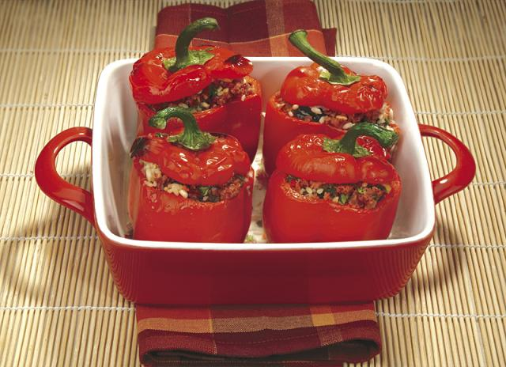
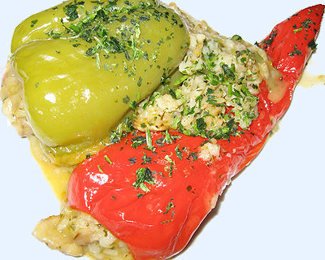
Stuffed peppers traditionally are stuffed with previously stewed rice, onions, minced meat and some seasoning, which after some thermal preparation in advance are stuffed in the peppers previously drawn, washed and pricked with a needle.

Slide 8
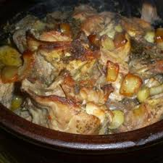
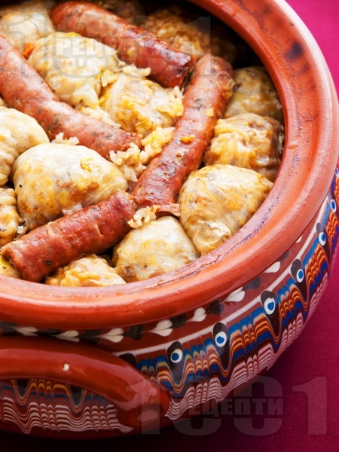
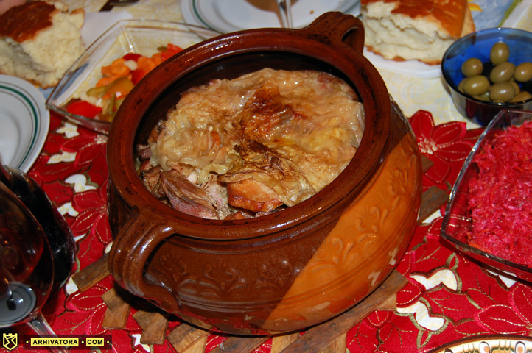
Dish called “Kapamah”
A traditional Bulgarian national dish . It comes from the area of the town of Razlog and it is one of the most popular native dishes. It is prepared from many products. The original “Kapamah” is cooked in a cooper on open fire. Now a more popular way of cooking is famous – it is cooked in earthenware under cover (“gyuvech”) sealed with dough.

Slide 9
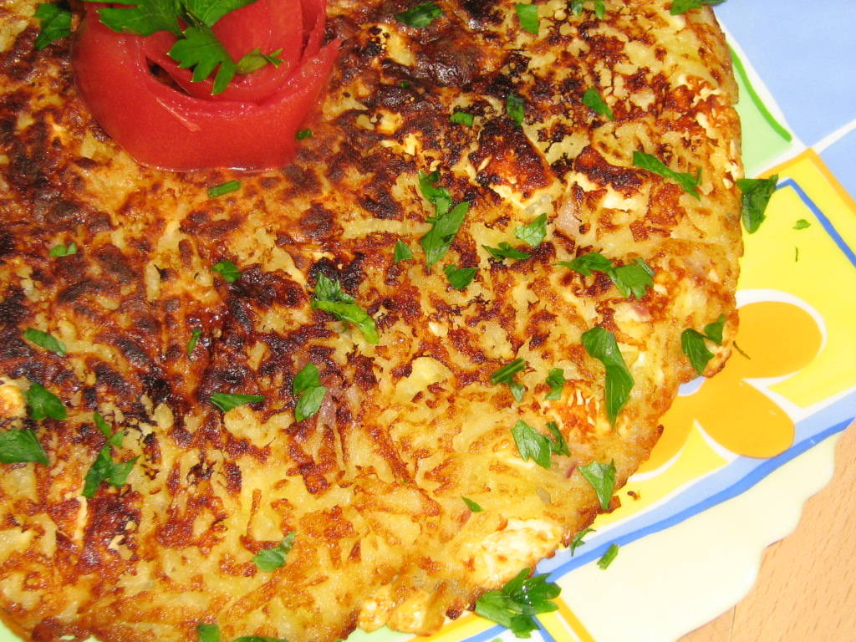
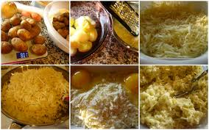
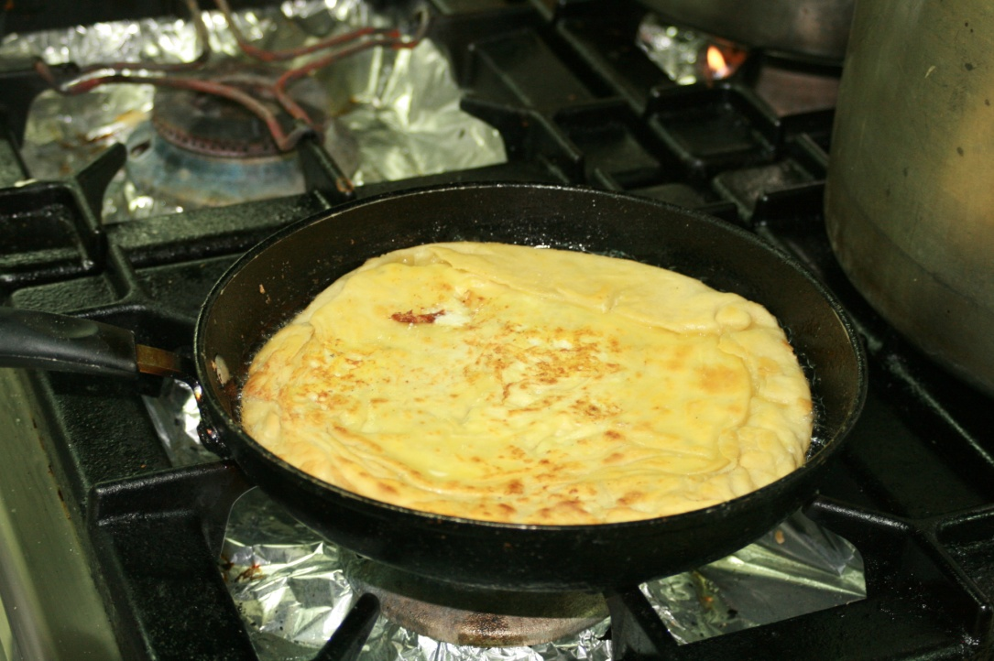
Dish called “Patatnik”
To prepare it potatoes and white cheese are used. It can be with or without meat. The classic recipe is with only potatoes, white cheese, an egg, onion, and some seasoning – salt, black pepper, fresh mint, and oil. While serving you can add some yoghurt and fresh vegetables.

Slide 10
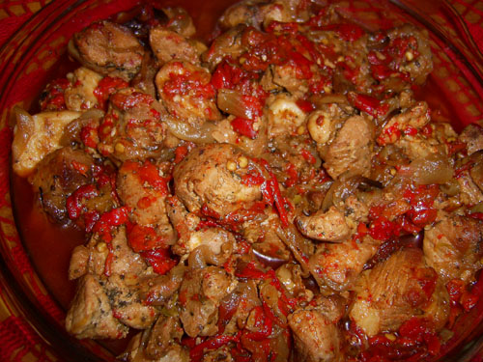
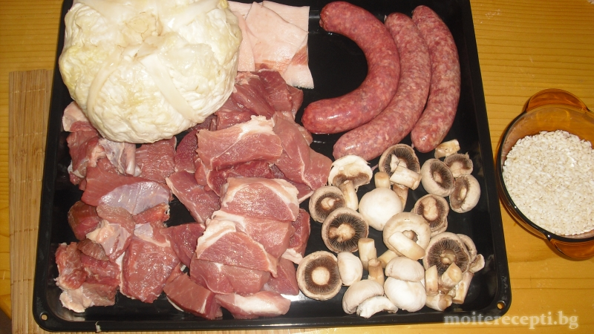
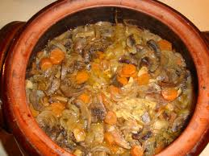
Dish called “Kavarmah”
One of the most emblematic Bulgarian dishes well-known all over the country. It is not only tasty but nutritious. It is usually served as a main meal. “Kavarmah” is cooked in earthenware under cover that gives it a unique taste.

Slide 11
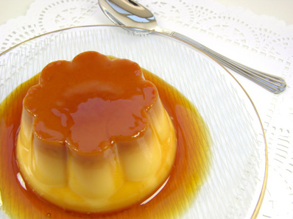
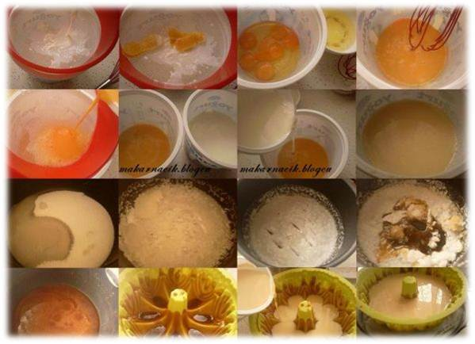
Dish called Caramel Cream with burnt sugar
How to prepare it:
Burn 100 grams of sugar to make golden caramel
Pour the liquid of burnt caramel on the bottom of fireproof metal cups or bowl
Dissolve rest of the sugar in milk and add the eggs beating them up
Add some vanilla in the mixture, strain it and pour it in the vessels, putting previously the burnt sugar on the bottom
Put the vessels in a baking-pan and pour some warm water in it to reach the middle of them (bain-marie)
Bake the Caramel Cream in 130-140 °C for about two hours, and pour some more hot water in the baking-pan if necessary.

Slide 12
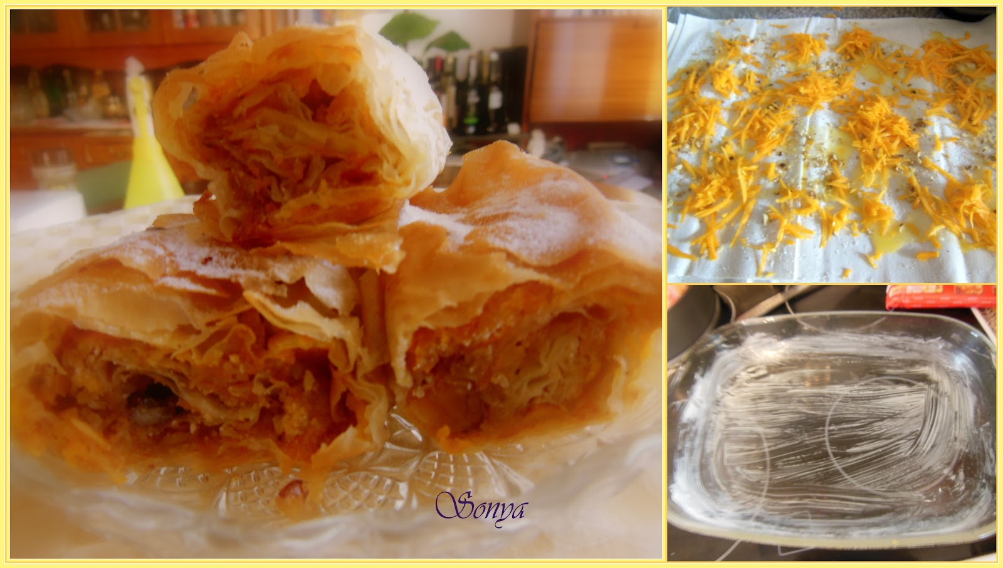
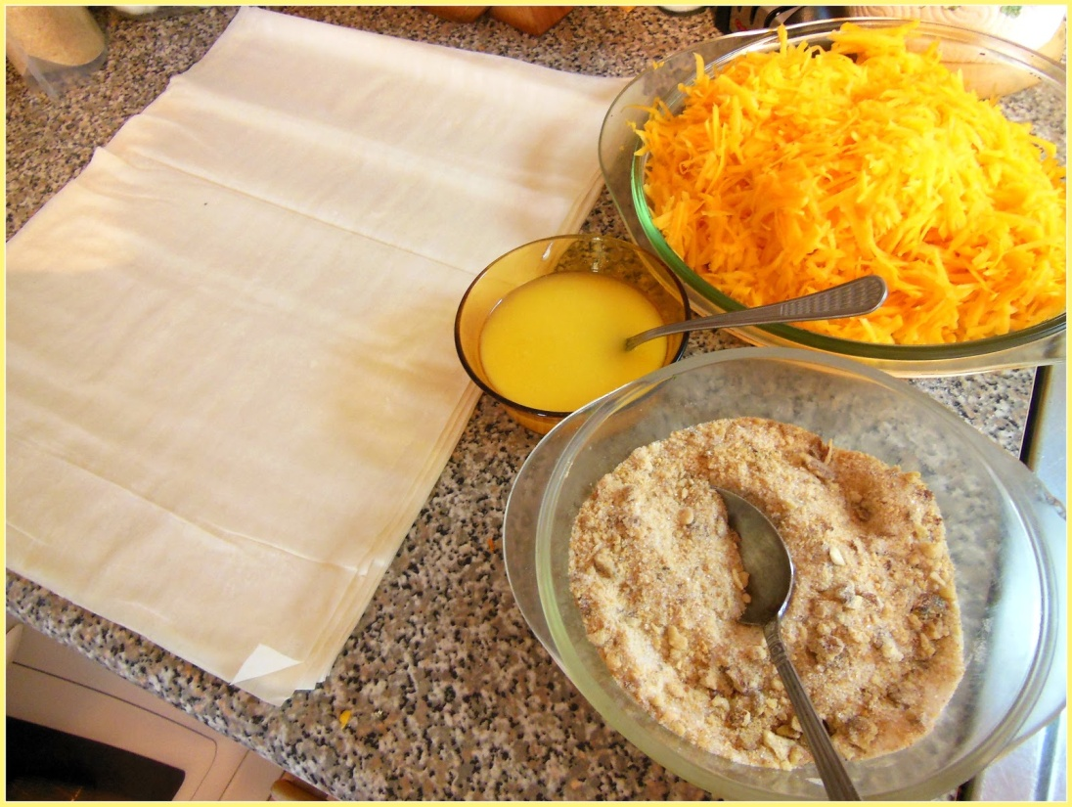
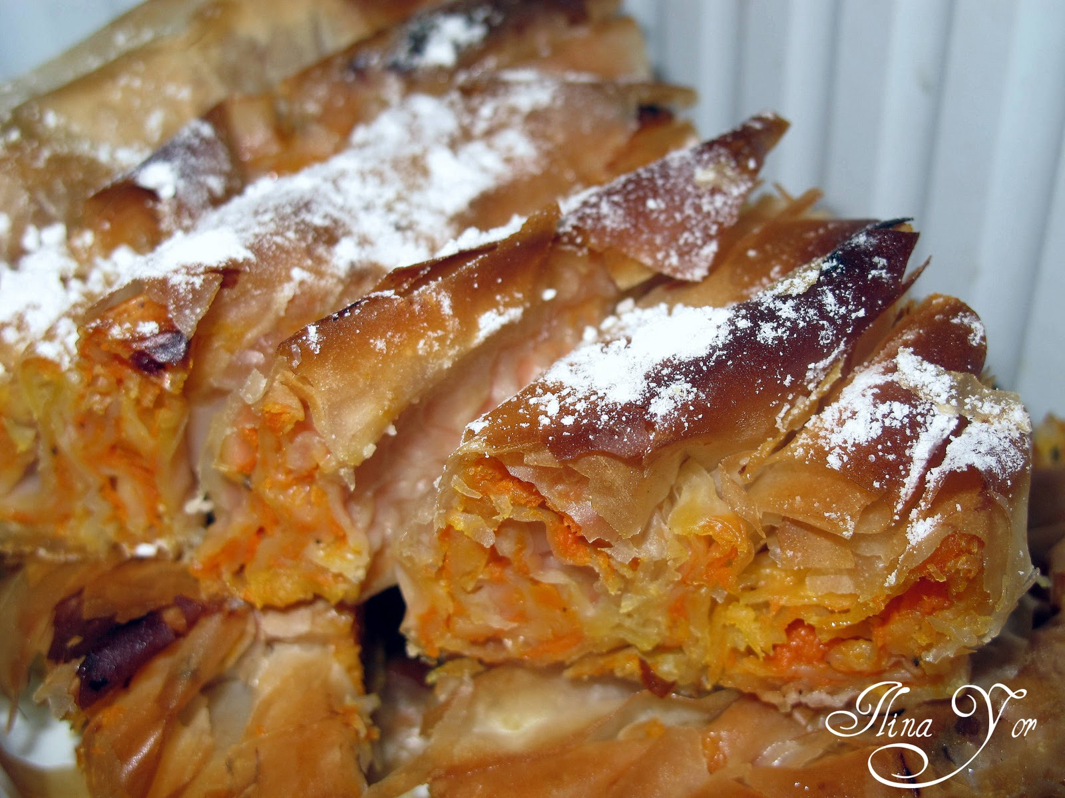
Dish called “Tikvenik” – a pasty with pumpkin filling

Slide 13
The students worked under control of teachers: Siyka Georgieva -English teacher; Denitsa Ivanova - IT teacher; Mariana Kostadinova – Home economy teacher

