Slide 1
CHRISTMAS CULINARY EXHIBITION “Sv.Sv.KIRIL I METODIY” school

Slide 2
OLD BULGARIAN SWEETS
The exhibition was opened by Snezhana Dineva –a student from 5th grade,who represented a traditional for the Melnik region candy called ‘’BANDRAMI’’.To prepare it we need walnuts put into fresh grape juice and dried.This candy is very old and natural used instead of sugar or chocolate and given for Christmas to children..

Slide 3
Traditional sweet cheese cake called “SARALIYA”, represented by Petrana Georgieva from 6th grade.

Slide 4
A Christmas Round Bun with a lucky coin in it ,prepared by Vladimira Yordanova a student from 6th grade.

Slide 5
The baked pumpkin and apples are required for Christmas dinner.

Slide 6
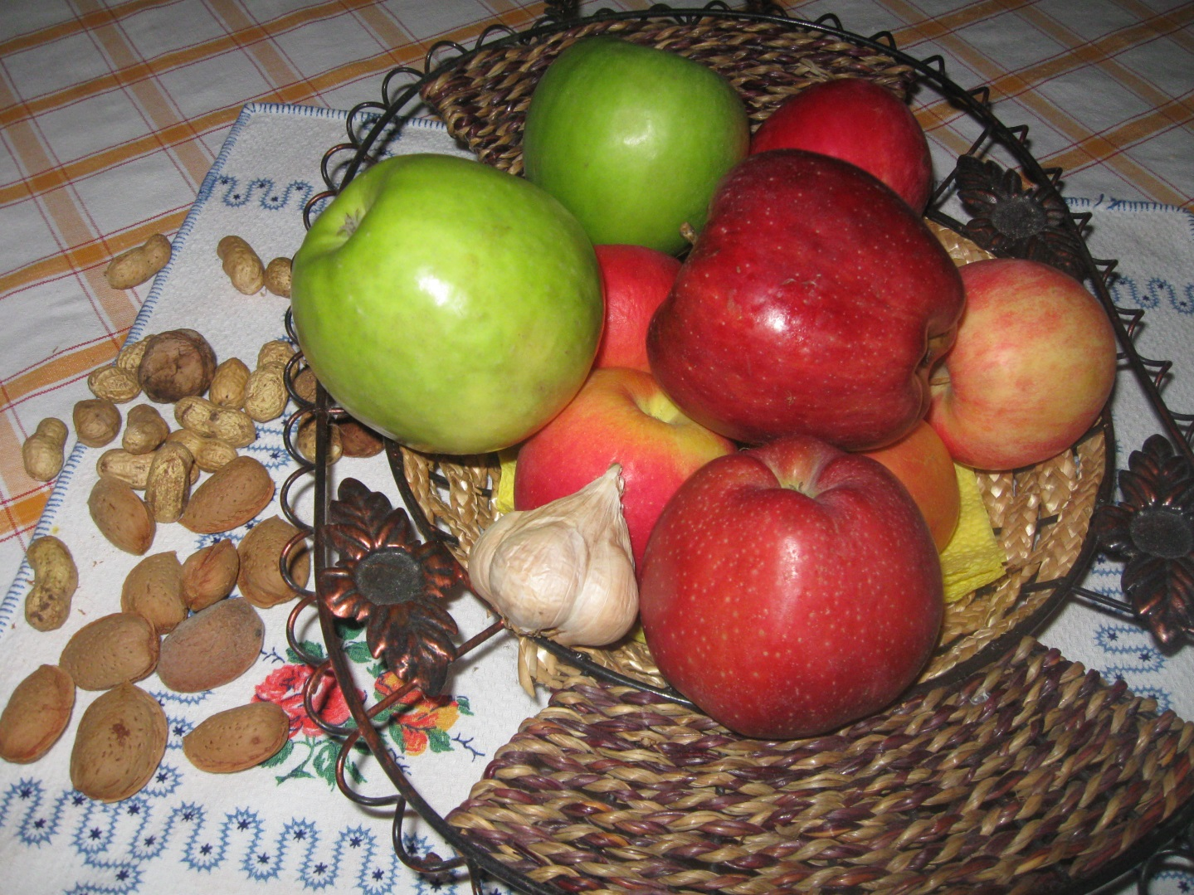
A lot of fresh and dried local fruit and nuts with their warm colours are put on the table for Christmas.

Slide 7
A stall with some traditional Bulgarian meals for Christmas were arranged by the students from 5th grade.

Slide 8
A delicious leek pastry called “ZELNIK” prepared by Katya Balkanska from 6thgrade.

Slide 9
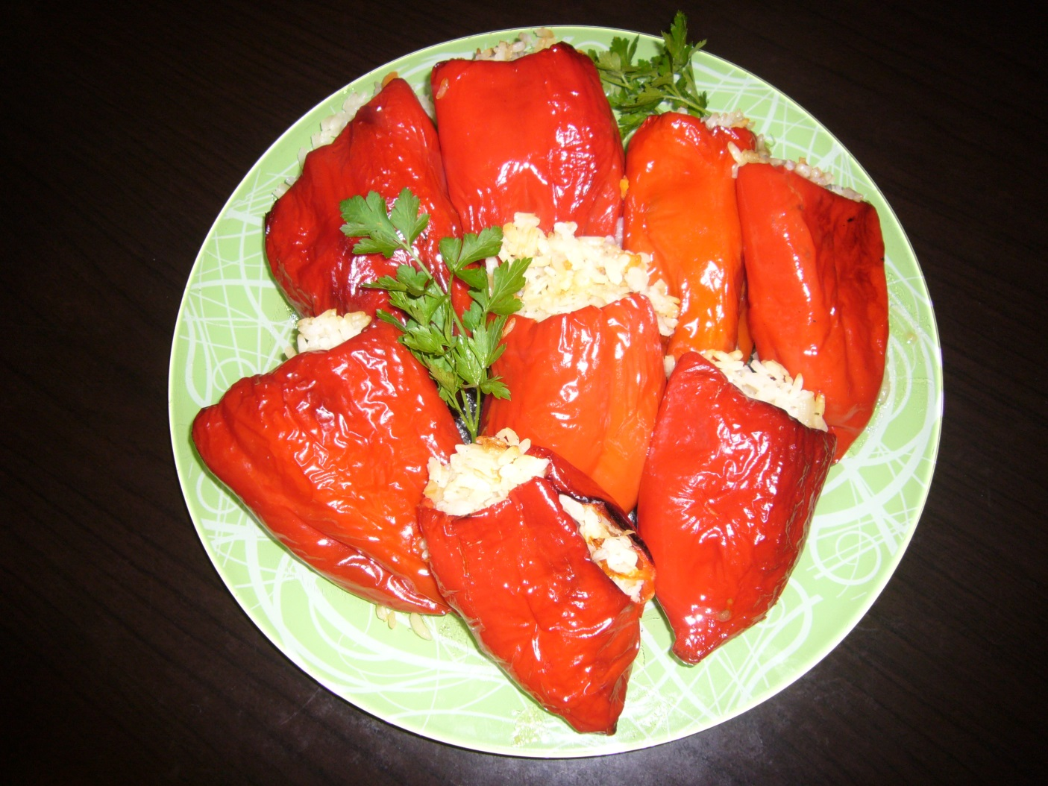
Red stuffed peppers prepared very carefully by Roberta Shumkova from 5th grade.

Slide 10
Some baked pumpkin prepared in figures as candy.

Slide 11
The Christmas dinner table has to have odd numbers of dishes on it.

Slide 12
This Christmas dinner was presented by the students from 7th grade.

Slide 13
You can see the beautifully arranged Christmas table.

Slide 14
A dish made from cabbage leaves sauerkraut stuffed with rice prepared

Slide 15
Another sweet cheese cake stuffed with pumpkin called “TIKVENIK”

Slide 16
The students who took part in the exhibition and prepared themselves the Christmas dishes.

Slide 17
The students from 5th grade are very proud of their Christmas dinner table.

Slide 18
What is Christmas without SANTA CLAUS ?

Slide 19
The students worked under control of the teachers:
Siyka Georgieva –English teacher
Rumyana Bozhinova – junior primary teacher
Mariana Kostadinova-home economy teacher

