Slide 1
ASLR Minix
Wade Gasior

Slide 2
1. Stack Randomization
STACK
BP
Approach: Randomize GAP size
GAP
DATA
TEXT
Notes:
The first task was to randomize the stack.
This diagram shows the structure of a process in memory. The gap is what the stack and heap grow into. The stack grows down, and the heap grows up. Low memory addresses are at the bottom, and high memory addresses are at the top.
My approach to randomize the stack was the randomize the size of this gap. The base stack pointer is altered when the gap size is adjusted.

Slide 3
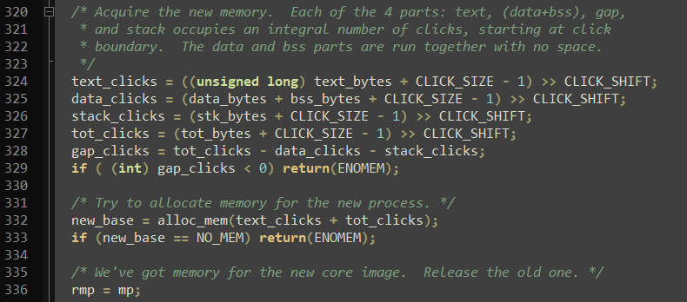
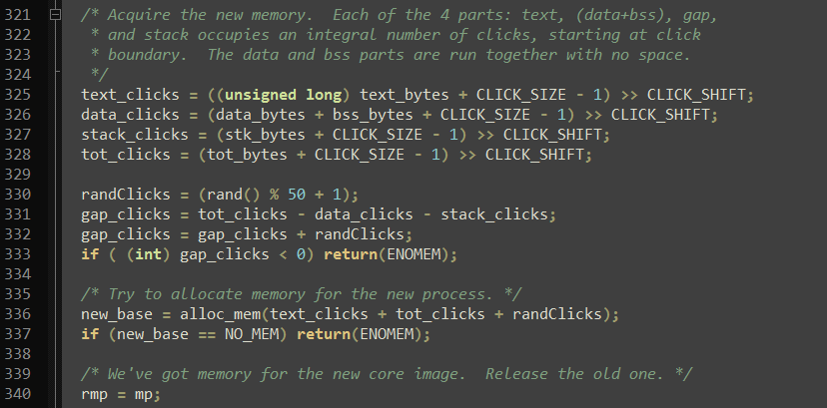
Edits to exec.c
/usr/src/servers/pm/exec.c
Notes:
To accomplish the gap randomization, I edited the exec.c file in /usr/src/servers/pm
(original code)
I alter the code by adding a random number of CLICKS (the memory unit in Minix) to the gap size. I also account for this added gap size in the total memory allocated to the process.

Slide 4
2. Heap Randomization
STACK
BP
GAP
Approach: malloc random space
(prior to first malloc)
RANDOM SPACE
DATA
TEXT
Notes:
The second task was to randomize the heap.
To accomplish this, we malloc a small random chunk of memory prior to the program’s first real call to malloc. This will cause the heap, as far as the program is concerned, to start at a different address each time.

Slide 5
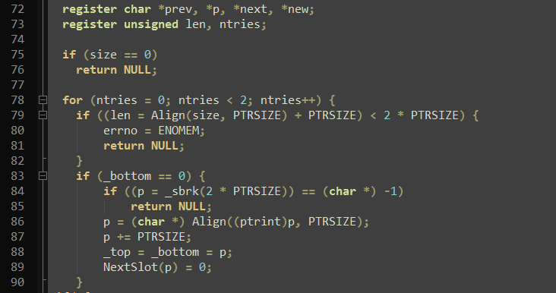
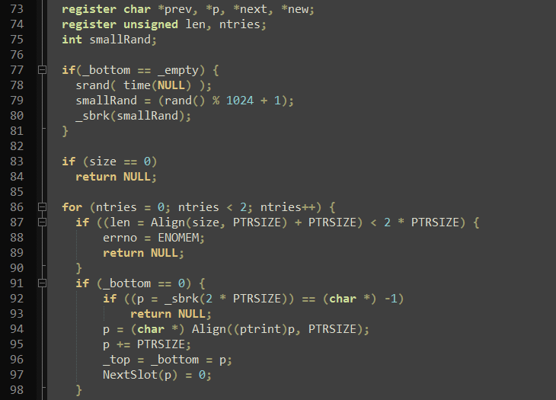
/usr/src/lib/ansi/malloc.c
Notes:
To implement this in code, I edited the file /usr/src/lib/ansi/malloc.c
(show original)
And here is the modification. Bottom keeps track of the bottom of the heap. Empty keeps track of the next available slot. If these two are the same, nothing is on the heap.
So if nothing is on the heap, we insert malloc our small amount of memory.

Slide 6
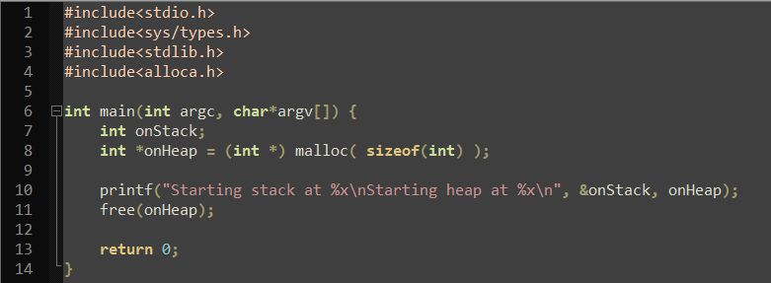
3. Test: print-adds.c
Notes:
Here is the program that I used to test the implementation.

Slide 7
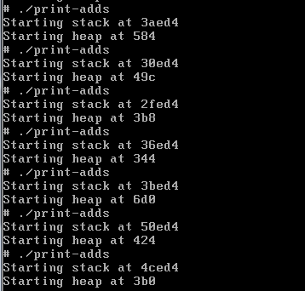
Test Results
Notes:
And here are the results. You can see that each address is different on each execution of the program.

