Slide 1
Noname
First person logic puzzle

Slide 2
Concept
First person camera
Simple cold colors with little amount of bright colors (QUBE is nice example)
Simple art stilistics
Big amount of logic puzzles
Lot of fun, 1-2 hours history campaign
Cold/atmospheric music/ Genre: ambient

Slide 3
Concept
Main weapon of player is time, gravity, logic,
Similar to: Q.U.B.E. , Portal
Walking on surfaces oriented differently / changing gravity properties for other objects
Player should have up to 5 key abilities successfully combined between each other (---type your ideas here---)
Special maps for Quick action mode, which could be played competing with other players
Coop maps

Slide 4
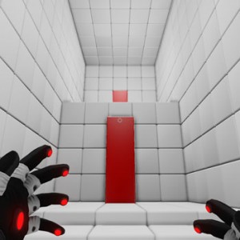
Q.U.B.E.

Slide 5
First abilities
Gravity
Changing global gravity field, so you can walk the wall
Changing gravity fields for specific objects
Make some objects shove one from other
Teleports but not as in Portal game
You've got slots for positions and you can teleport from one point to another very quickly so you could make "Teleport Combos" when puzzle require to be in different positions almost in same time
Changing the weight of object or size
Changing state of object solid/liquid/gaserous

Slide 6
Platform & target audience
PC Windows (Steam / GOG)
Not enough? Linux / Mac
Still not enough? PS4 / XOne
Audience:
Those who like puzzles or coop gameplay

Slide 7
Required effort
Engine
Simple physics engine
Player controller
Probably GPU particle physics for liquids to make game more impressive
Network, client - server interaction, if we are making coop and multiplayer
OpenGL implementation, if we decided to ship our game for other platforms + OS specific code

Slide 8
Required effort
Design
Levels, abilities, mazes
Every team member could participate
3D Artists
Player hands/animation, Environment(Cubes, roads, simple shapes)
2D Artists
Textures, Concepts,
Scenario
Simple short story, separated in notes stored in different corners of levels(could make some philosophical undertext)

Slide 9
Monetization
Standard cost: $ 10-15
Or Free for some standard edition of game and paid dlc
You could add some other ideas

