Slide 1
XDS Toolkit Version 3
Bill Majurski
NIST
May 14, 2014

Slide 2
Toolkit Contains
Client to initiate Transactions
Test mode, Utility mode
Simulators to accept Transactions
Several logging systems
A few dozen validators that are integral to client and sims
Configuration tools, monitoring tools
UI, deployment model

Slide 3
Problems
Each tool, validator, parser is hard wired and rigidly defined
Multiple logging systems, each inadequate to current challenges
Too hard to create new tool, simulator, client
Not the right shade of blue

Slide 4
V3 Goals
New architecture
New common logging system
Reorganize code for reuse – components
Components are combined into tools, simulators, services

Slide 5
Architectural Focus
Focus Areas
Simulators
Tools
Services
Proxy
Supported by
Re-usable components
and a structure for combining them

Slide 6
Simulators
Same definition as before – an Actor implementation, aimed at testing, that starts operation by receiving a Transaction
New internal organization

Slide 7
Tools
Things that have a user interface so they can be driven by the user

Slide 8
Services
Things that are driven by a REST/SOAP interface
Allows toolkit functionality to be integrated into larger things

Slide 9
Proxy
Drive operation by capture of messages via a proxy
Post-capture analysis
Tools (user interface) to trigger and/or display analysis

Slide 10
Components
All of these systemic approaches are composed of Components
Components are the reusable pieces of the system
Components are organized into Components Groups which link and organize the components
A Component Group + UI = Tool
A Component Group + REST Interface = Service

Slide 11
Component Groups
Current v2 code will be broken up into components and glued back together into Component Groups
A Component catalog will be maintained
A Component Group is composed via configuration file, not code re-compilation
Configurable – code implements “validate SOAP header”, config param controls what SOAP Action is expected.

Slide 12
Component Groups(2)
With Components and Component Groups, creating a new test or simulator should be much faster if something similar has been done before

Slide 13
Tool (UI Interface)
Service (REST Interface)
Component Group
Component
Component
Component
Component
Simulator (Servlet)
Command Line
Component = Java class + properties + inputs + outputs

Slide 14
Components
A Component is a Java class which implements a simple Interface
Component Groups are orchestrated by an execution engine
Components:
Linked by setters/getters
Getters found by class inspection at runtime
Setters identified by Java Annotations
@Inject void setMetadata(Metadata metadata)
This Pub/Sub mechanism is type/class sensitive

Slide 15
Validator-type Components
If a component does validation, two approaches are available:
Direct calls to Assertion API to record validation results
Indirect execution organized by Java Annotations on the Component
Each validation is a method with proper annotation

Slide 16
Logging system
To be used by all tools
Capture more detail from validators
Common UI
Based on MIT/Google work on Artifact Repositories
Each artifact is made up of property collection plus optional document
Our implementation uses raw file system for storage

Slide 17
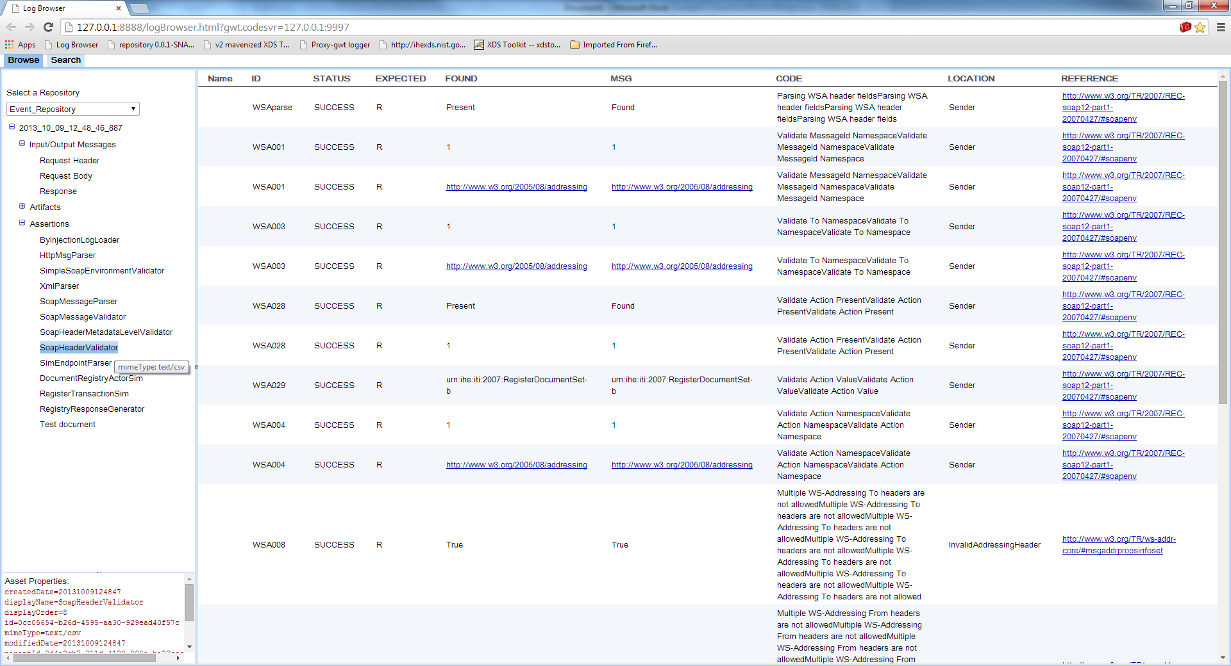
Log Browser View

Slide 18
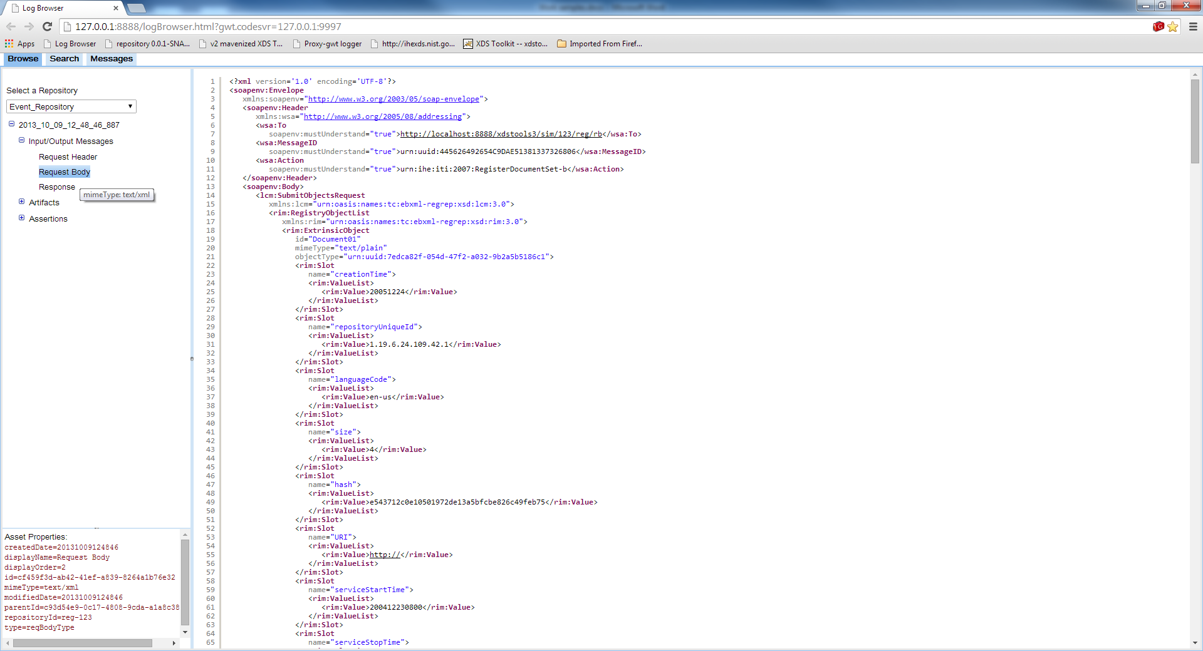
Raw Message

Slide 19
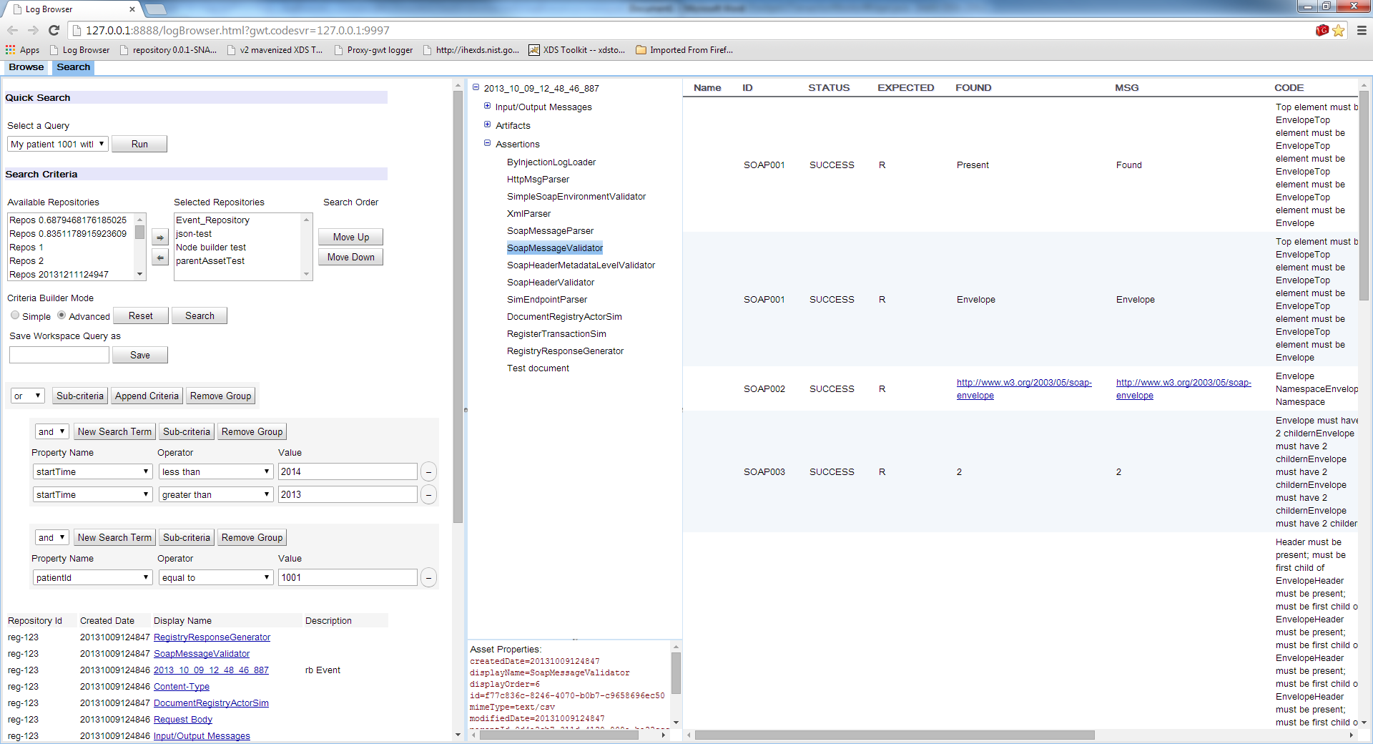
Search

Slide 20
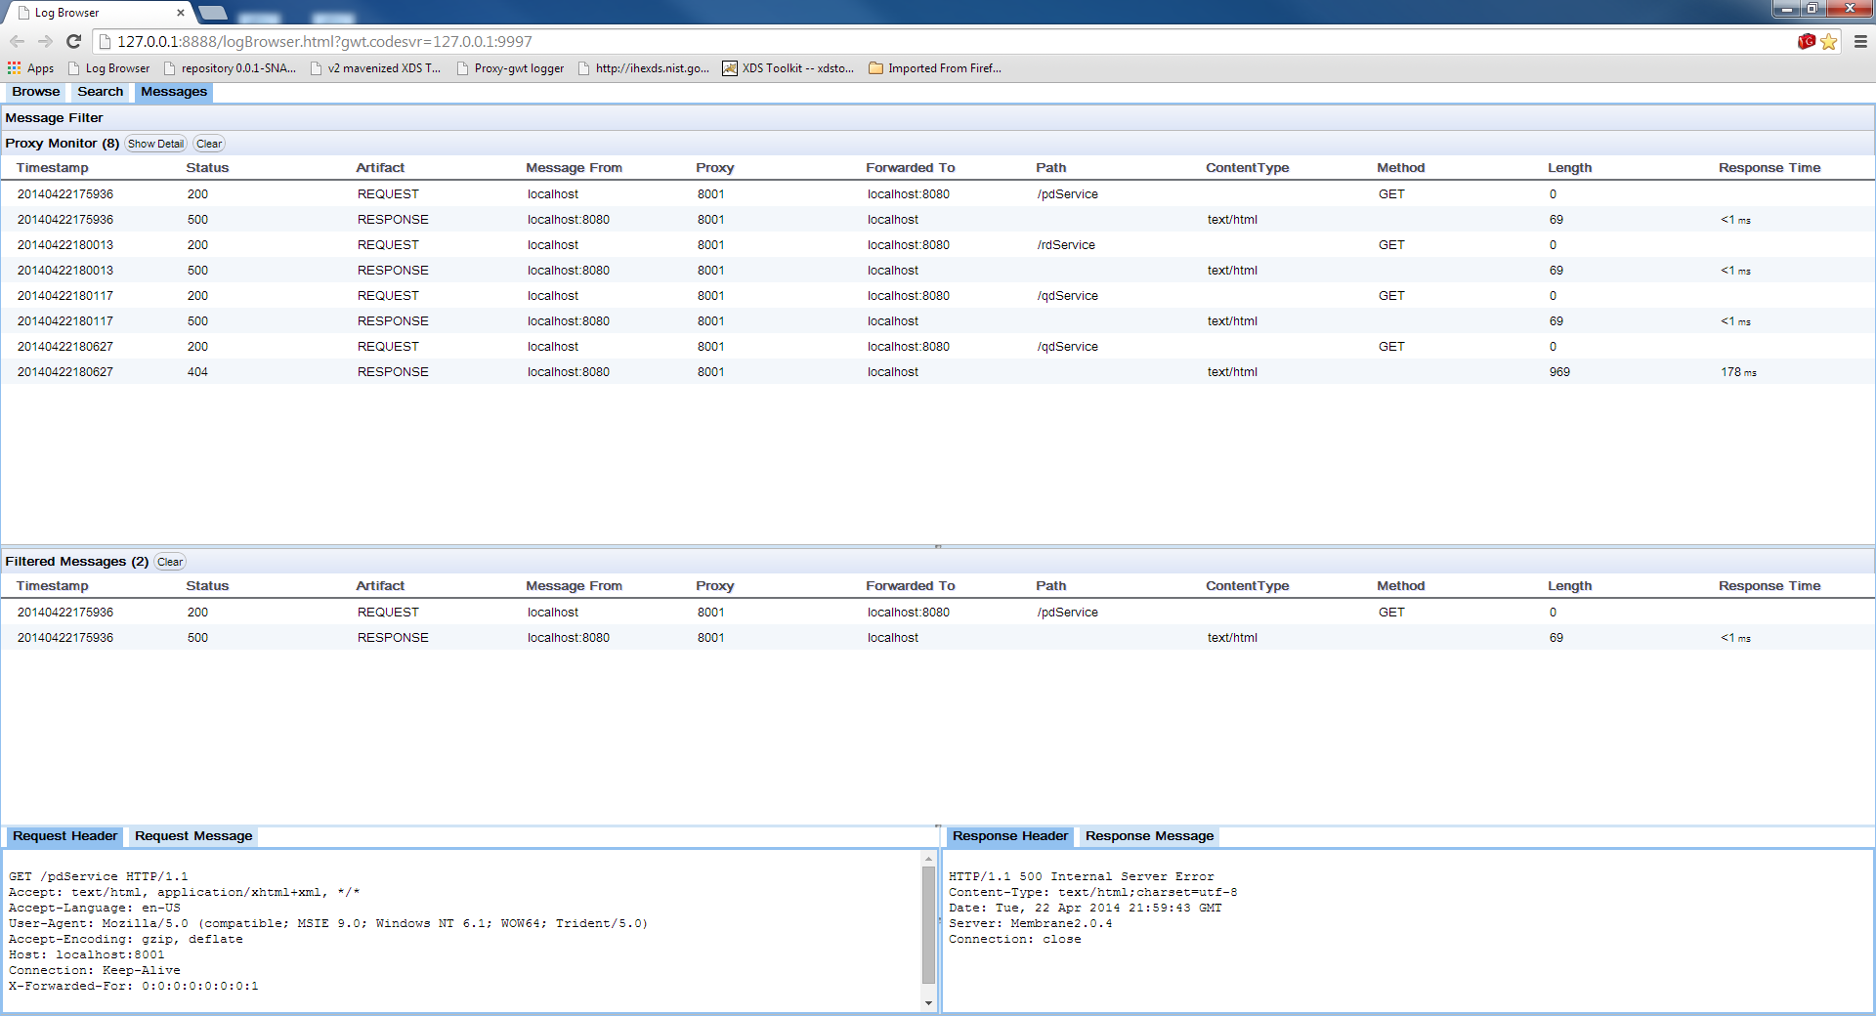
Proxy Filtering

Slide 21
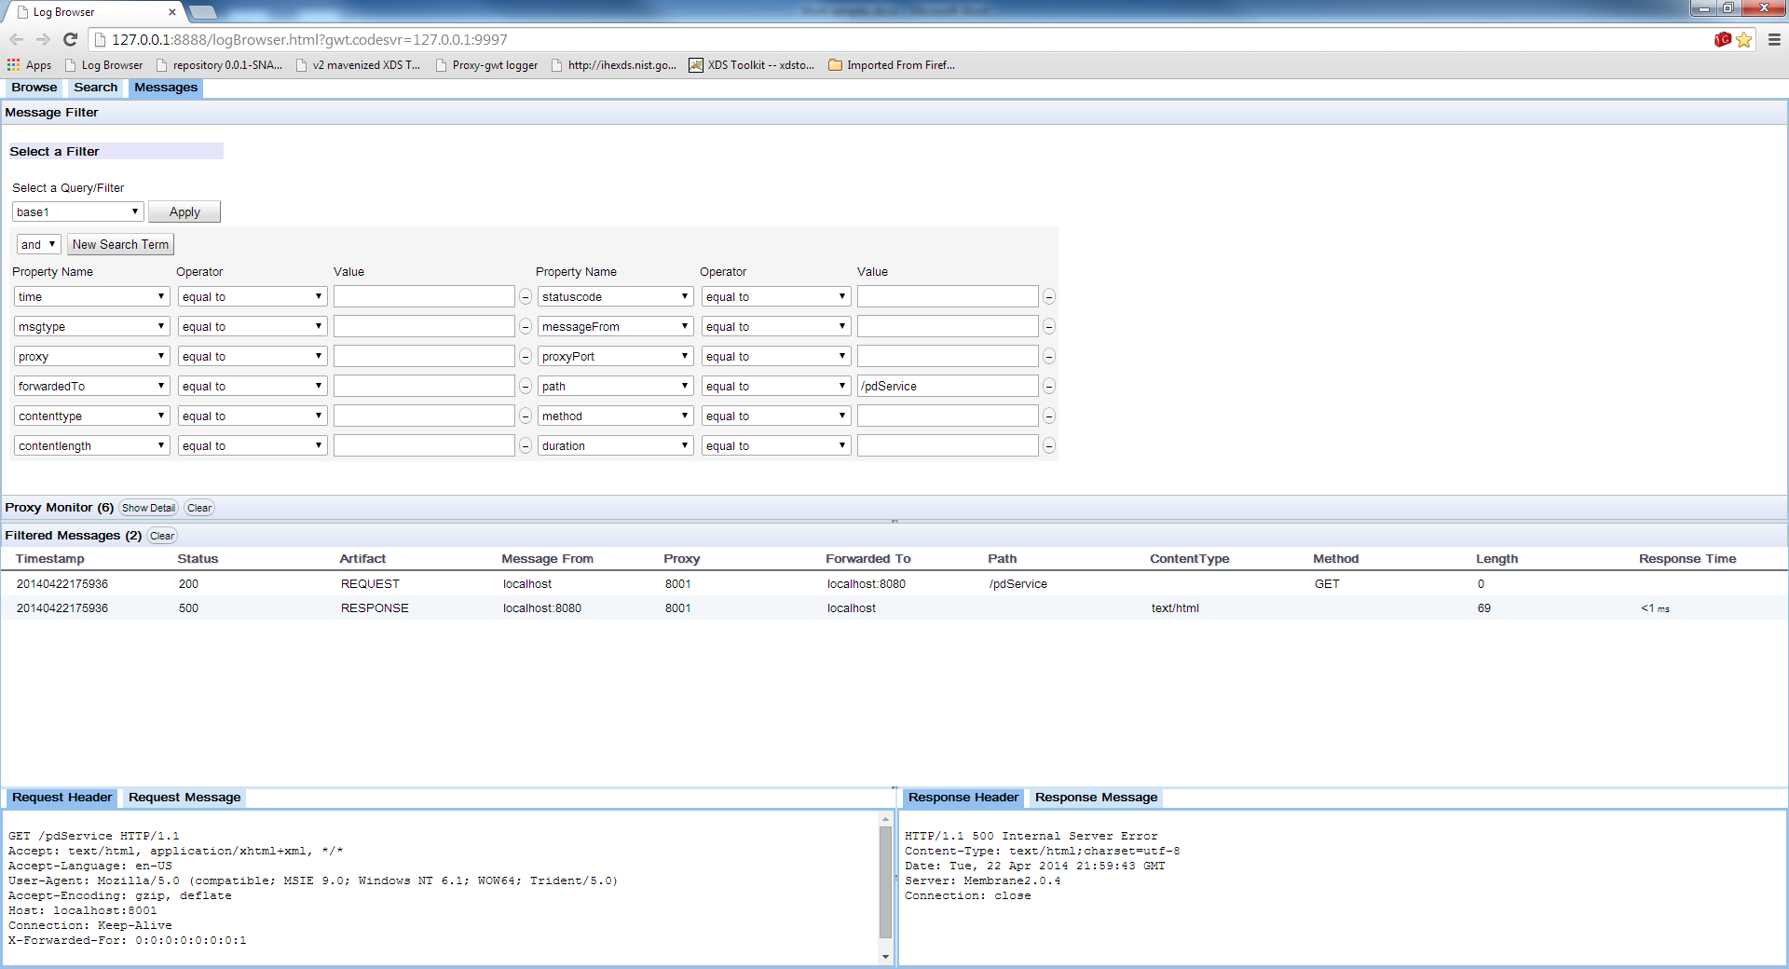
Proxy Filtering Setup

Slide 22
Schedule
First developer release June 1
Core System ✔
Log system and viewer ✔
Component and validation engines ✔
Examples, documentation
One example simulator (SOAP Responder)
Simulation Servlet so sim can be exercised by v2 toolkit or other external tools

Slide 23
Developer Release
Set of 1 or more JAR files
Downloadable via public Maven Nexus repository (coming soon)
Sources included

Slide 24
Focus areas of later releases
SOAP Async
Updated UI (long term project)
Test engine cleanup and update
Proxy
Service interfaces
Convert additional sims
New tests and sims

