Slide 1
FootBar Week 6
Scrum Master : Young Beom Ko
Project Owner: Salah Bourim(DROP)
Developer: Javier Pajuelo
Developer: Immanuel Lewis

Slide 2
Week 6: updates
Task assigned.
Young:
Regular User profile page
Business User Profile page
Javier:
Facebook integration
Lewis:
Add way to for Business User to add new Events
Rating system for the Bar Owners

Slide 3
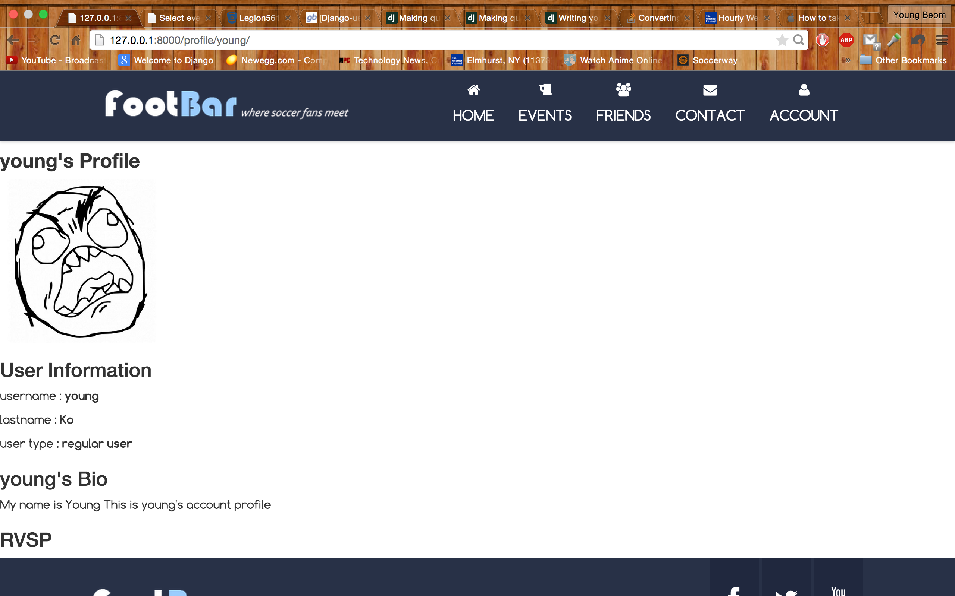
User Profile Page

Slide 4
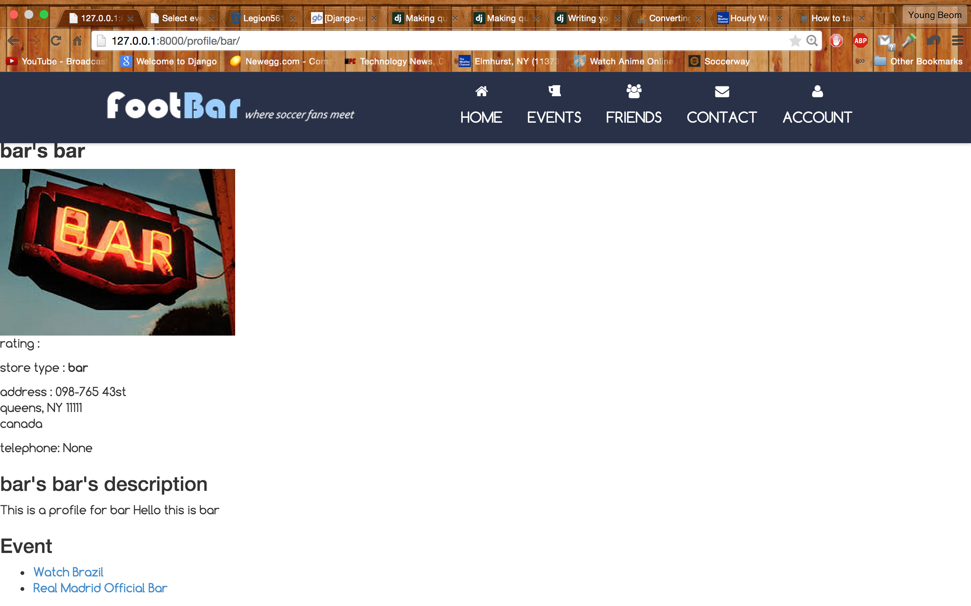
Business User Profile Page

Slide 5
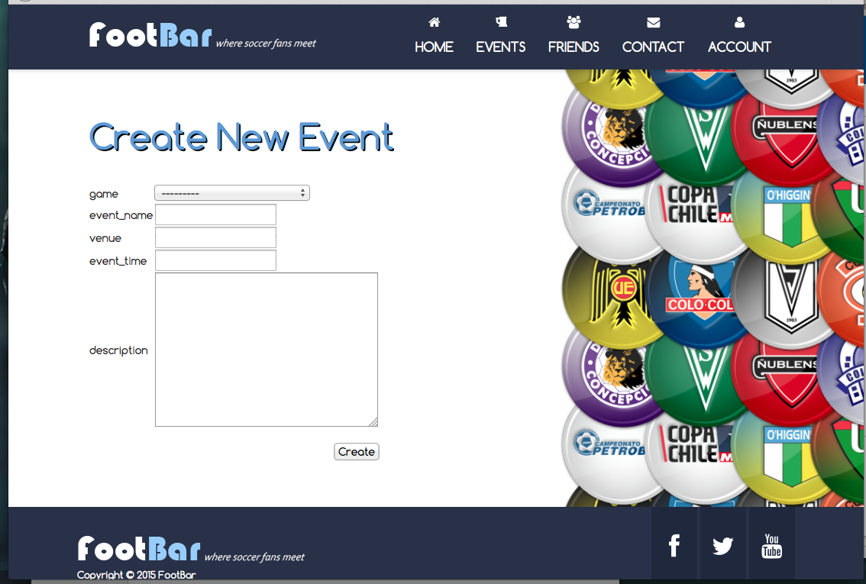
Event Creation

Slide 6
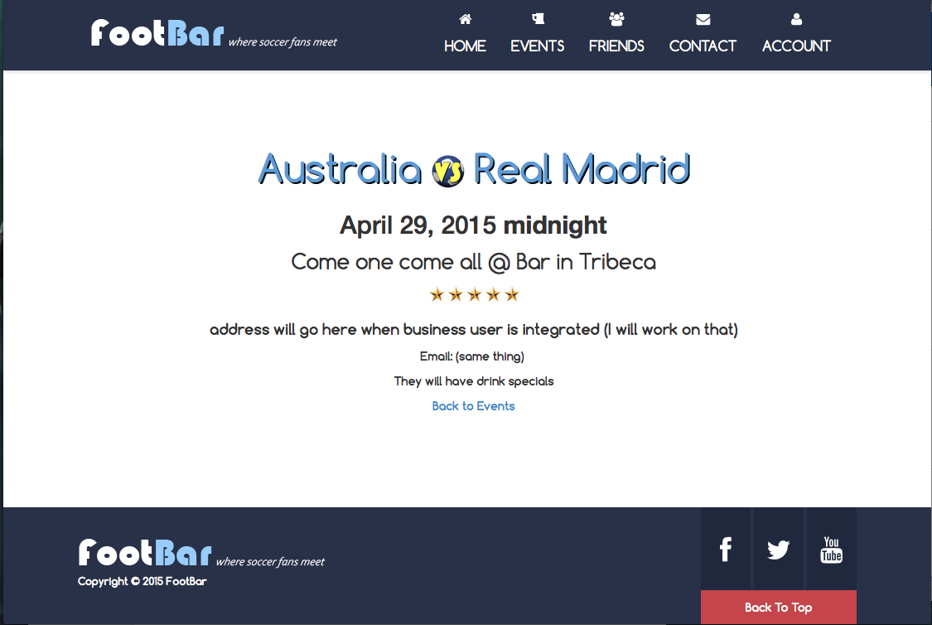
View Event

Slide 7
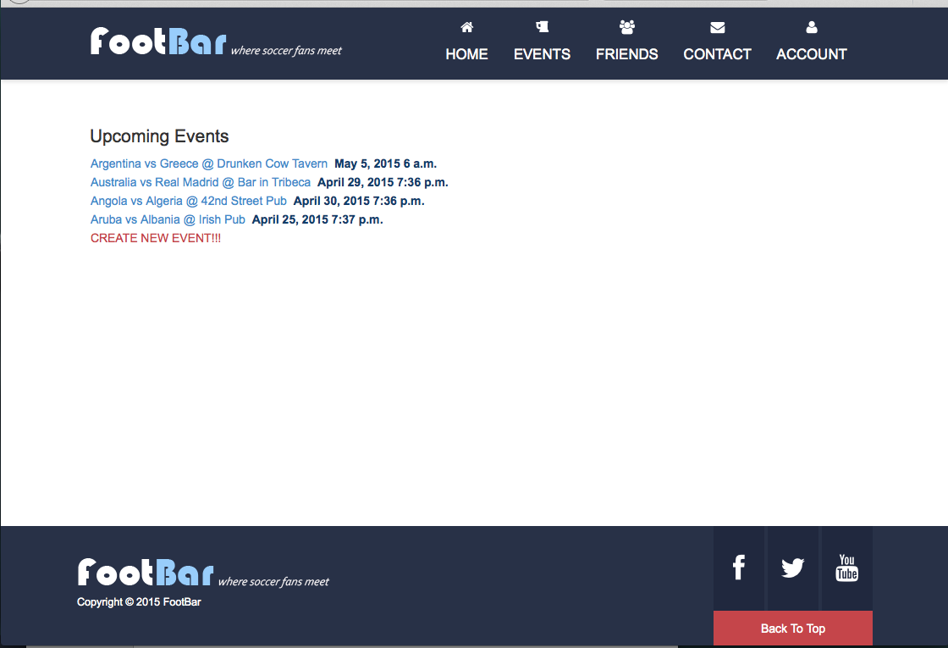
View Events

Slide 8
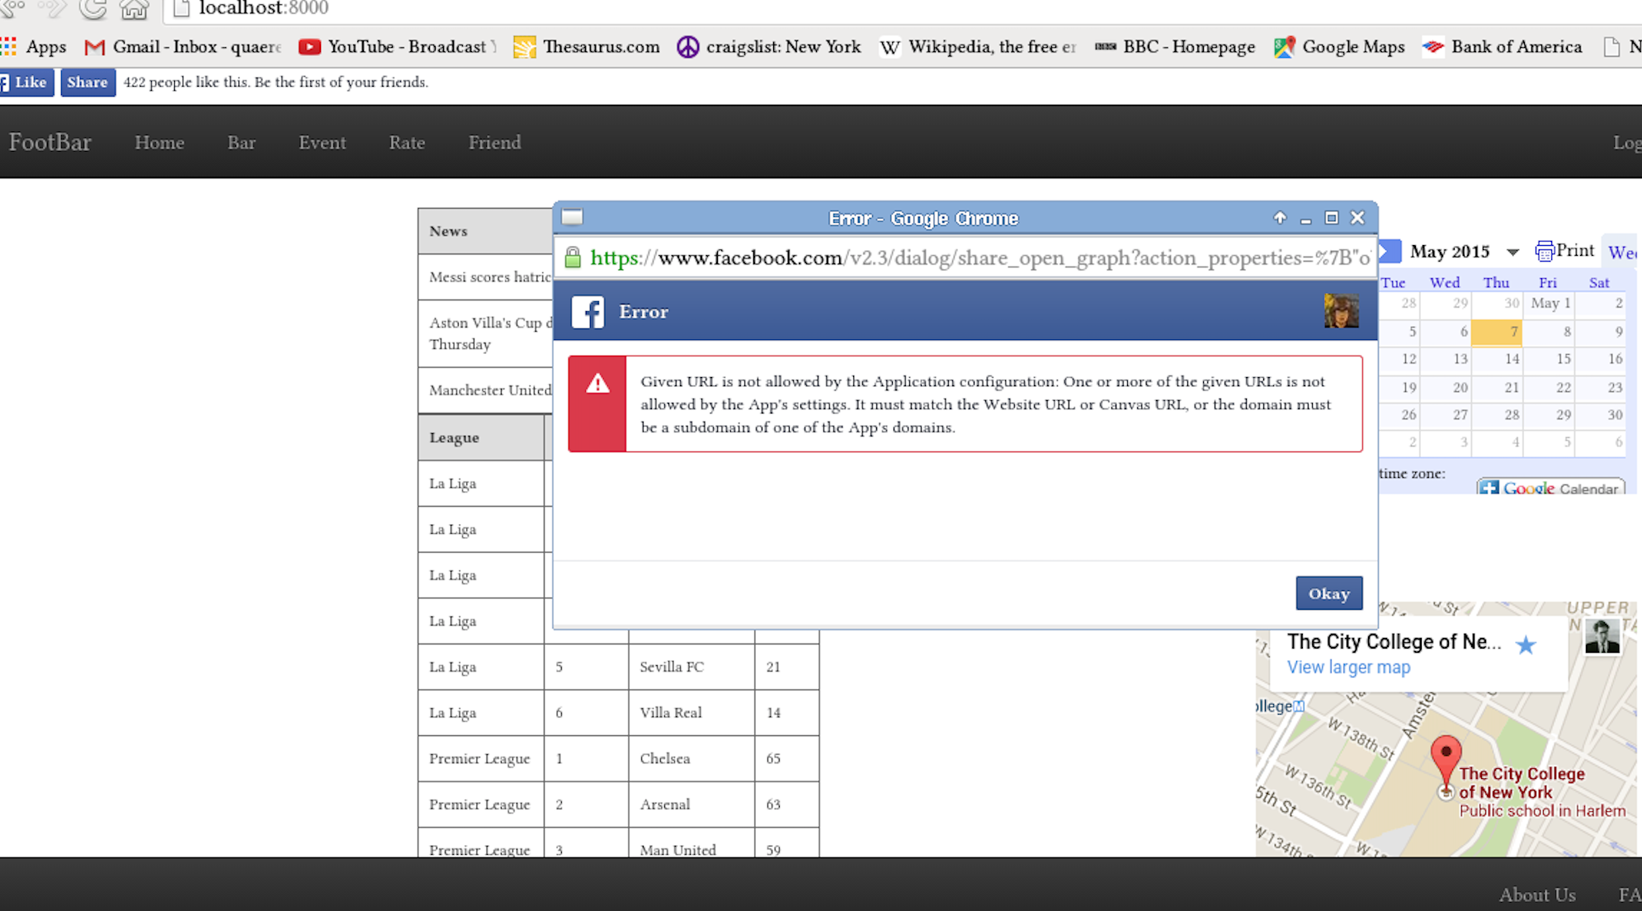
Facebook Feed

Slide 9
Test coverage

Slide 10
Pylint Testing

