Slide 1
FootBar
Week 5
Scrum Master : Young Beom Ko
Project Owner: Salah Bourim(DROP)
Developer: Javier Pajuelo
Developer: Immanuel Lewis

Slide 2
Week 5: updates
Task assigned.
  Young:
    Regular User profile page
    Business User Profile page
  Javier:
    Facebook integration
  Lewis:
    Add way to for Business User to add new Events
    Rating system for the Bar Owners

Slide 3
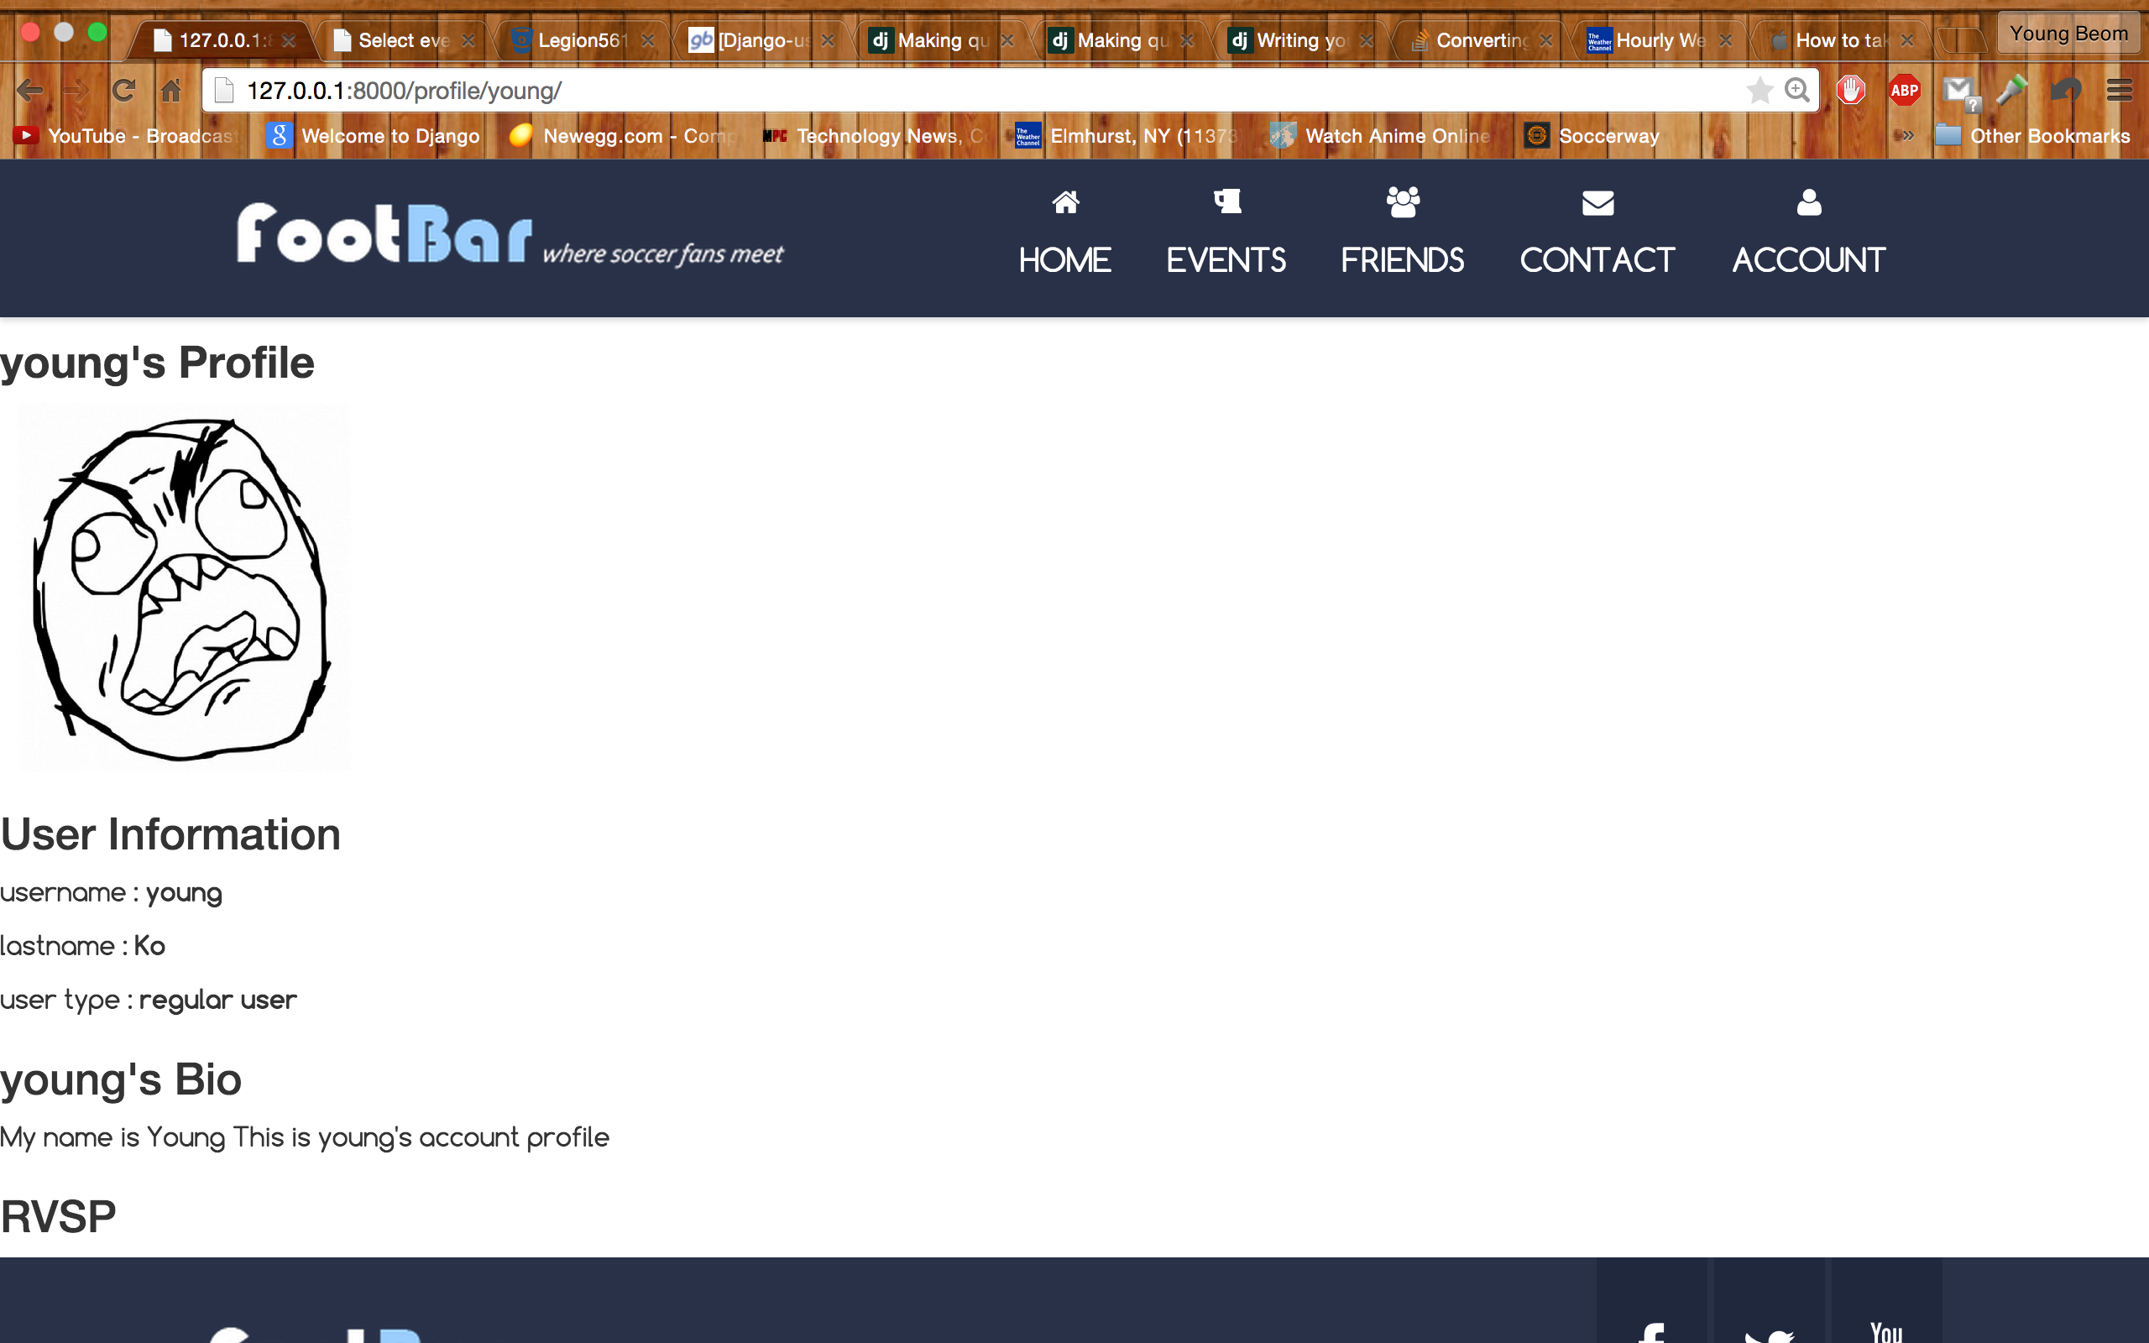
User Profile Page

Slide 4
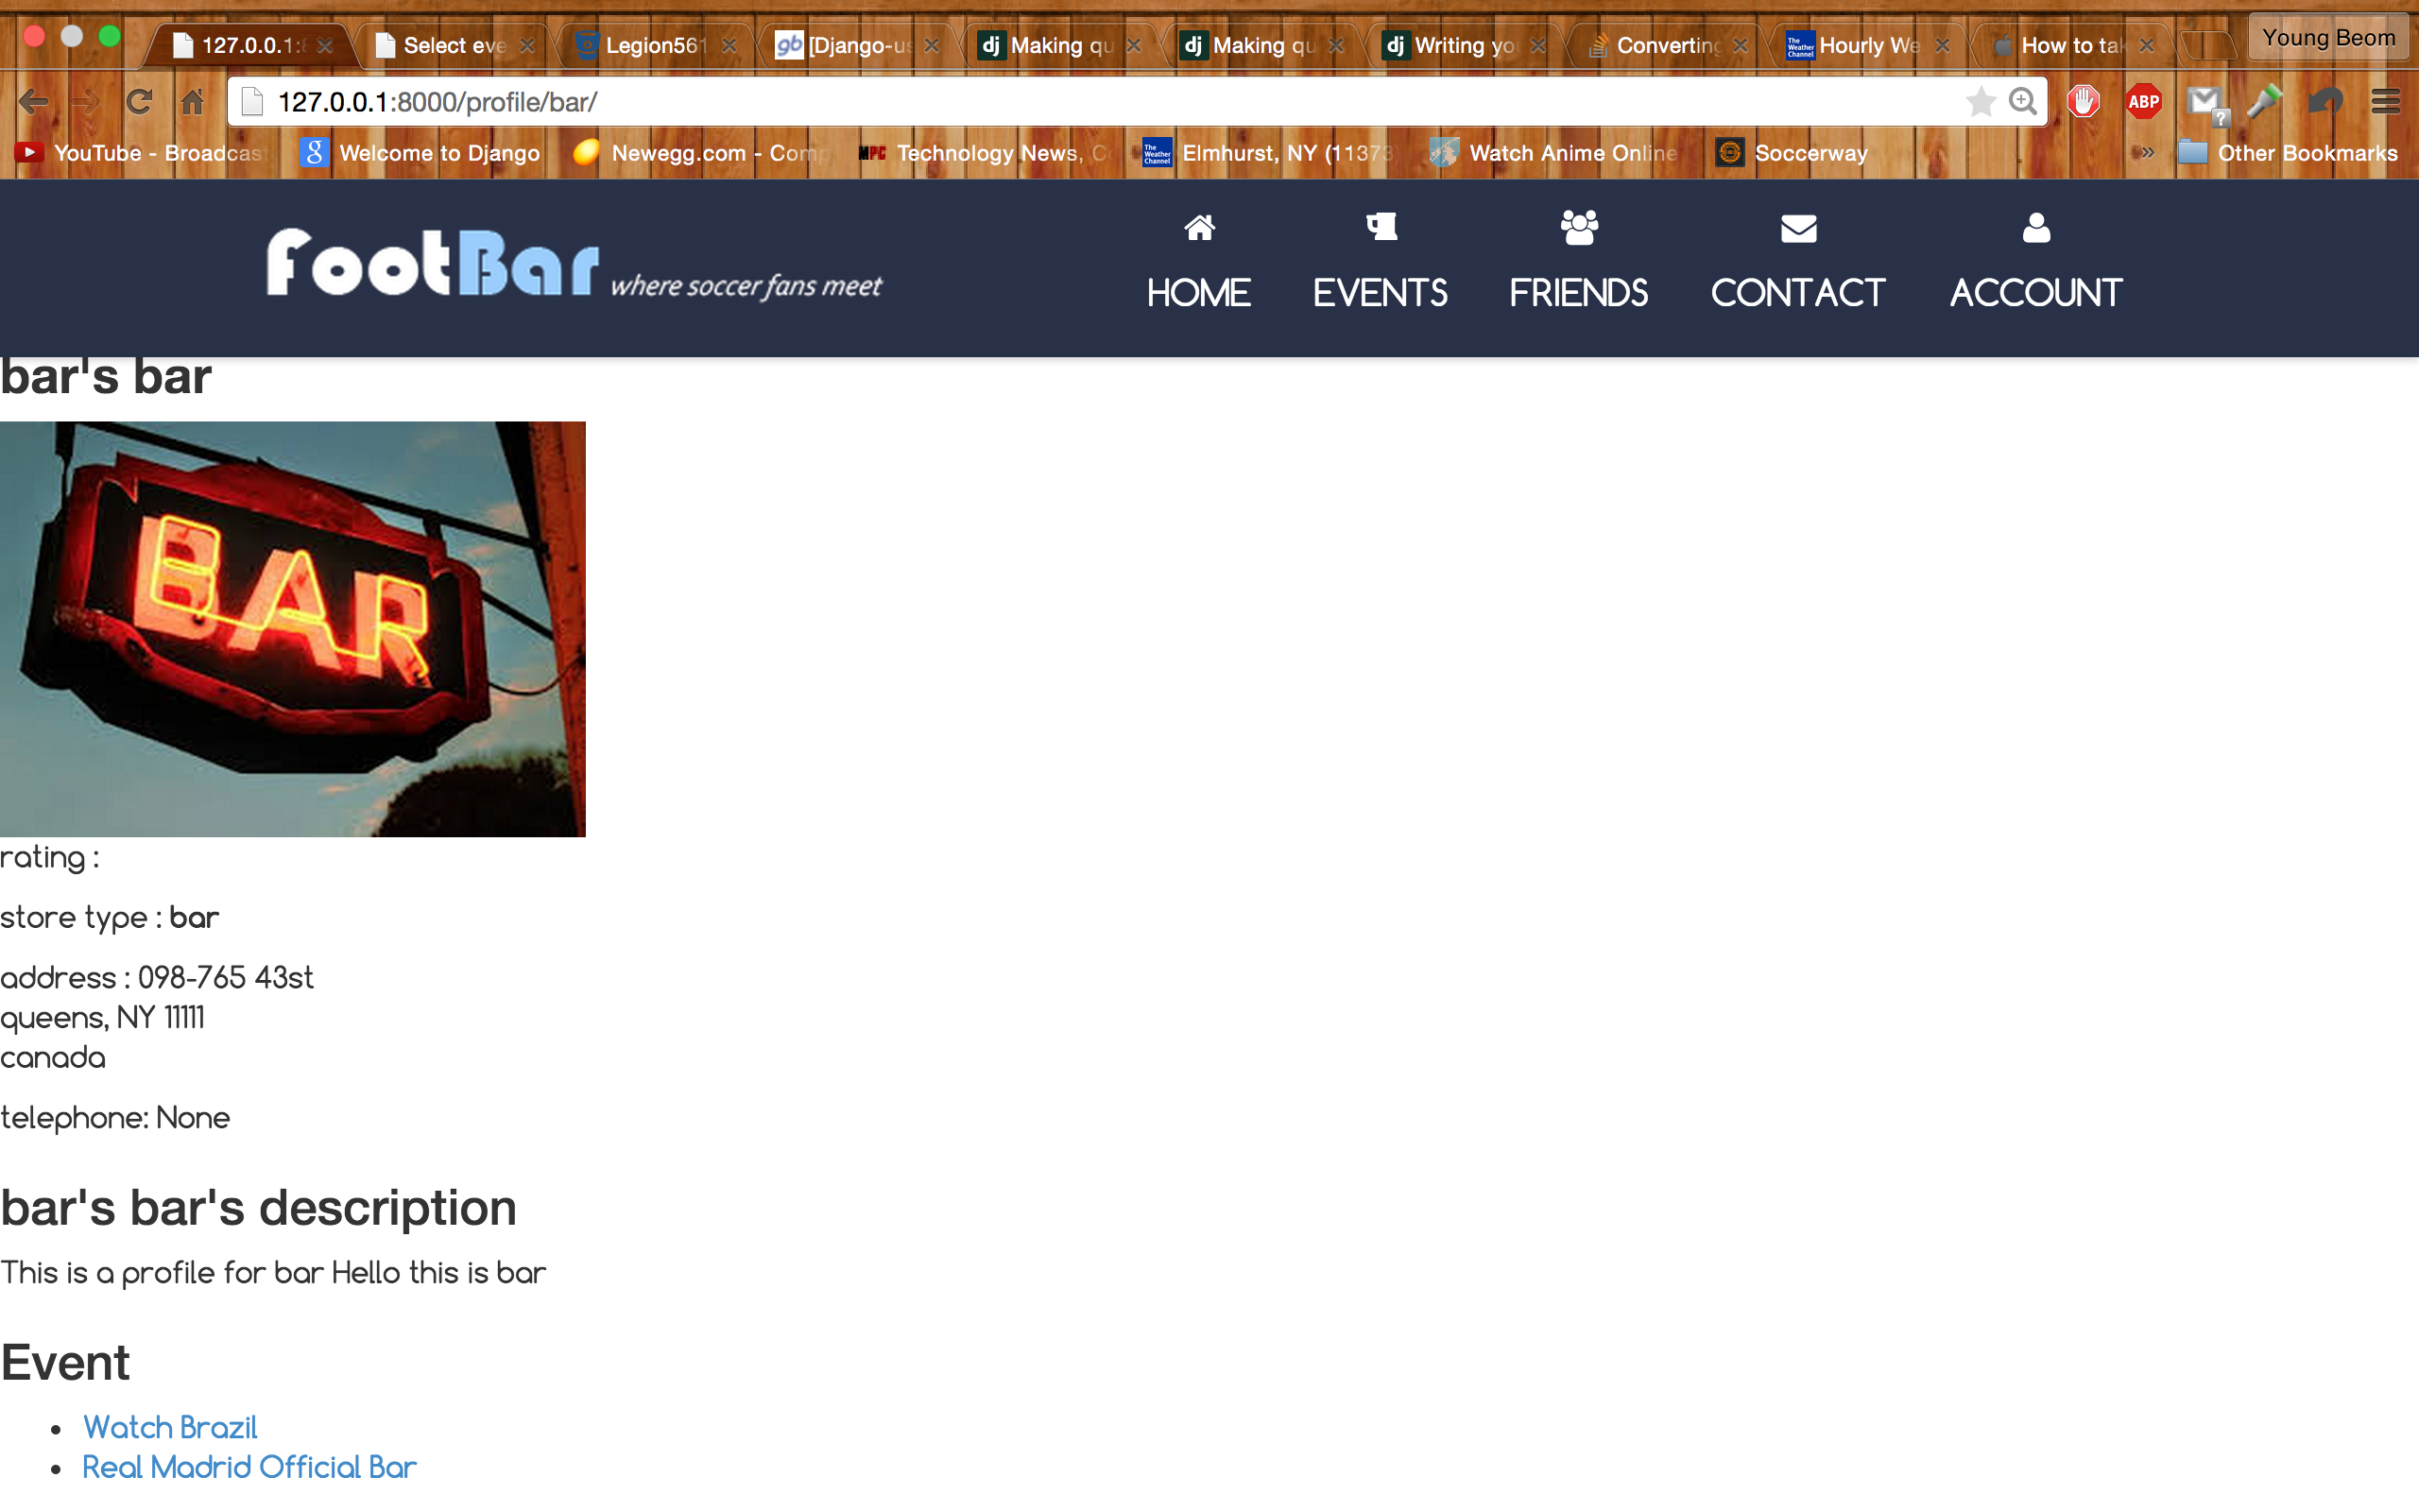
Business User Profile Page

Slide 5
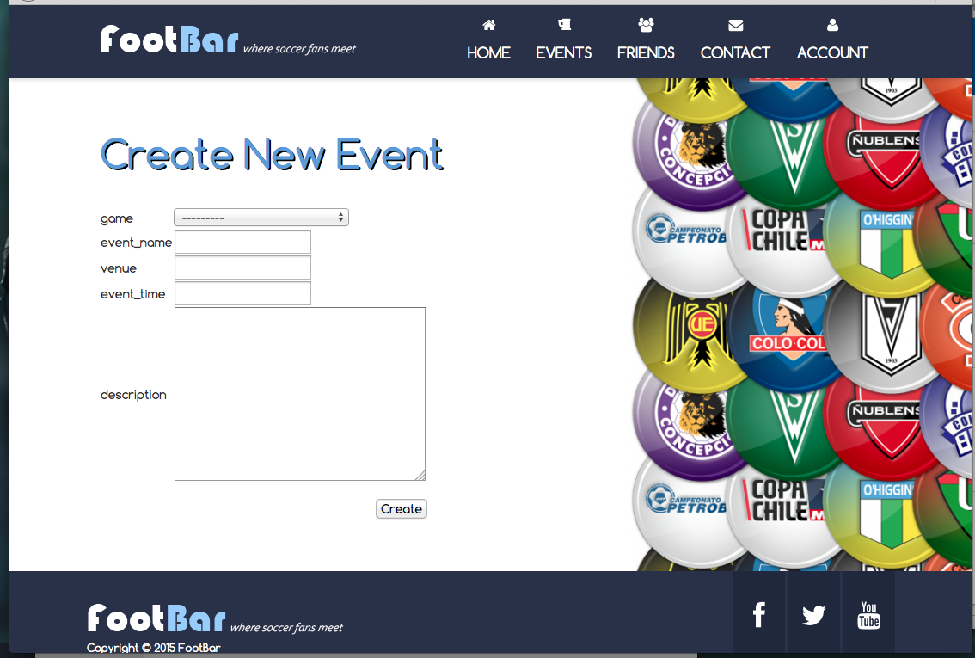
Event Creation

Slide 6
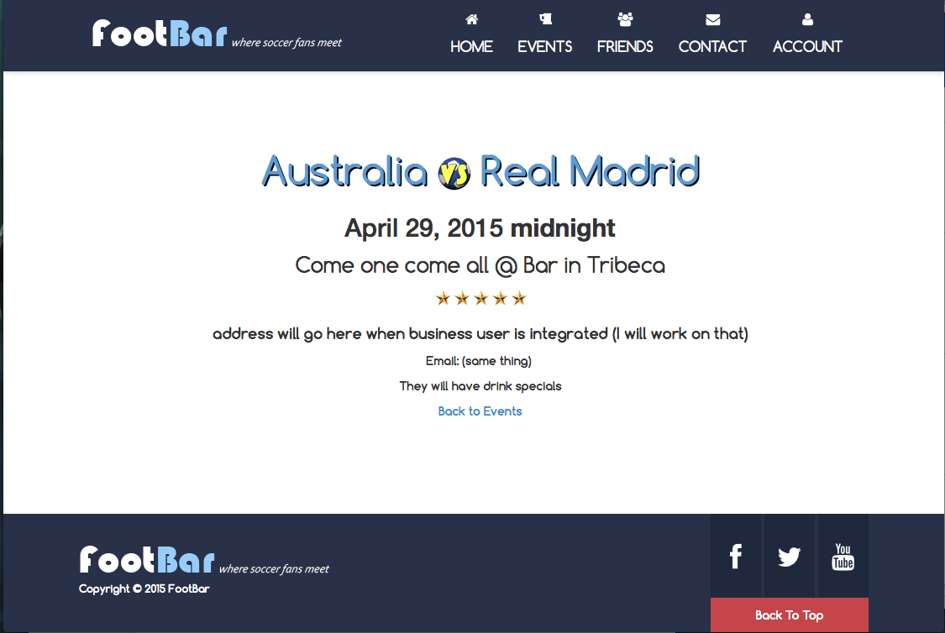
View Event

Slide 7
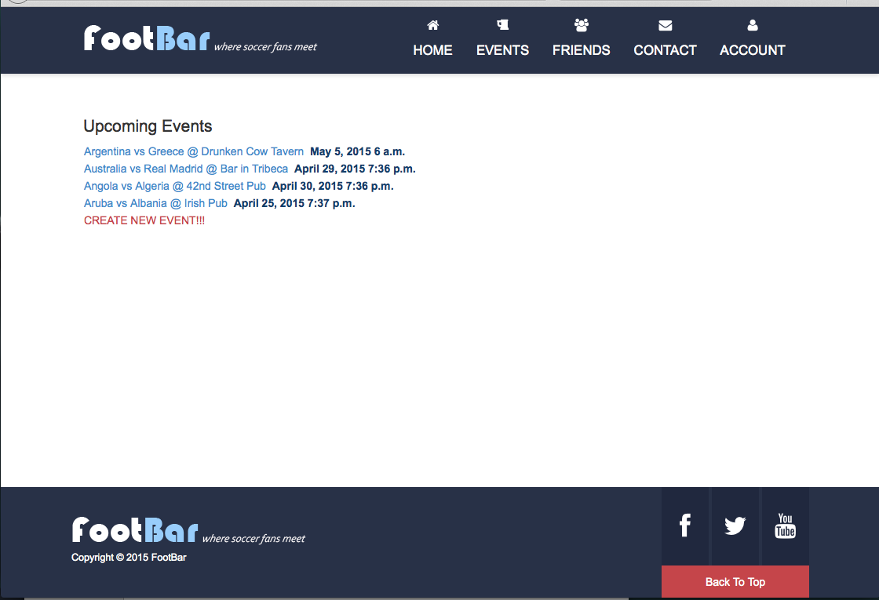
View Events

Slide 8
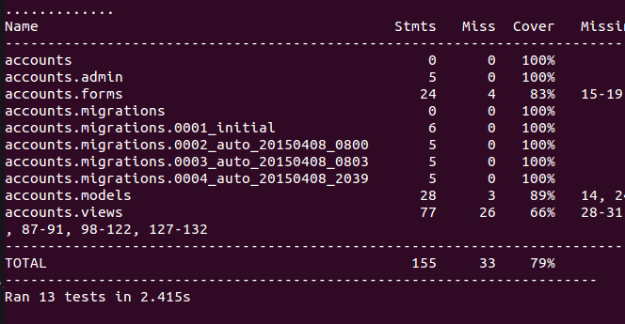
Test coverage

Slide 9
Pylint Testing

