Slide 1
FootBar
Week 3/4
Scrum Master : Young Beom Ko
Project Owner: Salah Bourim(DROP)
Developer: Javier Pajuelo
Developer: Immanuel Lewis

Slide 2
Week 4: updates
Task assigned.
  Young:
    Regular User and Business User Login and registration.
    Regular User profile page
  Javier:
    Create a league Standing, and news for site
    Regular User Friend system and Subscription to busniess user
  Lewis:
    Front end design for main home page as well as layers to be used on all sites
    Event and game schedule db
    Business User rating system

Slide 3
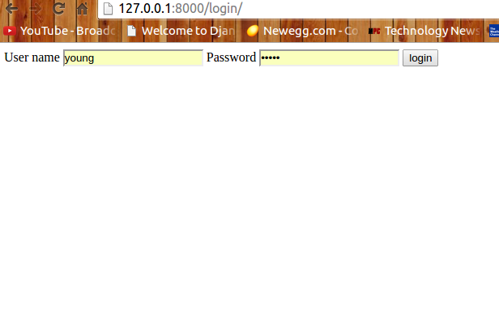
Login page

Slide 4
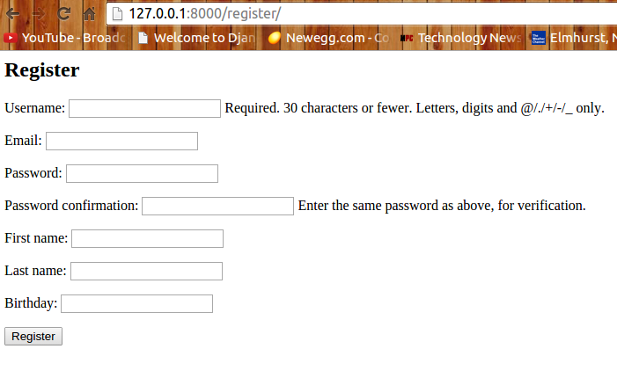
Regular Register

Slide 5
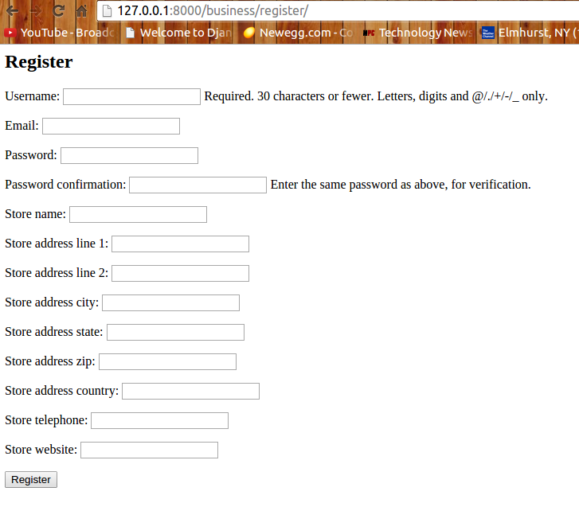
Business User Register

Slide 6
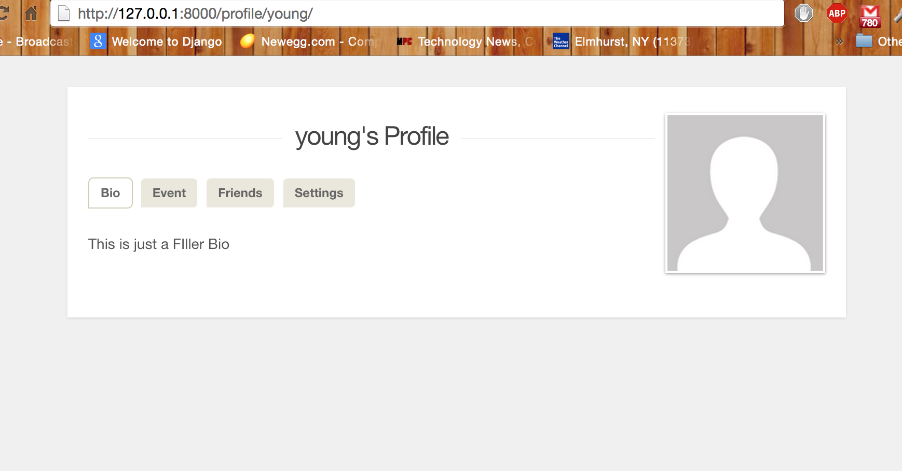
Regular User Profile Page

Slide 7
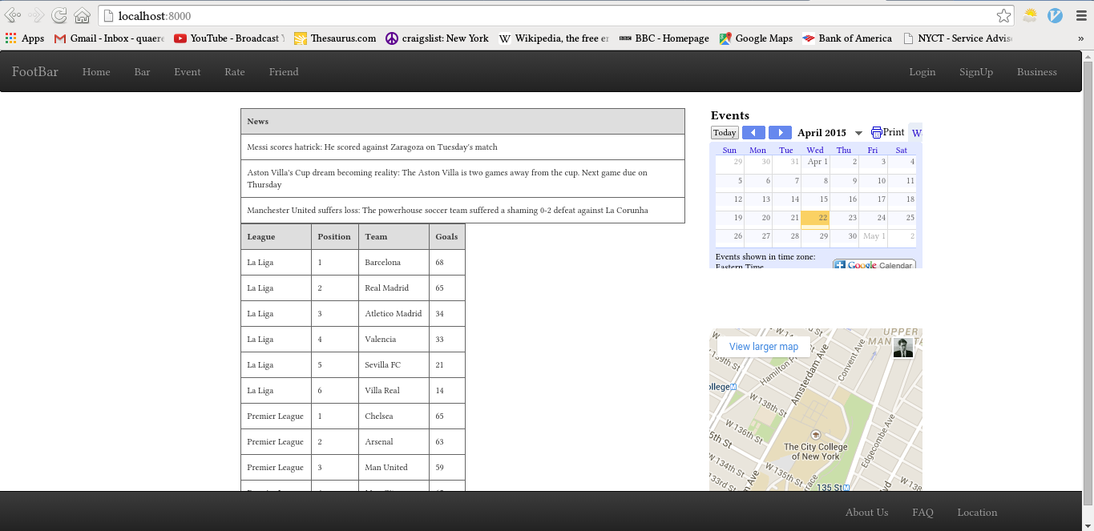
News and League Standing

Slide 8
Home Page by Lewis

Slide 9
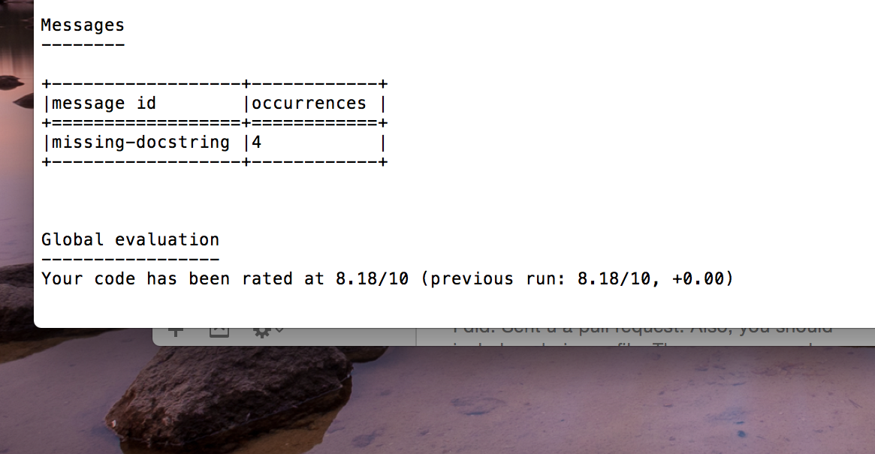
Pylint Score

Slide 10
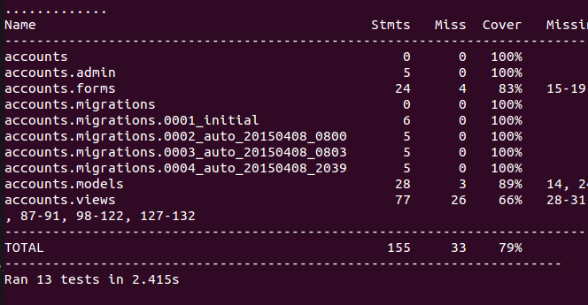
Test coverage

