Slide 1
FootBar
Week 2
Scrum Master : Young Beom Ko
Project Owner: Salah Bourim
Developer: Javier Pajuelo
Developer: Immanuel Lewis

Slide 2
Week 2: Back to Square one
We had to redo our management of master repo after class on Tuesday.
All code that has been done are now had to be redone with testing included for test driven development.
At this point Master repo only has initial Django project using Django with old Home page file
All Issue assigned are postponed till old Issues are fixed as we need to do testing to what we are working with.

Slide 3
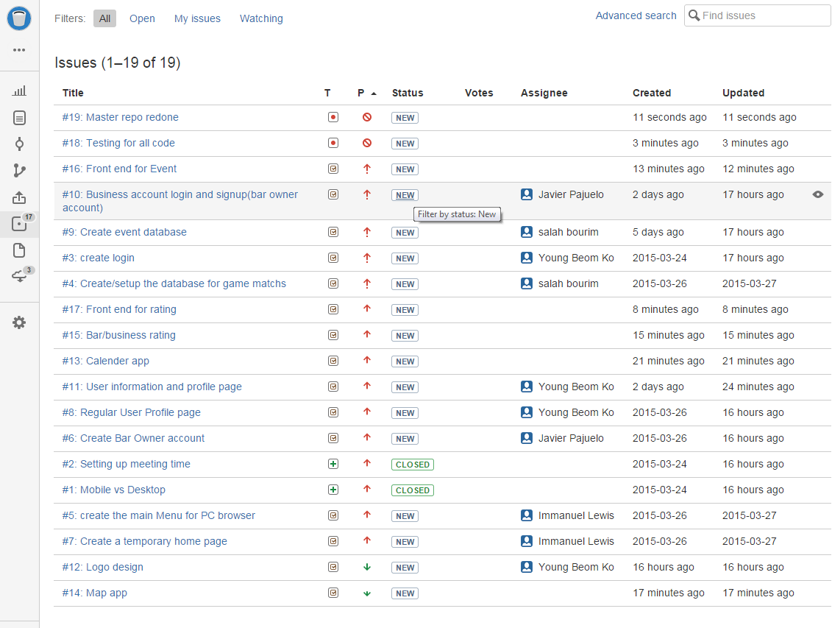
Master Repo Issue Tracker

Slide 4
Task at Work currently
Javier is currently working on Bar/Business owner account with event DB
Salah is working on Soccer match schedule DB
Lewis is working on Front end design
Young is working on Regular User login with User profile as well as re-managing the Master Repo

Slide 5
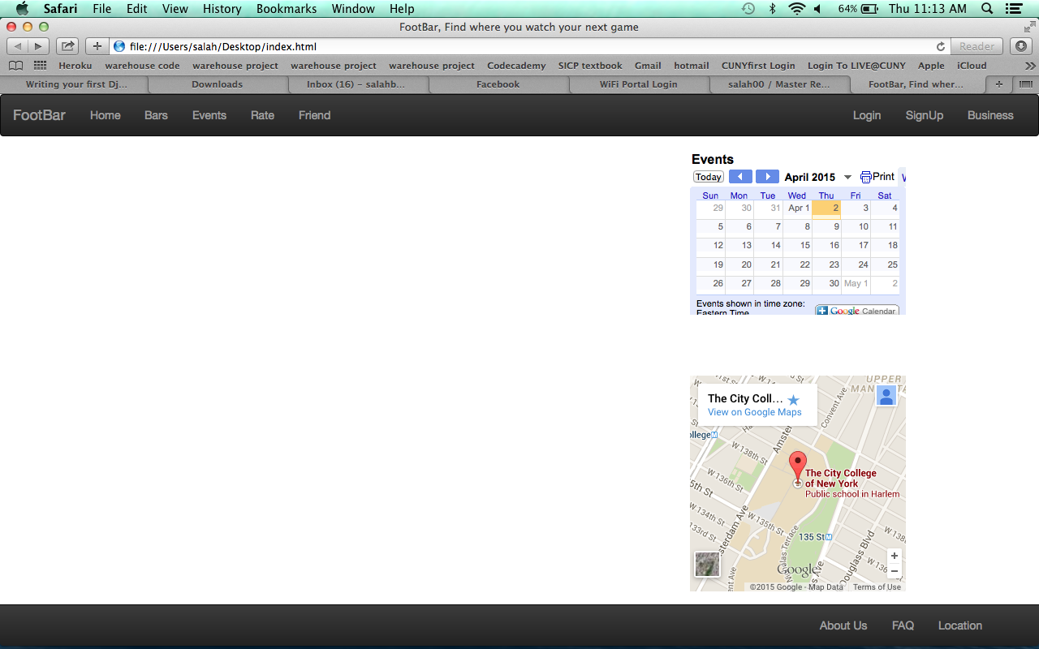
Old Home Page

Slide 6
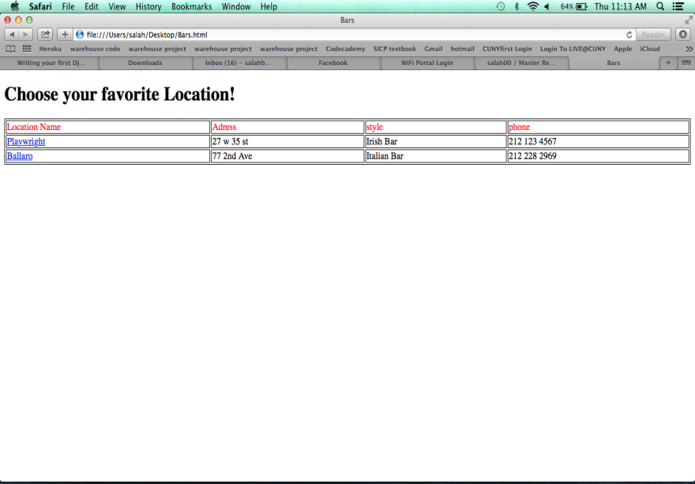
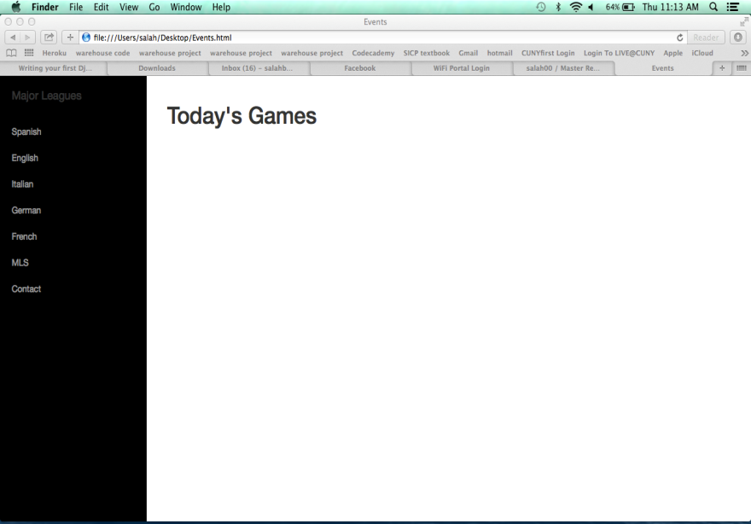
Current Work with Bar and Event
Bar
Event

Slide 7
Home Page by Lewis

Slide 8
Pylint Testing

Slide 9
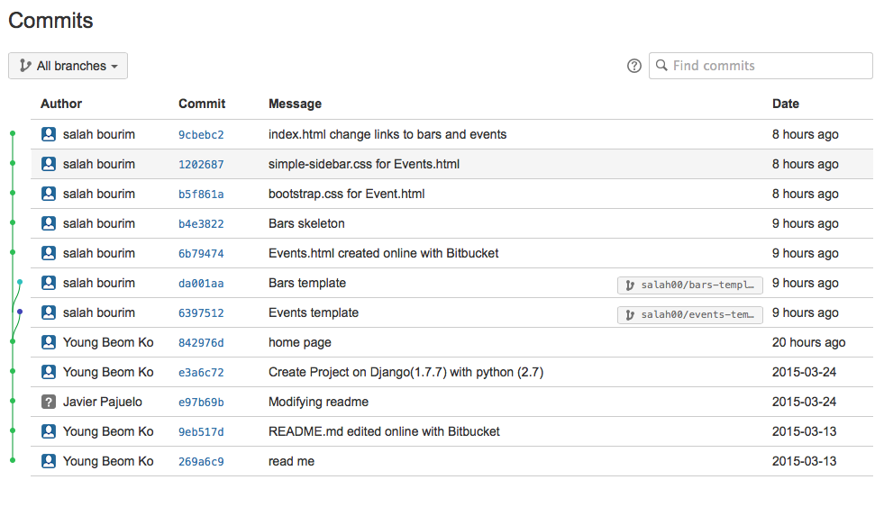
Commits

