Slide 1
Supporters Spot (FootBar)
Scrum Master : Young Beom Ko
Project Owner: Salah Bourim
Developer: Javier Pajuelo
Developer: Immanuel Lewis

Slide 2
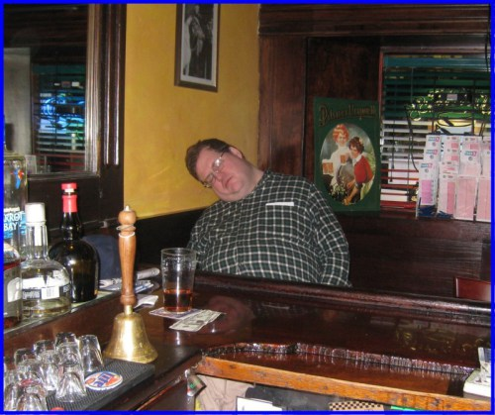
Problem
Have you ever wanted to watch a sports game in a bar yet to find out it’s empty and boring?

Slide 3
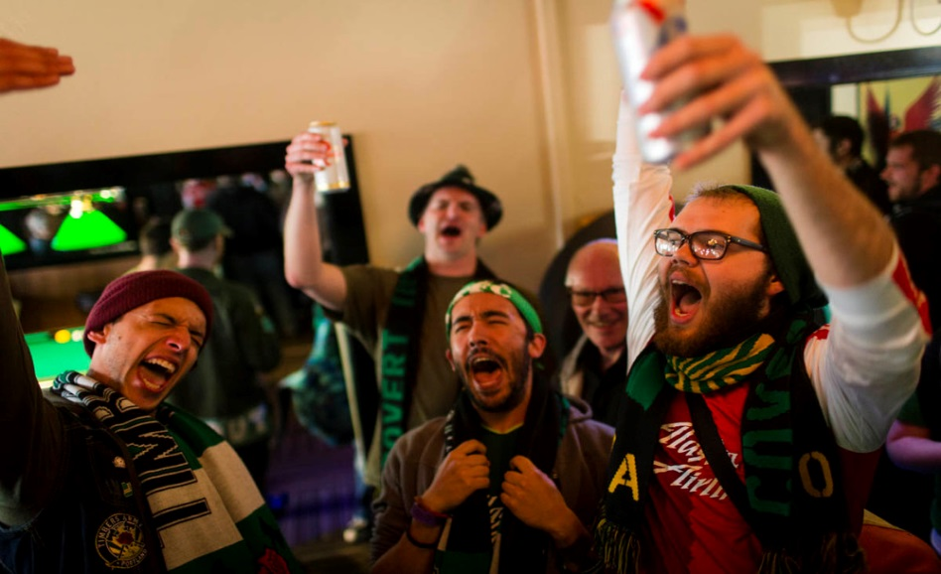
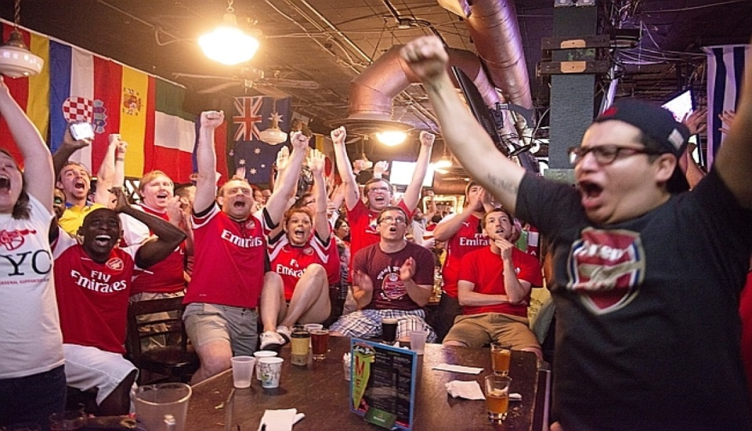
Problem
Games are best watched with follow friends and fans
We want to bring this experience to many people as possible

Slide 4

Product
Our mission is to connect fans together with other fans to give the experience of watching sports at whole new level

Slide 5
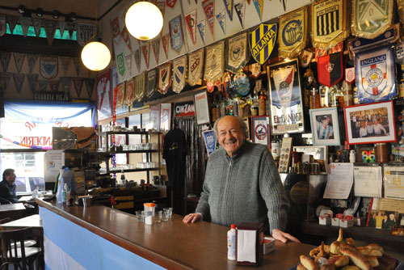
Product
We also wants to give the bar owners new business opportunity.

Slide 6
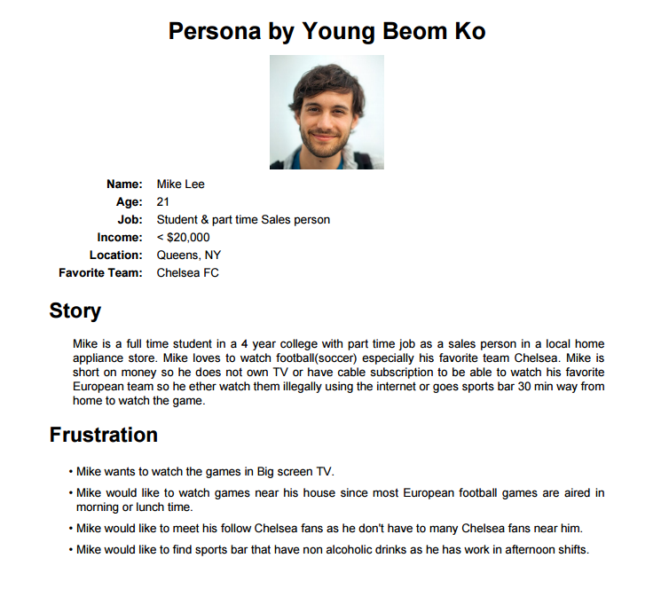

Slide 7
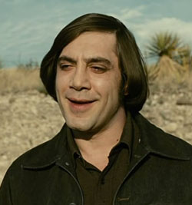
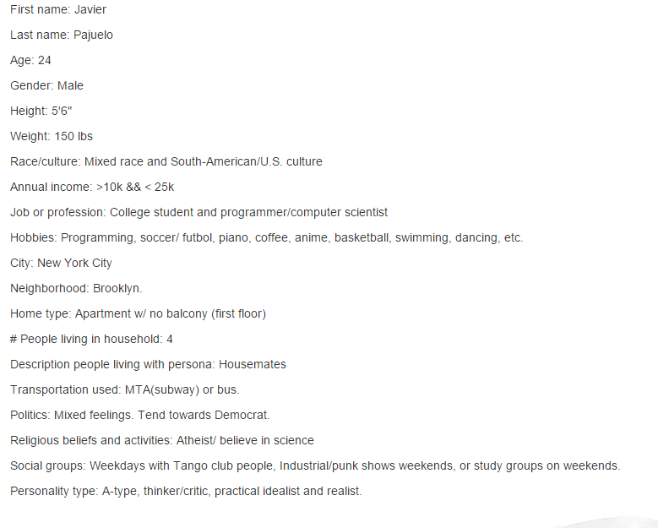

Slide 8
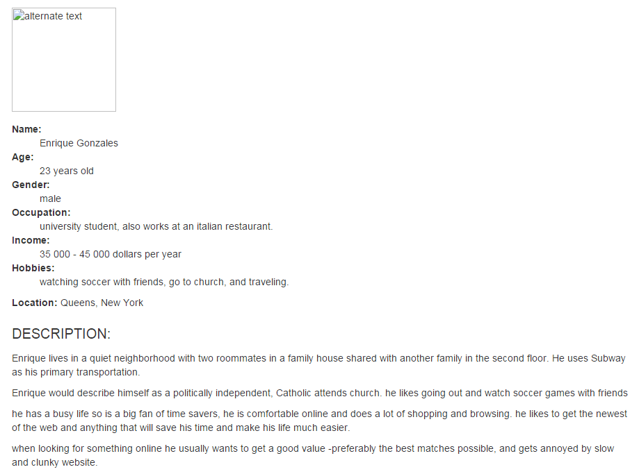


Slide 9
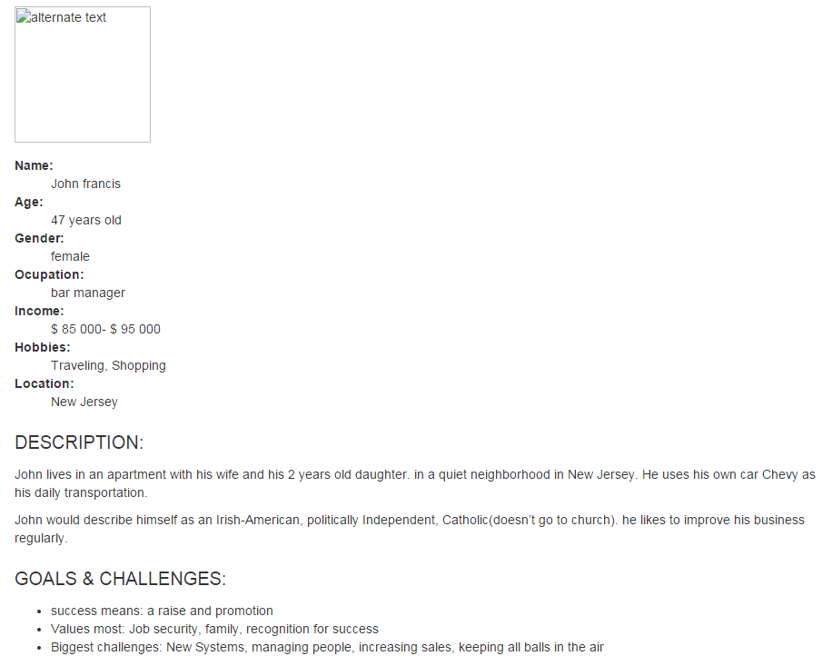
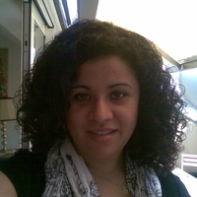

Slide 10
User Story by Young Beom Ko
As a Regular User, I want to see what bar near me is broadcasting what games so that I go to a bar that is broadcasting the game I want to watch and also have choice on all bars broadcasting that game..
As a Regular User, I want to see how many people are going to see the game at certain bar so that I can go to a crowded bar for atmosphere or empty bar for comfort.
As a Regular User, I want to RVSP to a bar I want to go so that I can easily tell my friends and my friends i am going to this bar so that they can join me.
As a Regular User, I want to go to a bar with only my team supporters so that I can watch the game only with people who support my team.
As a Regular User, I want to find bar that is nearest to my current location that is broadcasting game i want to watch so that I don't have to go bar to bar searching for bars.
As a Regular User, I want to see the rating of the bar by the other users so that i can go to the best bar possible.
As a Regular User, I want to see the Menu/drinks served at the bar so that bar i choose have menu/drink i want.
As a regular User, I want to see the schedule of when the game is going to be played so that i can schedule my day around that schedule.
As a Regular User, I want to get information on bars such as TV size, capacity of the bar, image of the bar, map of the bar, and other useful information so that i can choose right bar to watch the game.
As a Regular User, I want to send invites to friends when i RVSP a bar so that they can easily know where i am going to watch the game and join me.
As a Bar Manager, I want to see demographic of which teams my customers supports the most so that i can choose which game to broadcast.
As a Bar Manager, I want to post which game to broadcast so i can tell my customers what game we are broadcast at what date/time.
As a Bar Manager, I want to see what games bar near mine are broadcasting so i can avoid any competition or compete with other bars.
As a Bar Manager, I want to have an ways to post any event or sales information so that i can attract more customers.
As a Bar Manager, I want to upload Images, information, menu/drinks, and more of the bar so that more customers can come in to my bar.
As a Admin, I want to receive report messages from users so that if any bugs or problem is reported we can fix the issue.
As a Admin, I want to give warring and remove any users from the site so that if any user is using the site for wrong reason we can ban or flag the user.

Slide 11
User Story by Javier Pajuelo
"As a soccer fan, I want watch a game with new people and friends so that I get to meet more people with same interests and expand my social circle“
"As a bar owner, I want to host large groups of people in my bar and offer good service during game days so that I can make extra income and attract even more clientele.“
"As a database admin, I want to have a consistent, easily accessible, and updated database of all Premier League and La Liga matches so that I can keep relevant information for the website and attract more users, recognition, and income.“
"As a web-developer, I want to make server integration into the website seamless. I want to be very modular in all the work I do, so that we can recognize problems easily and keep order in the web construction, so that web users visit our site more often. Web users such as soccer fans would visit our site and create revenue for us by propaganda spots on our website. Bar owners would benefit us in the same way. Moreover, bar owners would notice our companies potential and either tell other companies about it or hire us for another endeavor.
"As a <role>, I want <goal/desire>" "As a soccer fan, I want to expand my circle of friends interested in soccer and enjoy my time watching the game.“
"As a bar owner, I want to maximize my clientele. In particular, I want to bring a larger group of people during match games.“
"As a database admin, I want to improve my database and organizational skills. I want to keep a consistent and reliable soccer match database.“
"As a web developer, I want to attract more people to our site by making it more user friendly."

Slide 12
User Story by Salah Bourim
as a user, i want to login so that i can choose if i am a bar owner/manager or a customer
as a bar manager, i want to be able to choose the games i want so that it will be shown in the app
as a customer, i want to be able to check a game so that i can see all the bars showing the game and number of people potentially attending every bar
as a customer, i want to be able to add my self as an attendee to a specific bar so that it will be displayed in the app
as a customer, i want to be able to search a bar so that i can see directly info about this bar
as a customer, i want to be able to search a game so that i can see directly info about the game
as a customer, i want to be able to choose a bar as my favorite bar so that i can always see its information first
as a customer, i want to be able to write a review so that it will be displayed as guide
as an admin, i want to be able to block specific users from an IP address so that I can limit access to the site from spammers.
as an admin, i want to be able to manage the bars database so that i can add/delete bars
as a admin, i want to be able to manage the games database so that i can update the game schedule
as an admin, i want to be able to manage the reviews so that no spams and no dishonest review will be still posted

Slide 13
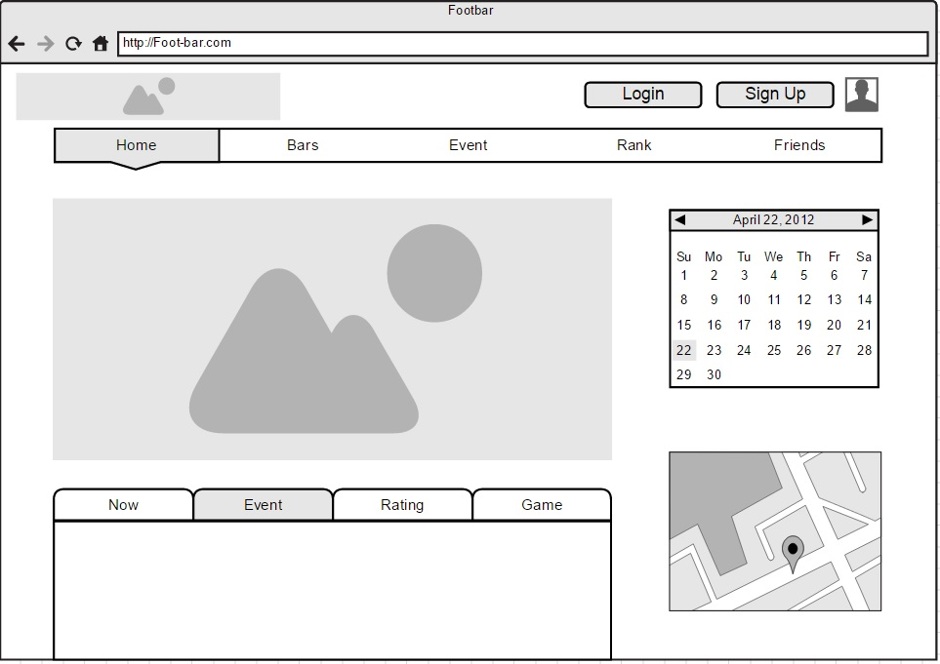
Wireframe

Slide 14
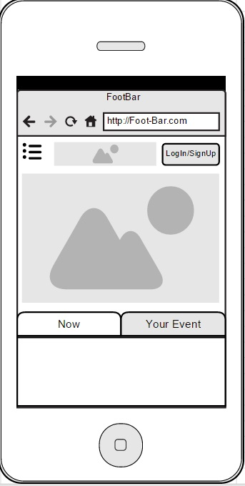
Wireframe

Slide 15
FootBar
Week 2
Scrum Master : Young Beom Ko
Project Owner: Salah Bourim
Developer: Javier Pajuelo
Developer: Immanuel Lewis

Slide 16
Week 2: Back to Square one
We had to redo our management of master repo after class on Tuesday.
All code that has been done are now had to be redone with testing included for test driven development.
At this point Master repo only has initial Django project using Django with old Home page file
All Issue assigned are postponed till old Issues are fixed as we need to do testing to what we are working with.

Slide 17
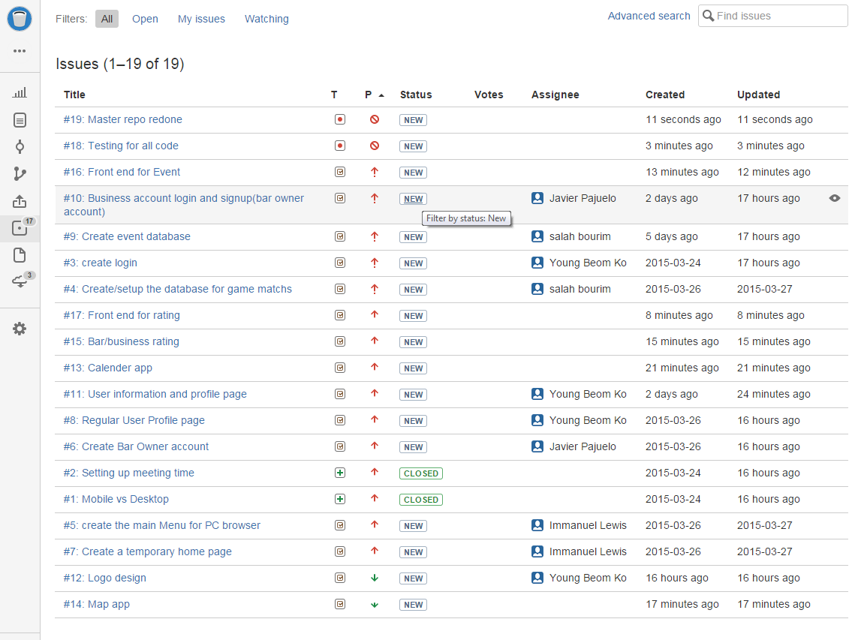
Master Repo Issue Tracker

Slide 18
Task at Work currently
Javier is currently working on Bar/Business owner account with event DB
Salah is working on Soccer match schedule DB
Lewis is working on Front end design
Young is working on Regular User login with User profile as well as re-managing the Master Repo

Slide 19
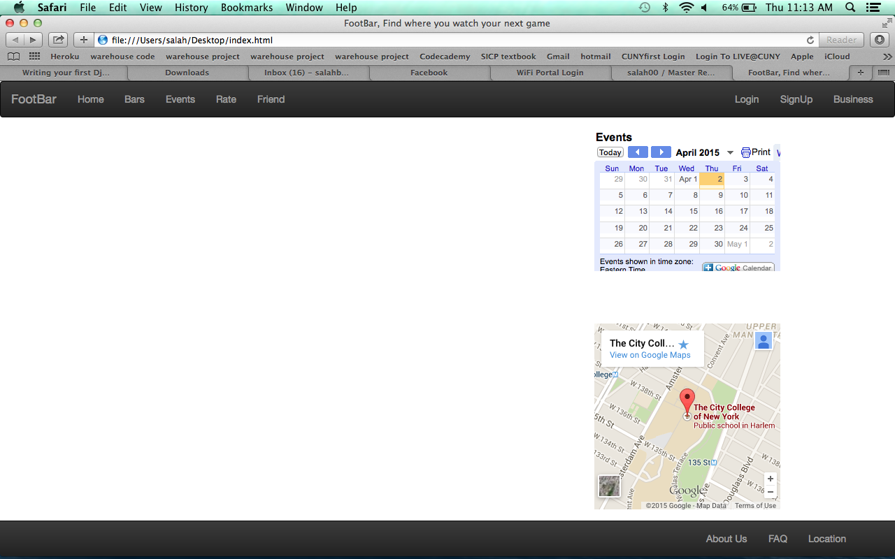
Old Home Page

Slide 20
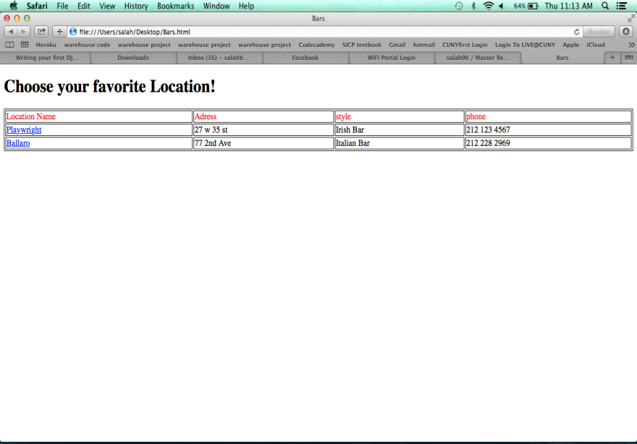
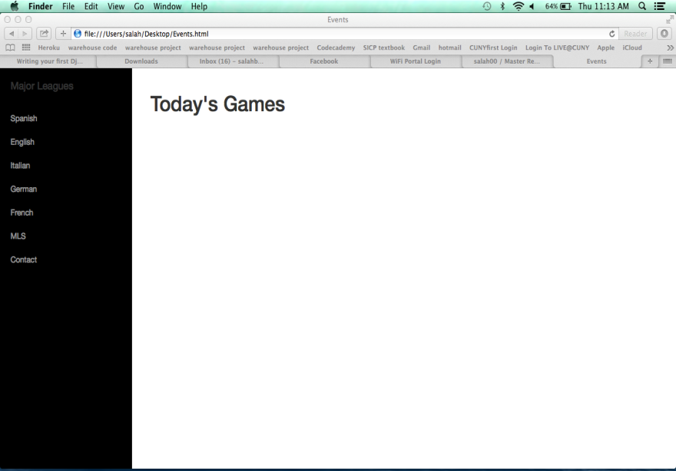
Current Work with Bar and Event
Bar
Event

Slide 21
Home Page by Lewis

Slide 22
Pylint Testing

Slide 23
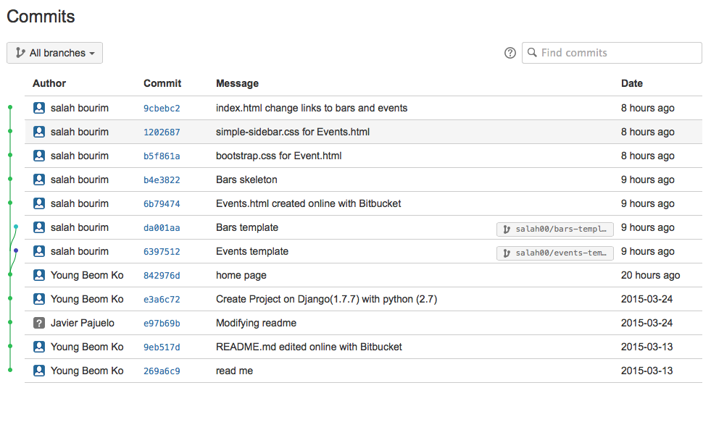
Commits

Slide 24
FootBar
Week 4
Scrum Master : Young Beom Ko
Project Owner: Salah Bourim(DROP)
Developer: Javier Pajuelo
Developer: Immanuel Lewis

Slide 25
Week 4: updates
Task assigned.
  Young:
    Regular User and Business User Login and registration.
    Regular User profile page
  Javier:
    Create a league Standing, and news for site
    Regular User Friend system and Subscription to busniess user
  Lewis:
    Front end design for main home page as well as layers to be used on all sites
    Event and game schedule db
    Business User rating system

Slide 26
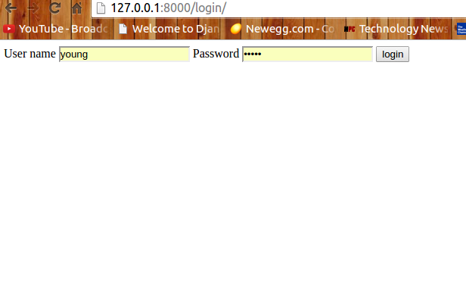
Login page

Slide 27
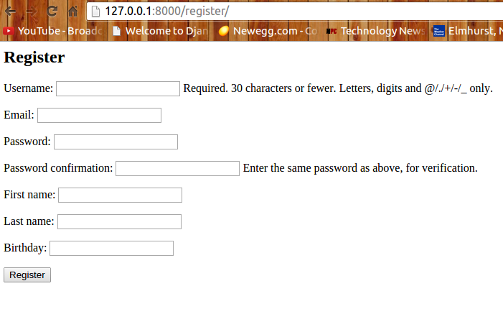
Regular Register

Slide 28
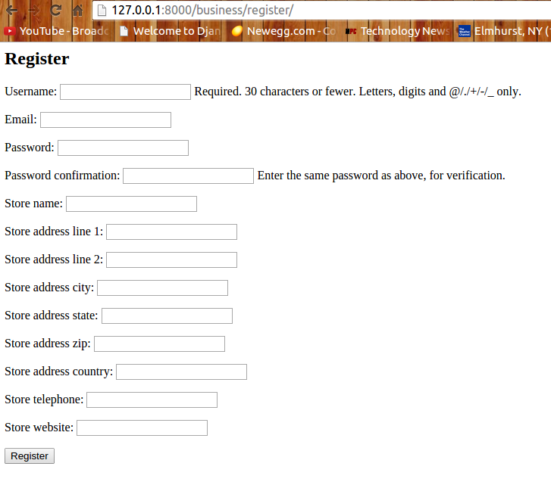
Business User Register

Slide 29
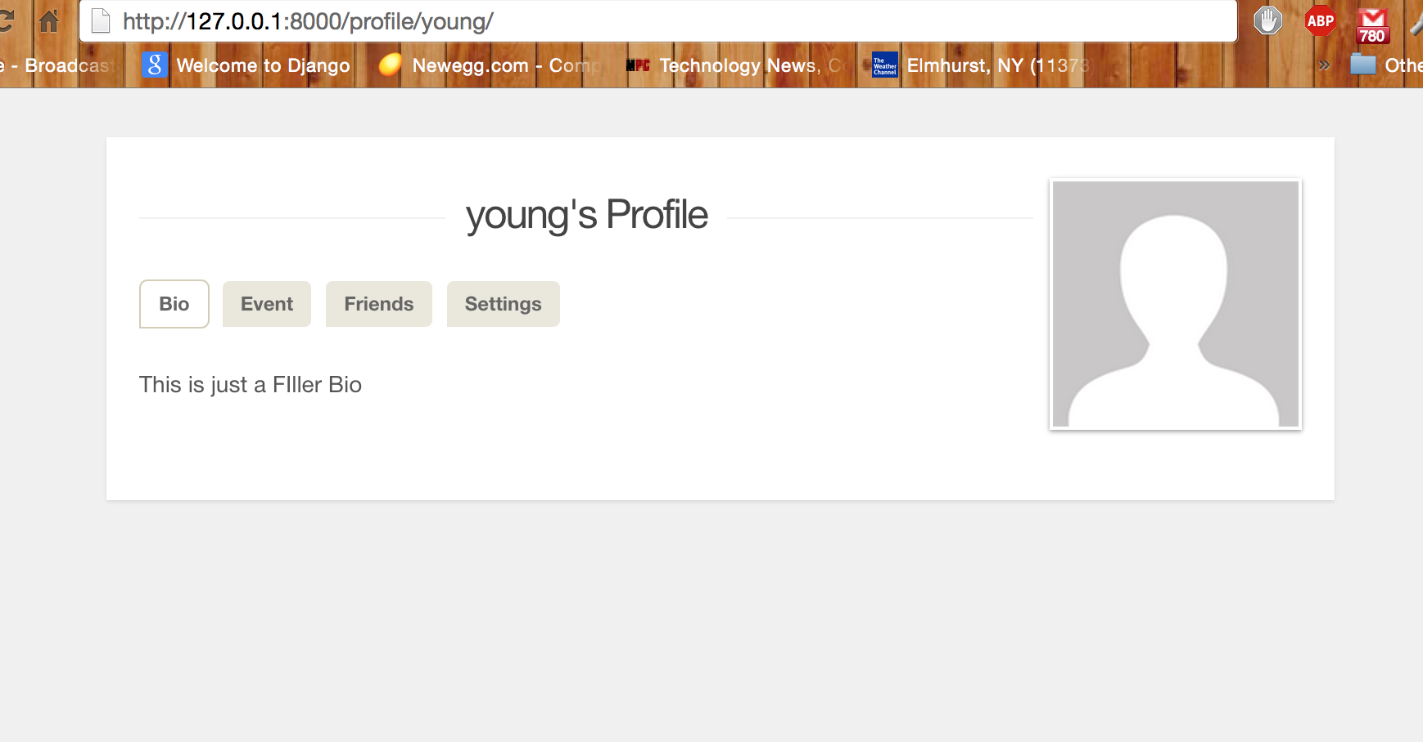
Regular User Profile Page

Slide 30
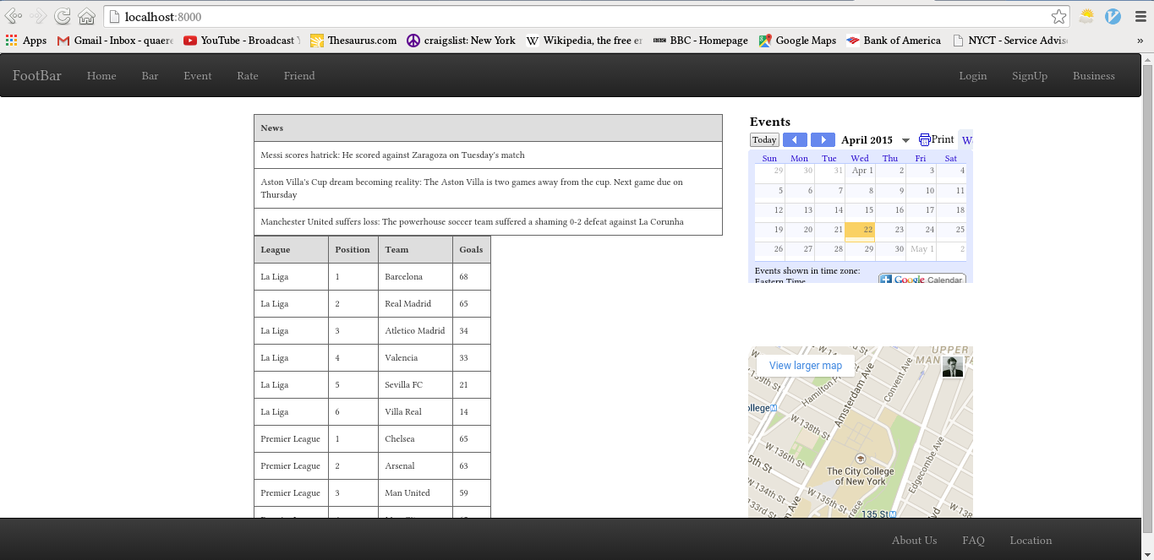
News and League Standing

Slide 31
Home Page by Lewis

Slide 32
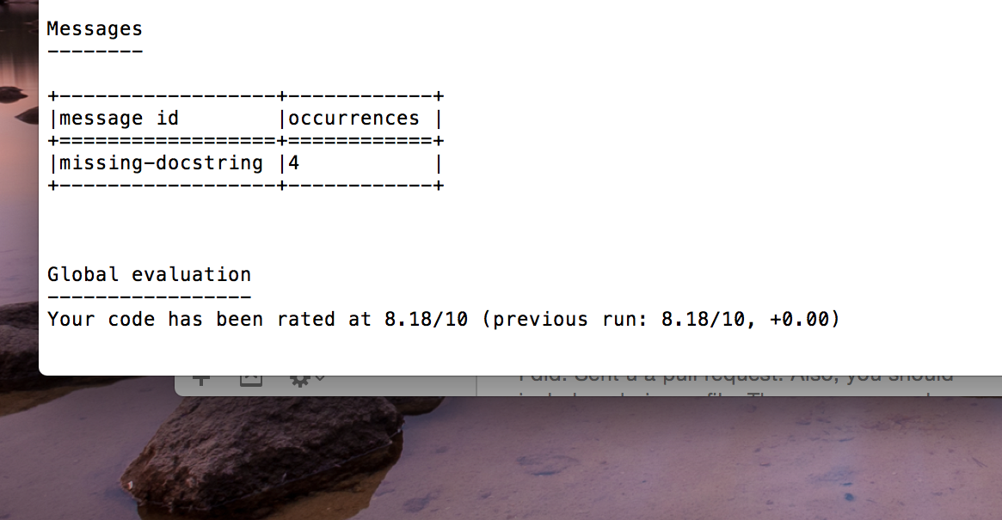
Pylint Score

Slide 33
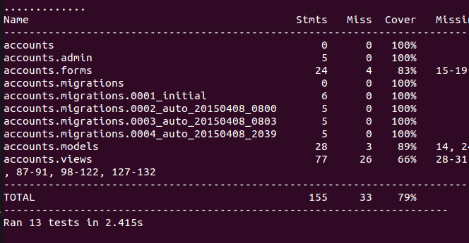
Test coverage

Slide 34
FootBar
Week 5
Scrum Master : Young Beom Ko
Project Owner: Salah Bourim(DROP)
Developer: Javier Pajuelo
Developer: Immanuel Lewis

Slide 35
Week 5: updates
Task assigned.
  Young:
    Regular User profile page
    Business User Profile page
  Javier:
    Facebook integration
  Lewis:
    Add way to for Business User to add new Events
    Rating system for the Bar Owners

Slide 36
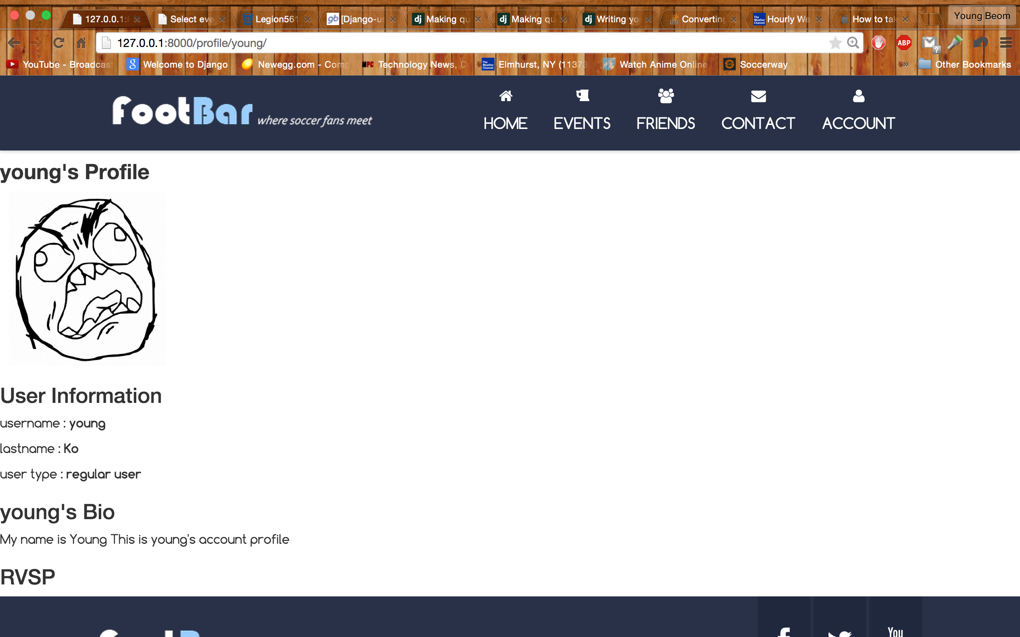
User Profile Page

Slide 37
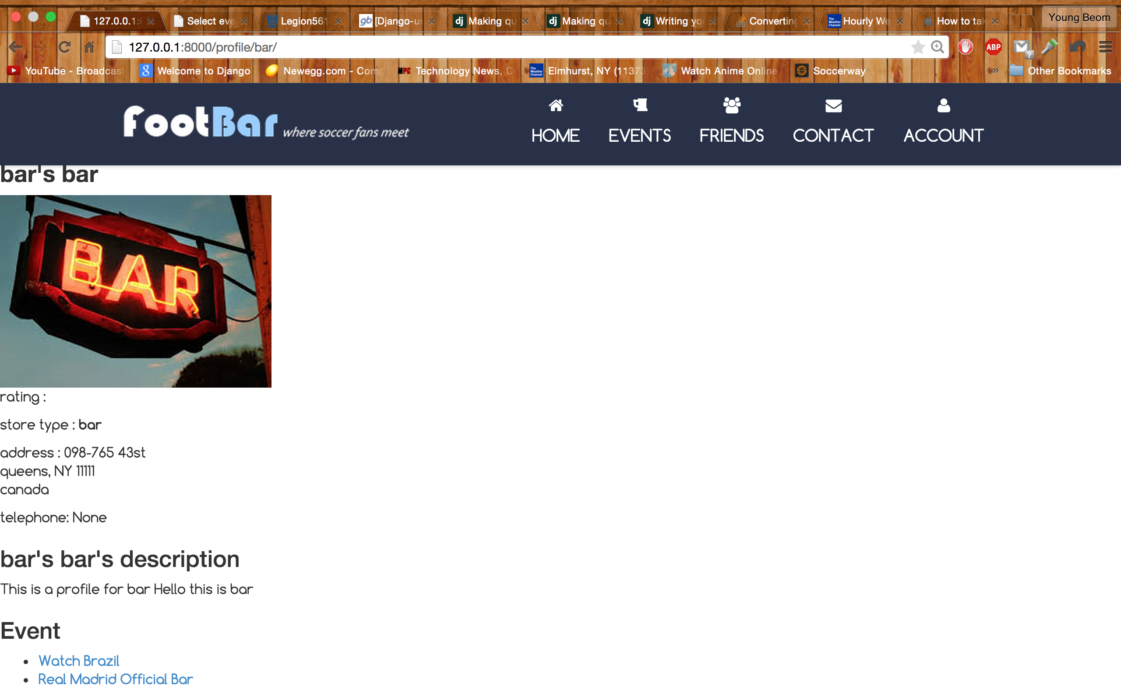
Business User Profile Page

Slide 38
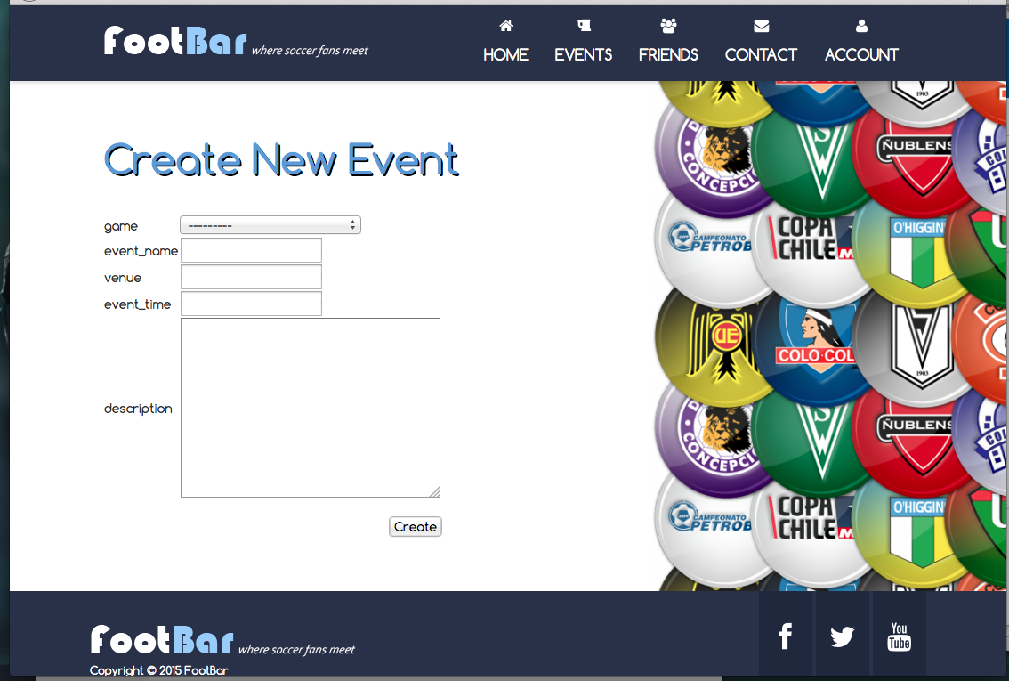
Event Creation

Slide 39
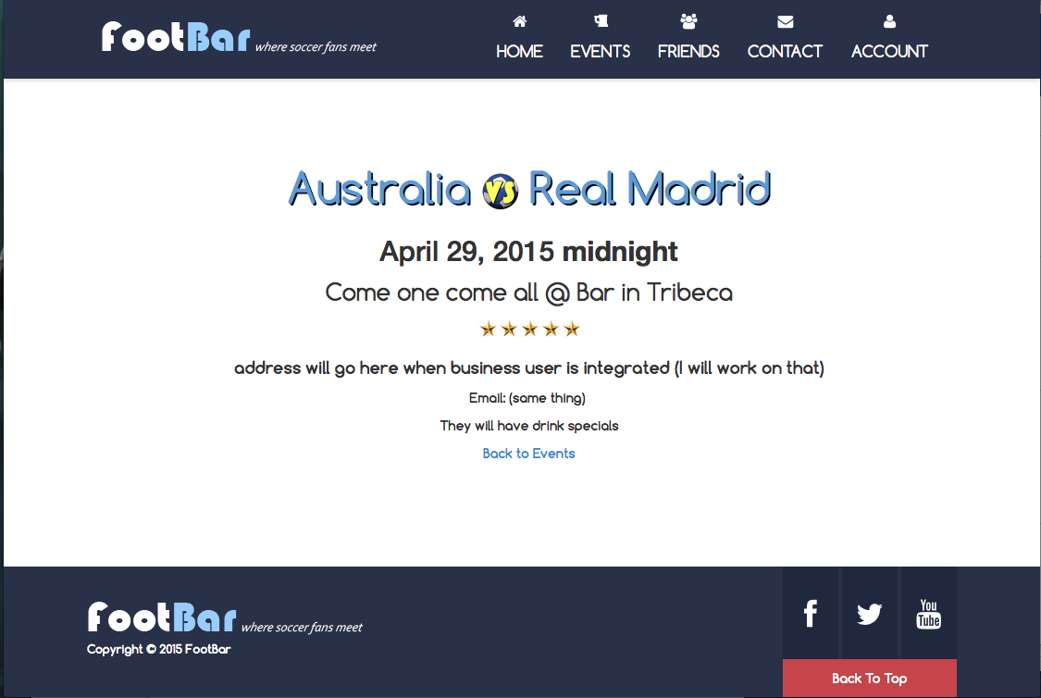
View Event

Slide 40
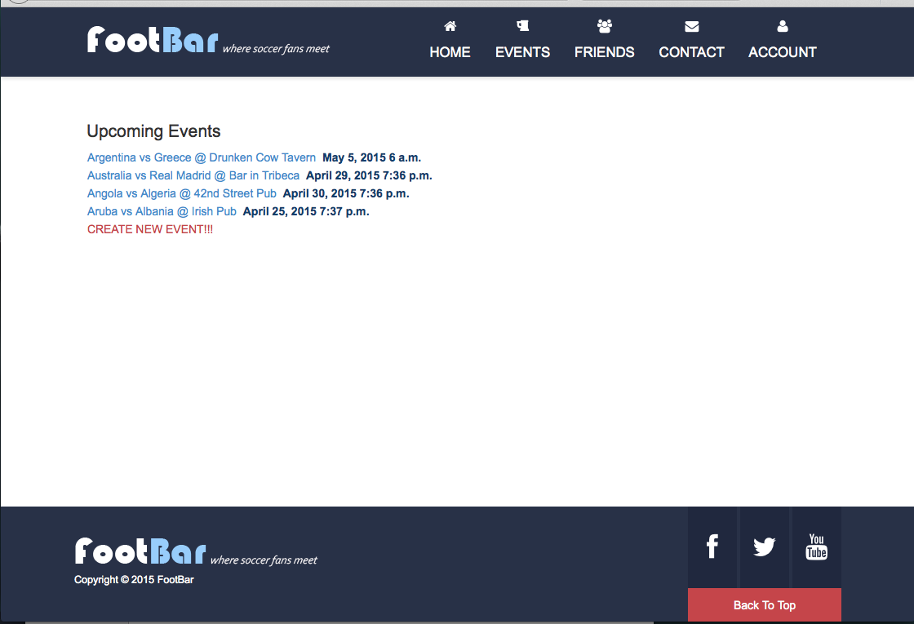
View Events

Slide 41
Test coverage

Slide 42
Pylint Testing

Slide 43
FootBar
Week 6
Scrum Master : Young Beom Ko
Project Owner: Salah Bourim(DROP)
Developer: Javier Pajuelo
Developer: Immanuel Lewis

Slide 44
Week 6: updates
Task assigned.
  Young:
    Regular User profile page
    Business User Profile page
  Javier:
    Facebook integration
  Lewis:
    Add way to for Business User to add new Events
    Rating system for the Bar Owners

Slide 45
User Profile Page

Slide 46
Business User Profile Page

Slide 47
Event Creation

Slide 48
View Event

Slide 49
View Events

Slide 50
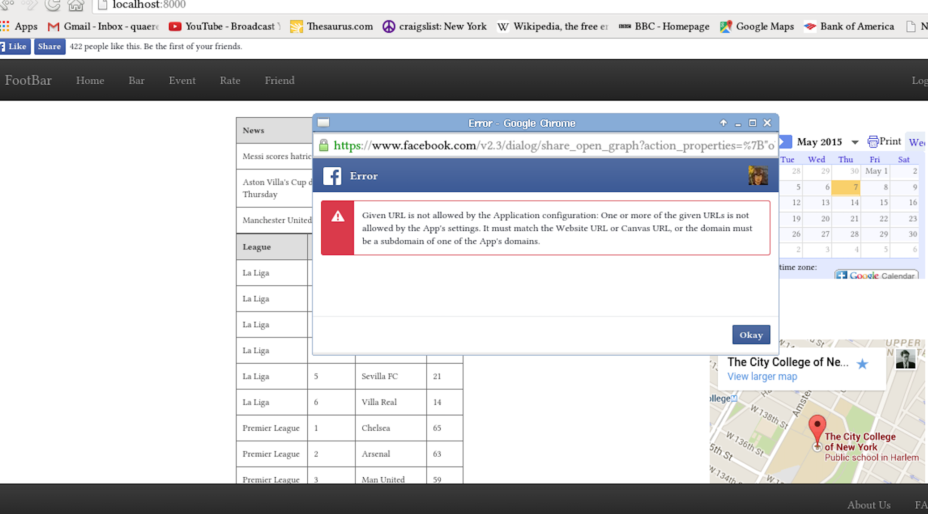
Facebook Feed

Slide 51
Test coverage

Slide 52
Pylint Testing

Slide 53
FootBar
Week 7 (final week)
Scrum Master : Young Beom Ko
Project Owner: Salah Bourim(DROP)
Developer: Javier Pajuelo
Developer: Immanuel Lewis

Slide 54
Week 6: updates
Task assigned.
  Young:
    Improve Pylint and Test coverage
    Integrate individual apps together
    Documentation
  Javier:
    Facebook integration
    Upload and make FootBar Live
  Lewis:
    Pylint score and improve Event features
    Work on visuals

Slide 55
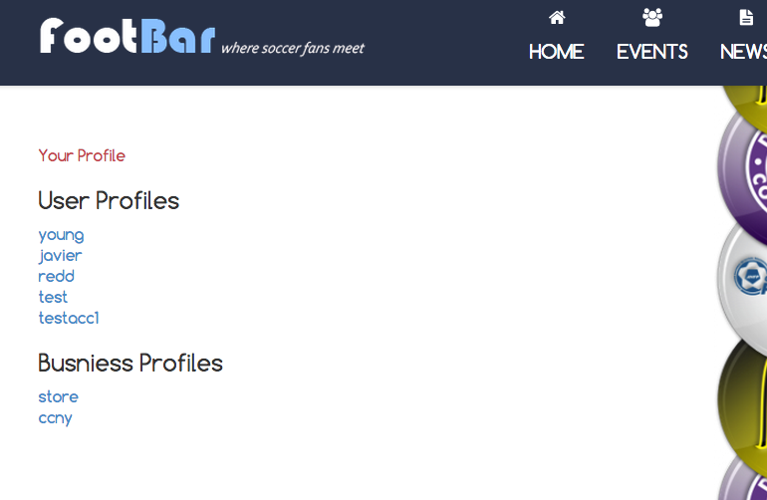
View all Profile Page

Slide 56
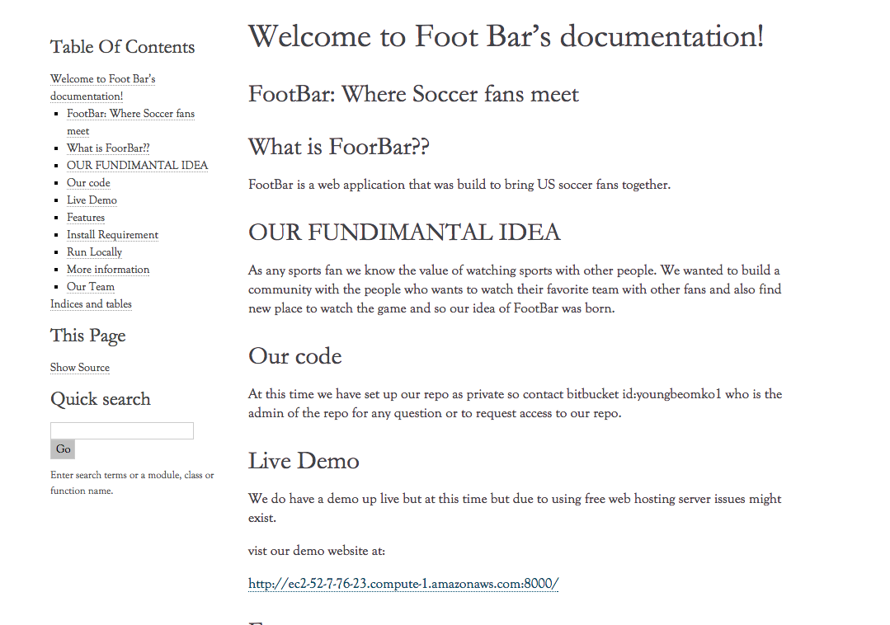
Sphinx Document

Slide 57
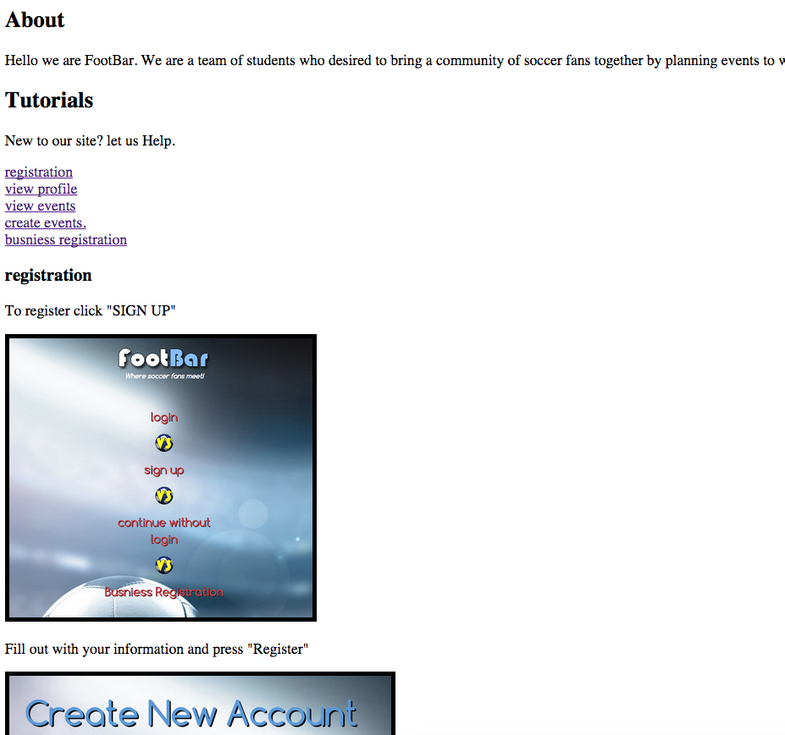
About/Tutorial

Slide 58
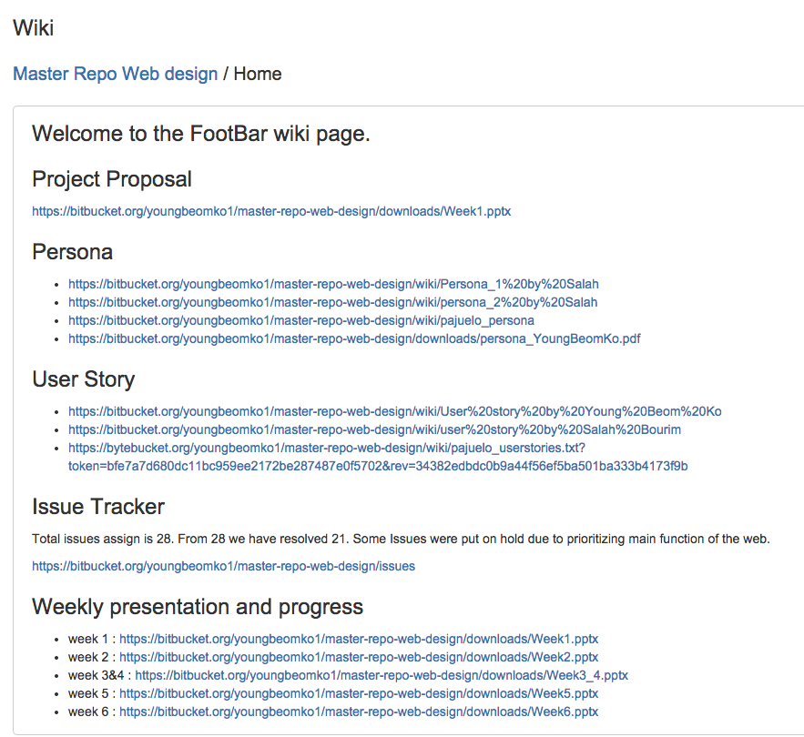
Wiki Document

Slide 59
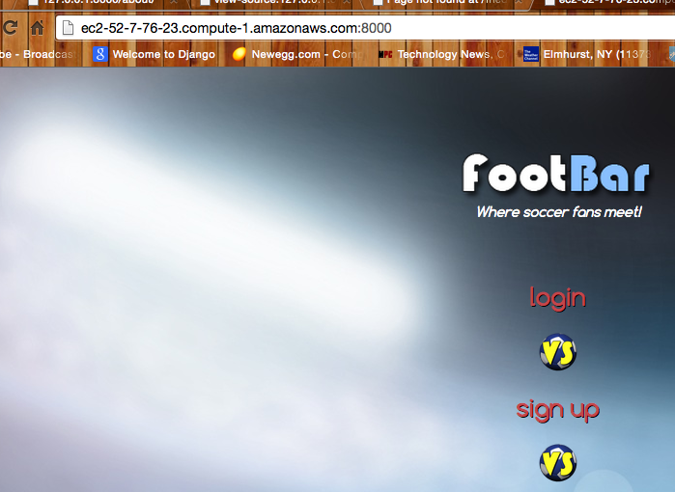
Live in Amazon Server

Slide 60
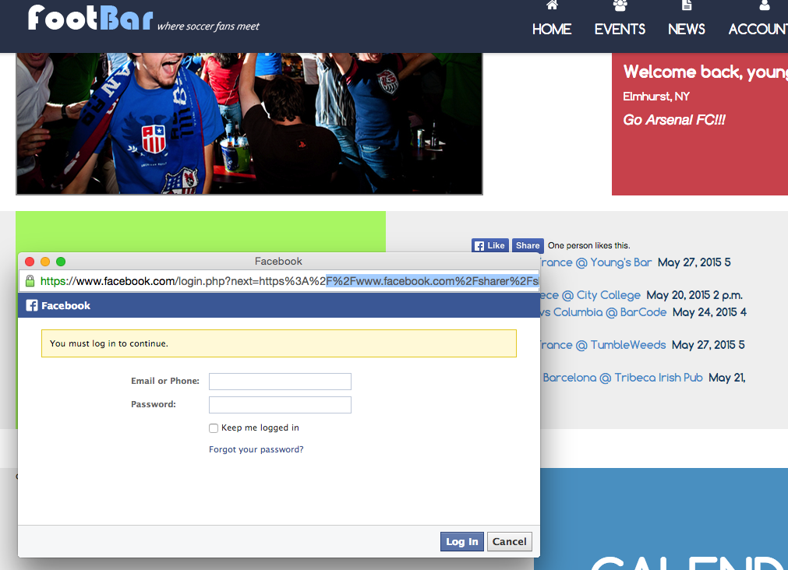
Facebook Integration

Slide 61
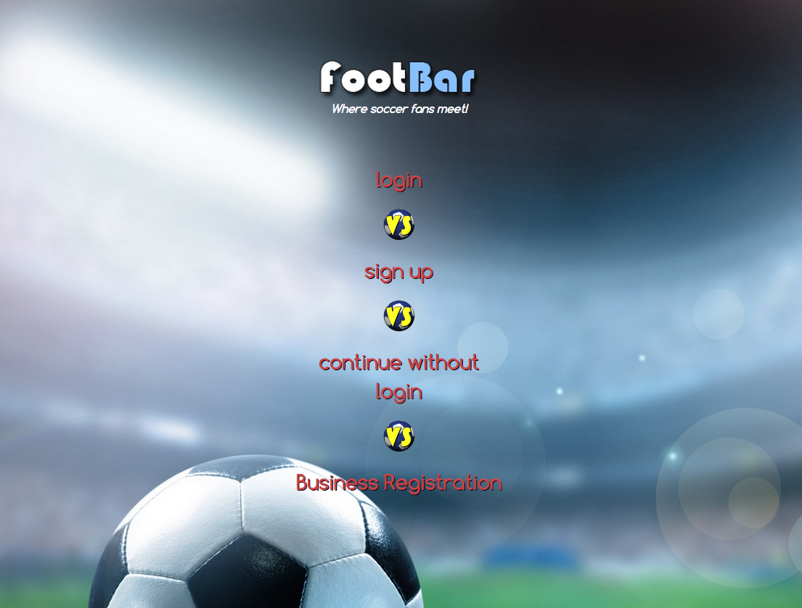
Improve visualization

Slide 62
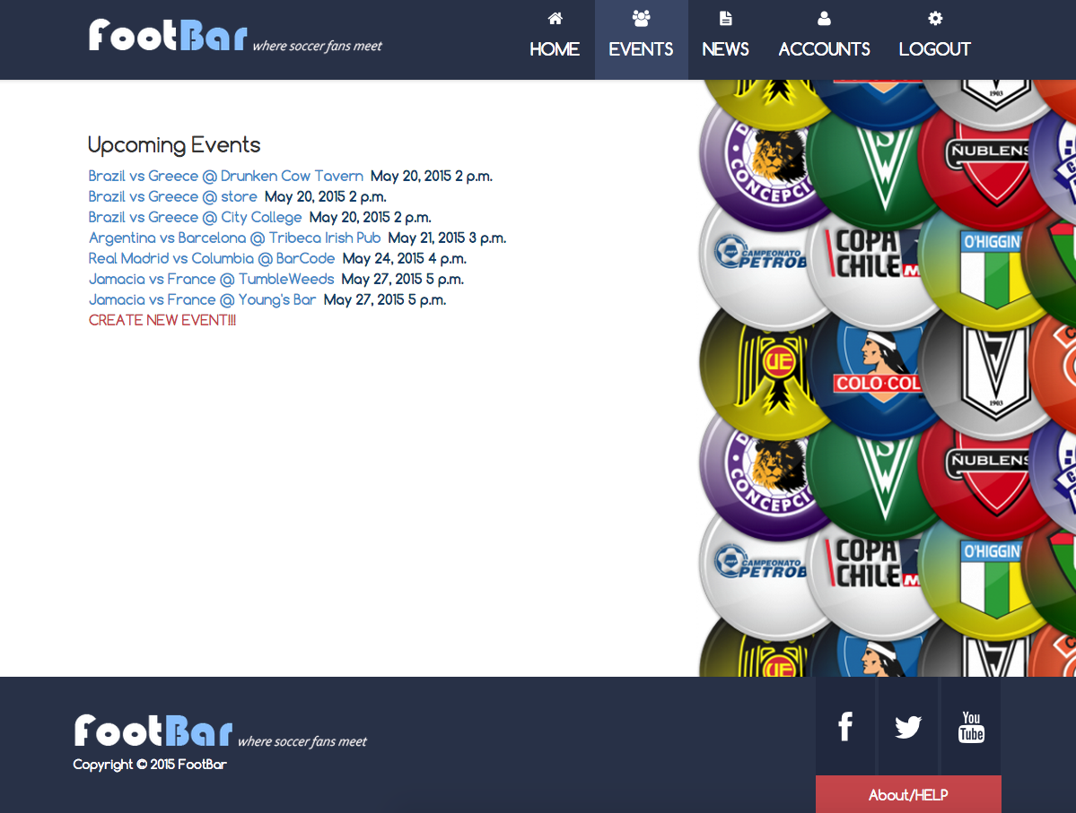
Improve visualization

Slide 63
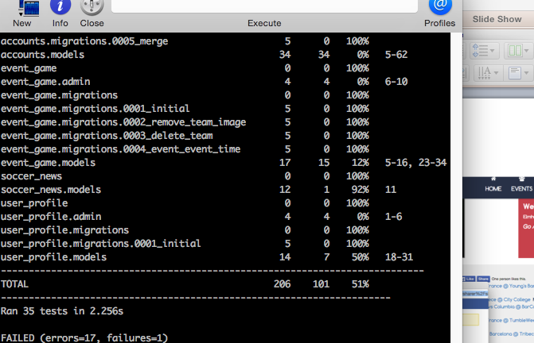
Test coverage

Slide 64
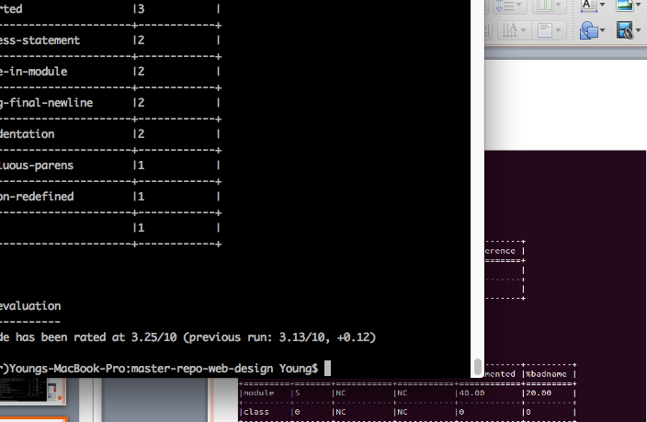
Pylint Testing

