Slide 1
Get Moving With Core Motion!
Jonathan Blocksom
Tuesday Sept 28 2010 2:00 – 3:15 PM
http://www.slideshare.net/jblocksom/core-motion-presentation

Slide 2
Agenda
Intro
SDK
Experiments
Q & A
Intro level, but lots of code

Slide 3
About Me
Jonathan Blocksom
blocksom@gollygee.com
augmentedjonathan.tumblr.com
@jblocksom
Computer Vision Software Engineer, SET Corp
Computer Graphics background
Several years working with Remote Sensing

Slide 4
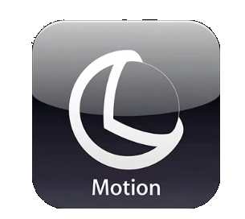
Meet Core Motion!
Core Motion Framework: High level interface to the orientation and movement data from the device
Based on Accelerometer and Gyroscopes
Acceleration, Gravity, Rotational Acceleration
High level filtering

Slide 5
Core Motion isn’t…
For GPS data
That’s Core Location (LocationManager)
For Compass data
Also Core Location
High Level Motion Events
Orientation change
Shake events
Perfect

Slide 6
Quick Demo
CoreMotionTeapot (WWDC 2010 sample code)

Slide 7
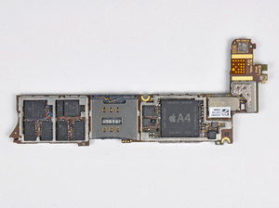
Accelerometer
Available since iPhone 1
Consider it a “Gravity Detector”
Noisy
iPad, iPhone 4: STMicro STM33DH 3-axis accelerometer
Photo by David Hodson http://www.ifixit.com/Guide/Image/meta/IP1qEpYFQSSqwSbg

Slide 8
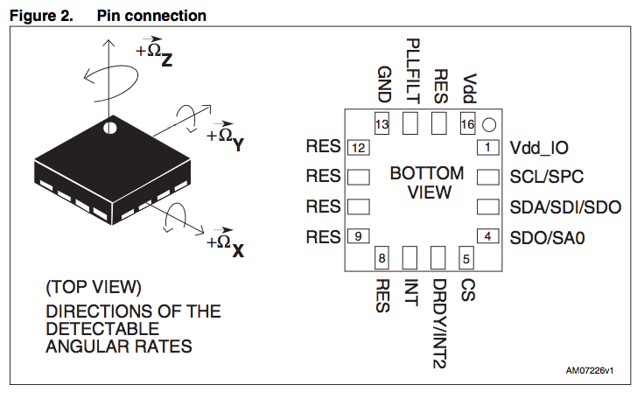
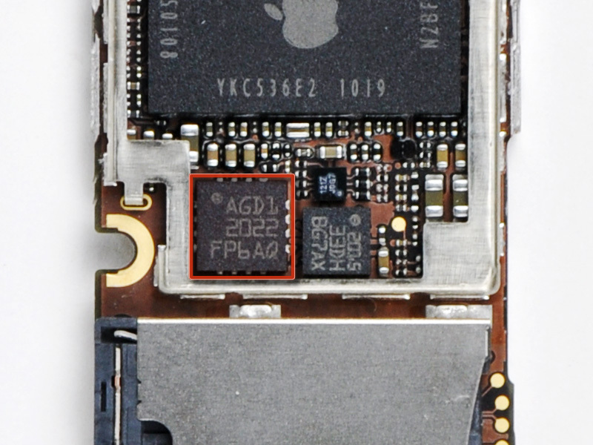
Gyroscopes
New in iPhone 4, iPod Touch 4
Detects rotation rate along three axis
Chip datasheet: http://www.st.com/stonline/products/literature/ds/17116.pdf
200/500/2500 dps (degrees per second)
0.03 dps error

Slide 9
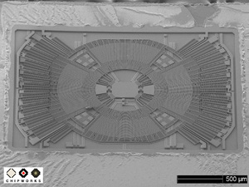
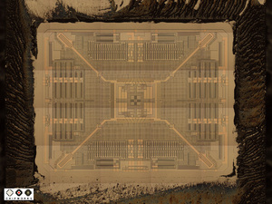
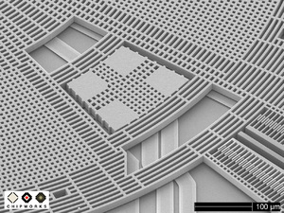
Gyro Teardown
http://www.ifixit.com/Teardown/iPhone-4-Gyroscope-Teardown/3156/1
Andrew Bookholt:
http://www.ifixit.com/Guide/Image/meta/UurGsklhtJRW2uuB (left)
http://www.ifixit.com/Guide/Image/meta/MeunHawo54qPRY5S (right 1)
Miroslav Djuric
http://www.ifixit.com/Guide/Image/meta/RUQLo2PP1oqVtVsD (right 2)

Slide 10
Accelerometer, Gyro & Device Motion
Accelerometer
Gyro
Device Motion
Gravity
User acceleration
Attitude
Rotation Rate
x, y, z
yaw, pitch, roll

Slide 11
Supported Devices
 | iPhone 1 | iPhone 3G | iPhone 3GS | iPhone 4 | iPod Touch | iPod Touch 4 | iPad
Accelerometer | Y | Y | Y | Y | Y | Y | Y
Gyros |  |  |  | Y
iOS 4 |  | Y | Y | Y |  | Y
Yay!
If we must…
No.
iPhone 4 iPod Touch 4
iPhone 3GS
iPod Touch
iPad w/ iOS 4
iPhone 1
iPad iOS 3.x

Slide 12
Classes
Class | Description
CMMotionManager | The Gateway
CMAccelerometerData | Acceleration data X, Y, and Z relative to device In G’s
CMAttitude | Orientation Roll, Pitch, Yaw Rotation Matrix Quaternion
CMDeviceMotion | Roll up of sensors Differentiates gravity from user acceleration
CMGyroData | Rotational Velocity
CMLogItem | Timestamped Measurement | Parent Class for measurements

Slide 13
CMMotionManager
Tells you what’s available
is<Acclerometer|DeviceMotion|Gyro>Available
Sets the update intervals
set<…>UpdateInterval
Starts and stops updates
start<…>Updates
start<…>UpdatesToQueue:withHandler:
stop<…>Updates
Lets you poll for updates
accelerometerData
gyroData
deviceMotion

Slide 14
CMMotionManager
CMMotionManager *mgr = [[CMMotionManager alloc] init];
Initializes reference frame at construction
Only make one of these for your app

Slide 15
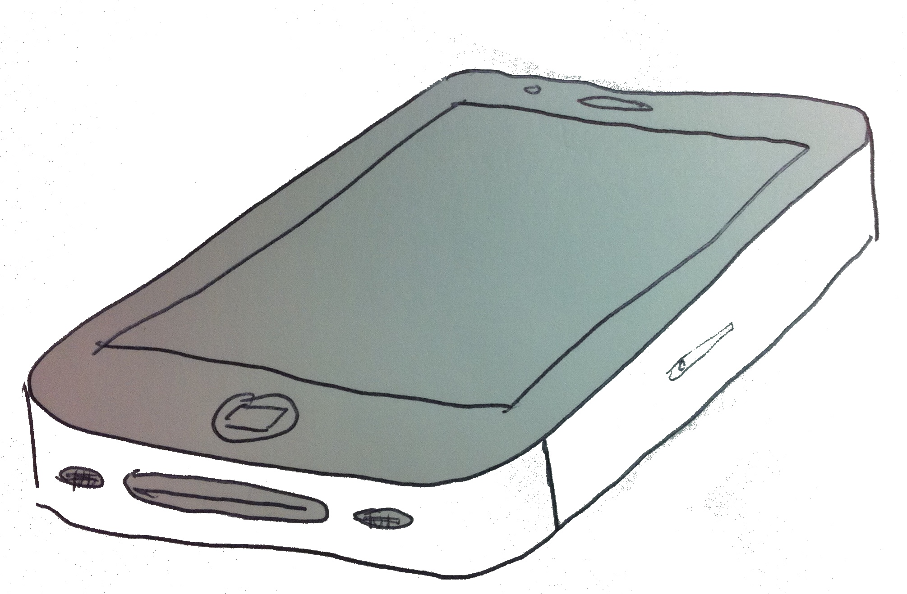
Core Motion Coordinate System Quick Reference
z
yaw
pitch
x
roll
y
Accelerometer
Gyroscopes

Slide 16
CMAccelerometerData
acceleration CMAcceleration struct: typedef struct { double x; double y; double z; } CMAcceleration;
Measured in G’s

Slide 17
CMGyroData
YAGNI
Gyro’s have bias; DeviceMotion fusion algorithms remove this
Get orientation from DeviceMotion instead

Slide 18
CMDeviceMotion
CMAttitude attitude
CMRotationRate rotationRate
CMAcceleration gravity
CMAcceleration userAcceleration

Slide 19
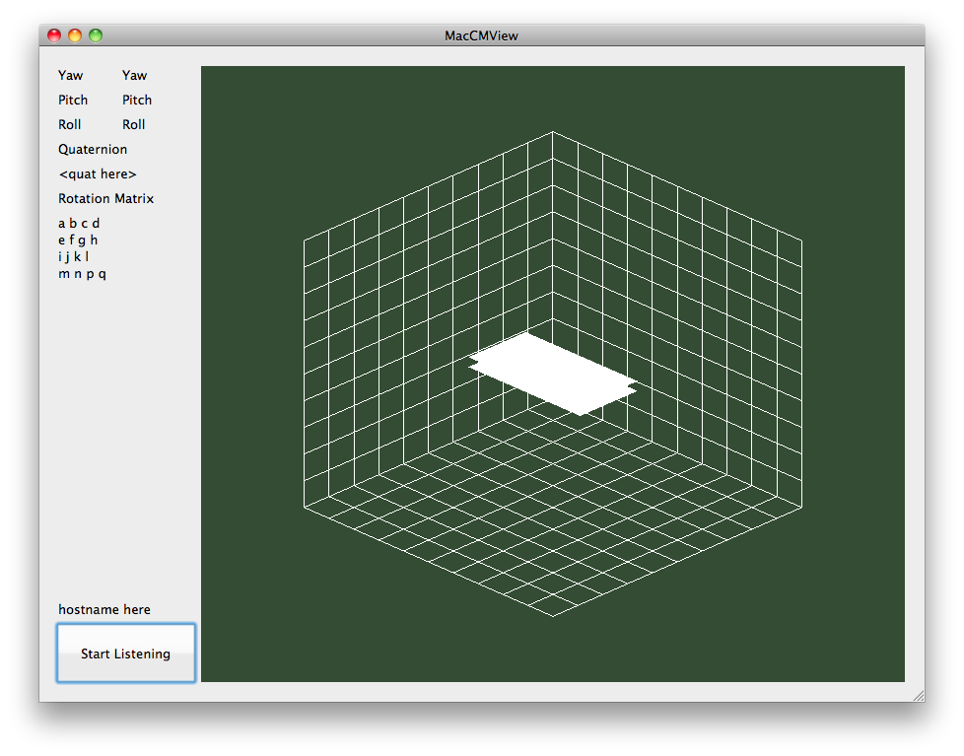
DEMO
MacCMViewer
CMIPViewer
Source code available: http://bitbucket.org/jblocksom/coremotionviewer

Slide 20
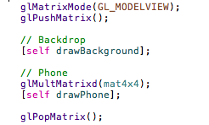
MacCMView: What’s Going On?
Mac opens socket; iPhone connects
iPhone sends CM updates to Mac
Mac uses rotation matrix for display
From CMAttitude

Slide 21
CMAttitude
Rotation as
Yaw, Pitch, Roll
Quaternion
Rotation Matrix
multiplyByInverseOfAttitude:

Slide 22
Why Quaternions?
Great technique for representing rotations
Mutiplying q1 and q2 is composing rotations
Can easily pull out axis / angle
Avoids “Gimbal Lock”
http://en.wikipedia.org/wiki/Quaternions_and_spatial_rotation is a pretty good treatment
Graphics Gems textbooks
Notes:
Wikipedia rant – great for Epipolar Geometry, terrible for Quaternions

Slide 23
multiplyByInverseOfAttitude:
Teapot Demo revisited

Slide 24
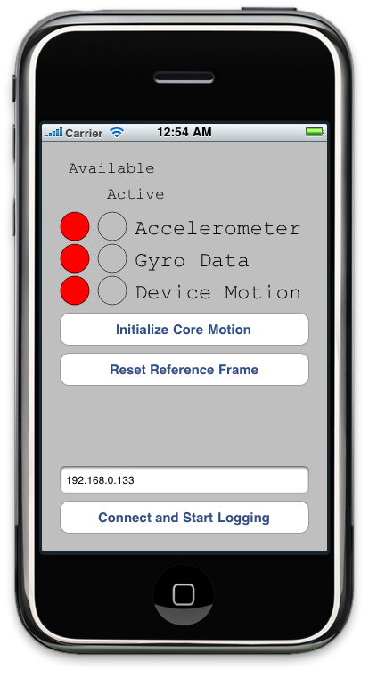
Core Motion in Simulator
Accelerometer: Not available
Gyros: Not available
Device Motion: Not available
Workaround thoughts…

Slide 25
Final Steps: App Requirements
Add UIRequiredDeviceCapabilities for accelerometer gyro
Not needed for orientation / shake events
See Event Handling Guide, “Setting Required Hardware Capabilities for Accelerometer and Gyroscope Events”

Slide 26
Experiments
iPhone 3GS vs iPhone 4
Intertial Navigator
Salad Spinner

Slide 27
Further Reading
Event Handling Guide for iPhone OS
Look under “Motion Events”
Section titled “Core Motion”
Core Motion framework reference
Sample Code
WWDC ’10: CoreMotionTeapot
iPhone Sensor Group?

