Slide 1
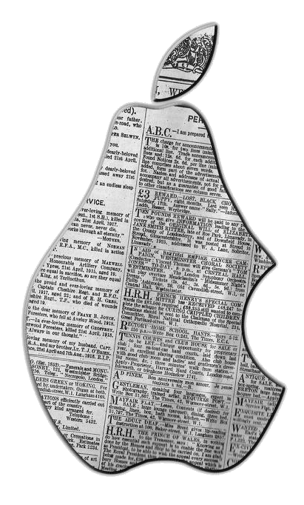
iNewsies
Gabriel McFann • Kyle Hart • Deep Bajwa
Client: Mr. Wilbert Ochoa
Advisor: Dr. John Anvik

Slide 2

Presentation Preview
Problem & Project Review
Testing
Use Cases
Quality Assurance
Software Design
Demonstration
Lessons Learned
A Newsie.

Slide 3
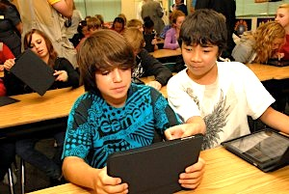
Real World Problem & Review
An iPad Application for young journalism students does not exist.
Create/Edit/Design an
E-Newspaper
Share/View Newspapers
App Named: Analect

Slide 4
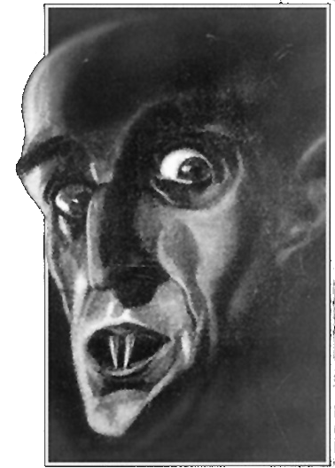
Stumbling Blocks
Network Dependency
Nuances of Objective-C
Geological location of client
Work load of other classes

Slide 5

Testing
Smoke Testing
  App runs ✓
  Login/Logout function works ✓
  App loads up on iPad2 and newer models ✓
  Navigate through pages ✓
  Main button works – save, open, home ✓
Acceptance Testing
  Core requirements are met ✓
  Regular communication with client ✓

Slide 6
Testing
Non-Functional Testing
  Compatibility testing – iPad2 and higher models ✓
  Security testing – SSL ✓
  Load testing ✓
  Installation testing ✓
Testing Plan
    User Testing
  On site testing – In progress

Slide 7

Use Cases
  Student Use Cases
  Login / logout ✓
  Create newspaper ✓
  Edit newspaper ✓
  Format newspaper ✓
  Save work ✓
  Navigate through pages ✓
  Add / remove images ✓
  Run a spell check ✓
  View other classmates pages
Admin Use Cases
  Login / logout ✓
  Add / remove students ✓
  Check recently submitted work ✓

Slide 8
Quality Assurance – UI Features
  iOS standards are met
  Easy of use – gesture based
  User Feedback
    Pop up messages
    Progress indicator
    Elegant look

Slide 9
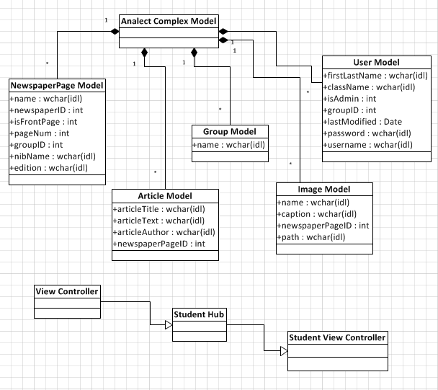
Software Design

Slide 10
Demo

Slide 11

Conclusion
Lessons Learned
Be more realistic with the requirements
Familiar language – faster development

Slide 12
Summary
Problem
  An app to create E-Newspapers
Status
  Functioning App but not robust
  Better communication with database
What’s Next
  Upload final build to App Store
  Finish testing
  Keep in contact with client for maintenance

