Slide 1
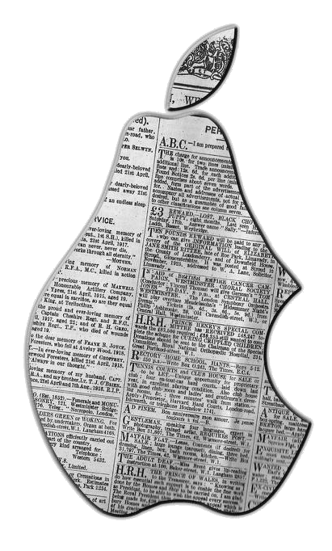
iNewsies
Gabriel McFann • Kyle Hart • Deep Bajwa
Client: Mr. Wilbert Ochoa
Advisor: Dr. John Anvik

Slide 2

Presentation Preview
Problem & Project review
Demonstration
Milestones
Database Implementation
Tools Currently using
Lessons Learned
A Newsie.

Slide 3
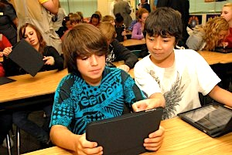
Real World Problem & Review
An iPad Application for young journalism students does not exist.
Create/Edit/Design an
E-Newspaper
Share/View Newspapers
App Named: Analect

Slide 4
Demo

Slide 5
Risks
Repo compatibility issues
Apple Dev Account issues
Communication with School District issues

Slide 6
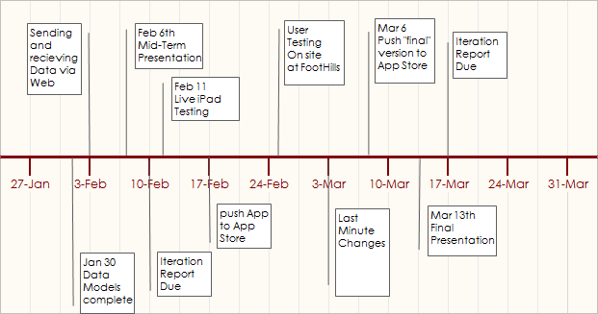
Schedule and Progress milestones

Slide 7

Software Development Tools
Visual Studio & MVC 4
Toad for SQL Server
SSL
Go Daddy

Slide 8
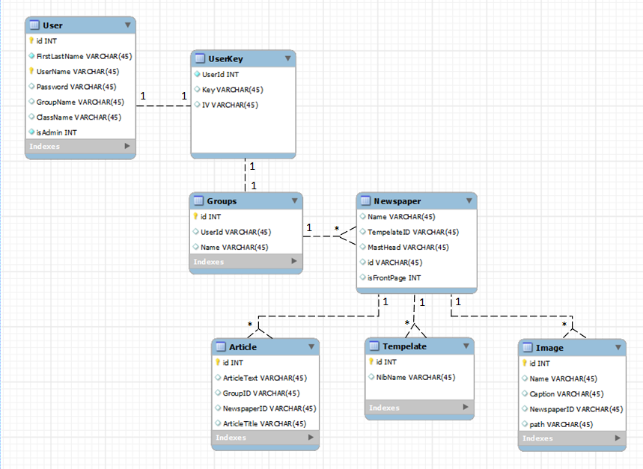
Database Implementation

Slide 9

Testing
Smoke Testing
White Hat
Acceptance testing – weekly with Client
User Testing

Slide 10
Conclusion
Lessons Learned
Database access: Web vs. Obj-C API
Working with a School District
Getting the App onto an iPad for Testing

Slide 11
Summary
Problem
  An app to create E-Newspapers
Status
  Semi-functioning App, minimal communication with database.
What’s Next
  Get App functional, Upload first build to App Store
  Onsite User Testing with Students

