Slide 1
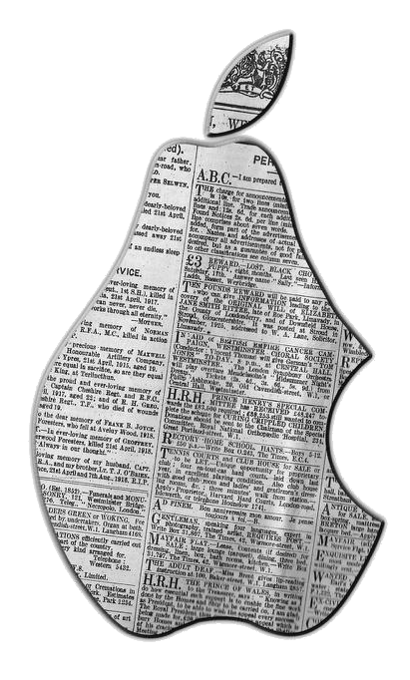
iNewsies
Gabriel McFann • Kyle Hart • Deep Bajwa
Client: Mr. Wilbert Ochoa
Advisor: Dr. John Anvik

Slide 2
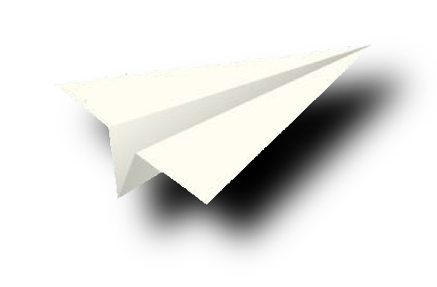
Presentation Preview
Problem
Project Overview
Risks
Project Requirements
High Level Design
Lessons Learned

Slide 3
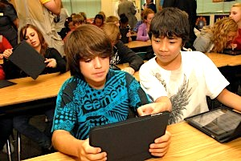
Real World Problem
An iPad Application for young journalism students does not exist.

Slide 4
Project Overview
Journalism iPad Application
The Stakeholder: Mr. Ochoa
Project Process - Agile

Slide 5
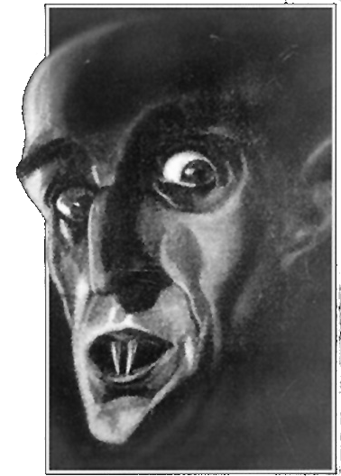
Risks
Client geographic location
Our App not compatible
with older iPad2
Loss of Data
Learning Objective-C

Slide 6

Software Development Tools
Jira
Mercurial
(Atlassian Source Tree)
Xcode
Design Tools – Microsoft Visio, Pencil, GIMP

Slide 7

Functional Requirements
Essentials:
Edit newspaper
Format the newspaper in different ways
Edit the text directly
Add photos
Desirables:
  Spell check work & dictionary
  Import audio and video
  Deadline notification of current assignments
  Access other classrooms' newspapers

Slide 8
Non-Functional Requirements
Interface is easy use
  Icons instead of labels
Secure
  Admin and Student accounts
Integration of Google Drive

Slide 9
High Level Design
Newspaper
View Collection
Views
Article Collection
Image Collection
Articles
Images

Slide 10
Testing
Unit Testing – XcTest
Integration testing – App & Database
Code Coverage – Gcov/Cover Story
Acceptance testing – weekly with Client
Installation test – iPad2
Usability Tests

Slide 11
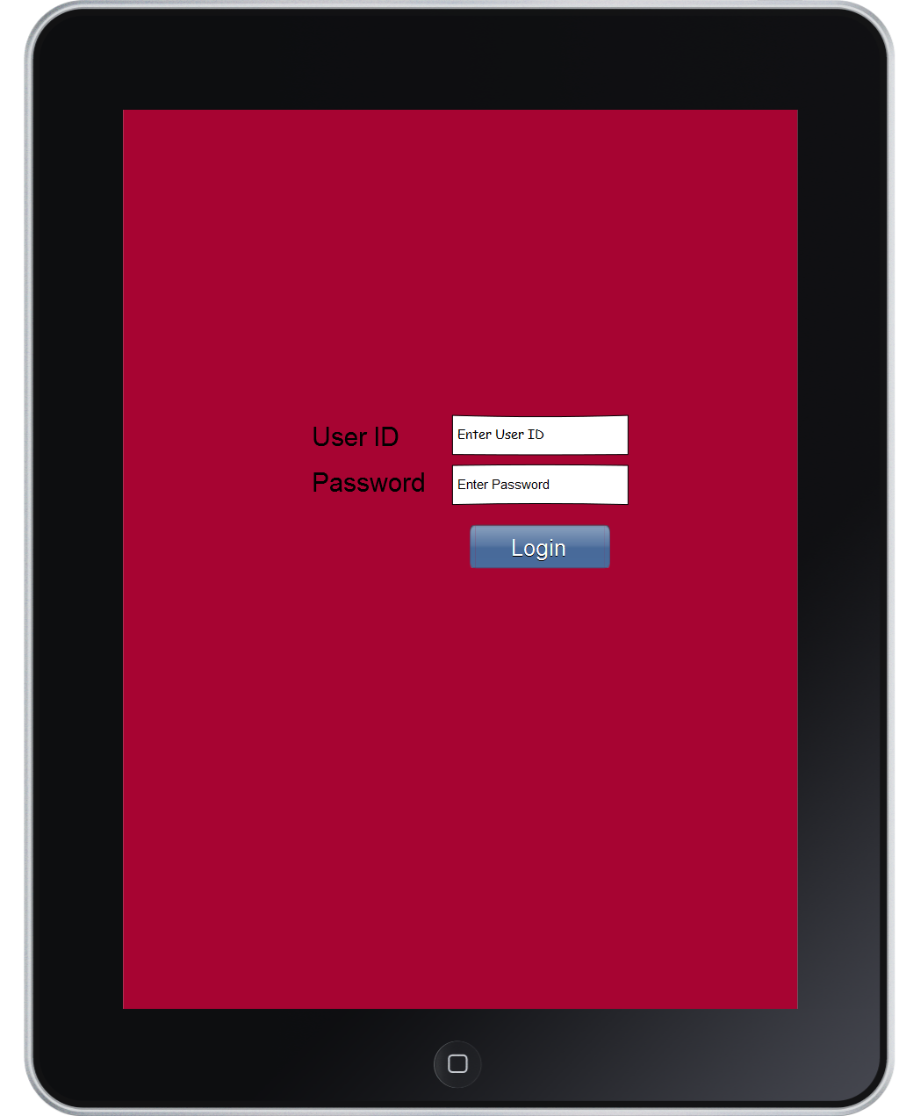
Paper Prototype

Slide 12
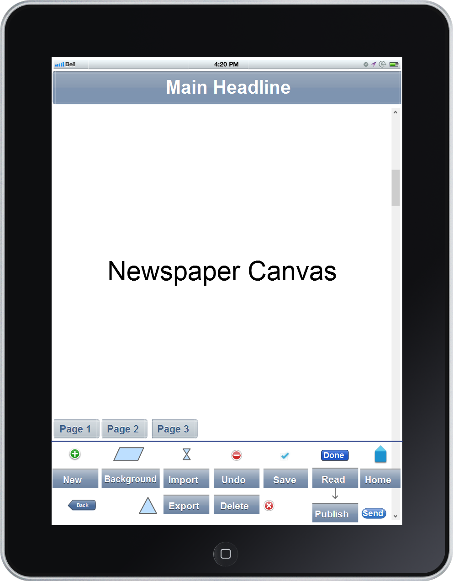
Paper Prototype

Slide 13
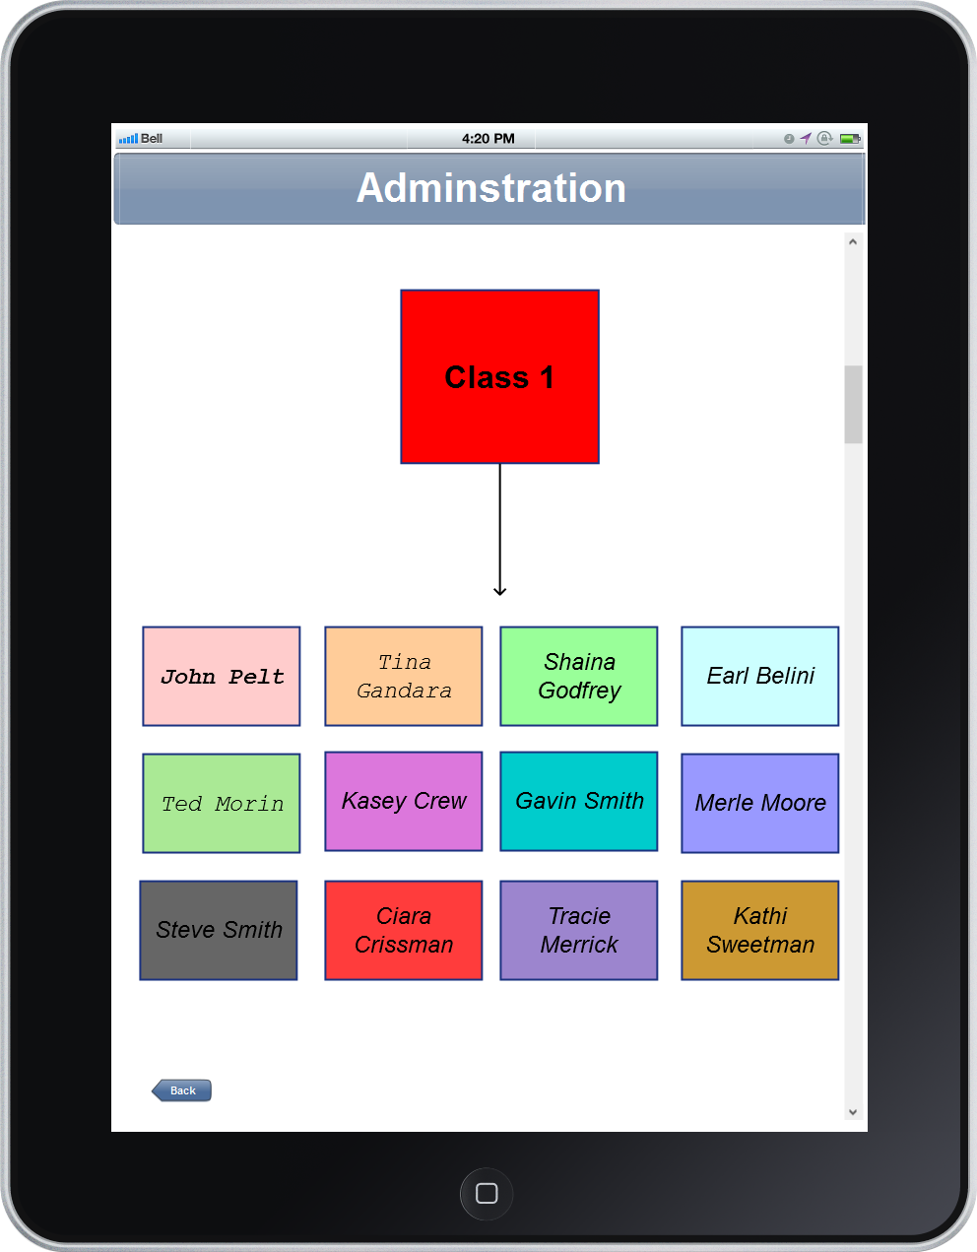
Paper Prototype

Slide 14
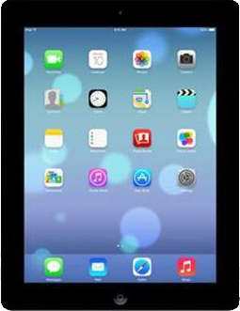
Live Use Case

Slide 15
Conclusion
Lessons Learned
Communication
Working with Macs

Slide 16
Summary
Problem
  A Journalism iPad App does not exist
Requirements
  Create and Edit a Full Newspaper
  App is Secure and Easy to use
Approach
An Agile process
Objective-C

