Slide 1
Facial re-recognition
Jared Beekman
Mentor: Dr. Paul Bender

Slide 2
Introduction
Technologies Employed
Graph Databases
Facial Recognition Algorithms
System Overview
System Implementation
Experiment and Results
Ethical Concerns
Future Work

Slide 3
Technologies Employed
OpenCV Computer Vision Library
C/C++/Java/Python/MATLAB
~2500 optimized algorithms
Designed originally by Intel and subsequently made open source
Hardware: Raspberry Pi 2.B
Python, Others dependent upon runtime necessity
Neo4j Graph Database, Py2neo Driver

Slide 4
Why a Graph Database
RDBMS, and traditional NoSQL, database are not good at handling… relationship models
Join tables add complexity
Monolithic and essentially unchangeable once past design stage
Slow when processing relationship style queries
Very large database end up requiring denormalization for speed
RDMS’s show exponential execution time for depth style searches
Neo4j has a shallow learning curve due to implementation of Cypher

Slide 5
Run Time Comparison
100,000,000 people with ~50 relationships on average
Relationship Depth | RDBMS exec time (s) | GDB exec time (s) | Records returned
2 | 0.016 | 0.01 | ~2500
3 | 30.267 (189,068.75 % inc) -> 2 | 0.168 (1,580 % inc) -> 2 | ~110,000 (4,300 % inc)
4 | 1543.505 (4,999.63 % inc) -> 3 (9,665,556.25 % inc) -> 2 | 1.359 (708.93 % inc) -> 3 (13,490 % inc) -> 2 | ~600,000 (445.45 % inc)
5 | Unfinished | 2.132 (56.88 % inc) -> 4 (1,169.05 % inc) -> 3 ( 21,220 % inc) -> 2 | ~800,000 (33.33 % inc)

Slide 6
Data Layout
Nodes
Person
Name
Image
Path
Id
File name
Decon
Path
id
Relationships/Edges
SOURCE_OF
DECON_OF *
SUBJECT_IN
USED_IN
* Back edges have been done away with as they are implied by CQL

Slide 7
Example of Cypher Query
MATCH (oim:Image:Original)-[*..2]->(face:Image:Decon:Subimage) RETURN oim.id as oim_id, face.id as face_id, face.path + face.fname as face_path

Slide 8
Data View

Slide 9
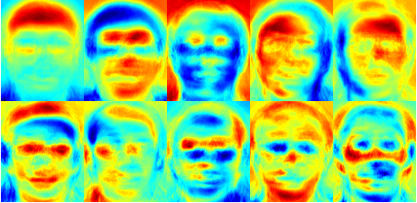
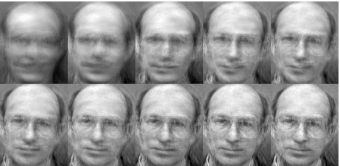
OpenCV Algorithms
Eigenfaces
Uses Principal Component Analysis (PCA) to deconstruct image
Principal components will carry most data
The components will be the Eigen matrix
For an MxN matrix with M > N guaranteed non-zero eigenvalues only for NxN
Light may provide some of the principal components

Slide 10
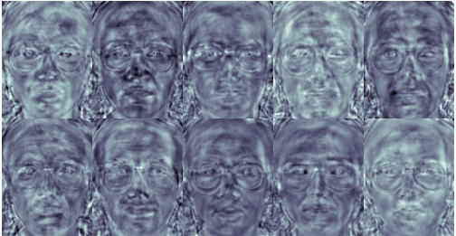
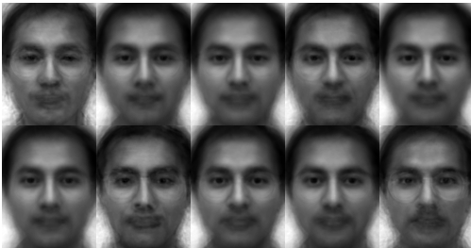
Opencv Algorithms
Fischer Faces
PCA components may not actually contain relevant data
Discriminant data may be lost in PCA
Uses Discriminant Analysis which maximizes the spread between classes
Tightens the intra class connections (like with like)
Very sensitive to quality of input data

Slide 11
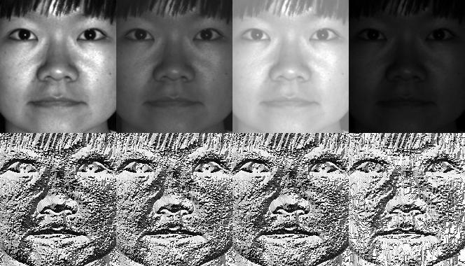
OpenCV Algorithms
Lesser Binary Patterns Histogram (LBPH)

Slide 12
System Overview
Using faked person data with real images from AT&T library
Calculate the three main image deconstructions from OpenCV library
Eigenfaces
Fischer Faces
Lesser Binary Pattern
Store person data and known deconstructions in graph database
Store remaining images in graph database
Execute program against orphaned images
Train against myself using large set of personal images from Lethal Arts’ work
Pray it works

Slide 13
Algorithm: Add Person to Database
Create Nodes
Person
Deconstruction
All images
Generate Resized Versions of Images
Execute two queries as opposed to N+1
Create, Train and Store Deconstructions

Slide 14
Algorithm: Pulling Faces From Group Photo

Slide 15
Algorithm: Search and Update

Slide 16
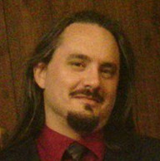
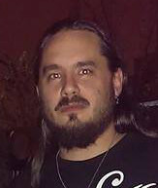
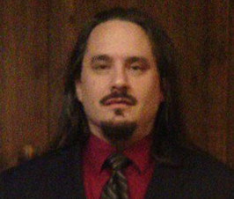
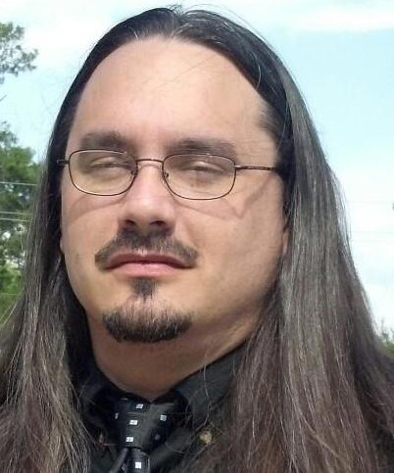
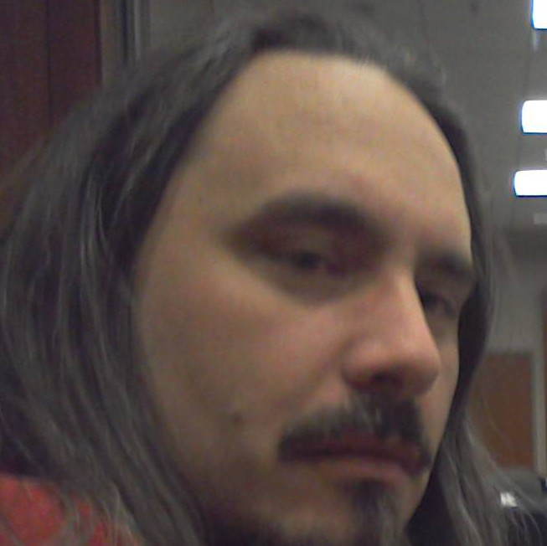
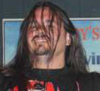
Experiment: Source Data: Me

Slide 17
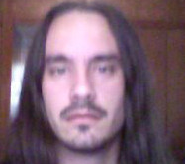
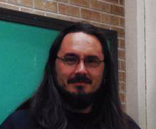
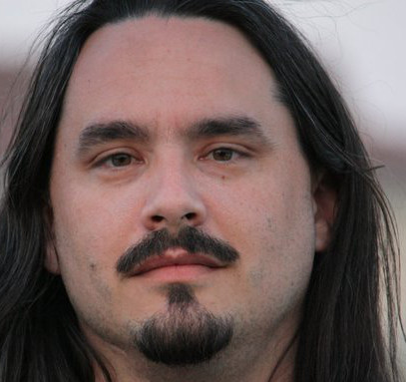
Experiment: Source Data: Me

Slide 18
Results: Person Add

Slide 19
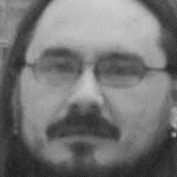
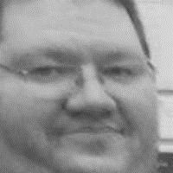
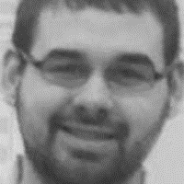
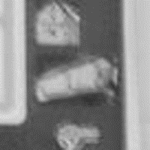
Experiment: Source Data: Testing

Slide 20
Results: Face Ripper

Slide 21
Results: Search
Eigenface Algorithm
LBPH Algorithm
Face ID | Confidence
6 | 10094.18
5 | 7479.20
4 | 8101.02
3 | 11148.14
Face ID | Confidence
6 | 258.71
5 | 222.14
4 | 191.19
3 | 272.27
3
4
5
6

Slide 22
Ethical Concerns
Data acquisition without permission or notification
Feature creep on properly acquired data
Allows anyone to collect this sort of data
Easily associated relationships
Particularly powerful when combined with augmented reality

Slide 23
Future Work
Redo totally in C++
Move away from embedded database to distributed client/server framework
Figure out how to properly perform analytics properly
Figure out a proper labeling system
Implement GUI system to tweak OpenCV algorithm parameters
Consider abandoning OpenCV, at least in part, for Sci Kit

Slide 24
Sources
Robinson, Ian and Jim Webber and Emil Eifrem. Graph Databases. Cambridge: O’Reilly, 2015. Pre-release, Web.
“Face Recognition with OpenCV.” Docs.OpenCV.org. OpenCV Documentation, 25 Feb. 2015. Web. 25 Apr. 2015.
Small, Nigel. “The Py2neo 2.0 Handbook.” Py2neo.org. Py2neo 2.0, 2014. Web. 27 Apr. 2015.
Neo4j Team. “The Neo4j Manual v2.2.1.” Neo4j.com. Neo Technology, 2015. Web. 27 Apr. 2015.
“Python Documentation contents (2.7.10 rc0).” Docs.Python.org. Python Software Foundation, 26 Apr. 2015. Web. 27 Apr. 2015.
“Getting Started with Neo4j.” Neo4j.com/GraphAcademy/. Neo Technology, 2015. Web. 10 Jan. 2015.
“Saving and Loading a FaceRecognizer.” Docs.OpenCV.org. OpenCV Documentation, 2014. Web. 25 Apr. 2015.
“Welcome to OpenCV Documentation!” Swarthmore.edu. OpenCV Dev Team, 14 Feb. 2015. Web. 25 Apr. 2015.

Slide 25
Computer Vision
$100

Slide 26
Computer Vision
Answers

