Slide 1
Containing IoT Sensor Telemetry
http://lect.europalab.com/dociotsen/
Samuel Cozannet, Canonical
Michael Schloh, Europalab

Slide 2
In this hour…
Dive into IoT
Added Value
Sensor telemetry
Actuator telecommand
Computing device nodes
Gateways and routing
Isolation and reliability
Transports and protocols
Maintenance reduction
Data management
SDP Workflows
Show and Tell
Embedded challenges
Computing node images
Research and develop
Deployment strategies
ARMHF image tour
Application layers
Sensory data flows
IoT service deployments

Slide 3
Dive Into IoT
Defining the Internet of Things

Slide 4
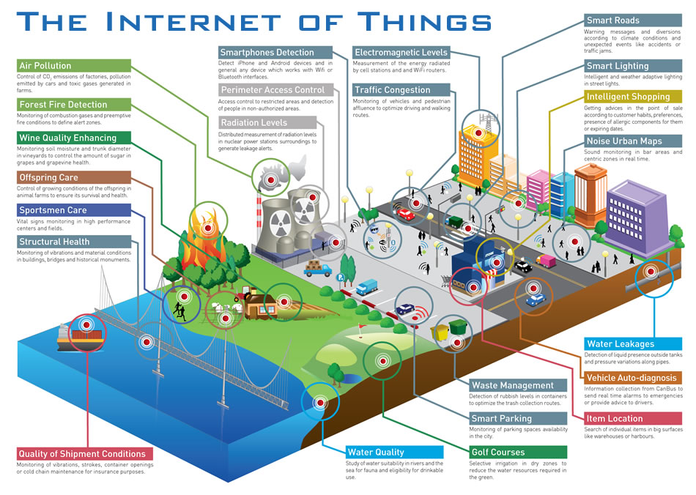
<number><number><number><number><number><number><number><number><number><number><number><number><number>

Slide 6
Sensor telemetry
Actuator telecommand
Computing device nodes
Gateways and routing

Slide 7
“Telemetry concerns remotely determining what a device senses, while telecommand directs a remote device to act”
—Michael Schloh von Bennewitz
<number><number><number><number><number><number><number><number><number><number><number><number><number>

Slide 8
Use Cases
Docker container roles in Internet of Things research and development

Slide 9
Release engineering
SDK and IDE deployment
Firmware infrastructure
Runtime management

Slide 10
Docker Container
IoT Network
IoT
R&D
Internet
of Things
Service
Docker Container
Internet
of Things
Service

Slide 11
New Workflows
Software Development Process departure from classic devops

Slide 12
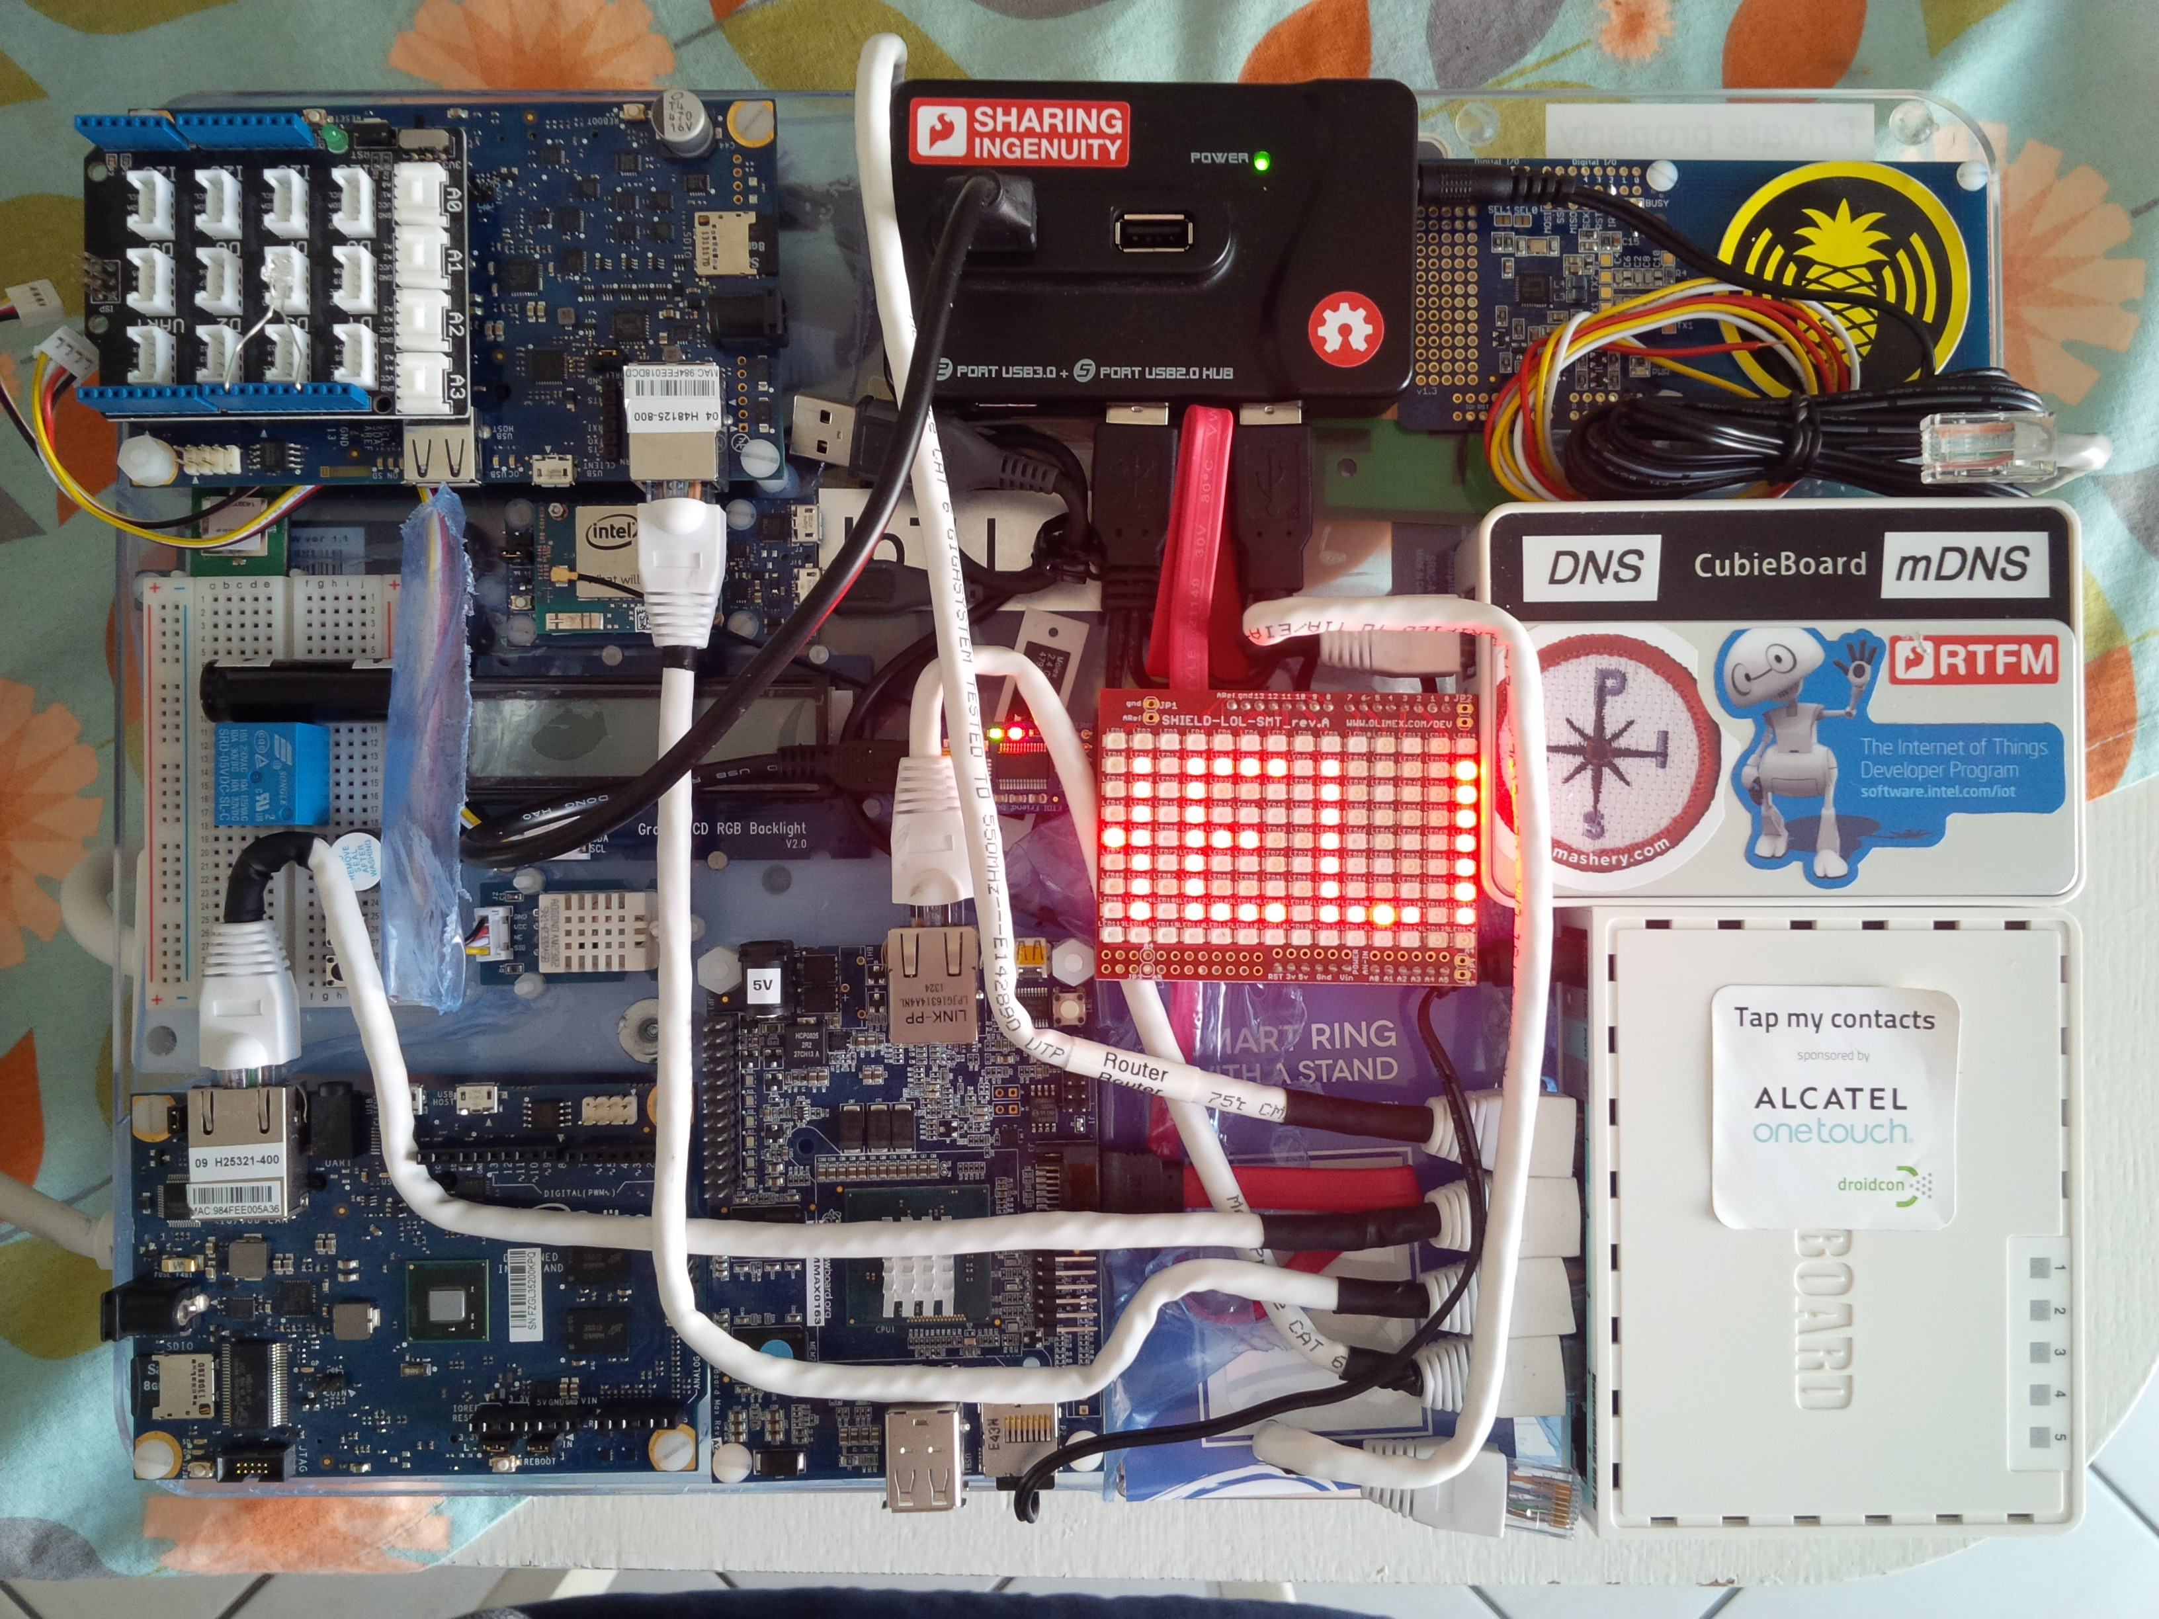

Slide 13
Embedded challenges
Computing node images
Research and develop
Deployment strategies

Slide 14
Adding Value
Smart engineering of ubiquitous systems in contrast to containers

Slide 15
Isolation and reliability
Transports and protocols
Maintenance reduction
Data management

Slide 16
$ docker pull msvb/armhf-iotempire
$ docker pull msvb/ia32-iotempire
$ docker run -t -i msvb/armhf-iotempire
-i: interactive stdin
-t: pseudo-tty stdin
Images are alpha tested
Sample image contents:
‣ MQTT ‣ AMQP ‣ LWM2M ‣ ZeroMQ

Slide 17
Show and Tell
Whirlwind tour of Docker assisted networks of cloudy sensor things

Slide 18
ARMHF image tour
Application layers
Sensory data flows
IoT service deployments

Slide 19
Front End
Human to Machine (H2M) interfaces

Slide 20
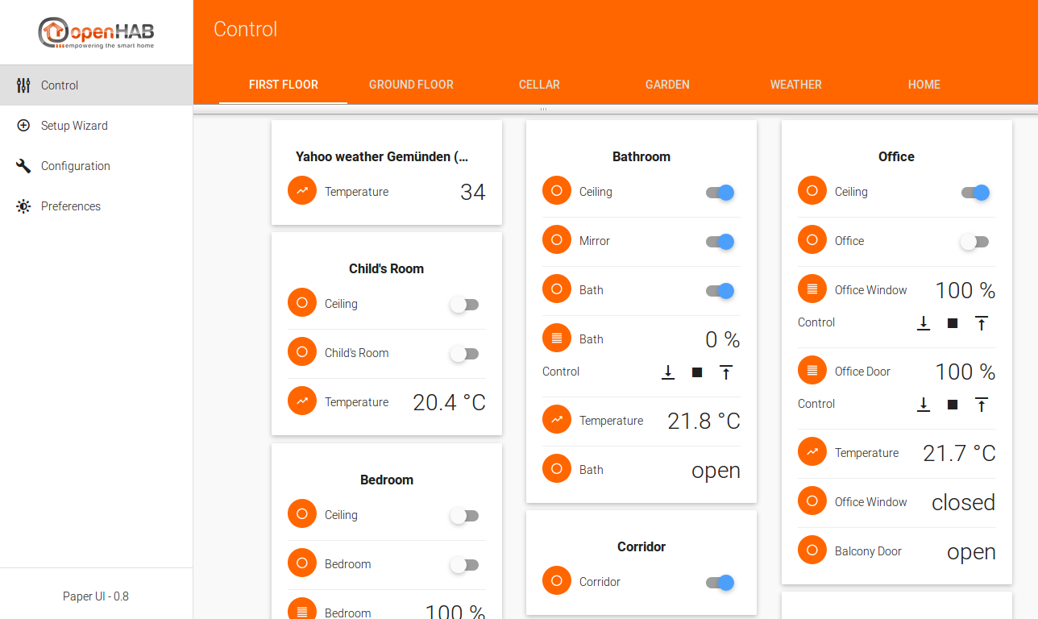

Slide 21
Back End
How to store & process all that data?

Slide 22
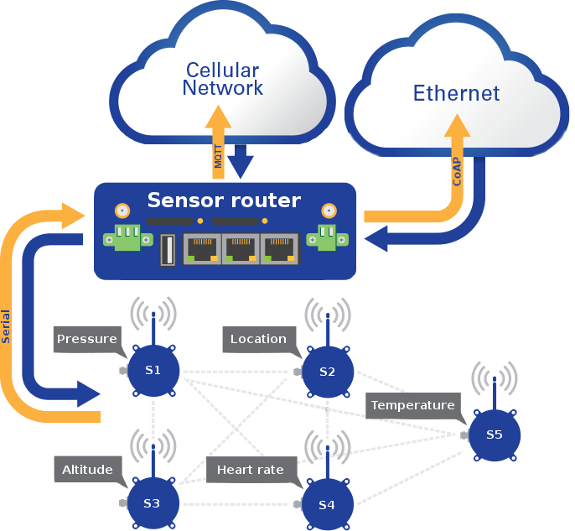
<number><number><number><number><number><number><number><number><number><number><number><number><number>

Slide 23
1 Million devices
1 tweet every 5 seconds
2.4PB / day

Slide 24
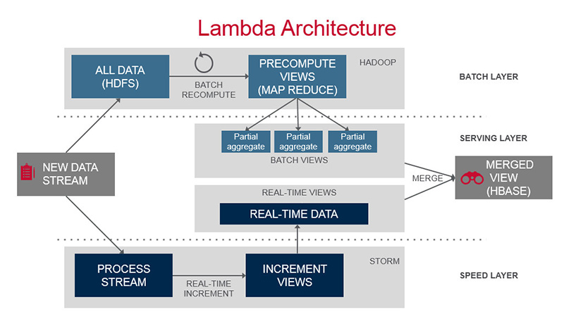
Source https://www.mapr.com
<number><number><number><number><number><number><number><number><number>

Slide 26
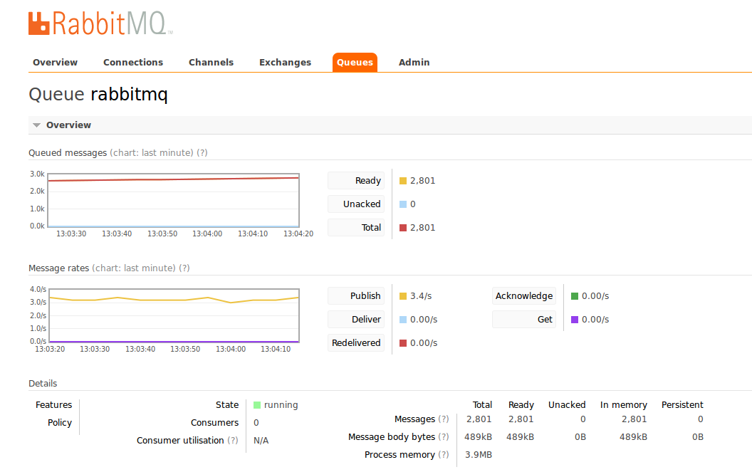

Slide 27
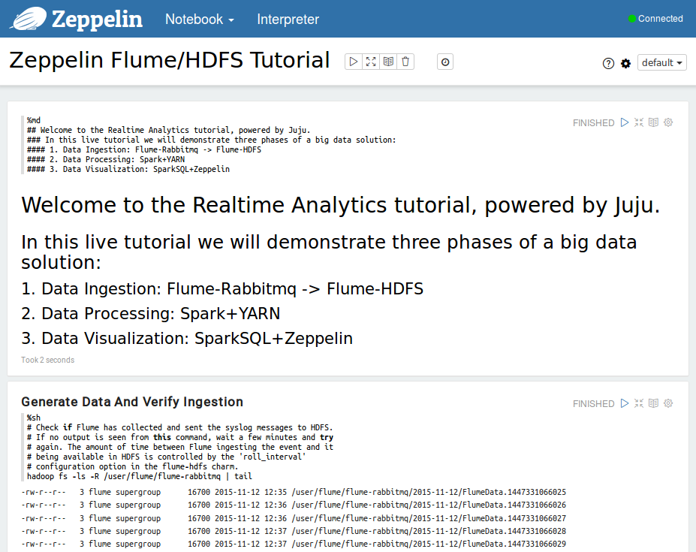

Slide 28
Thank you!
Michael Schloh
Von Bennewitz
Samuel Cozannet
samuel.cozannet@canonical.com
Canonical, Ltd.
michael@schloh.com
Europalab Networks
http://lect.europalab.com/dociotsen/

