Slide 1
Chapter 10
Testing
Copyright © 2014-2019 Dr. James D. Palmer; http://problemspace.neocities.com
This work is licensed under a Creative Commons Attribution-ShareAlike 4.0 International License.

Slide 2
Overview

Slide 3
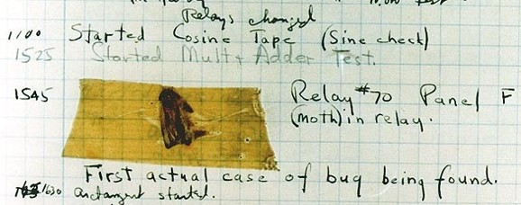
The First Computer Bug

Slide 4
Fail Early

Slide 5
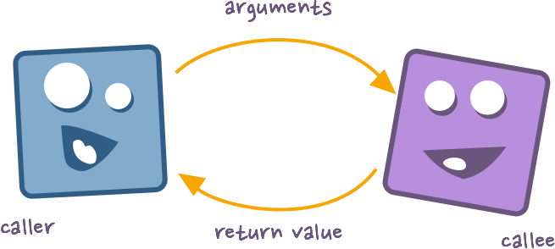
Contracts

Slide 6
Contracts
preconditions - relationships that must hold before a function is executed,
postconditions - relationships that must hold after a function is executed,
invariants - relationships that must hold while a function is executed.

Slide 7
Contracts

Slide 8
Contracts

Slide 9
Logging

Slide 10
Logging

Slide 11
Log Categories

Slide 12
Logging

Slide 13
Logging

Slide 14
Logging

Slide 15
Logging Output

Slide 16
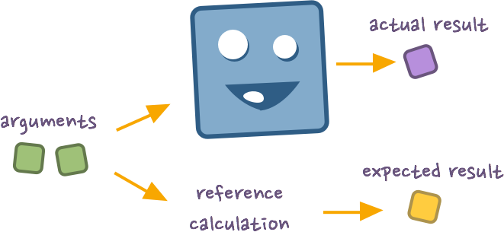
Unit Testing

Slide 17
Unit Testing

Slide 18
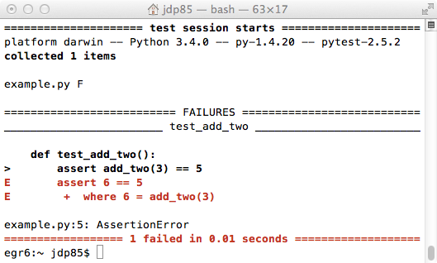
Unit Testing

Slide 19
Unit Testing

Slide 20
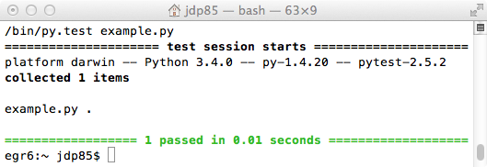
Unit Testing

Slide 21
Equivalence Classes
The equivalence classes we might consider for this code include:
even positive numbers
odd positive numbers
even negative numbers
odd negative numbers
zero

Slide 22
Equivalence Classes

Slide 23
Regression Testing

Slide 24
Test Driven Development

