Slide 1
Chapter 2
Getting Started with Python
Copyright © 2014-2019 Dr. James D. Palmer; http://problemspace.neocities.com
This work is licensed under a Creative Commons Attribution-ShareAlike 4.0 International License.

Slide 2
Overview

Slide 3
Why Python?
Python is simple
Python is easy to learn
Python is free
Python is a community
Python is a high-level language

Slide 4
Why Python?
Python is portable
Python is object-oriented
Python is extensible
Python is embeddable
Python is a batteries included language

Slide 5
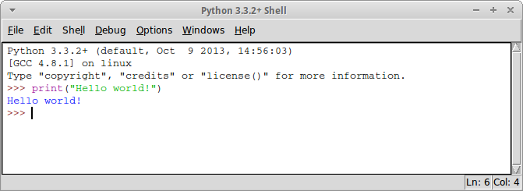
Hello World with Idle
Select File → New File from the menu.
Select the directory where you want to save the file and call it “hello.py”.
Select Run → Module from the menu.

Slide 6
Hello World with the Command Line
To run python in interactive mode type python and then return. If you have multiple Pythons installed you may need to type python3. Now you can type “Hello World!”

Slide 7
Hello World with the Command Line
If you have save your code in a file you can tell python to execute the code in the file. In this example I've put the instruction print(“Hello World!”) in a file called hello.py

Slide 8
Simple Input and Output

Slide 9
Simple Input and Output

Slide 10
Comments

Slide 11
Comments

Slide 12
Comments
Good comments document design decisions:
Good comments describe motivation:

Slide 13
Comments
Good comments give us context not obvious from the code:
Good comments give us context about the problem or our solution:

Slide 14
Comments
Bad comments state the obvious or don’t advance our understanding of the problem:
Good comments give us context about the problem or our solution:

Slide 15
Comments
Bad comments are outdated or incorrect:
Bad comments are overly terse or incomplete:
Consider this comment found in real code:

Slide 16
Comments
Bad comments are overly verbose or don’t get to the point:

