Slide 1

Chapter 1
Computational Problem Solving
Copyright © 2014-2019 Dr. James D. Palmer; http://problemspace.neocities.com
This work is licensed under a Creative Commons Attribution-ShareAlike 4.0 International License.

Slide 2
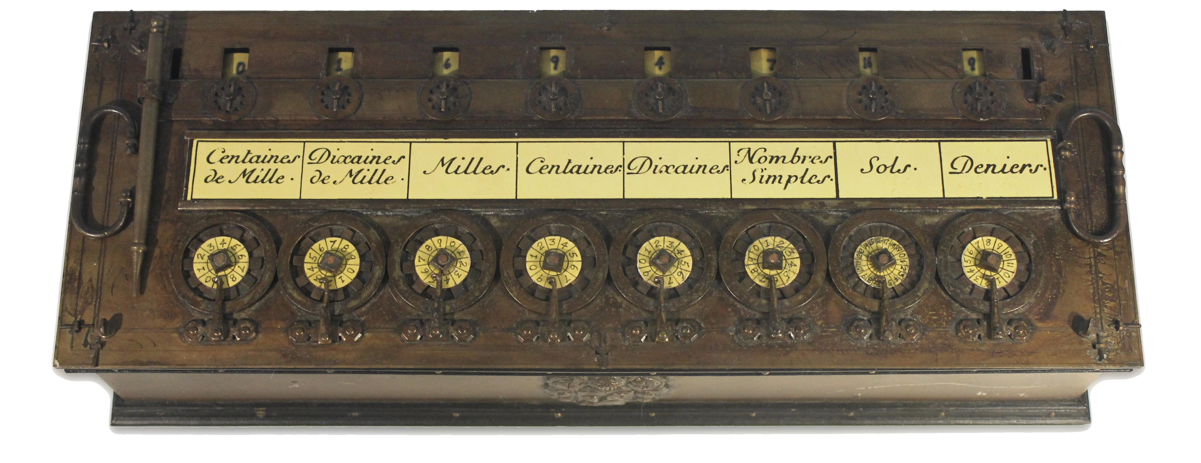
The Origins of Computation
A Pascaline calculator adds numbers using dials, gears, and other mechanical structures.

Slide 3
The Origins of Computation
The term “computer” originally referred to an occupation
People have been doing procedural mathematical calculations for centuries
Some of the most important theoretical problems in computer science are quite old!

Slide 4
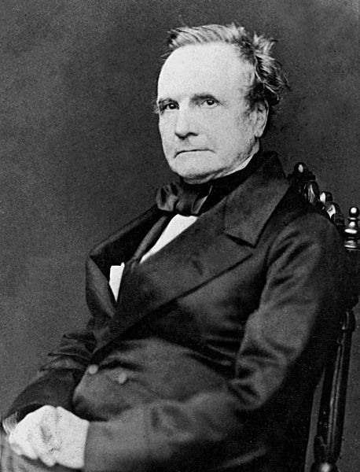
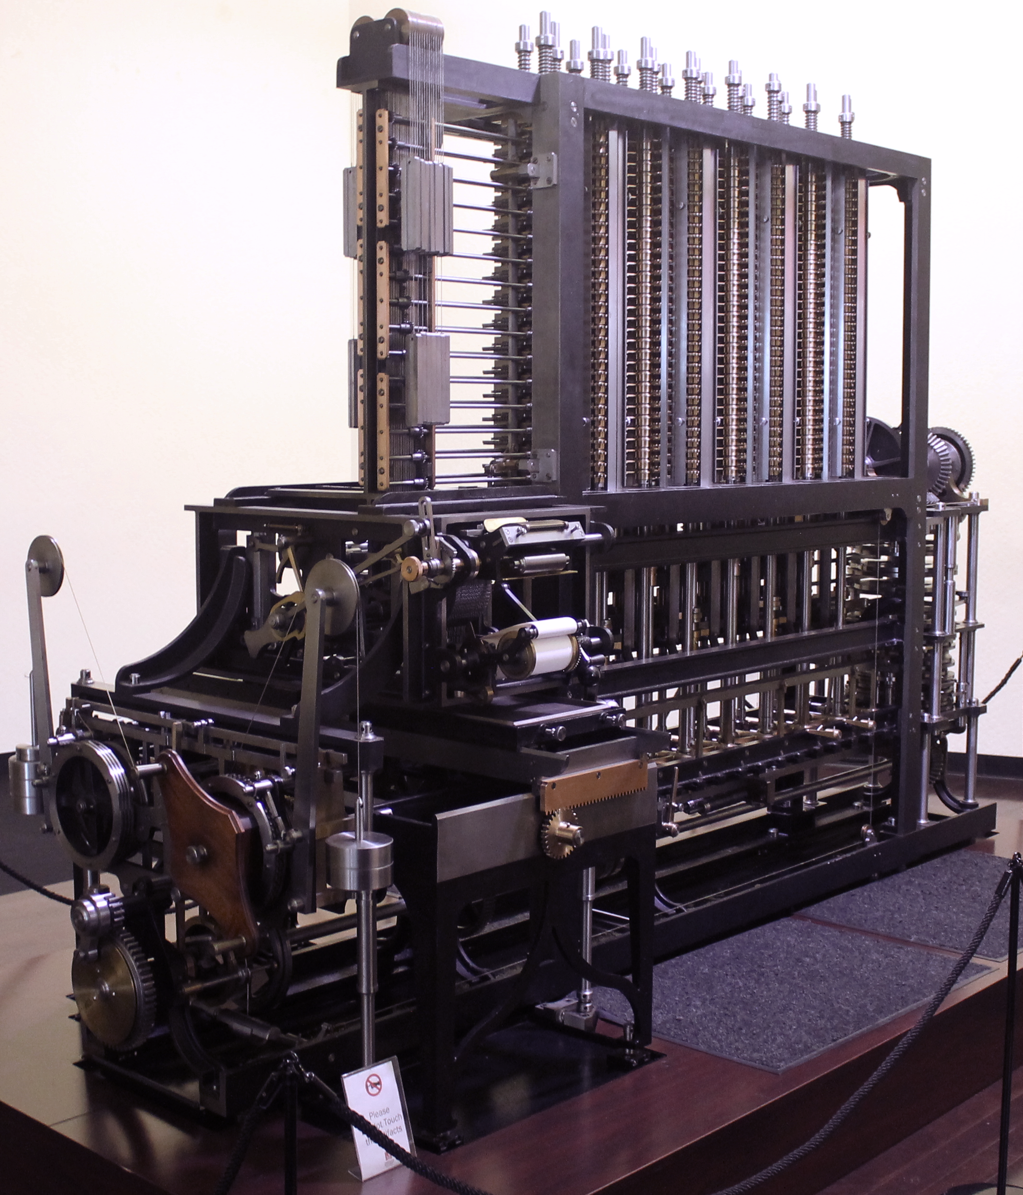
Charles Babbage

Slide 5
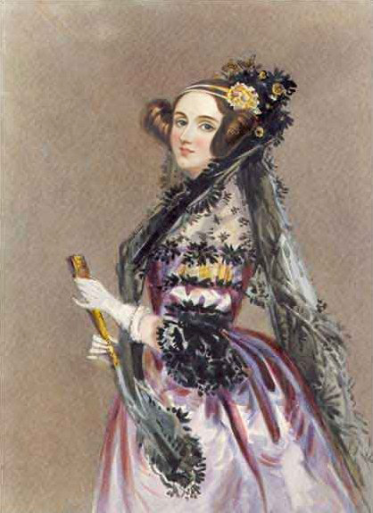
Ada Lovelace
Wrote the first algorithm designed for a computing machine making her the world’s first programmer

Slide 6

Alan Turing
Alan Turing is regarded by many to be the father of computer science.
A Turing machine can perform any mathematical procedure that can be represented by an algorithm.

Slide 7
Problem Solving Process
Understand the problem
Plan your solution
Implement and test your solution
Reflect on your solution

Slide 8
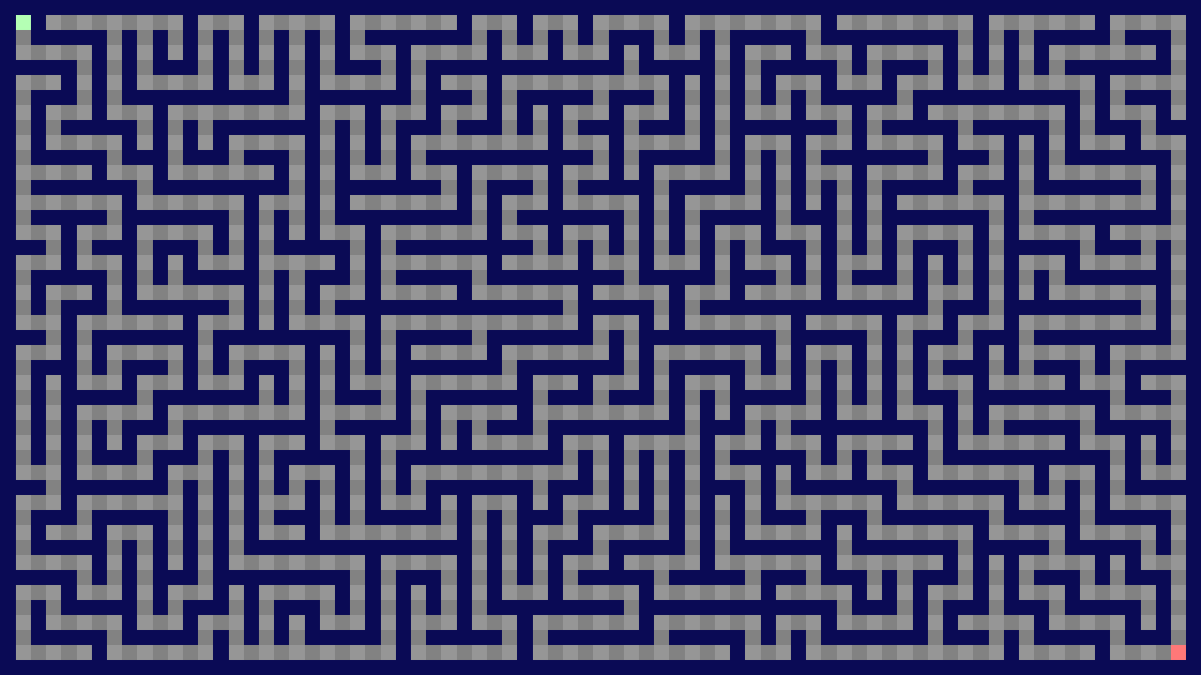
How would you solve a maze?

Slide 9
Principle 1 (Understand the Problem.)
Do I understand the problem?
Can I restate the problem in my own words?
Do I have the information needed to solve the problem?
Does the problem have a solution?
What does an answer to the problem look like?
Can the solution be verified?

Slide 10
Principle 2 (Plan a Solution.)
writing pseudo-code,
developing mathematical formulas,
drawing diagrams or flow charts, and
creating worked solutions for specific instances of the problem.

Slide 11
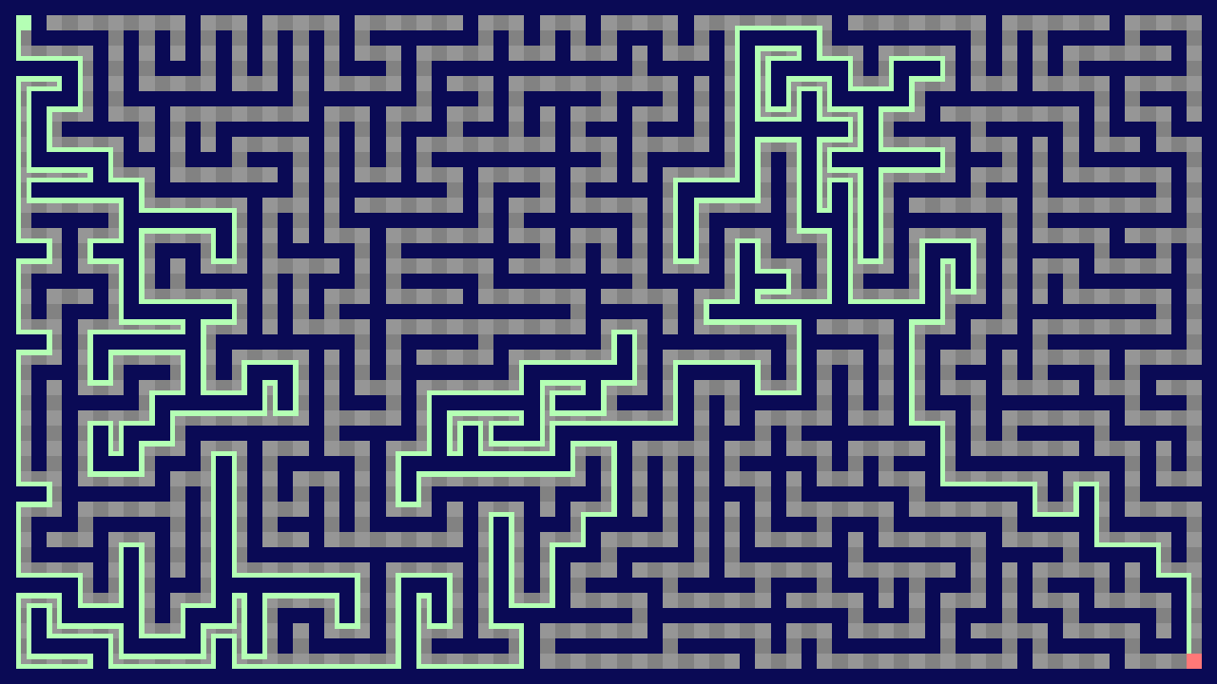
Principle 2 (Plan a Solution.)

Slide 12
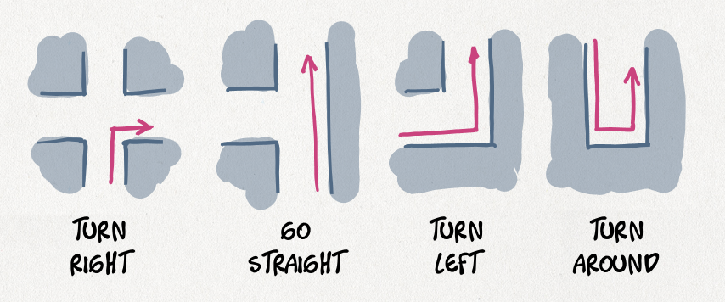
Principle 2 (Plan a Solution.)

Slide 13
Principle 2 (Plan a Solution.)

Slide 14
Principle 3 (Implement and Test)

Slide 15
Principle 3 (Implement and Test)

Slide 16
Principle 4 (Reflection)
Is there code that isn’t needed?
Is there code that is duplicated?
Can the solution be simplified?
Is there a different organization that could be used? Why were alternate organizations discarded?

Slide 17
Principle 4 (Reflection)
Is there a different problem solving heuristic that could have been used? What features of the problem or the strategy made one heuristic more attractive than another?
Could you generalize the solution such that it worked for other problems? What other problems are similar?

Slide 18
Principle 4 (Reflection)
What patterns were important in solving the problem?
What were the most important design decisions in solving the problem?
What alternatives could you have considered?

