Slide 1
jBPM and Drools Case Studies

Slide 2
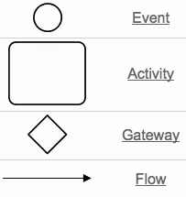
Introduction to BPMN and jBPM
The Business Process Modeling Notation (BPMN) is a graphical notation that depicts the end to end flow of a business process
The notation has been specifically designed to coordinate the sequence of processes and the messages that flow between different process participants in a related set of activities
jBPM is a light-weight, extensible workflow engine which can execute BPMN 2.0
Basic components

Slide 3
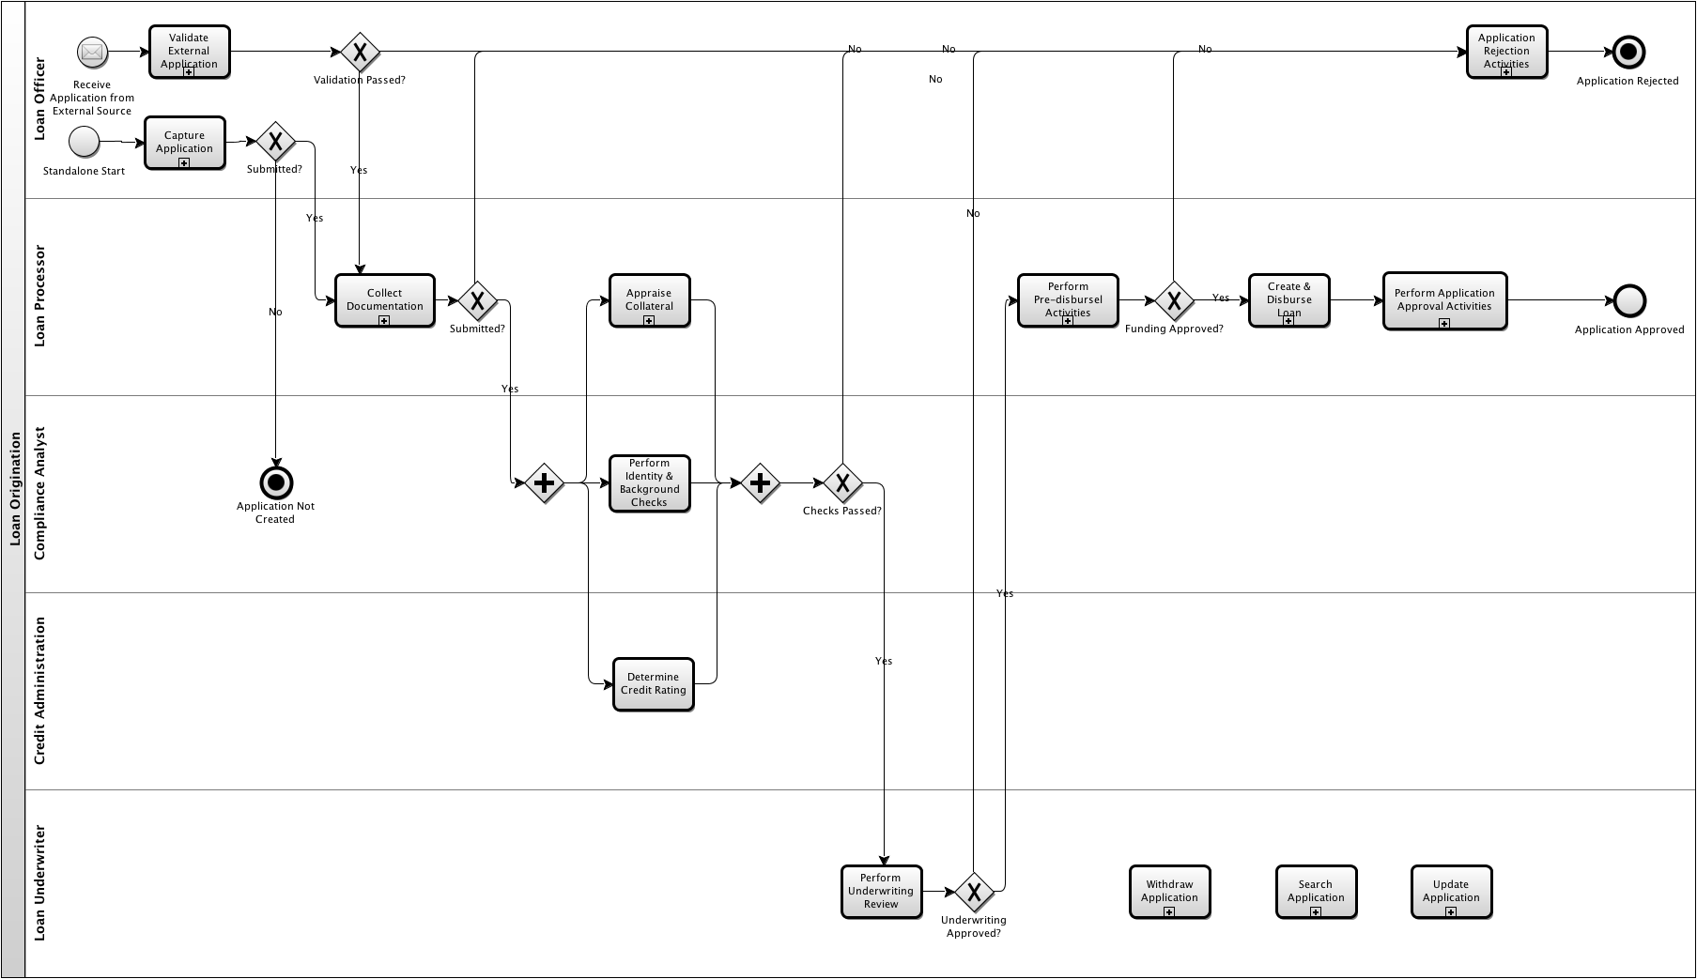
Can be implemented using Drools

Slide 4
Rules Engine
Rule engine usually includes three parts
Facts represented as working memory
Set of rules that declaratively define conditions or situations e.g. Prolog route(X,Z)<-road(X,Z)
Actions executed or inference derived based on the rules
Changes to facts
Facts/Data
Rules Engine
Rules
Actions

Slide 5
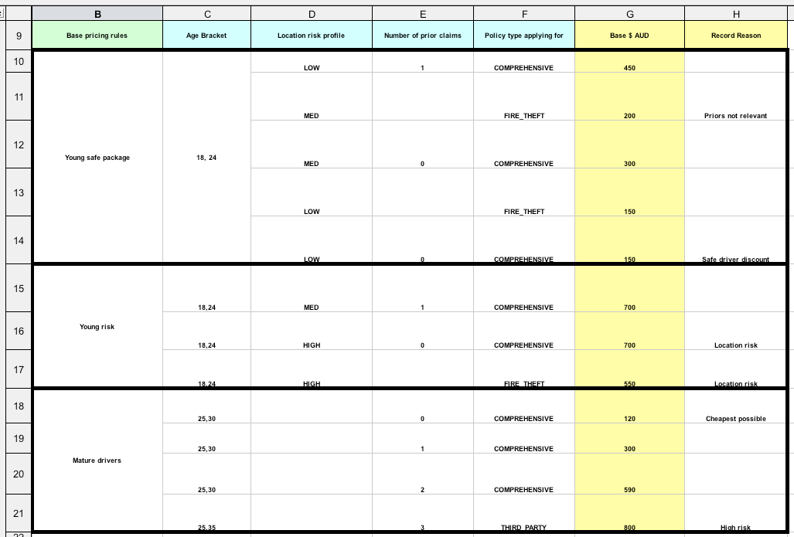
Defining Rules - Decision Tables

Slide 6
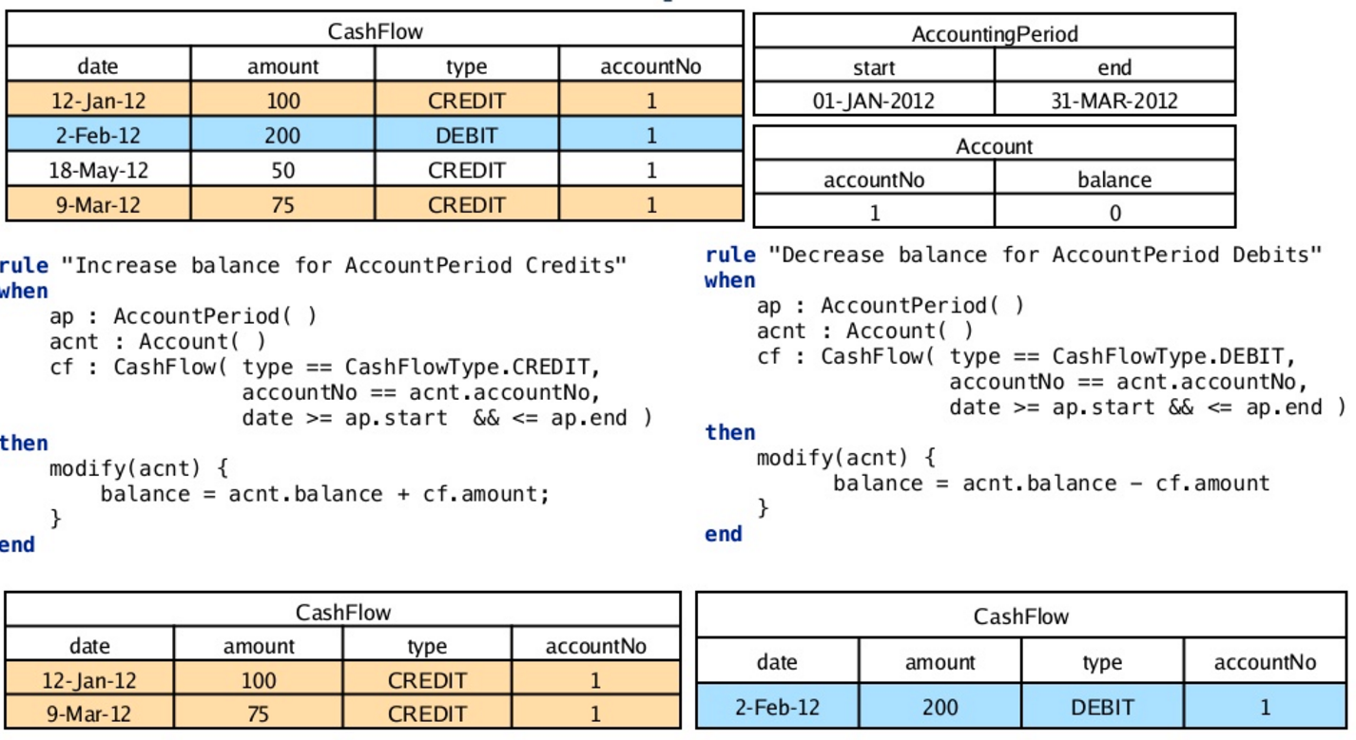
Defining Rules

Slide 7
Case Study
(A well known independent Loan Management System service provider)
The client is a well known independent business process service provider. Their services help their clients design, transform, and run advanced operating models to combat volatility, control costs, manage risk and enable growth. The client has a loan management system product and wanted to leverage Trantor’s ability to scale teams to enhance and maintain it.
CLIENT’S
TECHNOLOGY TEAM
CLIENT’S
BUSINESS LINES
‣ PMO
‣ Product Head/ Product Management ‣ Software Dev. & Testing Team
OFFSHORE CAPTIVE
DEVELOPMENT TEAM
‣ Banking & Financial Services
‣ Project Manager
‣ Technical Architect
‣ Software Dev
WHAT WE DID
BENEFITS
‣ Maintained and enhanced major components like credit scoring engine, pricing engine, business rules engine ‣ Integrated third party services like Yodlee, Credit Bureaus
‣ System Maintenance - upgraded framework from v4 to v5
‣ Customized the JBPMN task model to assigned task to group and sub-group for credit decision team.
‣ Data migration of old application to new application
‣ Developed Custom user portals for several customers
‣ Technology used: Java, Spring, Hibernate, JSF, JBPM, Drools, Servicemix Fuse, OSGI, Oracle, Postgres, Jenkins, XML/XSD/XSLT, Apache Camel, Apache CXF, Git Hub
‣ Team Size: 35
‣ Quick ramp up of development team
‣ Scalable platform allowed client to integrate with easily with multiple partner apps
‣ Reduced manual effort that led to 55% cost savings
‣ 80% coverage API testing through automated scripts
‣ Savings of $1M in solution development cost

Slide 8
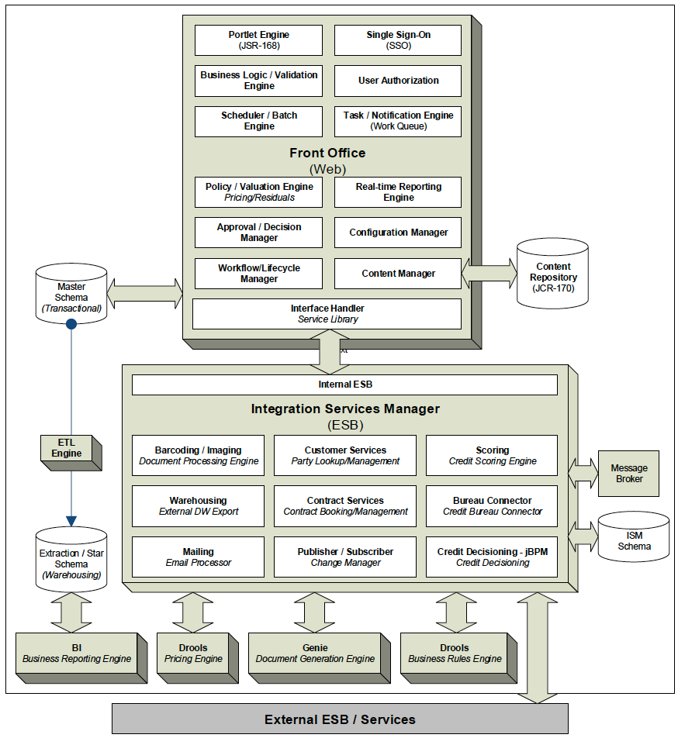

Slide 9
Case Study
(Pricing Engine for Bella Hotel and Spa, France)
The client, Bella Hotel and Spa is a member of the Bramcom Holding Ltd. They have a complex pricing and discounting schedule. They wanted to develop a pricing and discounting engine based on Drools
CLIENT’S
TECHNOLOGY TEAM
CLIENT’S
BUSINESS LINES
OFFSHORE CAPTIVE
DEVELOPMENT TEAM
‣ PMO
‣ Product Head ‣ Software Testing Team
‣ Hospitality
‣ Development
‣ Testing
WHAT WE DID
BENEFITS
‣ Developed a pricing and discounting engine to calculate the room rates based on factors like seasonal price, occupancy, age of guests, meals etc.
‣ Invocation of the workflow through a REST webservice call
‣ Technology used: Kie Workbench, jBPM, Drools
‣ Team Size: 2
‣ Built robust technology platform to automate business operations
‣ Quick team ramp up

