Slide 1
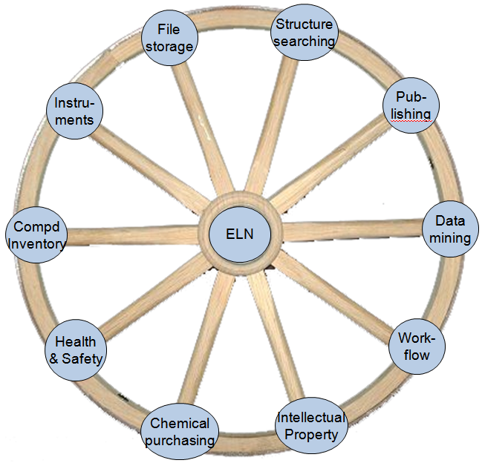

Using the IDBS ELN in the University of Cambridge Chemistry Department
IDBS Product Innovation Seminar
Little Chesterford, Wednesday 10th March 2010
Brian Brooks
CLARION Project Manager
CLARION – Chemical Laboratory Repository In/Organic Notebooks
Principal Investigator: Peter Murray-Rust
Co-Investigator: Jim Downing
Unilever Centre, Department of Chemistry, University of Cambridge
The CLARION Project is funded by JISC

Slide 2
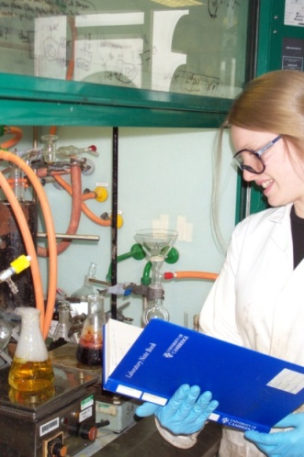
Some background
In early summer 2009, the Chemistry dept started work on deploying the IDBS EWB ELN
Early-adopters were nominated from about a dozen interested groups
Emphasis on
  1st-year PhD students
  Post-Doctoral Research Associates
Variety of chemistry disciplines involved

Slide 3
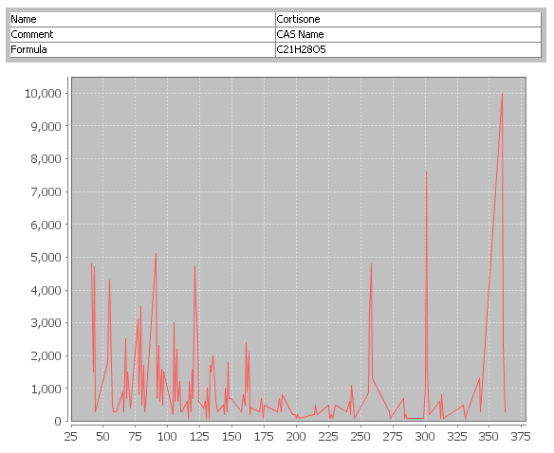
ELN rollout at Cambridge
Two ways to approach the project
  Deploy Later:
    Requirements analysis
    Development; integration, configuration
    Rollout
  Deploy Sooner:
    Vanilla out-of-the-box
    Minimum startup time
Deploy Sooner...
  ... about 3 months
“Light-touch” rollout
  Give it to a few scientists, see how it goes
Notes:
So, how did we tackle the ELN rollout at Cambridge?
KISS. Bit like buying a house; live in it for a year before you start making significant changes

Slide 4
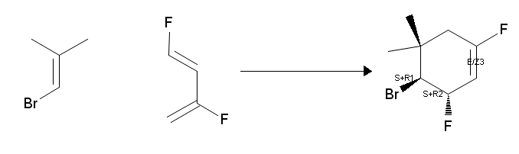
Background II
One day of training was given to users
  Plenty to get them up and going
    Probably benefit from an advanced refresher half-day to learn new tricks
    V8.2 an opportunity?
In October, the first early-adopter users started using it (EWB v8.1)
Now been in use for just over 4 months

Slide 5
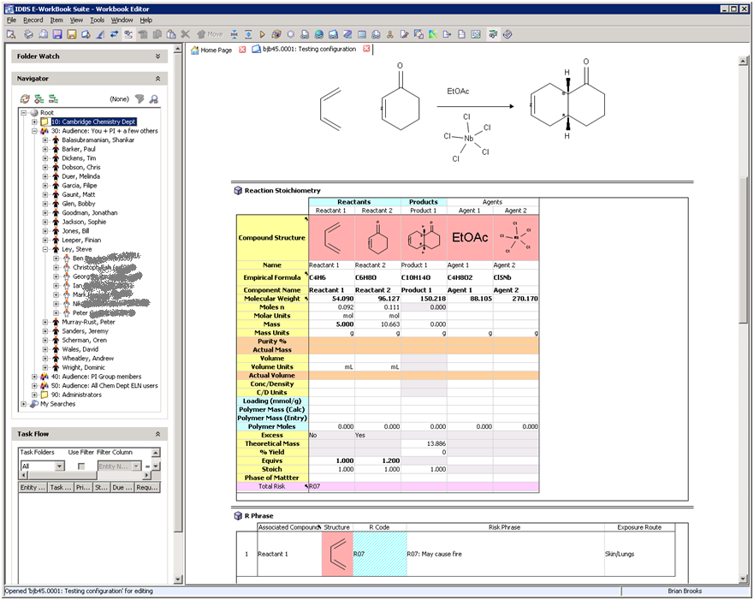

Slide 6
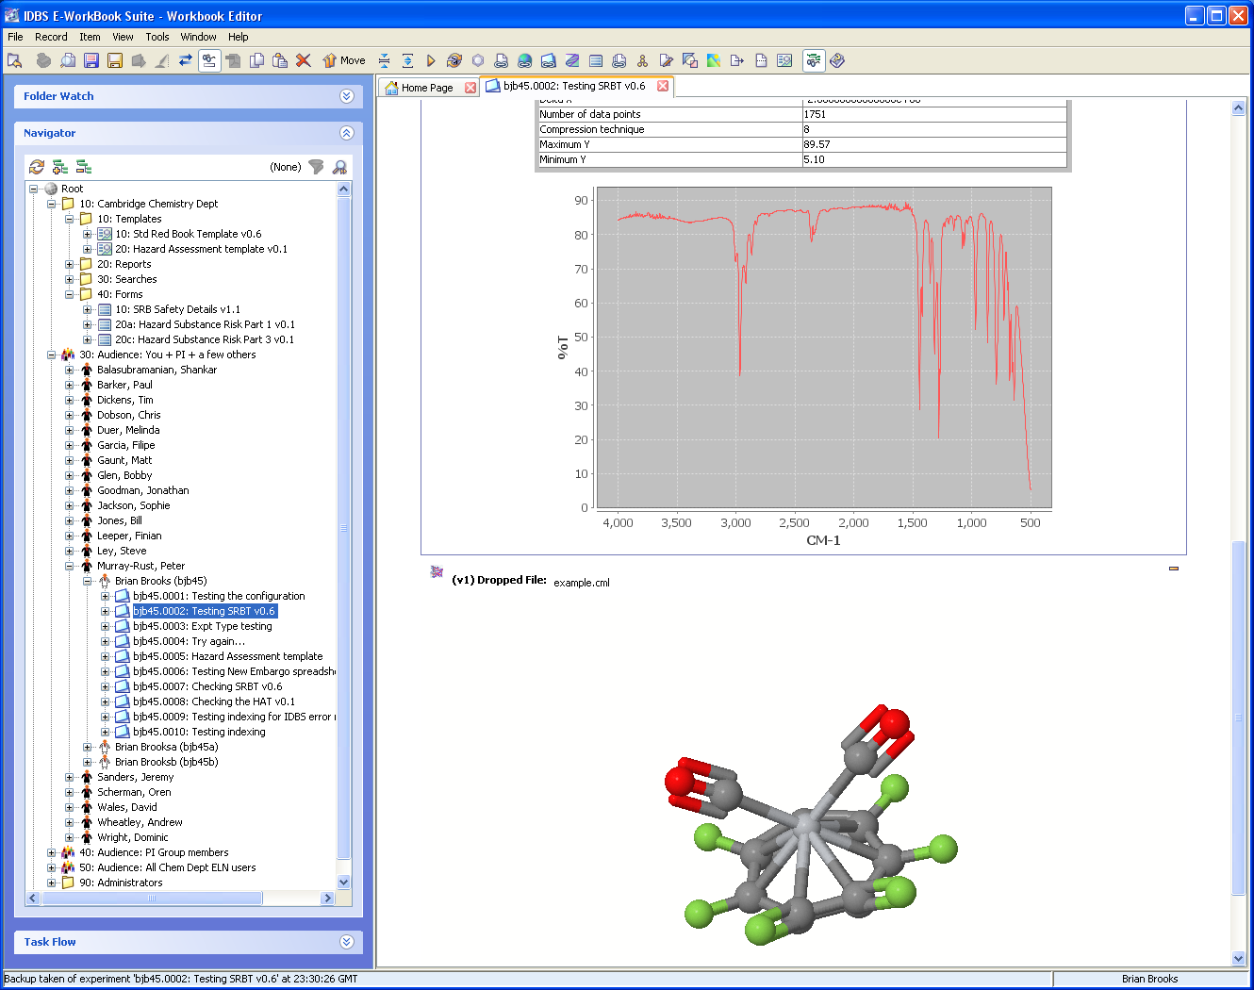

Slide 9

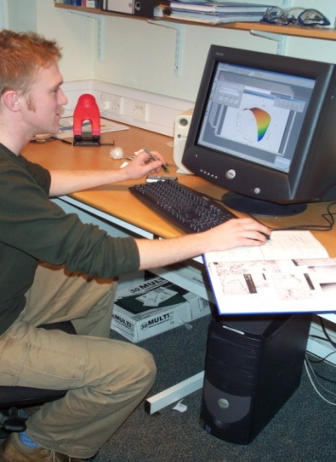
ELN – some quotes from Cambridge scientists
From a scientist:
“For a new computer system to be a success, it must do one of two things:
  Make something possible that currently isn’t
  Make something easier that’s currently difficult”
From a PI:
“When a group member has left, it can be extremely difficult to find out what they worked on”
From a scientist:
“I just wrote a paper. It was 2 pages long... and had 150 pages of supporting information”
From a PI (somewhat tongue-in-cheek):
“Every four years we start to repeat what we’ve done before because the people who knew have left”

Slide 10
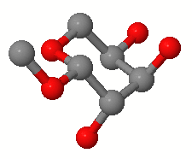
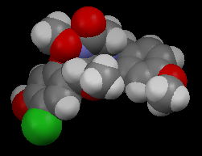
Some good questions to ask scientists:
“Have you tried to find something from someone else’s data?”
“Have you ever been unable to find some information to support a paper?”
“Have you ever lost any data that was stored on a computer?”
“Do any of your grant awarding agencies require publication of your source data?”
“Do you collaborate with colleagues within the department?”

Slide 11
The current environment
Open Data
People turnover – 3-year positions
  PhD Students, PDRAs
  Continuity;
Granting authorities
  Public money, public data
Journals requiring supporting data
Publish publish publish
Citations are good
Scientific fraud...

Slide 12
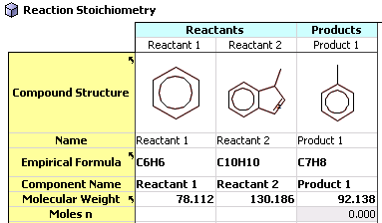
Possible reasons for adopting an ELN
Information sharing
  With your group – locally, or geographically dispersed
  With other collaborating groups
Searchability
Ability to access info from previous colleagues
Protection of IP
Facilitate processes; H&S, Controlled substances
Desire to improve organisation of data
Facilitate downstream publication
  Scientific papers; Open Data
Information security
Make all the data available
  Un-successful reactions as well as the successful

Slide 13
Why use an ELN?
Industry
Academia
IP protection
Structure to the data
  In one place; info-entropy
Electronic format
  Searchability; archiving
Workflow improvements
Scientist’s efficiency
Sharing expt details
  Large teams
  global sites
Information security:
  Physical; legibility
Outsource/collaborators
  Workflow; up-to-date
IP protection (+/?)
Structure to the data (?/+)
  In one place; information-entropy
Electronic format (+/?)
  Searchability; archiving
Workflow improvements (?)
Scientist’s efficiency (?)
Sharing expt details (+)
  PI groups; collaborators
  Students/PDRA who have left
Information security (+)
  Physical; Legibility
Collaborators (?)
Publishing (++)
  Preparing papers; finding
  info; Supporting data

Slide 14
Differences between Academia & Industry
Industry
Academia
The Boss is The Boss
IP protection is paramount
No worry about needing to publish data openly
Resident programming staff
One big, focused mission
Integration across depts
Funding comes from within the organisation
  => more direct influence on allocation
The Bosses are the Bosses
Number of Bosses >= # of PI’s
Programming support a rarity
Maintenance staff a rarity
Many different missions
Less integration across depts
Less money
Most funding comes from outside the organisation
  => less ability to influence
  => less certainty over budget
Short (1-3-yr?) funding cycles

Slide 15
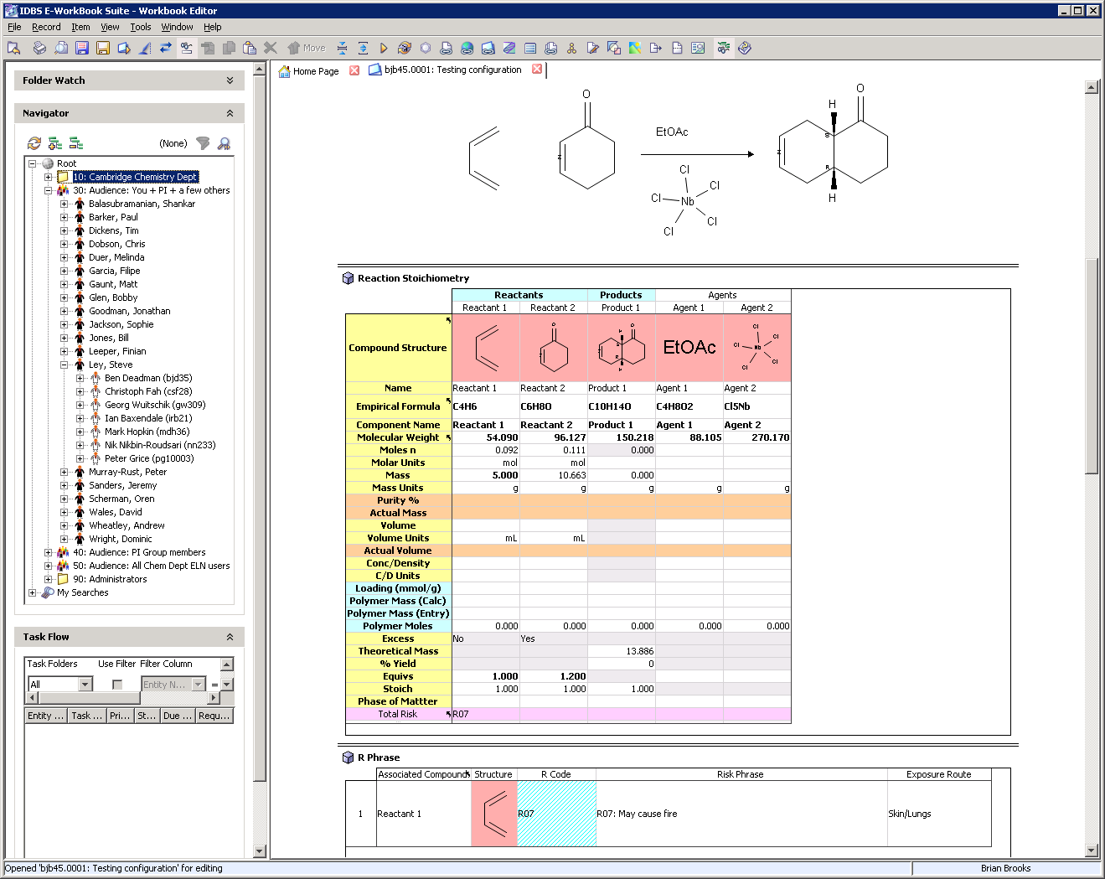
Adopting an ELN – factors to consider
Costs – Purchase, maintenance, support
  pLNBs don’t need technical support
  Daily operational support needed
  Technical infrastructural support
Long-term
  Reliability (pLNBs don’t crash...)
  Data storage in electronic format
  Exit strategy... just in case...
Develop open-source vs. Buy
Computers & network needed!
Notes:
Factors to consider when deciding to implement an ELN
Frank will cover the technical issues in more detail

Slide 16
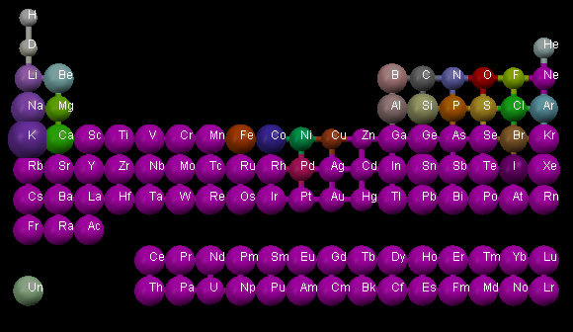
Challenges for ELN in Academia
Resource constraints
Configuration, Deployment
Diversity of platforms
Diversity of lab & office environments
Diversity of Principal Investigators, subjects, funding
Managing / support longer term
Lock-in – technical, organisational
ELN is a commercial product
  Advantage re: ongoing development, support
  Disadvantage: cost, responsiveness
Mantra for our deployment:
=> Keep simple
=> Super-Users

Slide 17
ELN rollout: Barriers & enablers
People vary:
  Some love computers; some hate them
  Some keen to try new things; some aren’t
  Some use Macs, some use Proper Computers
  Some are organised; some aren’t
  Some already use ELN
Scientists have a choice
  ELN vs Word vs pLNB vs stand-alone ELN vs mish-mash
  Different people choose different decision
    Challenge is to make it compelling to use our ELN

Slide 18
Some people use ELN assiduously; some don’t. Why the difference?
(+) Support from PI
(+) Availability of computers
(+) Others within the group
(+) New PhD & PDRAs – while they’re finding their feet
(-) Have an existing methodology for storing data
(-) Coming to the end of their position
(-) Computer availability

Slide 19
ELN – should I, shouldn’t I...?
Can I be bothered to organise all my data into the ELN as I go along
  Think longer term; effort expended now is regained with interest later
I can manage my own data in my own way
  But can other people see and understand it...?
  And in 3 years time when you’ve left & started another job...?
  Altruism – do it for your colleagues
  Selfish – do it for yourself for later

Slide 20
Viewers - filetypes
Viewers are a fantastic feature for selling ELN
Scientists go “Wow!” on seeing Viewers
To scientists, Viewers make the difference between a MS-Word-like “scrapbook” and an ELN with active content
Many different file formats
  Standards help

Slide 21
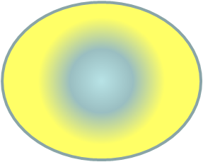
Access model:
Academia more complex than commercial
Company
Scientist
Scientist
Their Group
Commercial: Expt initially visible to scientist, then to whole company when finished
Their Dept
The World
Academia: more groups involved
=> security more complex to set up

Slide 22
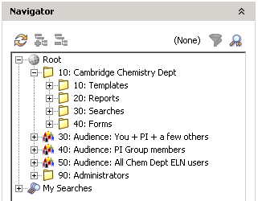
Audiences in the Navigator
Scientist
Their Group
Their Dept
The World

Slide 23
Summary of Security rules:
All scientists can see all the hierarchy of Principal Investigator (PI) names and Scientist names. They can only see Expt titles they're allowed to see
A scientist always has complete control over their own expt when it is in their own section (Create, Read, Edit, Move, Delete)
The ELN Admin for a group always has complete control over the expt of a scientist in their group
The PI and their Safety Reviewer(s) can always read expts from their group. (But not Edit or Delete expts)
In each PI's group area, the PI's group members can read all expts, but default is that they are not able to edit a colleague's expt

Slide 24

CLARION Project: EmMa - Embargo Manager
Embargo 1: Release to Dept
Embargo 2: Release to World
Scientist
The Scientist
in the Onion
Their Group
Their Dept
The World

Slide 25
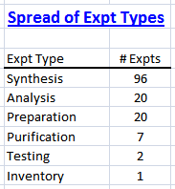
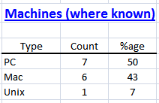
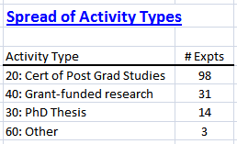
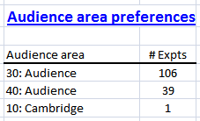
ELN – expts so far (2nd March 2010)

Slide 26

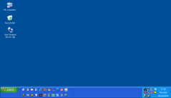
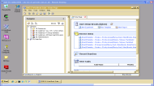
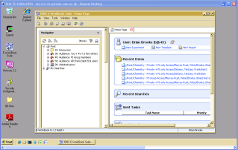
ELN setup:
Thick or Thin clients
Mac or PC
Thin client uses Remote Desktop Connection
Application Server
PC thick client
(ELN installed locally)
ELN
server
Database Server (Oracle)
PC or Mac thin client
(use Microsoft RDC)
Remote Desktop Connection
Terminal Server

Slide 27
ELN – a platform for IT innovation?
File
storage
Structure
searching
Instru-
ments
Pub-
lishing
Experiments are a fundamental part
of a research
scientist’s
activity
Compd
Inventory
ELN
Data
mining
The Electronic
Lab Notebook is
the “missing link” at
the centre of the wheel
of a scientist’s activities and data sources
Health
& Safety
Work-
flow
Chemical
purchasing
Intellectual
Property
Notes:
History of computers in research
Databases of specific types of data : Searchability : Calculation engines : Solutions to areas of pain
Still used pLNB to conduct all these sources
Recent years, set of circumstances ripe for ELNs: software, availability of computers, familiarity of folk with computers, legal situation
In 2002, we started a project to select an ELN and roll it out to Discovery. Goals: purely electronic; one app for chemistry & biology
It became clear that the pLNB / ELN is the missing link that pulls all the strands of a scientist’s research effort together

Slide 28
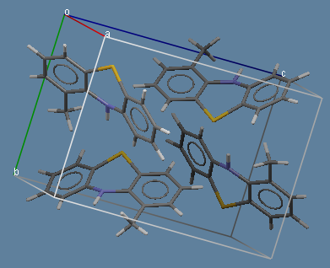
Questions...?

