Slide 1
REST assured
A generic approach to REST
EMEA PUG Challenge, 20-11-2014
Bronco Oostermeyer

Slide 2
Who am I?
{"speaker": [
{
"id": 1,
"firstName": "Bronco",
"lastName": "Oostermeyer",
"company": "Flusso",
"previous": "UNIT4,Progress,WALVIS",
"email": "b.oostermeyer@flusso.nl"
}
]}

Slide 3
Agenda
REST Adapter / Service types
Architecture
Why?
Steps
Code

Slide 4
REST
REST = Representational State Transfer
  Architecture, not a protocol
  Definitely not a standard
To the point
  Data transport via HTTP(S)
  Data via JSON (JavaScript Object Notation)
  Accessible from every technology
  “WebServices without SOAP overhead”

Slide 5
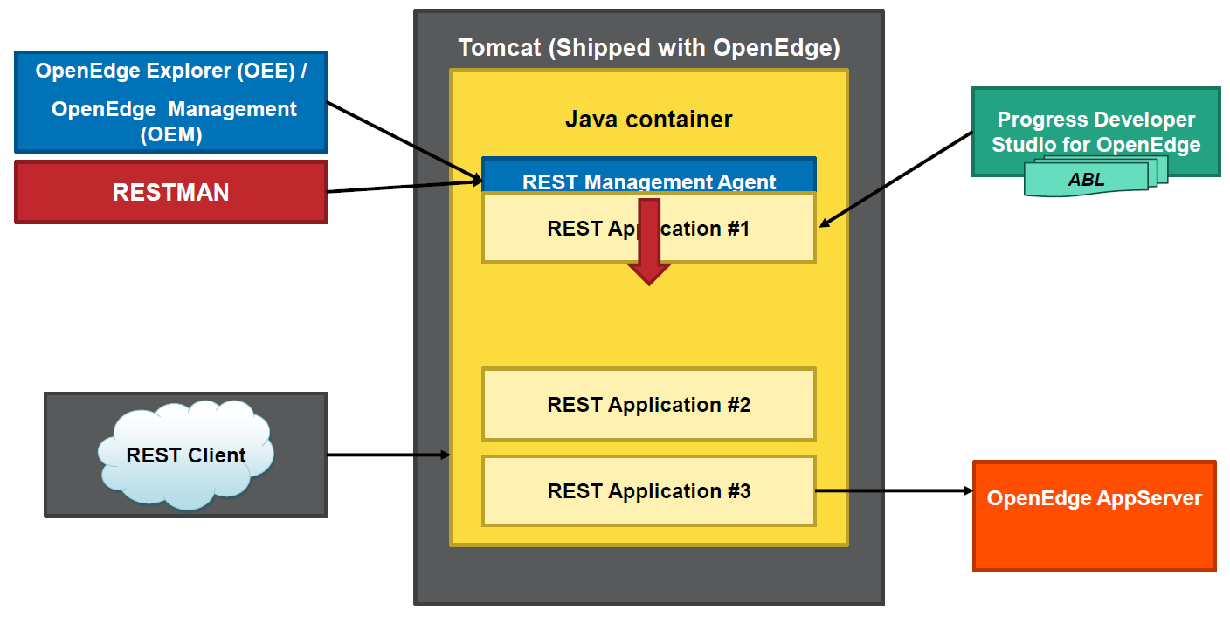
REST adapter - implementation
PSDOE installed Tomcat

Slide 6
REST Adapter – Servicetypes
REST Services
  GET: http://www.flusso.nl/pugapp/rest/api/router/speaker/{:id}
  Very flexible
  DIY (Do It Yourself)
Mobile Service
  GET: http://www.flusso.nl/pug/rest/pug/speaker?filter=...
  Standard CRUD support
  Service contract via catalog (to the client)
  Clientside JSDO available

Slide 7
REST Services - preliminary
PDSOE “obligatory”!
Essential for your workflow
Test client (Postman, SOAP UI)
Tools (Fiddler)

Slide 8



High over architecture
OpenEdge AppServer
Generic
Your application
Routing
Mapping
Business Logic
IRestBackendConnector implementation
http://.../pug/rest/pug/speaker
REST adapter
IRestBackendConnector
Service war

Slide 9
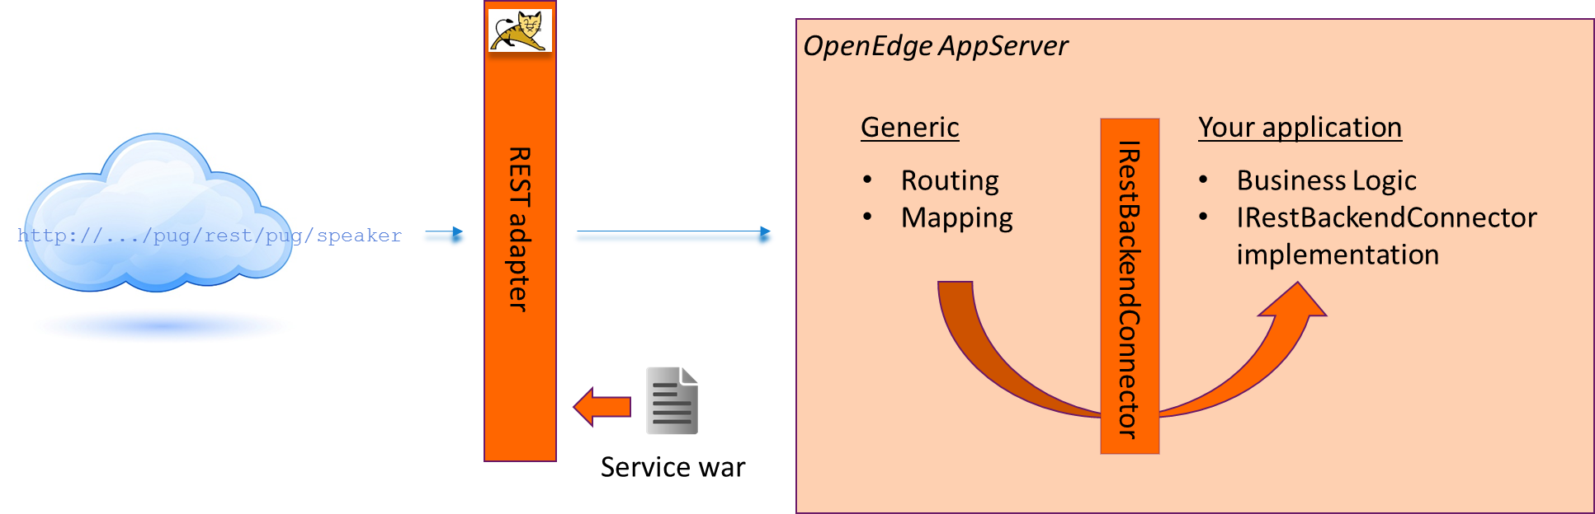
Why?
Separate generic REST related logic
  HTTP return codes
  Access paths
  HTTP Headers
  Routing
Access application via 1 interface
Web frameworks work well with REST
Easier collaboration

Slide 10
Steps
GET http://.../pugapp/rest/api/router/speaker
GET http://.../pugapp/rest/api/router/speaker/1
Create a ABL Router class interface methods
Define service (interface)
Create routing
Create BackEndConnector

Slide 11
RestRouter
Defines interface(s) for REST adapter to communicate with (CRUD)
Implements (part of) logic for forwarding request to BusinessLogic
Collects all info for response
  Data
  HTTP return value (codes 200, 404, 500 etc)
  (errors)

Slide 12
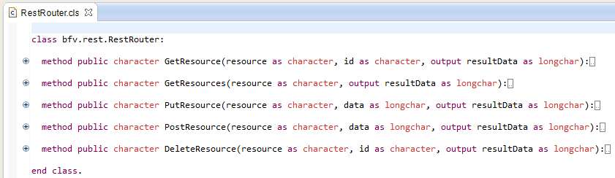
RestRouter (2)
The methods:

Slide 13
REST Service definition
Define the name, resources/verbs
  Path
  GET: Read, POST: create, PUT: update, DELETE: …
http://<server>:<port>/<servicename>/rest/<rel-uri>/<path>
Sample:
http://localhost:8980/pugapp/rest/api/router/speaker
(that’s long…)

Slide 14
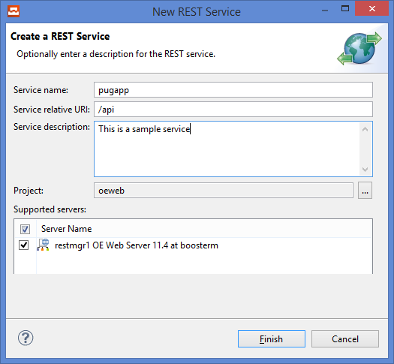
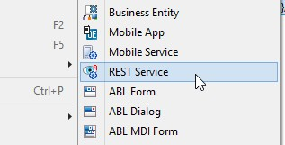
REST Service definition (2)
File → New → REST Service

Slide 15
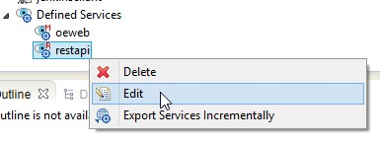
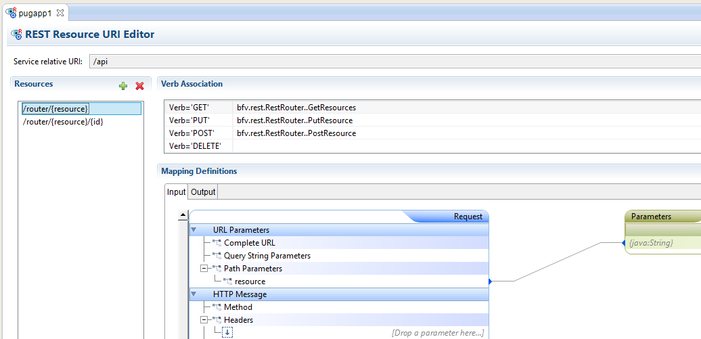
REST Service definition (3)

Slide 16
REST Service definition (4)
Map Resource / verb to method in class:
GET /api/router/{resource}
bfv.rest.RestRouter:GetResources()

Slide 17
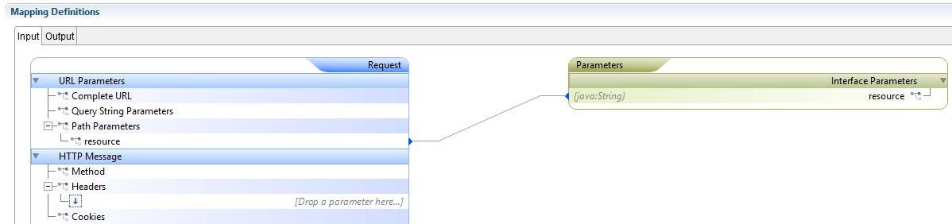
REST Service definition (5)

Slide 18
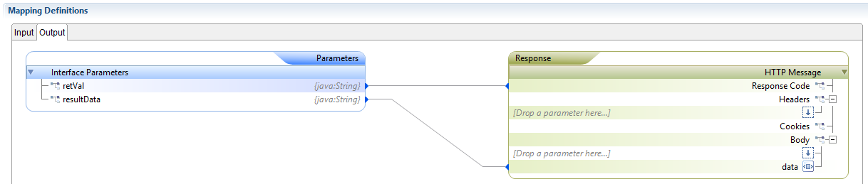
REST Service definitions (6)

Slide 19
Now for real

Slide 20
Factory
The factory maps the incoming resource (speaker) to:
  The REST class
  The application logic class
Factory class acts a static façade for ResourceFactory
  And casts a Progress.Lang.Object to IRestRequest
Get its info from XML (config/factory.xml)

Slide 21
Factory (2)
method public static IRestRequest GetRestReader(resourceName as character):
return cast(GetResource(resourceName), IRestRequest).
end method.
<?xml version="1.0" encoding="UTF-8"?>
<factory>
<resource name="speaker" implementation="bfv.rest.RestBusinessEntity" />
<resource name="speaker_data" implementation="pug.logic.beSpeaker" />
</factory>

Slide 22
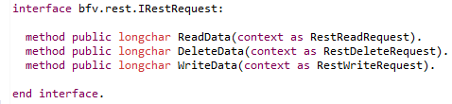
IRestRequest

Slide 23
Flow

Slide 24
RestBusinessEntity
General implementation
Supports all the basic patterns for CRUD on a resource
Can be inherited from for more specific use cases
  Specfic JSON output

Slide 25
Flow (2)

Slide 26
IBackendConnector
Interface which defines what is needed to make the generic stuff work with an application
The realization of this interface should part of application
The class which implements the interface should be stated in the factory xml
<interface name="bfv.system.IRestBackendConnector" implementation="pug.generic.BackEndConnector"/>

Slide 27
Pros & Cons
Pro
  Limited set of URL’s
  Making new resource available is easy
  Abstract the REST stuff from application
  Easy to implement more behavior (logging, tracing, etc)
Con
  No specific WADL’s

Slide 28
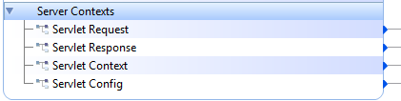
Caveats
Request query parameters via ServletRequest
http://.../speaker?user=bronco&role=dev
[
{"theName":"AuthType"},
{"theName":"ContextPath","theValue":"\/router\/speaker"},
{"theName":"Method","theValue":"GET"},
{"theName":"PathInfo","theValue":"\/router\/speaker"},
{"theName":"PathTranslated","theValue":"C:\\bin\\tomcat\\oe113\\webapps\\pugapp\\router\\speaker"},
{"theName":"QueryString","theValue":"user=bronco&role=dev"},
{"theName":"RemoteUser"},
{"theName":"RequestedSessionId","theValue":"712569786F702F64D2FB30FF2F379EFA"},
{"theName":"RequestURI","theValue":"\/pugapp\/rest\/api\/router\/speaker"},
{"theName":"RequestURL","theValue":"http:\/\/localhost:9080\/pugapp\/rest\/api\/router\/speaker"},
{"theName":"ServletPath","theValue":"\/rest"}
]

Slide 29
Deploying, architecture
Use a webserver in front of Tomcat
  Acts as reverse proxy (increased security)
  Port 443 possible (avoid 80)
  Hides Tomcat URLs except those you want to expose
  Shorten URLs
    http://.../data/speaker vs
    http://...:8980/pugapp/rest/api/router/speaker
  Nginx, Apache, IIS (if you have to)
Put Node.js in between?!
  Authentication via various providers
  All sort of cool connections to outside world
Webserver
REST adapter
OpenEdge AppServer

Slide 30
The code
Not a complete solution, just inspiration to extend yourself
Mercurial development repository:
https://bitbucket.org/bfv/pug2014
GIT: https://github.com/bfv/pug2014
MIT license

Slide 31
“to do”
PDSOE setup
Authentication (worth separate presentation)
Error handling
Deployment

Slide 32
Clients?
Anything which can talk HTTP
HTML5!
Angular
  Googles structural framework for dynamic web apps
  Session today at 16:45 Düsseldorf room
    by Maarten de Groot & Roel Lakenvelt

Slide 33
Questions?

Slide 34



follow us on:

Slide 35
Links
http://www.ics.uci.edu/~fielding/pubs/dissertation/rest_arch_style.htm (academic)
http://www.infosupport.com/RESTful_Webservices_Paul_Bakker (practical)

