Slide 1
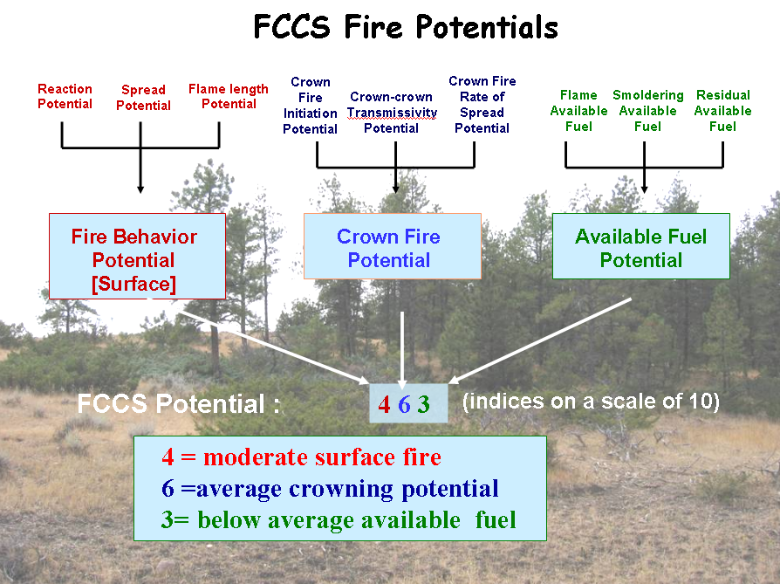
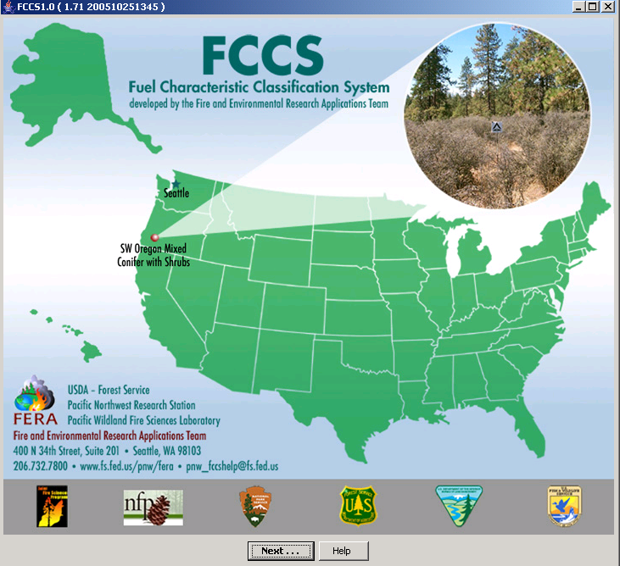





FCCS Fire POTENTIALS
Sam Sandberg
Susan Prichard
Cynthia Riccardi
Mark Schaaf
Roger Ottmar
Technical Fire Management
February 2012

Slide 2
FCCS Fire Potentials
Crown Fire Initiation Potential
Crown-crown Transmissivity Potential
Crown Fire Rate of Spread Potential
Flame Available
Fuel
Smoldering Available
Fuel
Residual Available Fuel
Reaction Potential
Spread Potential
Flame length Potential
Surface Fire Behavior Potential
Crown Fire Potential
Available Fuel Potential
Potential codes:
4 6 3
(indices on a scale of 0 to 9)
4 = moderate surface fire
6 = average crowning potential
3= below average available fuel
Notes:
Warning: point release will change crown fire potentials to Schaaf et al specifications.

Slide 3
Overview
Surface fire behavior - predictions of relative and actual surface fire behavior (reaction intensity, rate of spread, and flame length) based on benchmark environmental conditions.
Crown fire potentials – index only of crown fire initiation, transmissivity and rate of spread.
Available fuel potentials – tons/acre of available fuel under dry conditions.

Slide 4
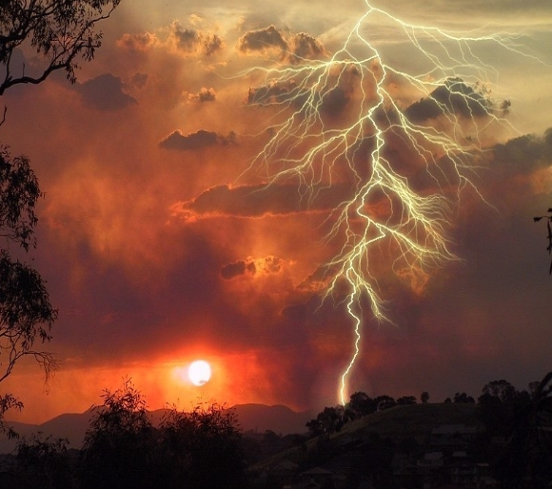
Environmental Scenarios
Default
4 mph windspeed
No slope
Dry fuel moisture scenario
- 6.5% dead FM
- 60% nonwoody FM
- 90% shrub FM
Surface fire behavior
Fuel moisture scenario (%)
Midflame windspeed (mph)
Slope gradient (%)

Slide 5
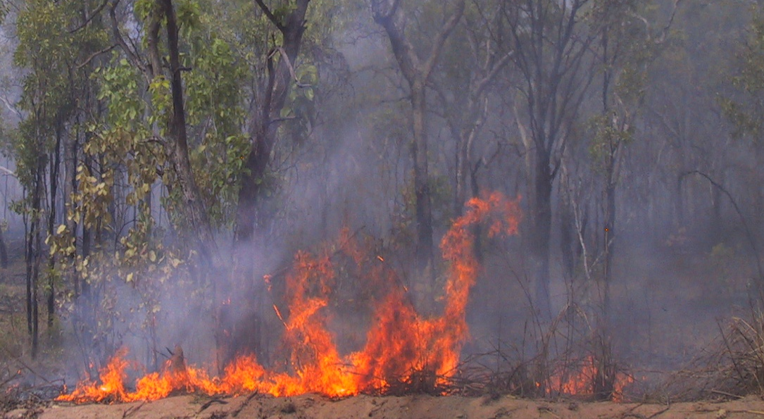
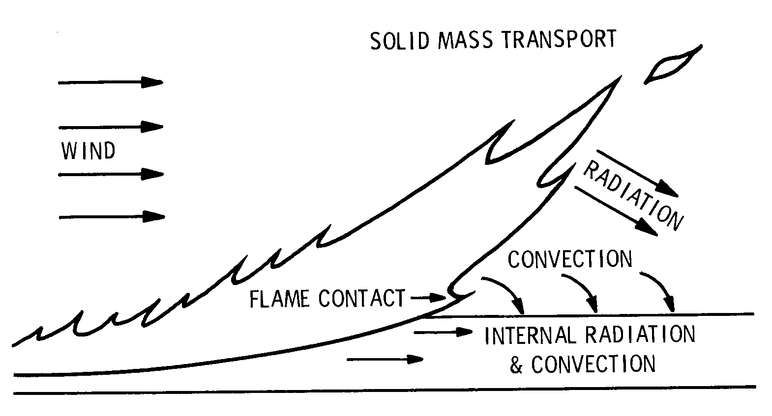
Part I. FCCS Surface Fire Behavior
Reaction intensity
(BTU/ft²-min)
Rate of spread (ft/min)
Flame length (ft)

Slide 6
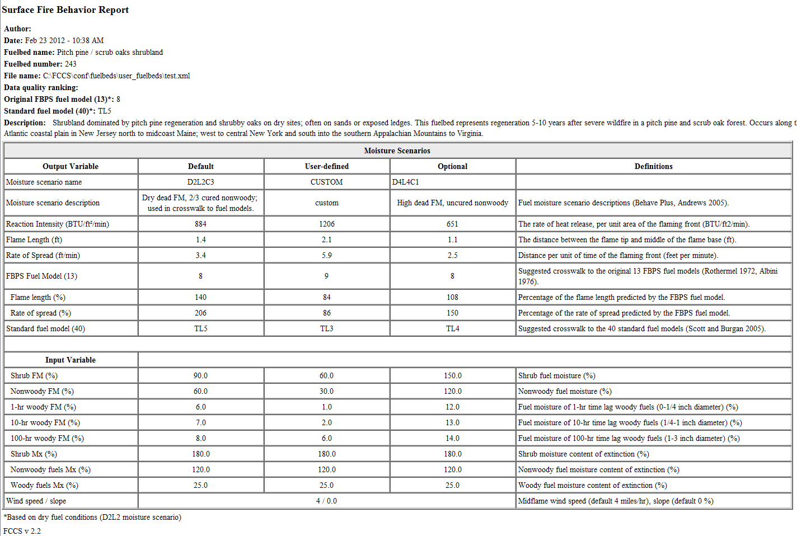
Surface Fire Behavior Report

Slide 7
Comparison of FCCS and
Rothermel’s Spread Model
 | ROTHERMEL (1972) | FCCS (2007)
ASSUMPTIONS | Steady state head fire Flaming front (fine fuels) Uniform fuel, FM, wind, slope Homogenous surface fuels | Same Same Same Heterogeneous surface fuels (4 layers)
OBJECTIVE | Support fire management operations in standard fuels under changing weather conditions. | Compare fire behavior between varying fuelbed characteristics and changing weather conditions
APPLICATIONS | Surface fire behavior modeling | Surface fire behavior modeling Fire effects modeling Fuel treatment assessment Habitat assessments
FUEL CHARACTERISTICS | Stylized fuel models | Realistic (measured) fuel characteristics
CROSSWALK | Fuel models cannot be crosswalked to realistic fuels | Crosswalk from fuelbeds to fuel models (original 13 and standard 40)

Slide 8
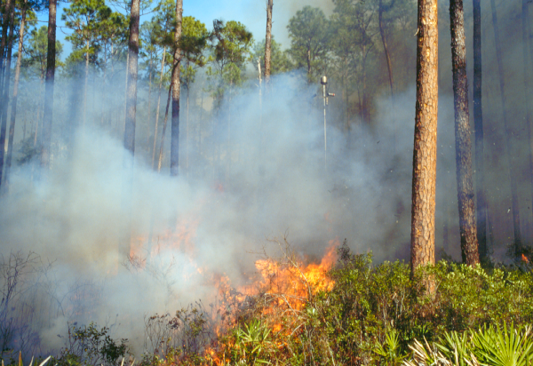
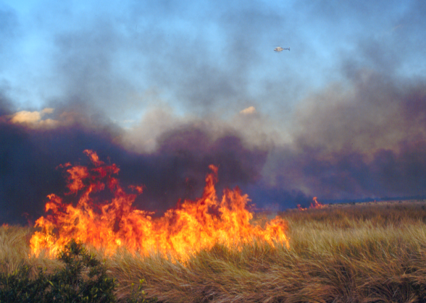
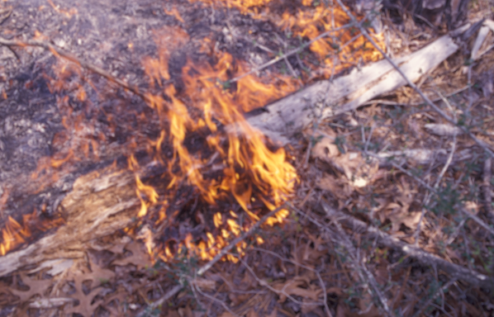
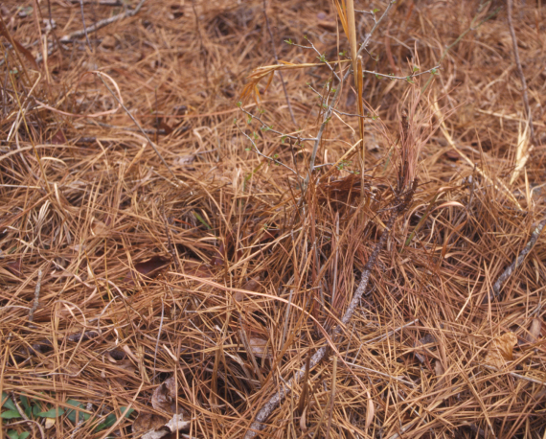
.
Shrubs
Grass
Small Woody
Litter

Slide 9
Reaction Intensity Equation
Reaction velocity
Fuel loading
Heat content
Mineral damping
Moisture damping)
Rothermel (1972)
Reaction Intensity (I_{R}) = Γ ’ w_{n} h η_{s}η_{m}
FCCS
Reaction Intensity (I_{R}) = Σ [Γ ’_{max} η_{β’} w_{n} h η_{s}η_{m}]
Shrubs
Nonwoody
Woody
LLM
Efficiency
Reactive load

Slide 10
Reaction Intensity (hardwood forests)
Shrubs
Nonwoody
Woody
Litter

Slide 11
Reaction Intensity (conifer forests)
Shrubs
Nonwoody
Woody
Litter

Slide 12
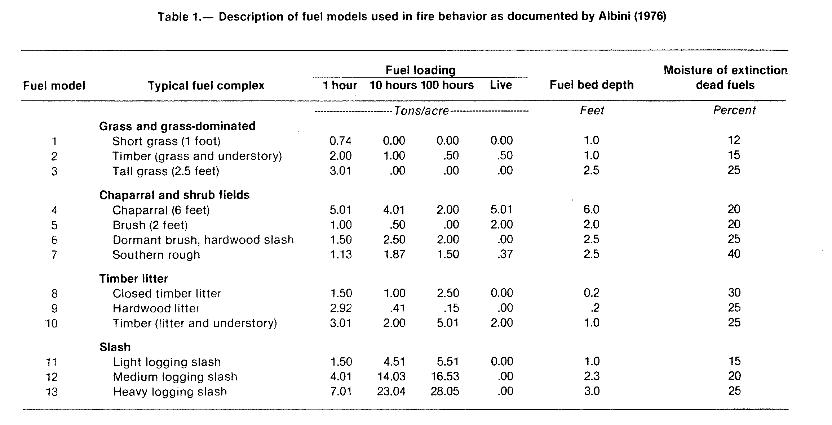

Slide 13
FCCS Surface Fire Behavior
Rate of Spread Equation
Rate of Spread = Heat Source
ΣHeat Sink
Function of:
  Reaction intensity
  Propagating energy flux
  Heat sink of unburned fuels in advance of flaming front
Notes:
Important point: We consider each fuelbed component acts separately as a heat sink. Rate of spread is proportional to heat source vs. heat sink. No longer requires an artificial fuelbed depth and scaling necessary in a fuel model out of the process. Validated by 216 fuelbeds. This really fixed a couple of deficiencies in Rothermel formulation – these used to be overcome by adjusting fuel models.

Slide 14

Rate of Spread Equation
Rothermel ROS =
(Heat source)
ROS =
(Heat sink)
(Heat sink weighted by cover and reactive load by fuel stratum)
Qig = heat of preignition (heat required for pyrolysis)
= effective heating number (preheated portion)
= bulk density of fuelbed element
= depth of fuelbed element
θ = prop ground surface covered by fuelbed element

Slide 15
Grassland fuelbeds vs. standard fuel models

Slide 16
Shrub fuelbeds: rate of spread

Slide 17
Flame Length Equation
FL = 0.045 x (RI x ROS x Flame Residence Time)^{0.46}
RI = Reaction intensity
ROS = Rate of spread

Slide 18
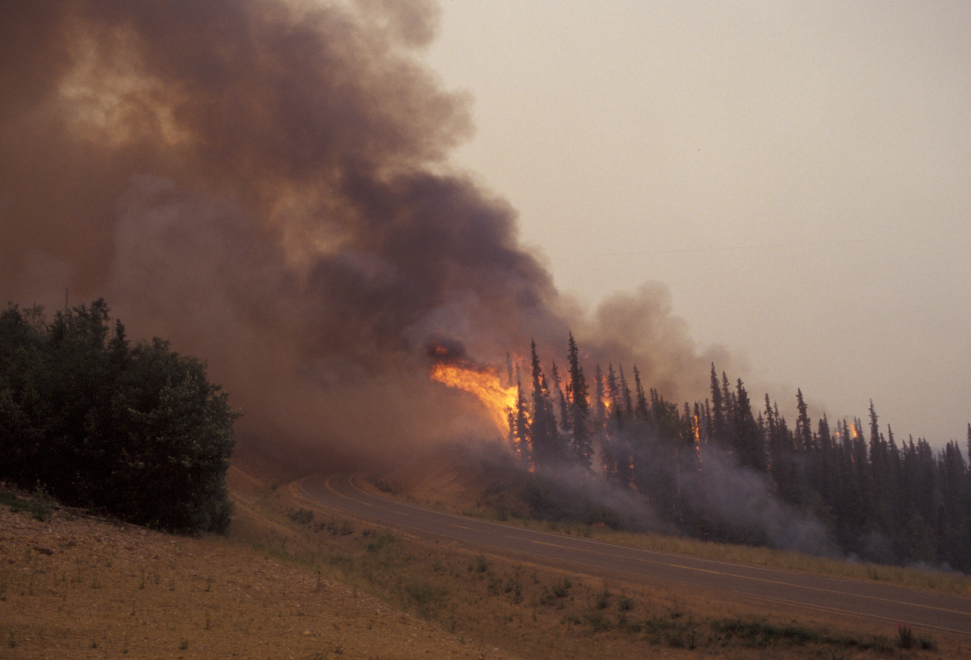
Part II. Crown Fire Potentials
Crown Fire
Initiation
Potential
Crown-Crown
Transmissivity
Potential
Crown Fire
Rate of spread
Potential
  Probability for surface fire to initiate into tree crowns
  Index of the ability of crowns to carry crown fire
  Index of the crown fire rate of spread

Slide 19
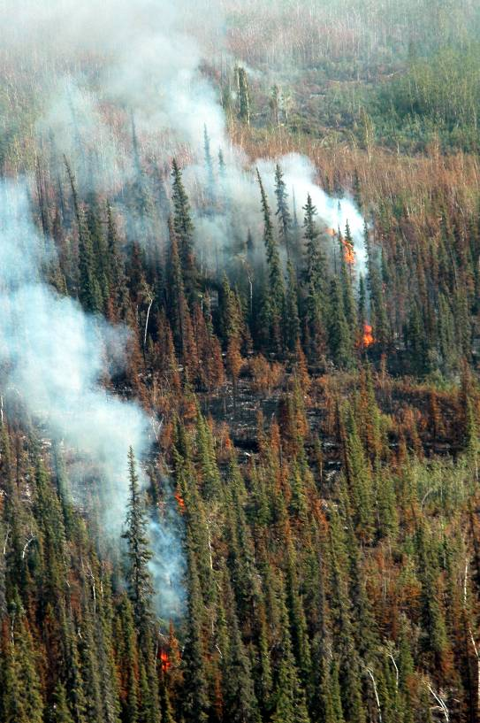
Crown Fire Initiation Potential
Surface fireline intensity
CI =
Critical fireline intensity
Where:
Surface fireline intensity (Btu/ft²/min) =
ƒ (surface reaction intensity, flame residence
time, and rate of spread)
Critical fireline intensity (Btu/ft²/min) =
ƒ ( constants, canopy base height,
canopy FM)

Slide 20

Crown-crown Transmissivity Potential
TC =
ƒ (canopy cover, leaf area index, windspeed)

Slide 21
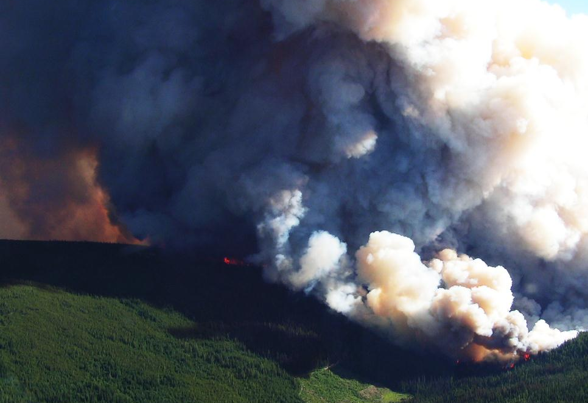
Crown Fire Rate of Spread Potential
Canopy heat source
RC =
Canopy heat sink
Where:
Heat source =
ƒ (RI surface, RI canopy, propogating flux ratio, windspeed factor)
Heat sink =
ƒ (heat sink of canopy wood (i.e., branches), canopy foliage, and surface fuels )

Slide 22
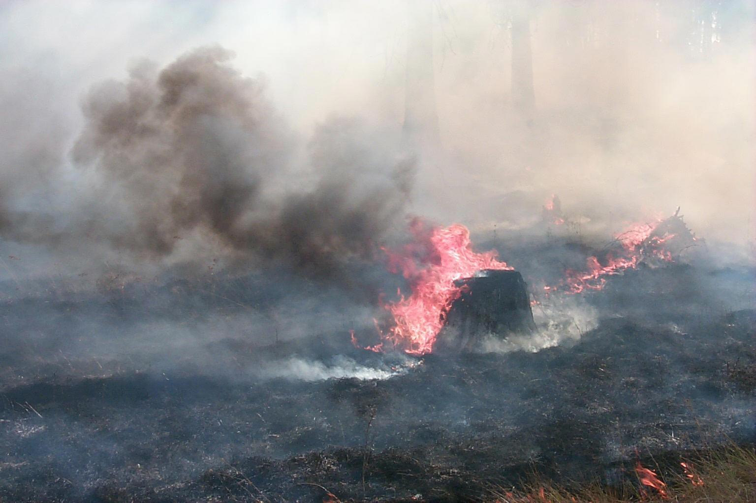
Part III. Available Fuel Potential
Flame Available Fuel
Potential
Smoldering Available Fuel
Potential
Residual Available Fuel
Potential
“Flash” Fuels
1-hr
100-hr
Log
Litter
Pyrolysis zone
Flame available
Smolder available
Residual available

Slide 23
FCCS Applications
Translating fuelbeds into fire hazard mapping and assessment

Slide 24
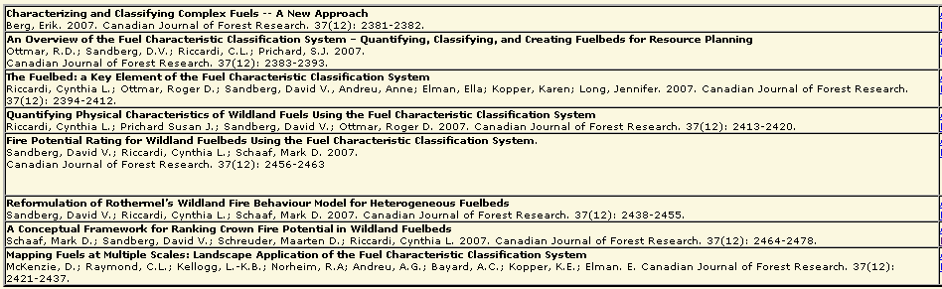
For More Information
http://www.fs.fed.us/pnw/fera/fccs/pubs.shtml

