Slide 1
www.skolat.com

Slide 2
About Skolat
Web framework for organizing the application and distribution process in an academic mobility program.
Consists of three modules
Applicants
Partners
Coordinators
Transparency of the whole process is ensured by involving all interested parties throughout it
Can be used out-of-the-box for Erasmus-Mundus Action 2 projects and can be further extended for other mobility projects
Online demo available on www.skolat.com

Slide 3
Features
Support of multiple calls within one installation
Support of simultaneously running calls
Applicants can copy previous application into new call
Statistics available to partners and coordinators
Full application information available to partners during the whole project
All actions have change logs to improve visibility and track changes
Automated emails; questions; scholarship letter generation

Slide 4
Academic mobility process:
Overview
New call is configured from the coordinator module
Partners enter capabilities – subjects available for applicants
Applications are submitted
Partners validate and set eligibility for the applicants originating from their institutions
Partners set acceptance for the applicants applying to their institutions
During consortium meeting applicants are distributed
Applicants see their status and if selected accept/reject the offer
Partners generate Scholarship letter for applicants

Slide 5
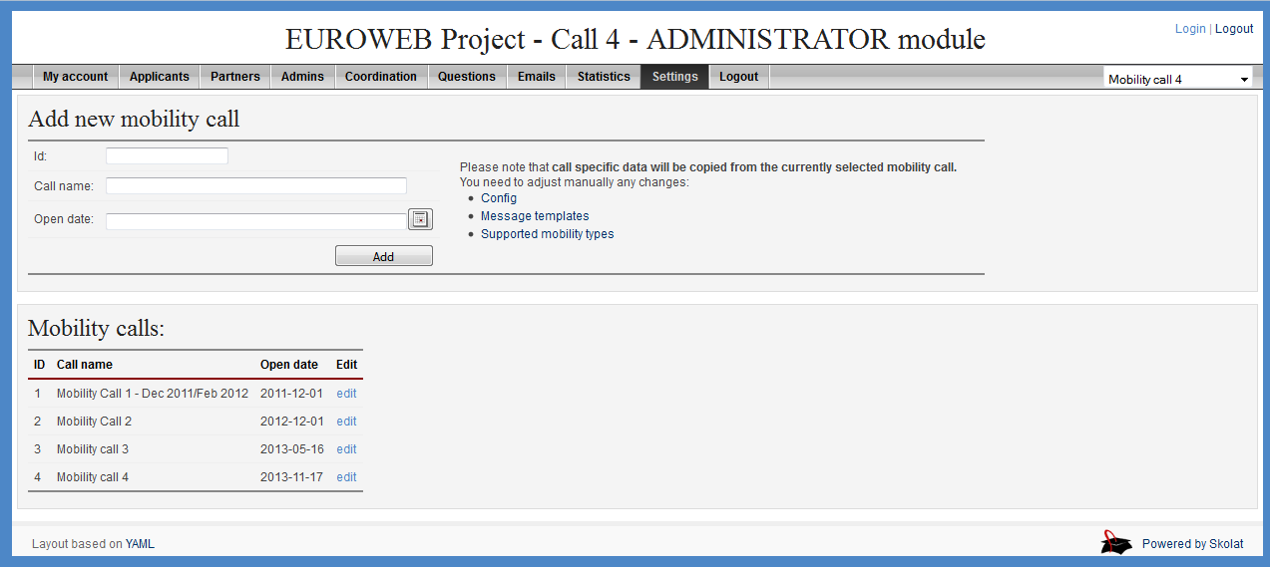
Academic mobility process
1. New call is configured from the coordinator module

Slide 6
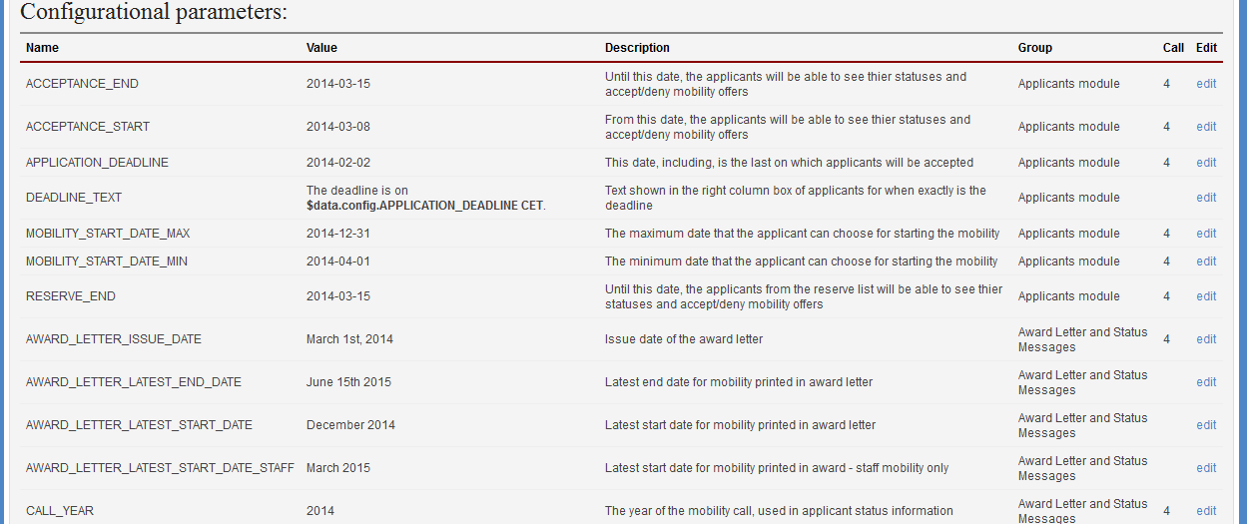
Academic mobility process
1. New call is configured from the coordinator module

Slide 7
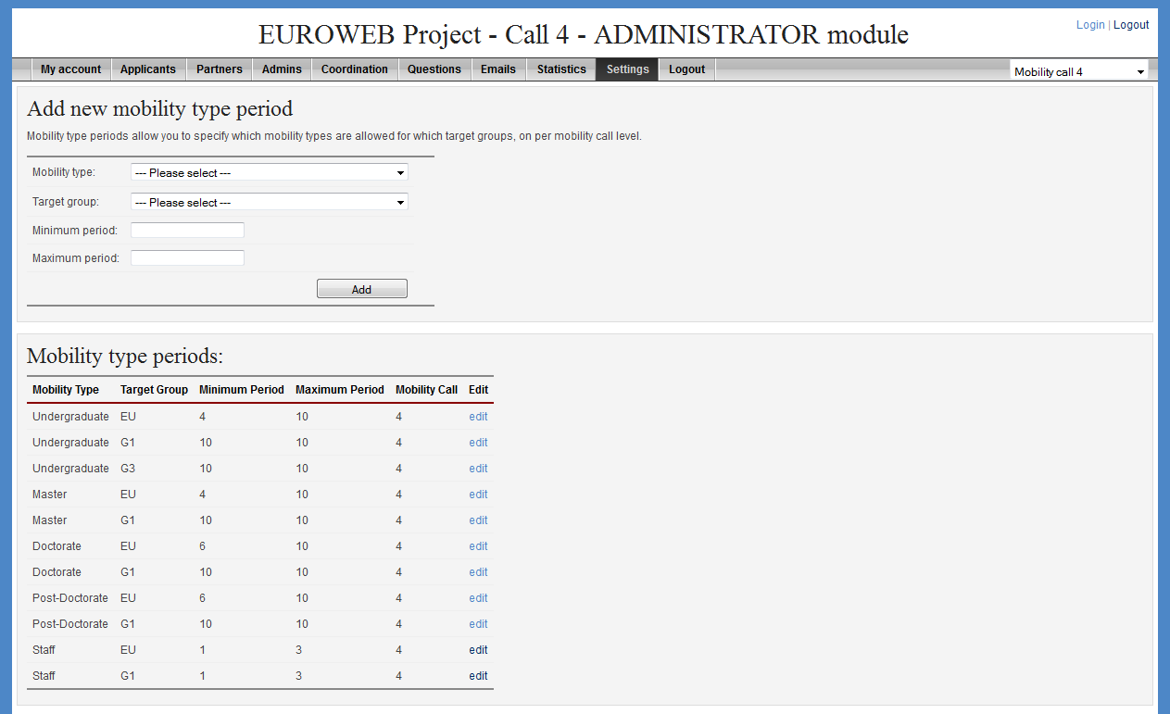
Academic mobility process
1. New call is configured from the coordinator module

Slide 8
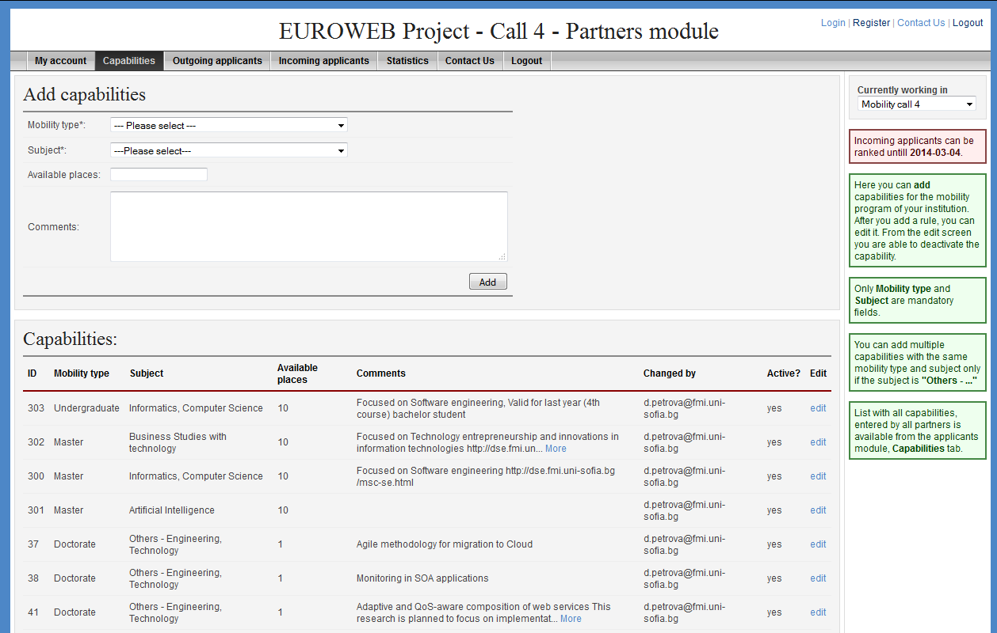
Academic mobility process
2. Partners enter capabilities – subjects available for applicants

Slide 9
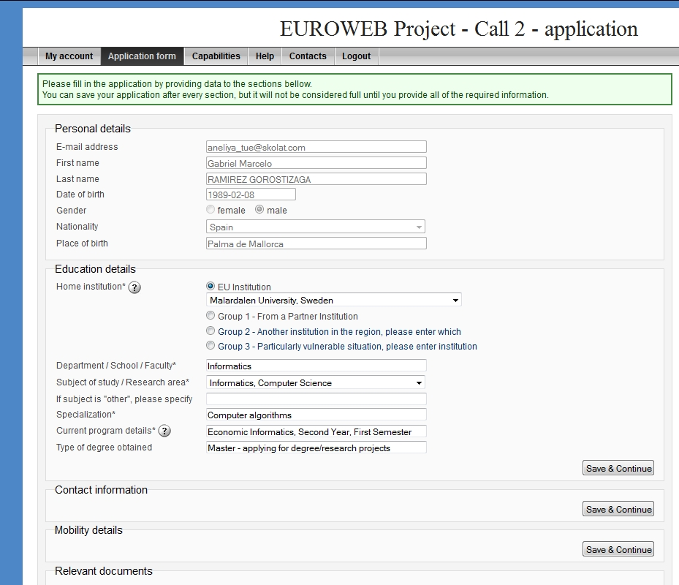
Academic mobility process
3. Applications are submitted

Slide 10
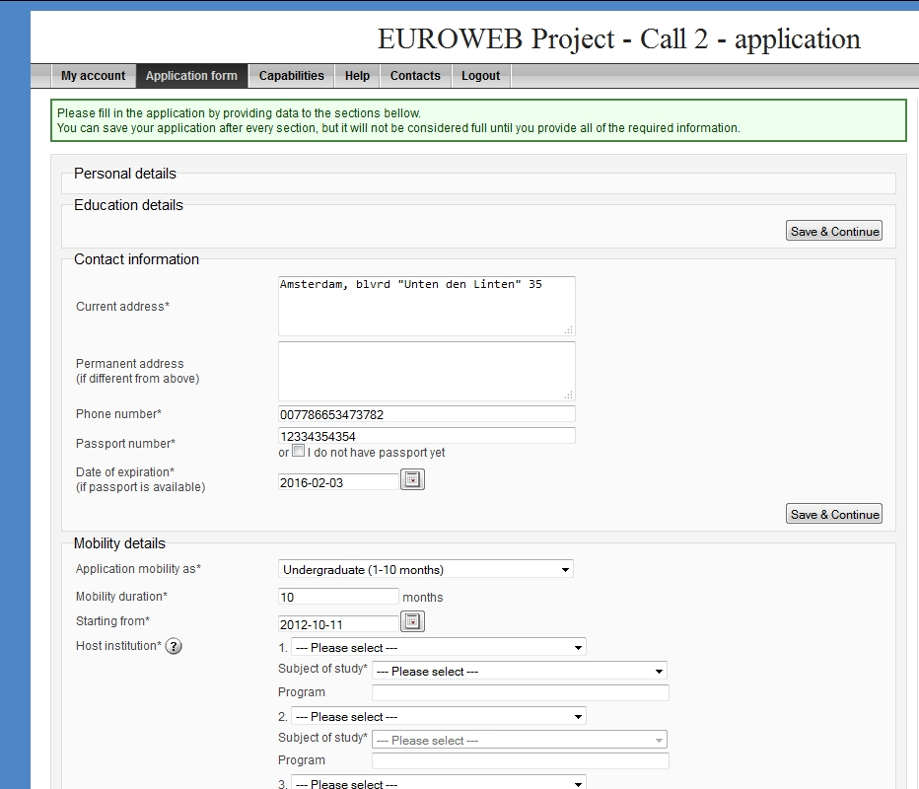
Academic mobility process
3. Applications are submitted

Slide 11
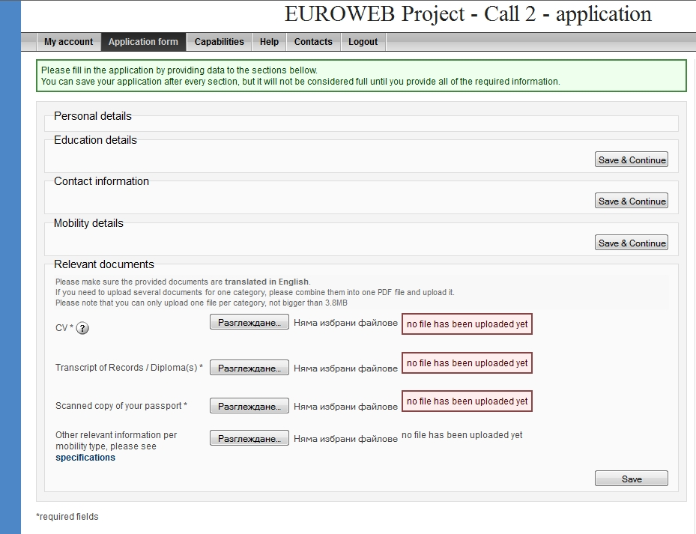
Academic mobility process
3. Applications are submitted

Slide 12
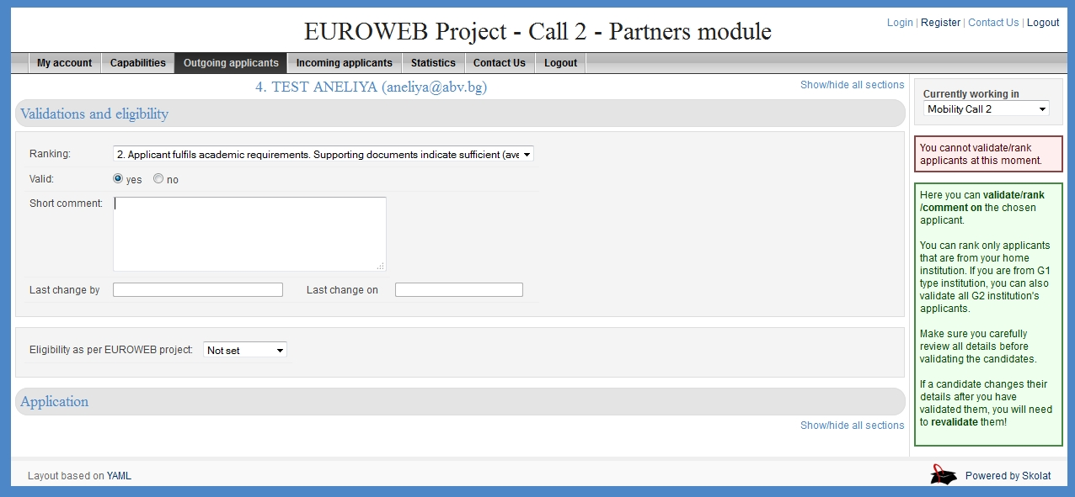
Academic mobility process
4. Partners validate and set eligibility for the applicants originating from their institutions

Slide 13
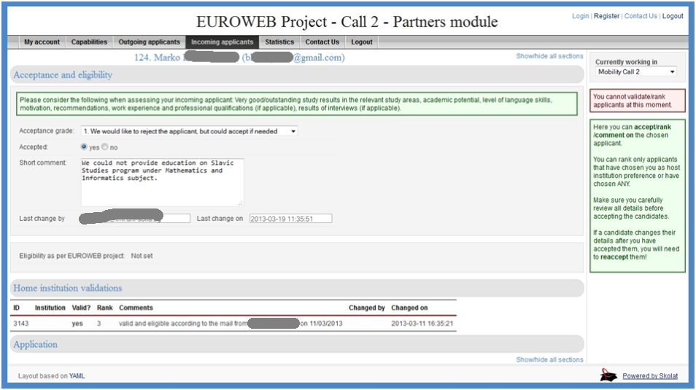
Academic mobility process
5. Partners set acceptance for the applicants applying to their institutions

Slide 14
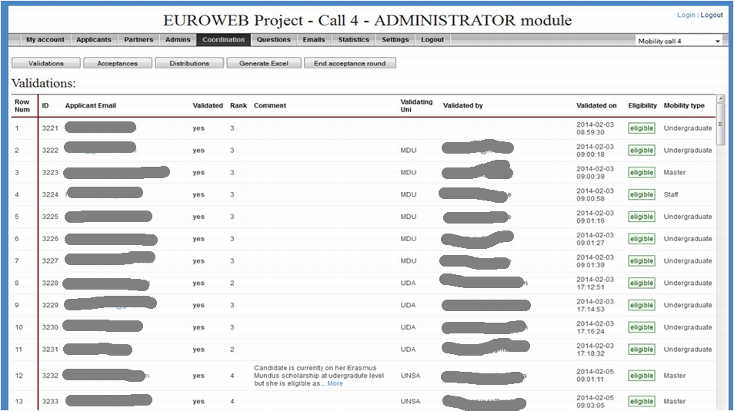
Academic mobility process
6. During consortium meeting applicants are distributed

Slide 15
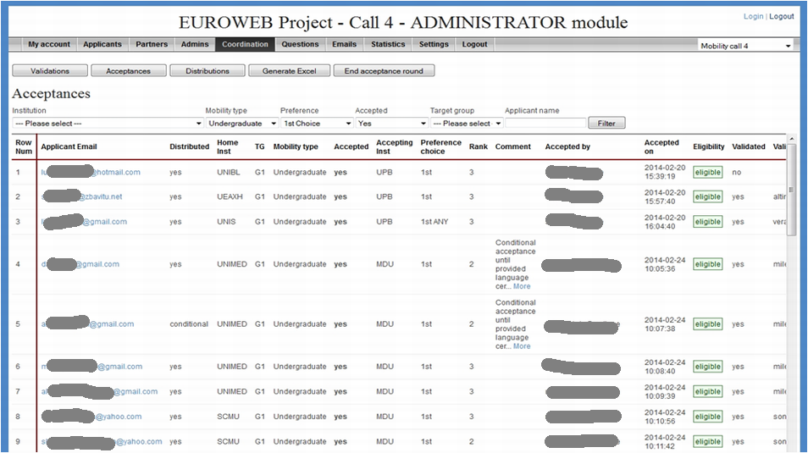
Academic mobility process
6. During consortium meeting applicants are distributed

Slide 16
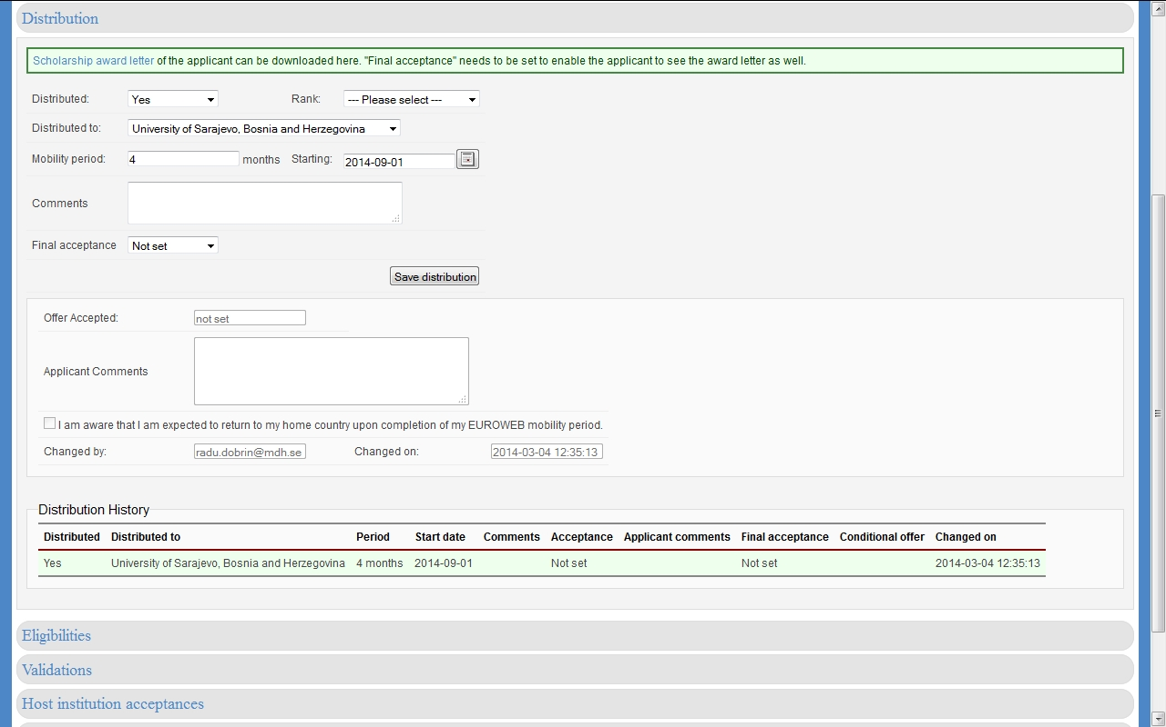
Academic mobility process
6. During consortium meeting applicants are distributed

Slide 17
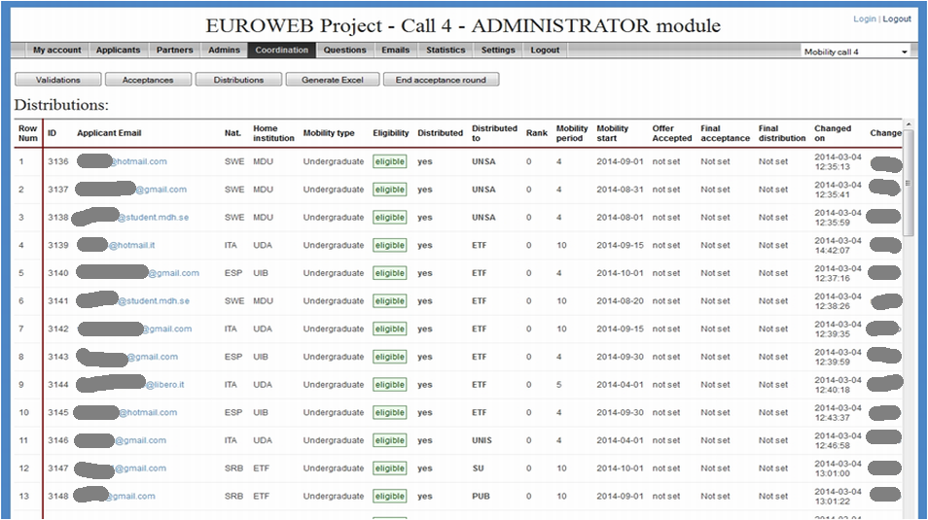
Academic mobility process
6. During consortium meeting applicants are distributed

Slide 18
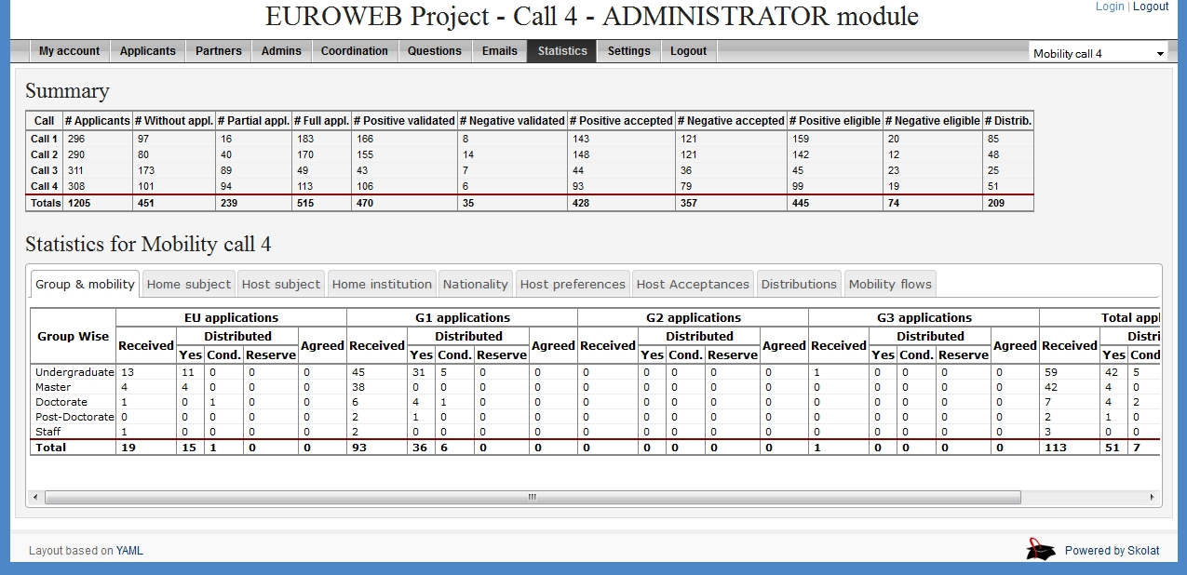
Academic mobility process
6. During consortium meeting applicants are distributed

Slide 19
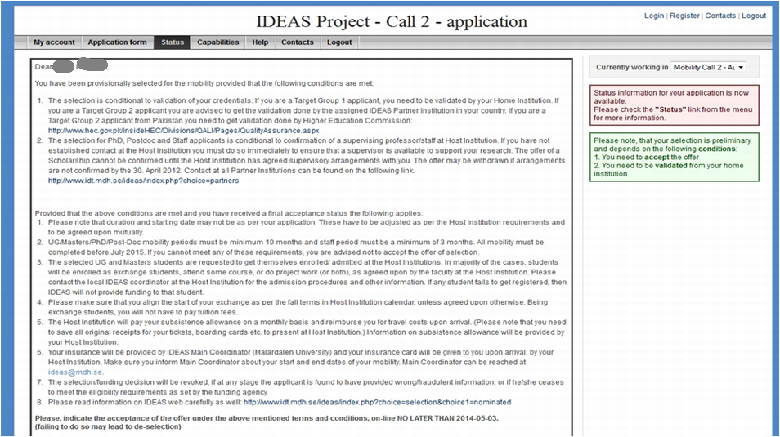
Academic mobility process
7. Applicants see their status and if selected accept/reject the offer

Slide 20
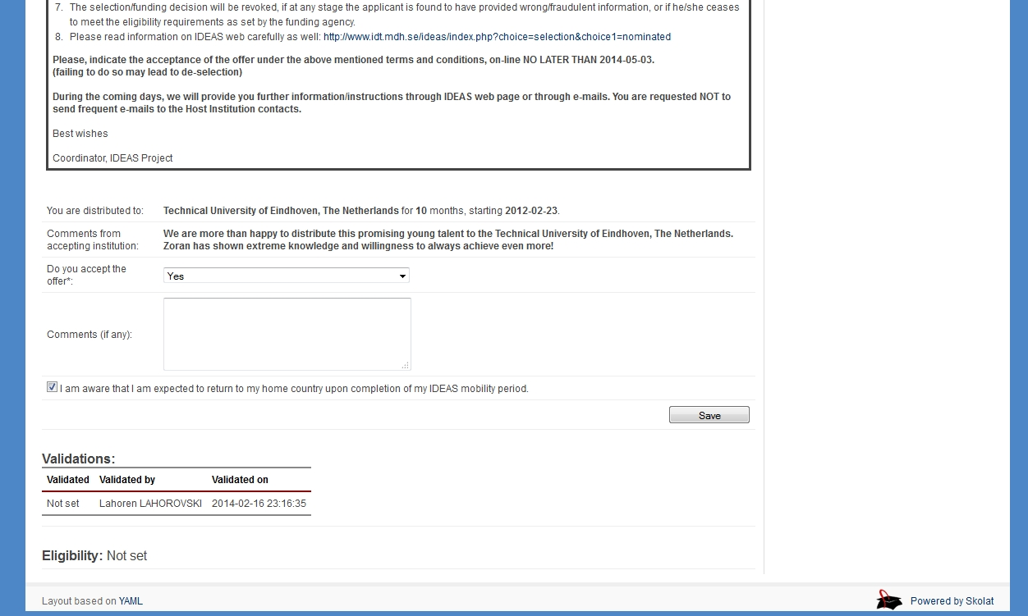
Academic mobility process
7. Applicants see their status and if selected accept/reject the offer

Slide 21
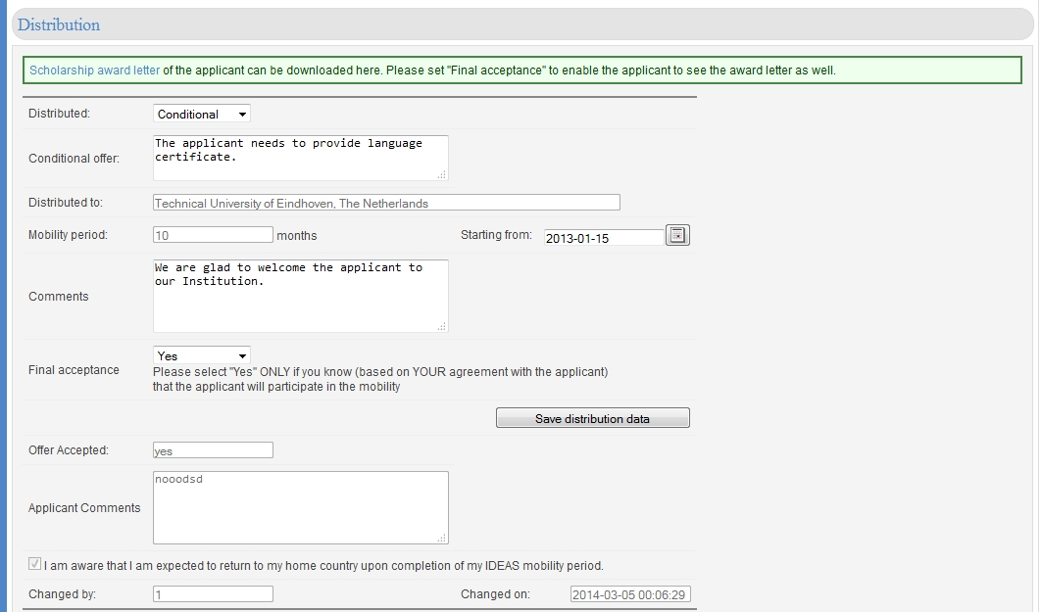
Academic mobility process
8. Partners generate Scholarship letter for applicants

Slide 22
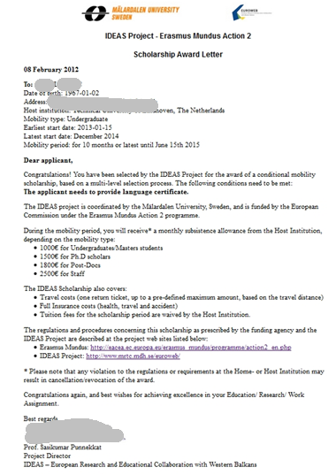
Academic mobility process
8. Partners generate Scholarship letter for applicants

Slide 23
Academic mobility process:
Overview
New call is configured from the coordinator module
Partners enter capabilities – subjects available for applicants
Applications are submitted
Partners validate and set eligibility for the applicants originating from their institutions
Partners set acceptance for the applicants applying to their institutions
During consortium meeting applicants are distributed
Applicants see their status and if selected accept/reject the offer
Partners generate Scholarship letter for applicants

Slide 24
Reasons to use Skolat
Structured - the academic mobility happens through a predefined process
Transparent – all parties are involved in the process
Secure – all activities are tracked within the system
Detailed – statistics give insight to the mobility program progress
Open source – can be used by all academic mobility projects
Configurable – project deadlines, email templates and award letter are fully customizable
Tested – successfully used in three Erasmus Mundus - Action 2 projects: EURECA, EUROWEB and IDEAS

Slide 25
Thank you!
Questions? Suggestions? Improvements?
Aneliya Vlaykova
aneliya.vlaykova@gmail.com
https://www.linkedin.com/in/aneliyavlaykova
www.skolat.com

