Slide 1
Test UI for UDFR
OntoWiki platform
June 2011

Slide 2
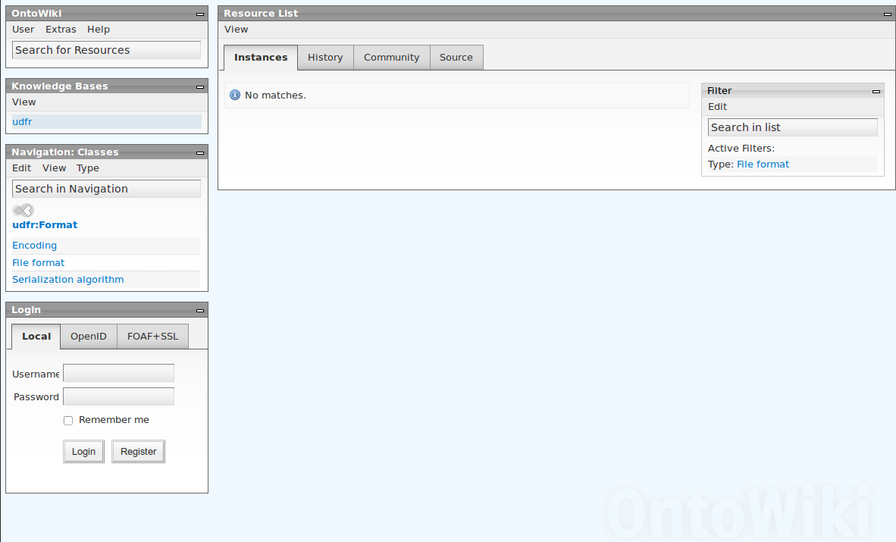
Search and Browse
Free text search
Hierarchical Browsing

Slide 3
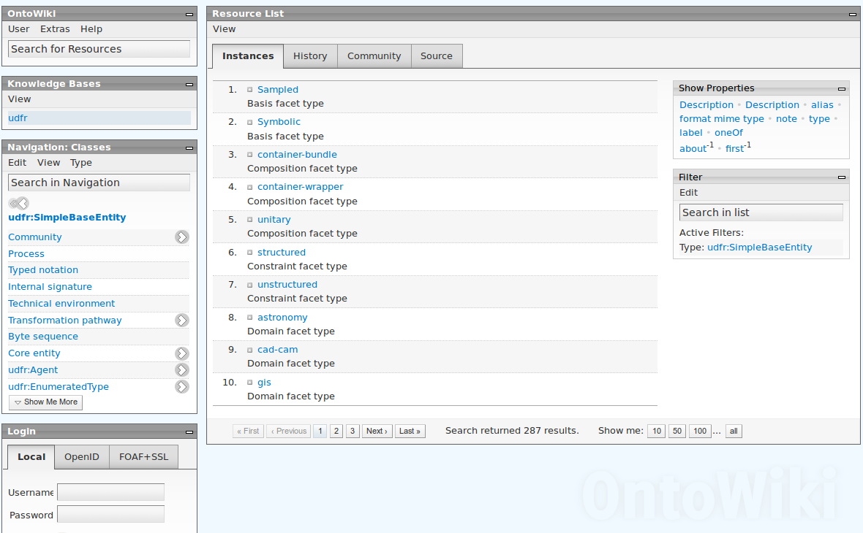
Retrieval
Shows all inherited
Instances of SimpleBaseEntity

Slide 4
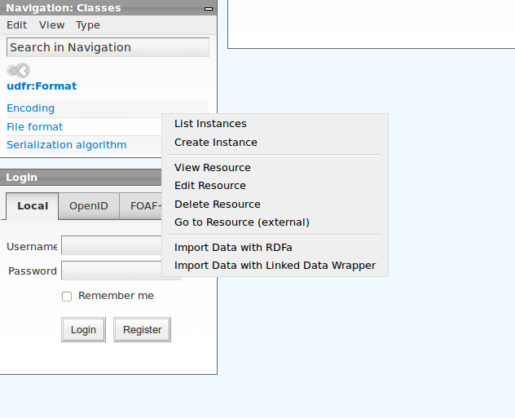
Editing
Editing Module

Slide 5
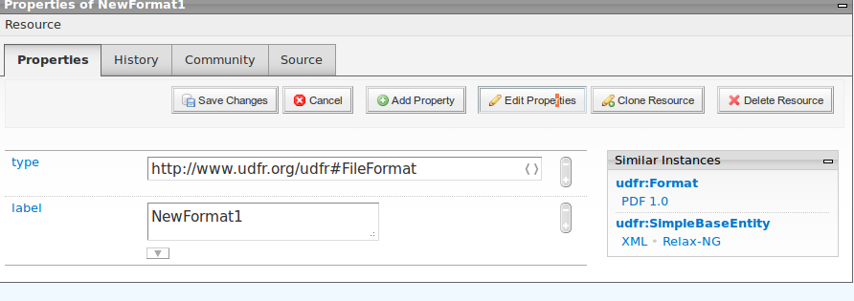
Editing
Create New Instance
Shows instances with from same
Class and parent classes

Slide 6
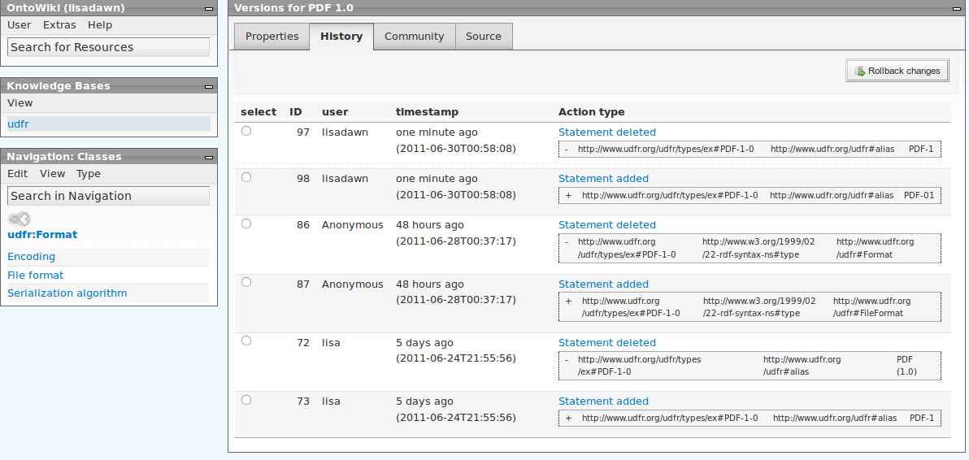
Provenance
User + TimeStamp
Change History details

