Slide 1
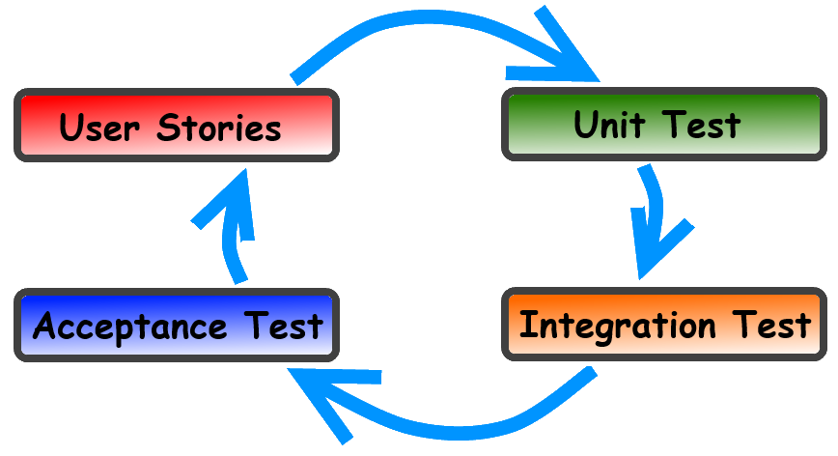
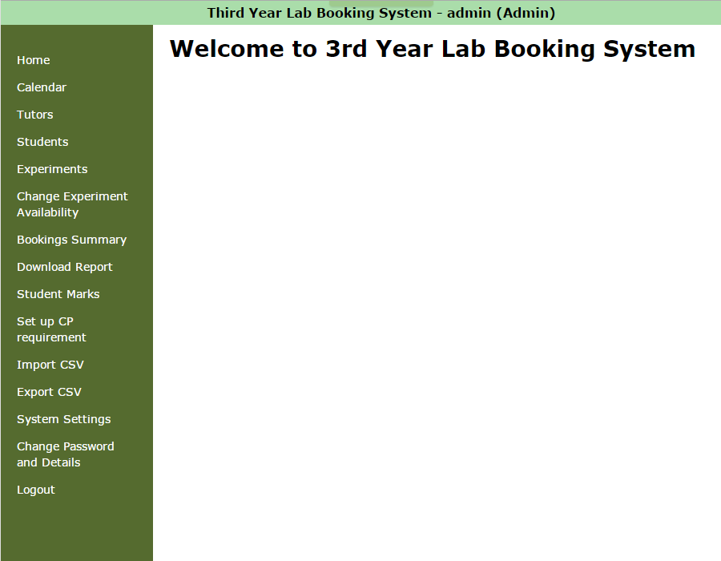
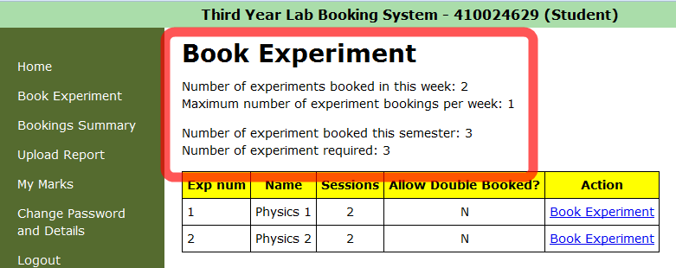
Third Year Physics Lab Booking System
Christopher Ballouz, Julio Deak, Kartik Gupta, Mohammed Heydari, Albert Hyde, Puravin Sivaganam Professor Judy Kay, Professor Xue Yang School of Information Technologies Faculty of Engineering & Information Technologies
What is this project about?
Introduction
In each semester, the School of Physics offers over 30 different experiments in Senior Physics Laboratory for the students to undertake and earn credit points. Students use the web booking system to book times for completing experiments and to view their marks.
Strategy
Thoughtful Testing
To ensure on the functionality, we have followed the Extreme Programming coding methodology. The methodology states to conduct 3 levels of software testing with pair programming to achieve completeness of tasks.
Unit testing are created before implementation to strict
on coding and to make clear of the goal to be achieved.
Integration testing follows after all unit test passes.
The test will combine individual works and checks if
any there are any conflicts.
Lastly, acceptance test is committed. The test refers
back if the implementation is meeting the client’s
requirements and expectations.
Aim
We were given a booking system with numerous flaws and defects. Our aim was to resolve these bugs and make a complete and deliverable product!
Novel Approach
To satisfy our client’s requirements and to not increase issues, we preserved the initial system’s settings and structures.
Object-oriented design patterns for Ruby made it possible to have a tight coupling of data structures, making it easier for us to develop and implement; each having a responsibility for different objects.
Conserving Model-View-Controller design pattern of Rails also assisted us to detect where the problem was occurring
Initial System
X
e treme
Fixed Bugs
Introduction
The system at initial state consisted of numerous bugs. There were visible bugs and hidden bugs which were found along our implementation. Below is the list of bugs we have found and resolved.
Administrator
At the students page, when administrator tries to add student and presses the ‘Create Student’ button, the new student will be created though administrator is redirected to Rails error screen.
When accessed Students’ Experiment Details page as administrator and press on back button, uncaught error is thrown.
System settings function, maximum number of experiments booked per week is broken,
programming
Additional Features
Administrator
Administrator can now change the availability for each experiments. At the Calendar page, administrator selects one experiment from the list of all experiments and when pressed ‘set’ button the respective Calendar will be shown.
Administrator is available to view the state of Students for each experiments. The state is either ‘booked’, ‘complete’ or ‘nothing’.
More powerful administrator control. Additional option for administrator to disable or enable the cancel bookings for students. Administrator is not affected to this option and can cancel booking at any time.
Student
Students are prompted with confirmation box before they proceed to make booking on the selected date to prevent fault action.
Students now receive emails whenever the student account is created and their booking has been changed.
Students can now receive emails whenever the student account is created and their booking has been changed. The email is also sent when administrator makes change to the student.
Student can only book experiment for the specified experiment’s available date.
Student can now not make multiple booking to the same date.
Student
At the book experiment page, when administrator makes alternation to student’s booking, the statistics does not get reflected.
At the Book Experiment page, the back button is not operating as expected.
Utility
Navigation bar is now scrollable. Before, when the browser screen was small, the navigation bar went out of the frame preventing User to gain control of those items.
Improved User Interface to make system intuitive and comfortable for the user to navigate.
THIS RESEARCH IS SPONSORED BY

