Slide 1
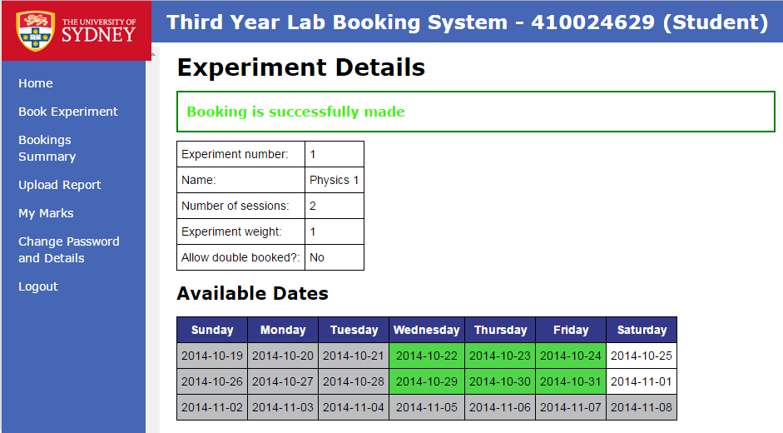
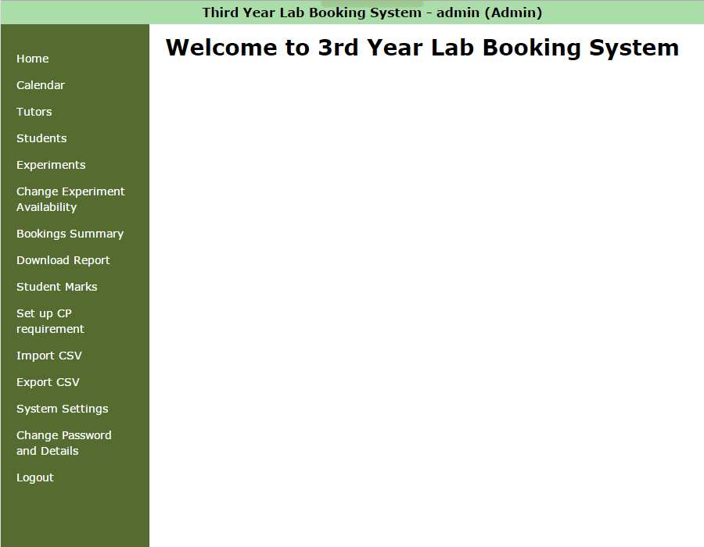
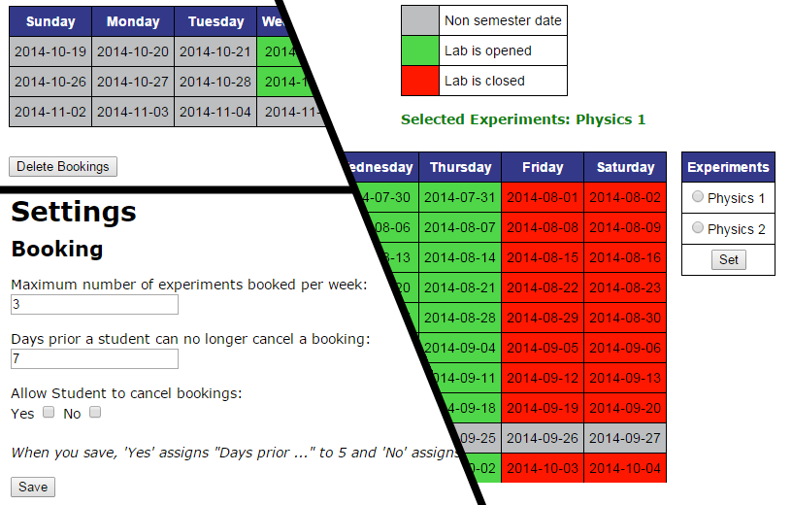
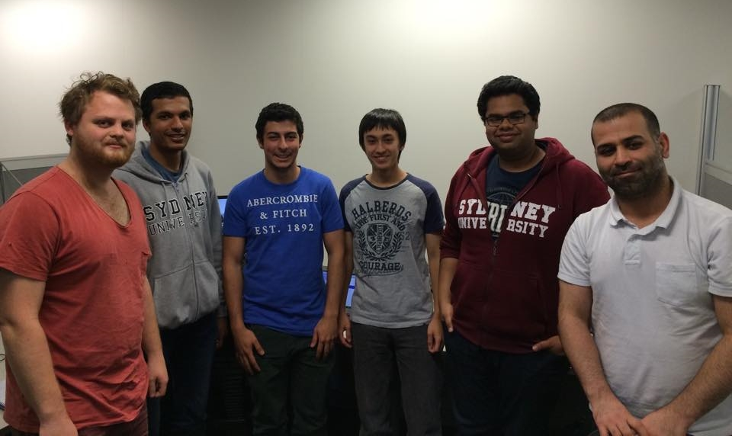
Physics Lab Booking System
Albert Hyde, Christopher Ballouz, Julio Deak, Kartik Gupta, Mohammed Heydari, Puravin Sivaganam Professor Judy Kay School of Information Technologies Faculty of Engineering & Information Technologies
What is this project about?
Introduction
In each semester, the School of Physics offers over 30 different experiments in Senior Physics Laboratory for the students to undertake and earn credit points. Student uses web booking system to book times for doing experiments and view their marks.
Aim
We were given a booking system with lots of flaws and defects. Our aim is to resolve these bugs and make a complete deliverable product!
Core Problems
Tiresome user interface
As can see from the picture on the left, the initial system had a murky design. To make the system more delightful, we’ve changed the style-sheet in the system and now, the notifications and calendars are more remarkable!
Initial System
Administrator control
Initial system did not allow admin to gain full control over the system. We have coded the system to fix the issues.
Admin can delete booking any time
Approach
To satisfy our client’s requirements and to not increase more of the issues, we preserved the initial system’s codes, settings and structures.
Object-oriented design of Ruby allowed to have a tight coupling of data structures, making it easy for us to develop and implement; having each a responsibility on different objects.
Conserving Model-View-Controller design pattern of Rails also assisted us to detect where the problem was occurring.
Admin can now select the availability for each experiment
More system settings for admin
Improved Student control
Students can now book for different sessions at the same slot.
Students are now receives email whenever the student account is created and their booking have been changed.
Project Team
System Specification
Web Framework
Ruby: 1.9.3
Rails: 4.1.1 (gem: 3.2.1)
Gems Installed
jquery-rails
paperclip 3.3.1
THIS RESEARCH IS SPONSORED BY
THIS RESEARCH IS SP

Slide 2
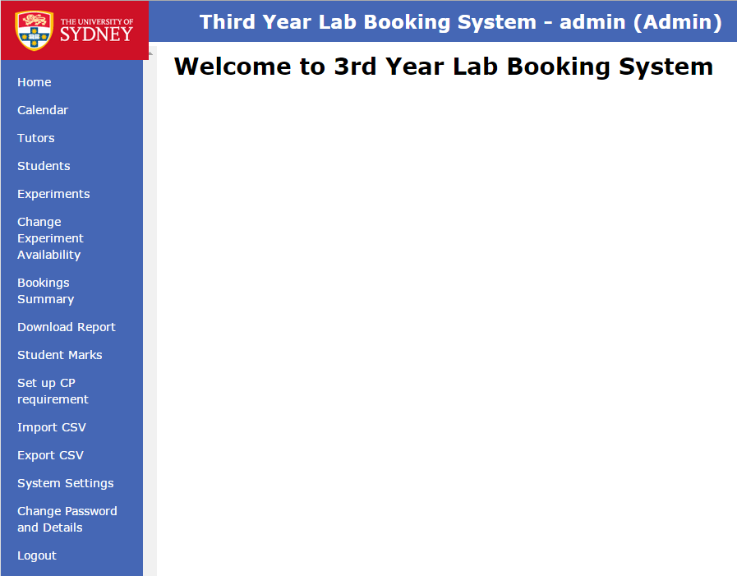
Core Problems
No Booking Confirmation!
Previously, students did not get any confirmation when they made a booking. To cater to our client’s request, we have made to show success message at the top of the page when booking is successfully made. Also the user who made the booking will receive a confirmation email to their registered account.
HEADING CAPS RGB 0, 152, 219 – Arial 28
Sub Head 2 - Text Arial Bold 24
Text Arial 23
Updated system!!

