Slide 1
3rd Year Physics Lab Booking System
Christopher Ballouz
Julio Deak
Kartik Gupta
Mohammad Heydari
Albert Hyde
Puravin Sivaganam

Slide 2
The Project
3rd Year Physics Lab Booking System
School of Physics, USYD
30 experiments
90 students
10 weeks
Students, Tutors, Administrators
Credit Point Requirements
Evenly Booked

Slide 3
The Client
Prof. (Dr) Xue (Sue) Yang
Very technical
Very clear on the system
Has existing system

Slide 4
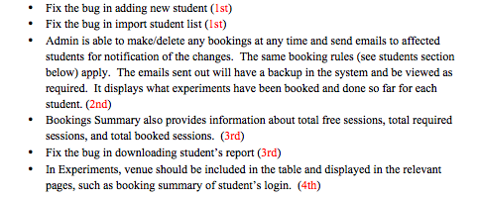
Clients Needs
Wants Bugs fixed and New Features
Divided into Students, Tutors and Administrators
Had Documents Ready
Prioritised by need
Notes:
----- Meeting Notes (23/10/14 16:17) -----
Add language used

Slide 5
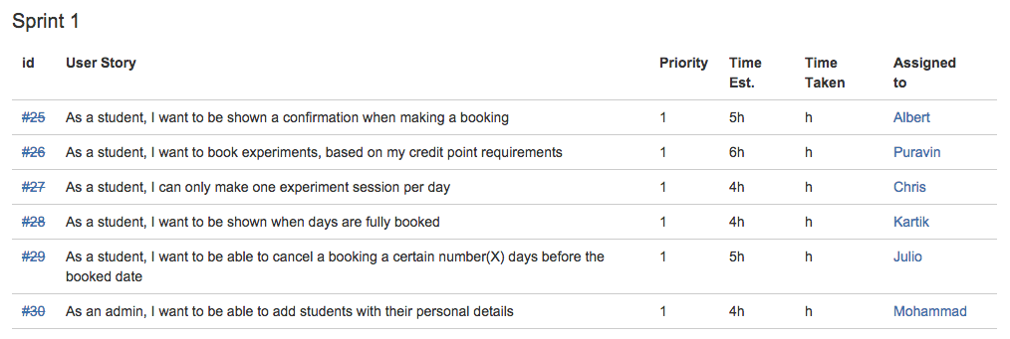
User Stories
Analysed documents from Client
Converted each task to a single unit of work i.e. User Story
Divided User Stories into Sprints based on Priority
Covered Priorities 1, 2, some of 3
3 Sprints + Usability Testing
Notes:
----- Meeting Notes (23/10/14 16:17) -----
Add fixed page

Slide 6
User Stories to Acceptance Tests
Acceptance Tests for each User Story
Sent these to the Client
Negotiated final Acceptance Tests
User Story | Our Acceptance Test | Clients Correction
As a student, I want to book experiments, based on my credit point requirements | Given I am a student, When I have credit points of 2, then 3 experiments will be available for me to book… | When booking, I choose one from the list of experiments. With 2 cps, I can only book 6 sessions;

Slide 7
Demo

Slide 8
The Team
6 Programmers
3 Experts
2 Testers
1 Client Liaison
1 Tracker
1 Project Manager
How to manage?!?!
Notes:
Clear concise insightful summary of the processes used
Critique of the processes used

Slide 9
Support Structure
Programmers
Experts
Manager, Tracker

Slide 10
Development in XP
User Story
Testing
Development

Slide 11
Unit Tests
Ruby/Rails
Acceptance Test
Merge
Create Pull Request
Accept/Decline
Create Branch
Integration Test

Slide 12
Escalation Plan
Teaching Team
Team Manager
Pair Programmer
Google/Self

Slide 13
BitBucket
Minutes
Assignment Information
Tasks

Slide 14
Strengths
Clean, testable and readable Code
Well Commented
Well named
Conforms to clients needs
Deployments in Week 7, 9 and 11
Continuous feedback from client
Client on BitBucket

Slide 15
Room for Improvement
Unit Testing (Rspec)
Rotation of pairs
Timely information on BitBucket
Cross Collaboration on Assignments
Loyalty to Group Contract

Slide 17
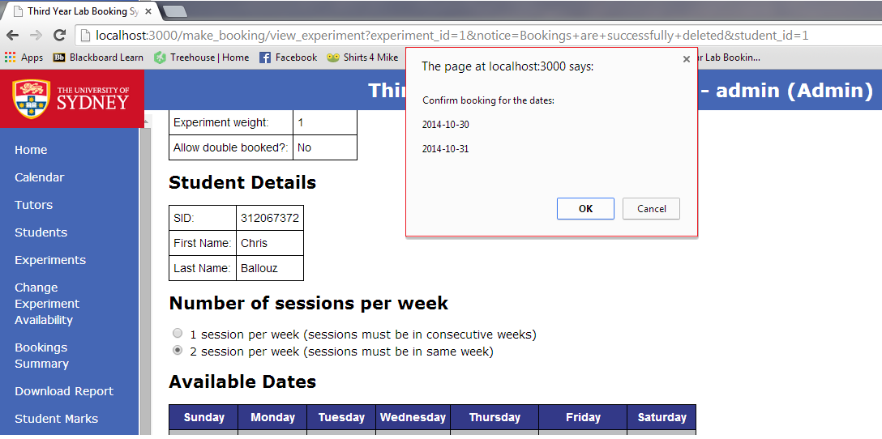
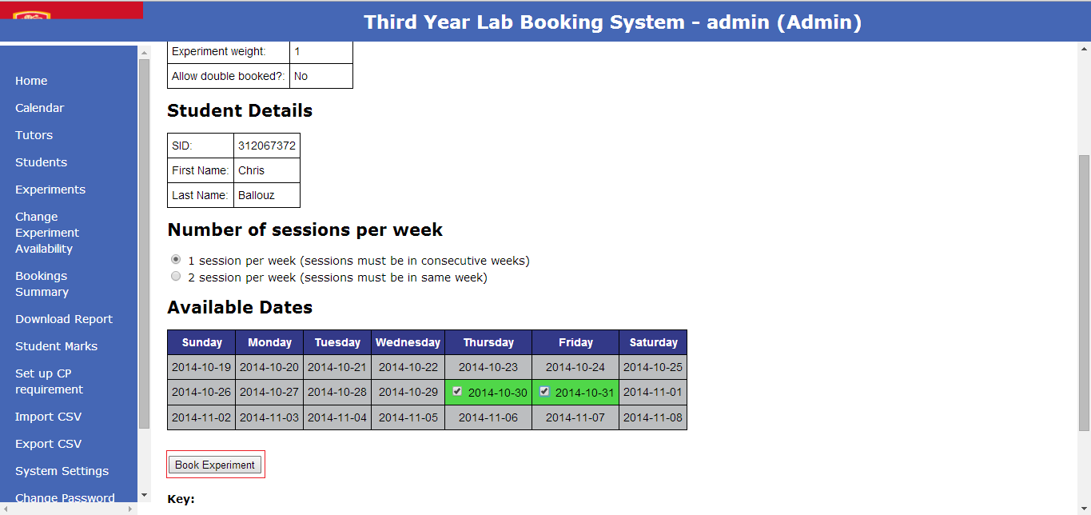
As a student or admin I want to get a confirmation when making a booking.
When I am either a student or an admin and I make a booking in the system, once the booking is successfully inputted to the database the current user will receive a success message that is clear and obvious about the booking being successfully made.
With the help of java-script, we added an alert that will confirm with the student the dates of the booking before committing the booking transaction.

Slide 18
As a student, I want to book experiments, based on my credit point requirements.
Information is provided to the student about the max number of session bookings possible and the number of sessions already booked. Using the information, the student understands the constraints of their credit point requirements and will be provided a message depending on whether the booking was successful or over the max number of sessions possible.
Added three new classes (info, data, and data-num) to improve the presentation of the information displayed on the “book experiment” page.

Slide 19
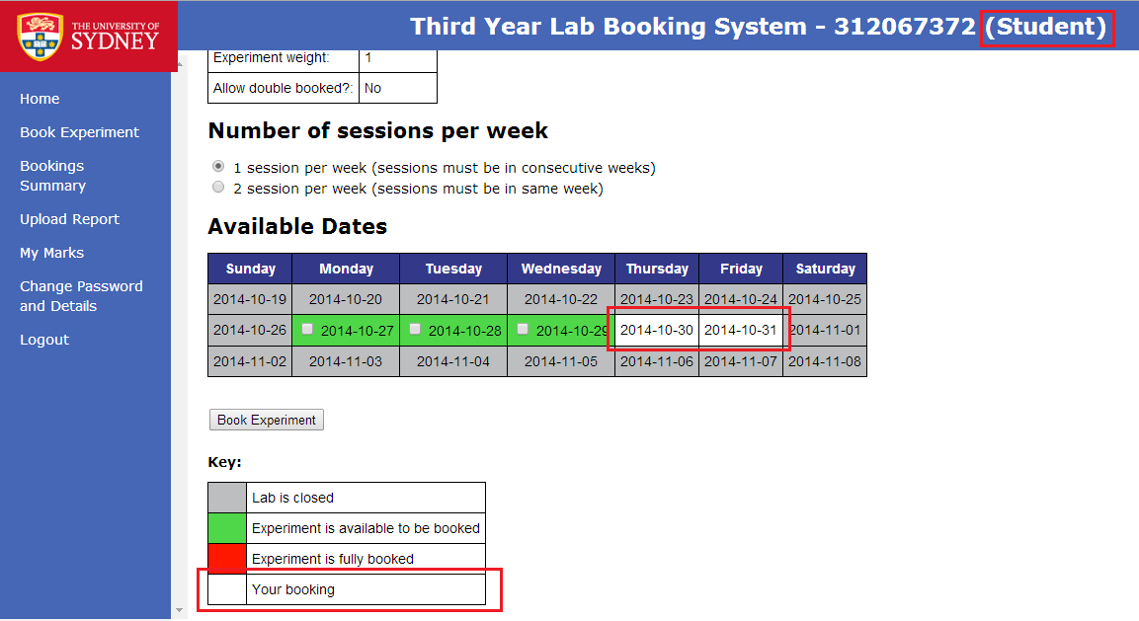
As a student, I can only make one experiment booking session per day
The student is able to identify the dates that they have made a booking for another session.
Created a new variable @bookings_exp to store all the experiments that the student has made for the booking to ensure that student is only able to delete the session booked.
Added a control statement that loops through the dates selected and checks if the current student has made a booking on the same particular date.

Slide 20
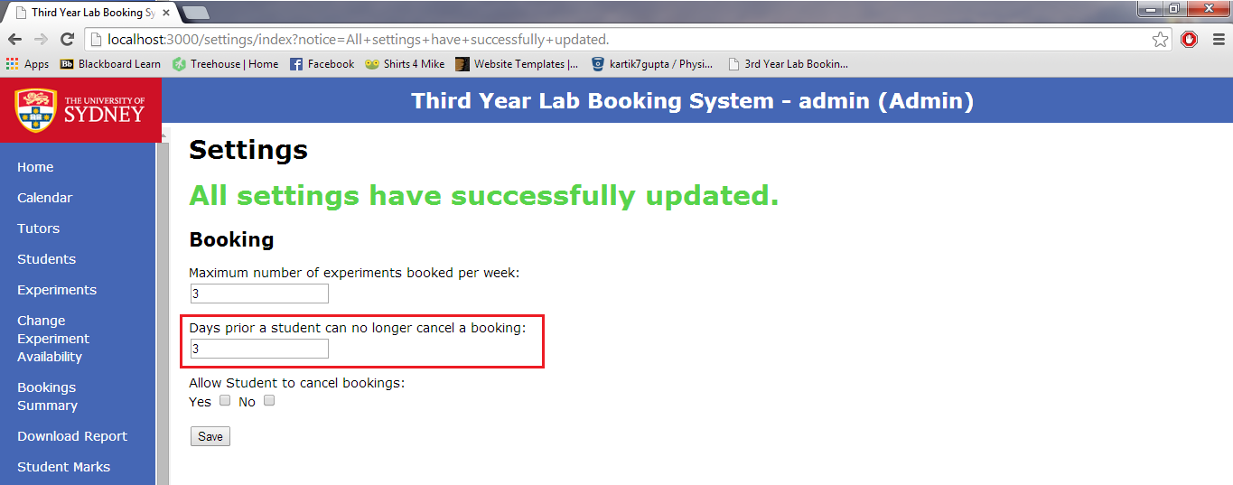
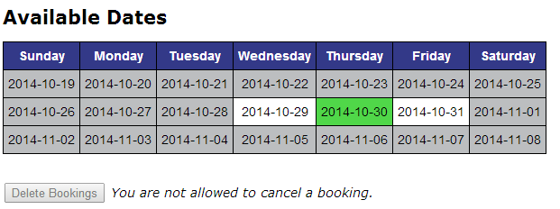
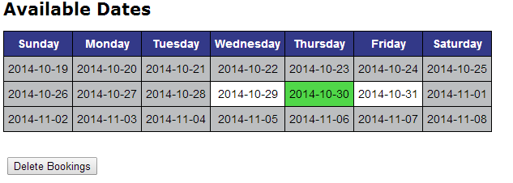
As a student, I want to be able to cancel a booking a certain number(X) days before the booked date
Administrator selects certain number (say this number is X). Students can make a cancellation if the day is X days before the booked date.
A variable that is used in both the booking page and the system settings page. It can be changed in the settings page via the admin, and the number of days is used the current date and the date of the experiment to either allow cancelation or not.

Slide 21
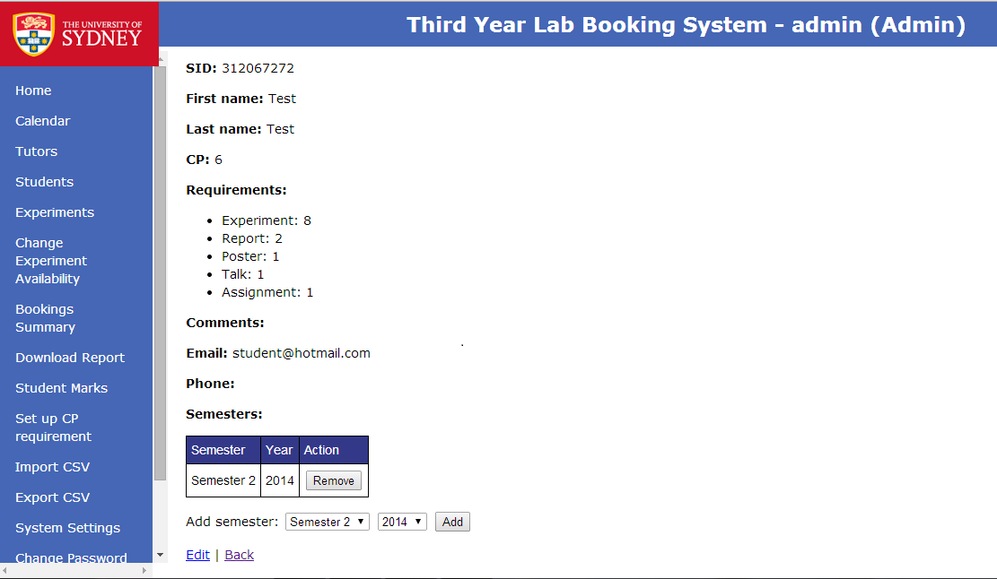
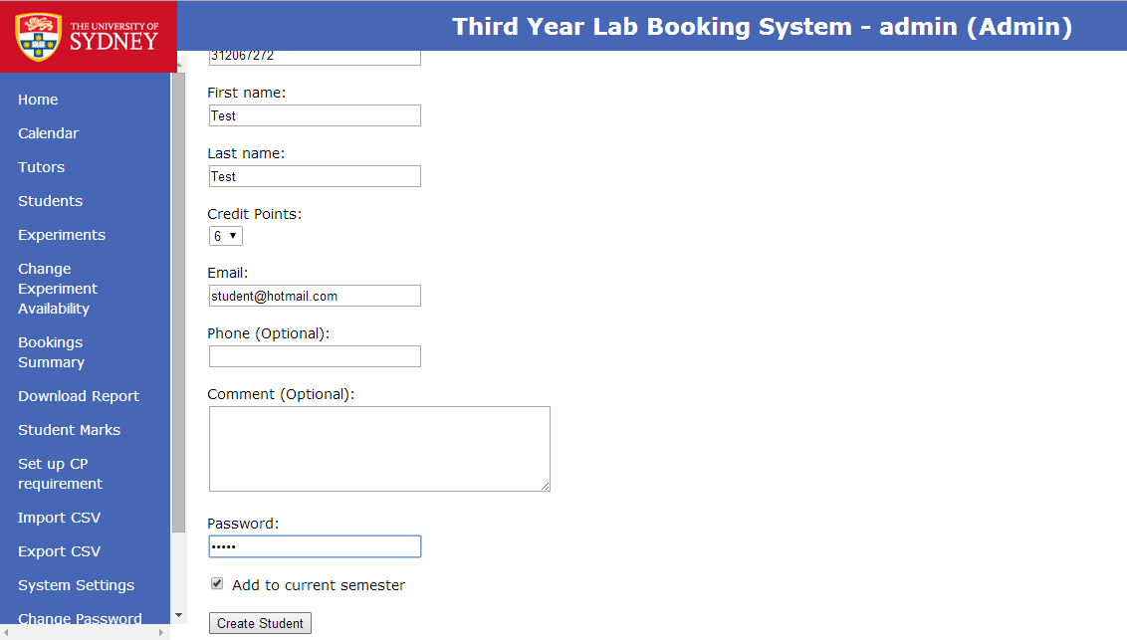
As an admin, I want to be able to add students with their personal details.
Administrator of the system needs to create students based on their personal details i.e. SID, name, email address, and password. SID and email need to be unique and they need to follow a pattern to match up.
This was a bug in the old system where an error use to pop up when adding a student. It was an error with the email address that would allow this bug to occur.

Slide 22
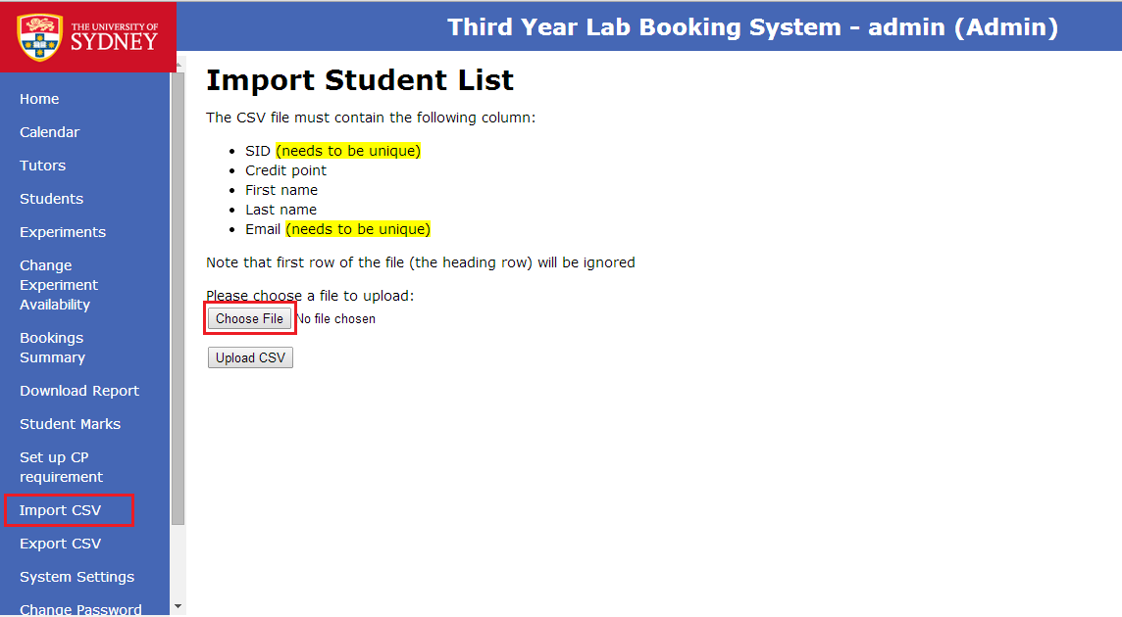
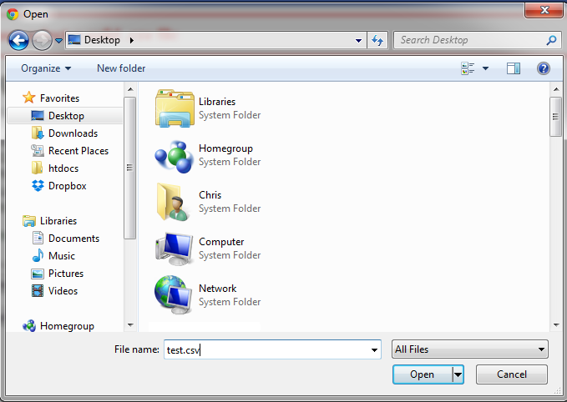
As an admin, I want to import/upload a list of students
Administrator can upload a csv formatted file, based on a predefined format, to upload a list of students. The CSV file must follow the format that is being described in the relevant view; otherwise an error will be shown. Each student in the list will then be created and saved into the database. A Confirmation email will be sent to each student to indicate that they have been added to the system.

Slide 23
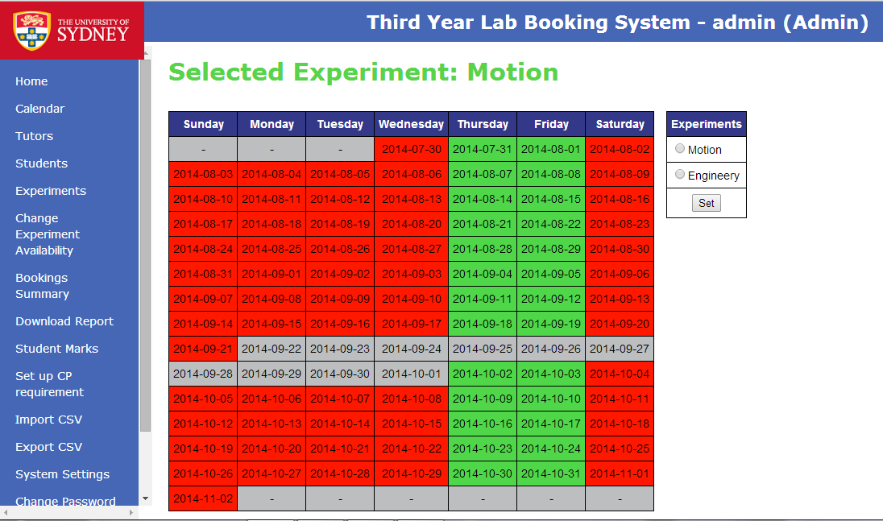
As an admin, I want to select dates for each experiment in the current semester
The administrator is able to view the experiment list side by side with the calendar and select the availability for each experiment individually.
Added new functionality that will display and store the selected experiment that you want to show. Firstly, @@exp_selected is a global class variable that gets filled with the id of an experiment when it gets posted whenever the ‘Submit’ button gets pressed in the experiment table. Secondly, toggle_calander is used as a radio button to select a experiment to be shown.

Slide 24
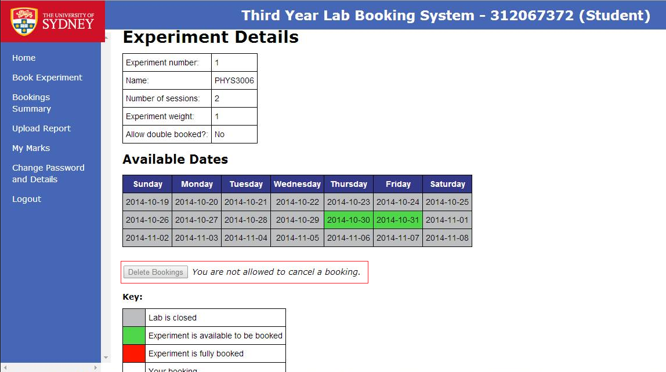
As an admin, I want to disable the option for students to cancel a booking
Main idea was to use a variable that changes according to the check box that is used.
We tried to use a new variable and assign it globally but that didn’t work, so we used the same variable that was already being used for the min_day_cancellation, but added more functionality with it.

Slide 25
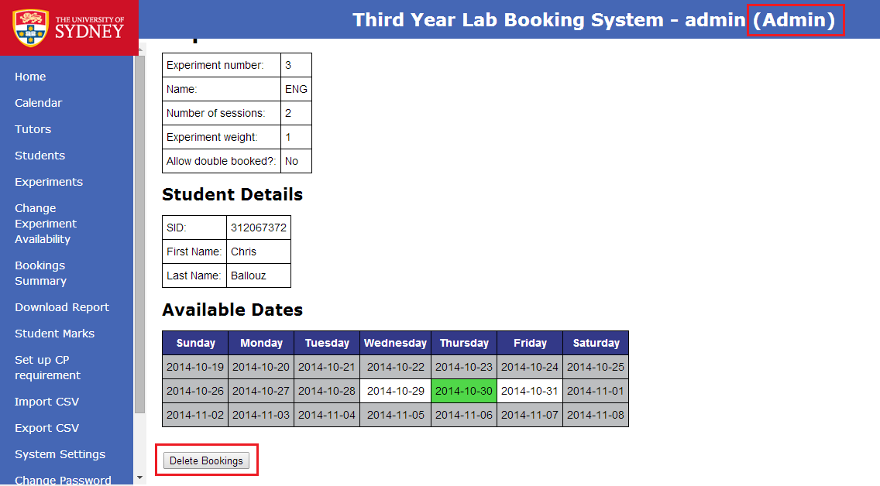
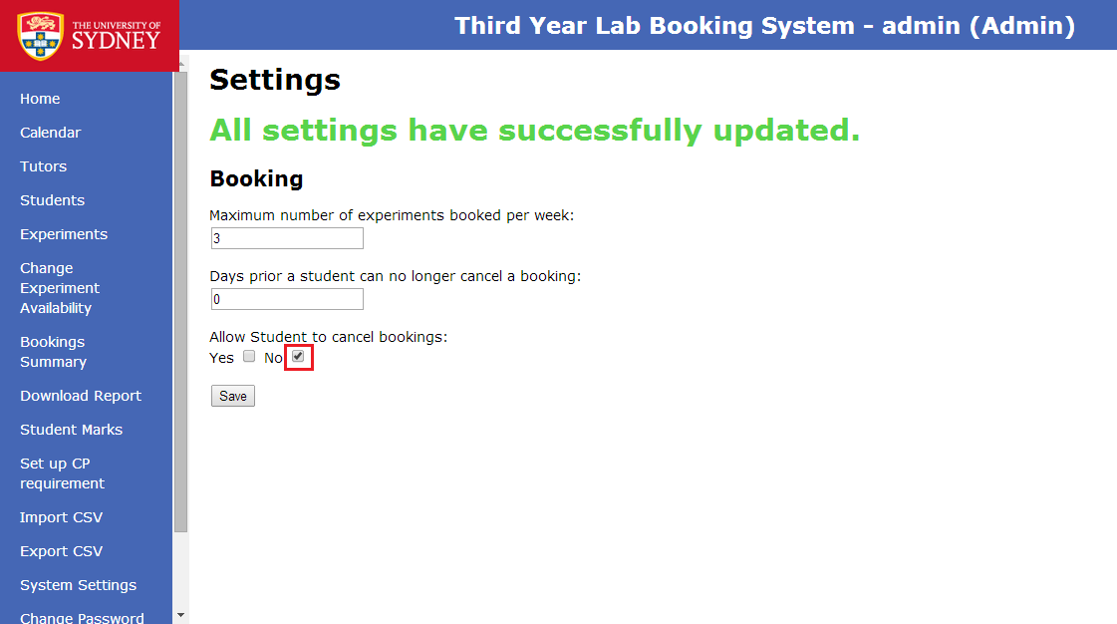
As an admin, I want to be able to cancel bookings at any time for enrolled students.
As issues can arise during a semester an admin should be able to cancel any booking made without having to worry about changing any settings. The admin level then over rules any other conditions in place and allows them to cancel the booking.
Added in a check when cancelling a booking that checks wither the current role is the admins and, if true does not check any other logic and removes the booking.

Slide 26
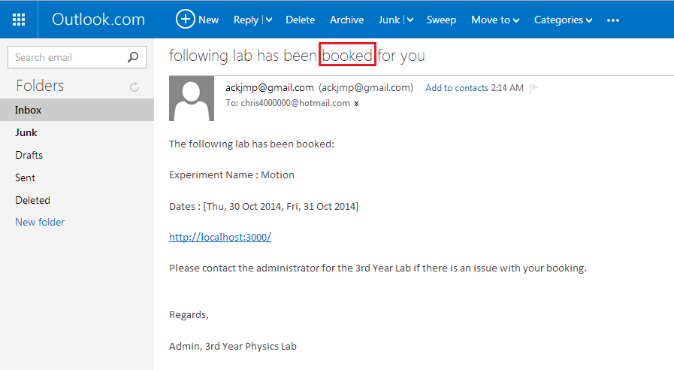
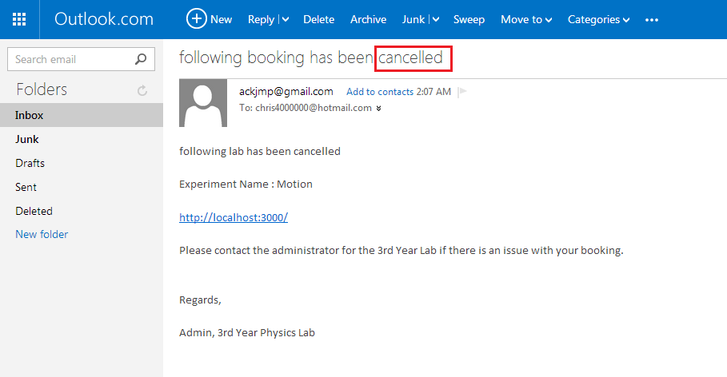
As an admin, I want email notifications sent when making/cancelling a booking
Email notification needs to be sent whenever the administrator makes a booking or cancels a booking for a student. Email notification will be sent to the student's email address that has been registered in the system.
Added two methods: ‘cancelBookingEmail’ and ‘makeBookingemail’. With these two methods, added methods calls whenever admin make/cancel a booking. So now email notifications can be sent out whenever a booking is being made or cancelled.

Slide 27
As an admin, I want to view the experiments booked and completed for each student
Administrator wants to know each Students state for each experiment. The state can be “Nothing’ if the student has not booked for that experiment, “Booked” if the student has booked for that experiment or “Complete” if the booking date has been completed. Not integrated into user story: information about total free sessions, total required sessions, and total booked sessions
Added the code to retrieve all bookings made by the user and set each experiments relative status.
Added if statement to distinguish administrator and students. If logged in as admin, new row in the table with header “Status” appears. The row will list each experiments status.

Slide 28
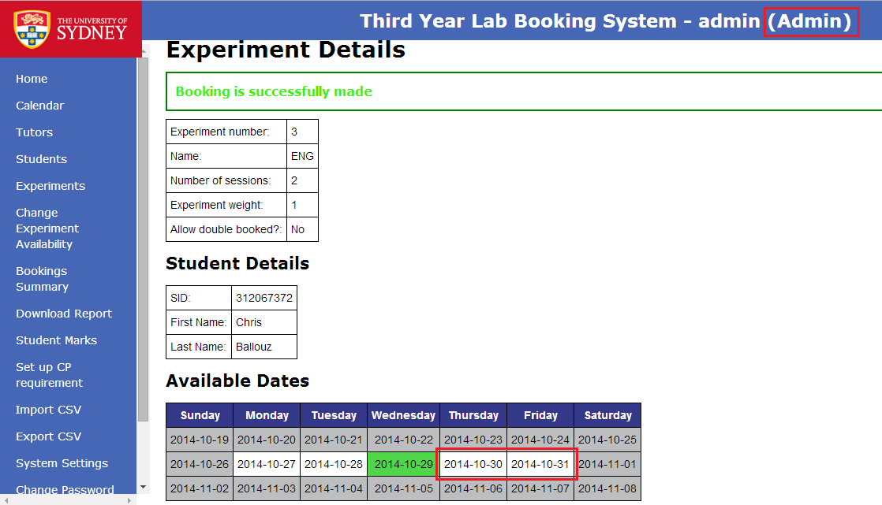
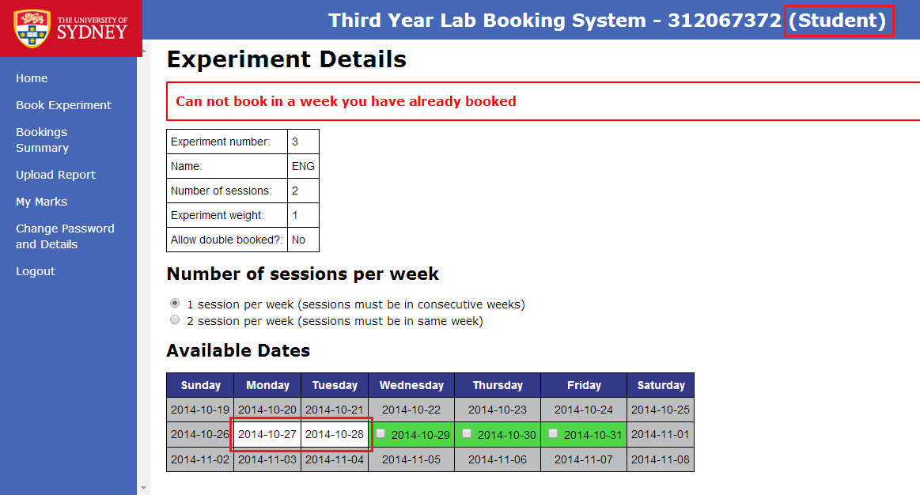
Student booking should be made evenly across the semester.
The student should not be allowed to make a booking for another experiment in one week and experiments should only be booked after another. All these changes will not affect the administrators ability to make bookings.
Added a condition to look at each of the students bookings and compare to the other dates that have been booked. If there is a conflict then raises a warning and does not make the booking.

Slide 29
Other work on top of our user stories:
Client Interaction – meeting minutes and emails
Meeting agenda.
Meeting minutes.
Personal wiki pages.
Unit tests, usability testing and testing framework.
Task page.
Issue Tracking
Cheat sheets and guides.

Slide 30
Individual Roles:
Integration Testing
Mercurial and Bit-Bucket Expert
Assignment tracker
Project Manager
Project Tracker
Xp Expert
Usability Tester
Client Liaison

Slide 31
Resource Links
Outcome 1:
Client needs
Outcome 2:
User stories
Acceptance tests
Outcome 3:
Group Processes and XP
Outcome 4:
QA
Outcome 5:
User Story Documentation
Meeting agenda, minutes.
Unit testing, usability testing and testing framework.
Client Interaction
A page can be found in bit-bucket with all the relevant links on the home page.

Slide 32
Goals and Achievements
Learn great communication skills within a group who have similar interests in project scopes.
To be able to lead and work diligently within a group.
To gain experience communication and managing a REAL project with a real client.
Completed the project
The ability to work effectively with a group.

Slide 33
Subject outcomes
Clients needs
User Stories
Acceptance Tests
Programming
Working as a group
Common goal

Slide 34
Gentlemen, we are going to relentlessly chase perfection, knowing full well we will not catch it, because nothing is perfect. But we are going to relentlessly chase it, because in the process we will catch excellence. I am not remotely interested in just being good.
-Vince Lombardi

