Slide 1
User Story 6
As an administrator, I want to be able to add new student with student's personal details.
Priority 1
Vital feature
It's been implemented in the system. however has bugs.
The Bug is when administrator click on "Create Student" button,
it crashes and shows error
It actually creates and saves the new entity to the database.

Slide 2
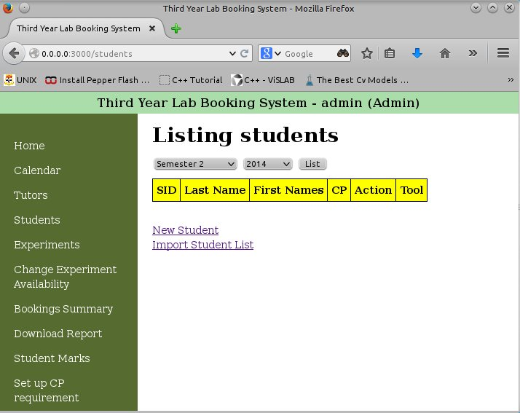
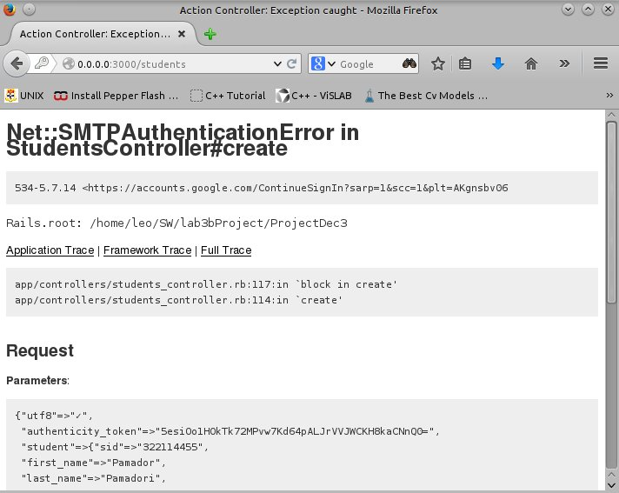
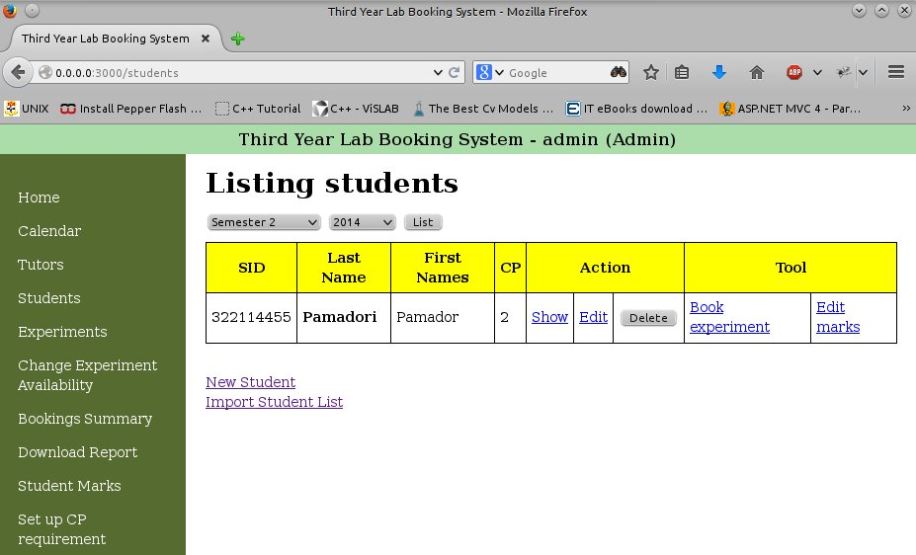

Slide 3
Unit Tests
Test on each field of student that reflected correctly on the database.
Test on student with duplicate, valid, invalid, and empty SID.
Test on students with duplicate, valid, invalid, and empty email address, .
Test on invalid password, password length.
Test on leaving student's name empty.
Test on number of students after it's been created
Test on number of student after cancellation.

Slide 4
Roles & Activities
I was in charge to make user stories, usability tester(s).
later on, administrator operations - part 1. I designed user stories for 14 administrator operations.
examined them for bugs, and logged them.
have written unit tests for them in natural English.
I defined the testing framework to be used for development.
My activity detail can be find on my personal Wiki page.

Slide 5
