Slide 1
Work
Acceptance Test
Unit Test

Slide 2
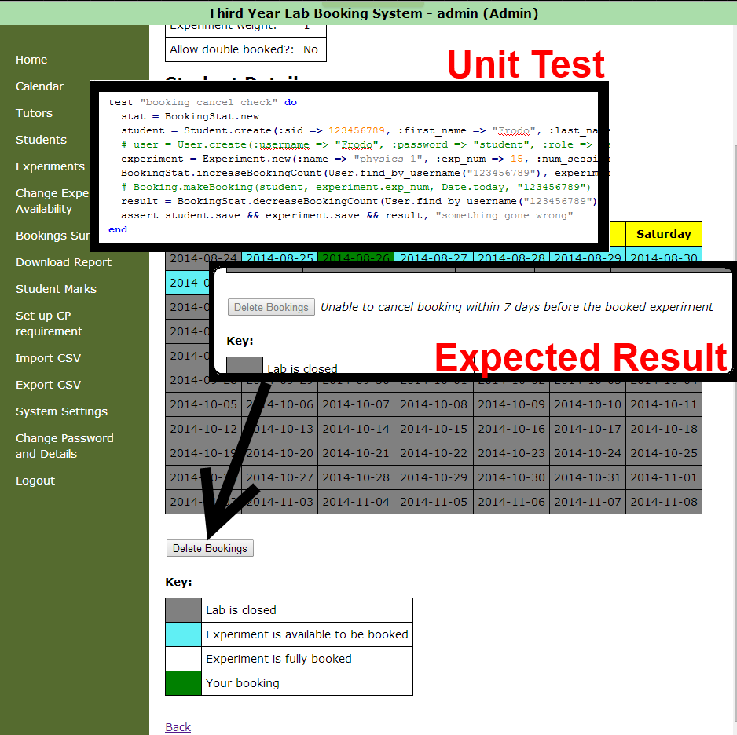
Coding and
testing the system

